Slide 1
Saliva testing
Objectives:
To recognise that our saliva can be used to detect Coronavirus
To explain the testing process using key vocabulary- how to submit a sample and what happens during the test￼
To discuss how transmission to others can be limited by identifying people who are infectious, linking this to the importance of testing

Slide 2
Video Introduction
Watch COVID-19 Warriors Video Introduction.
(*Optional)
Watch a short clip about saliva testing
https://www.youtube.com/watch?v=DvVUqWR4qgw

Slide 3
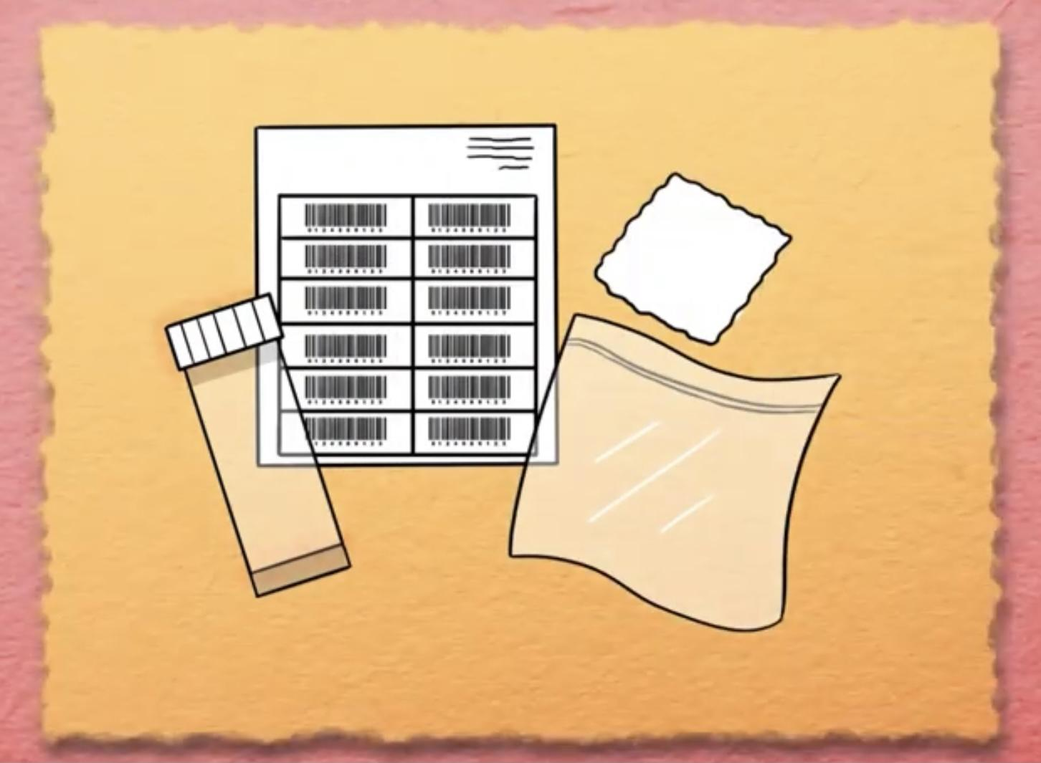
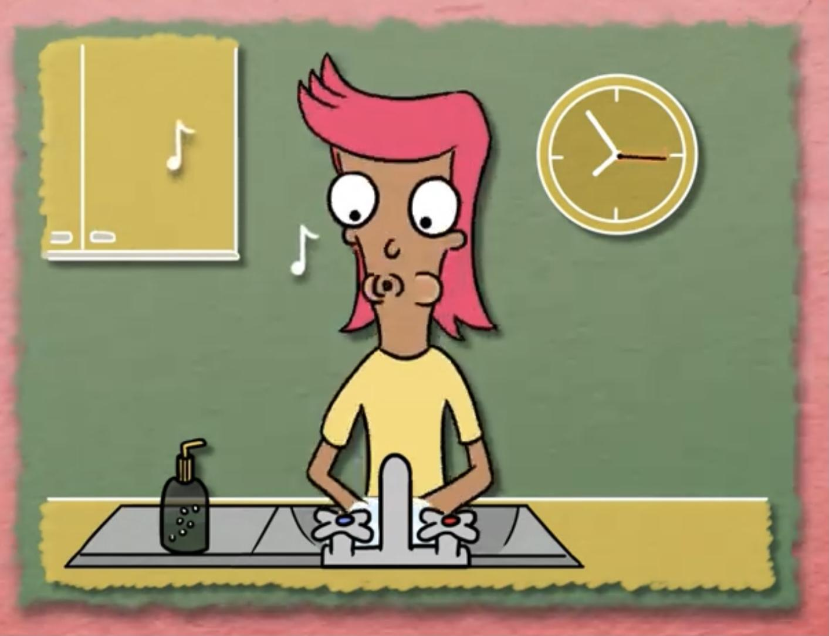
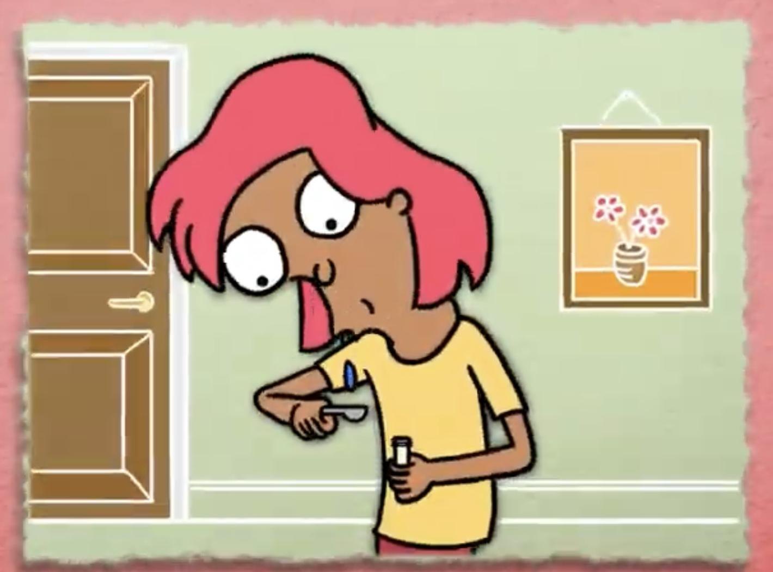
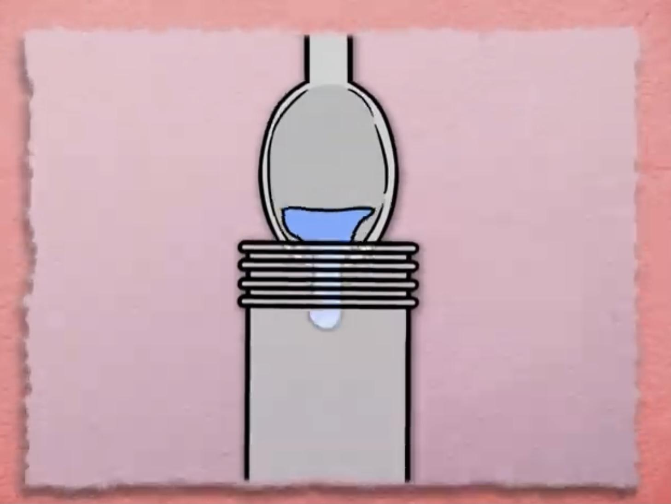
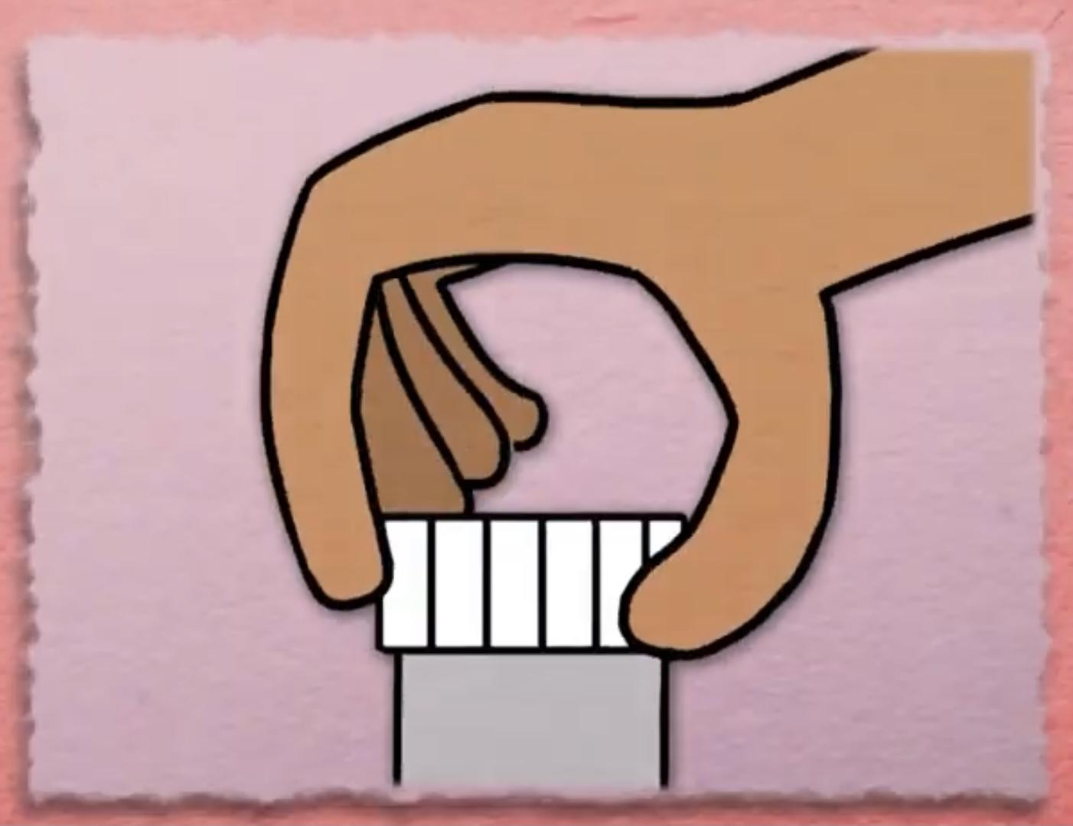
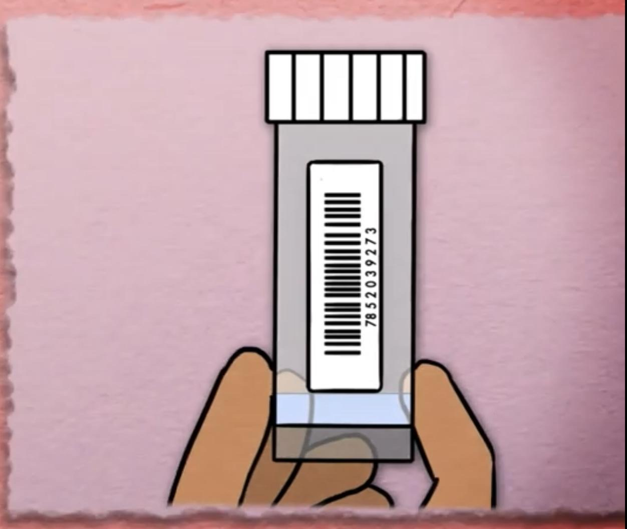
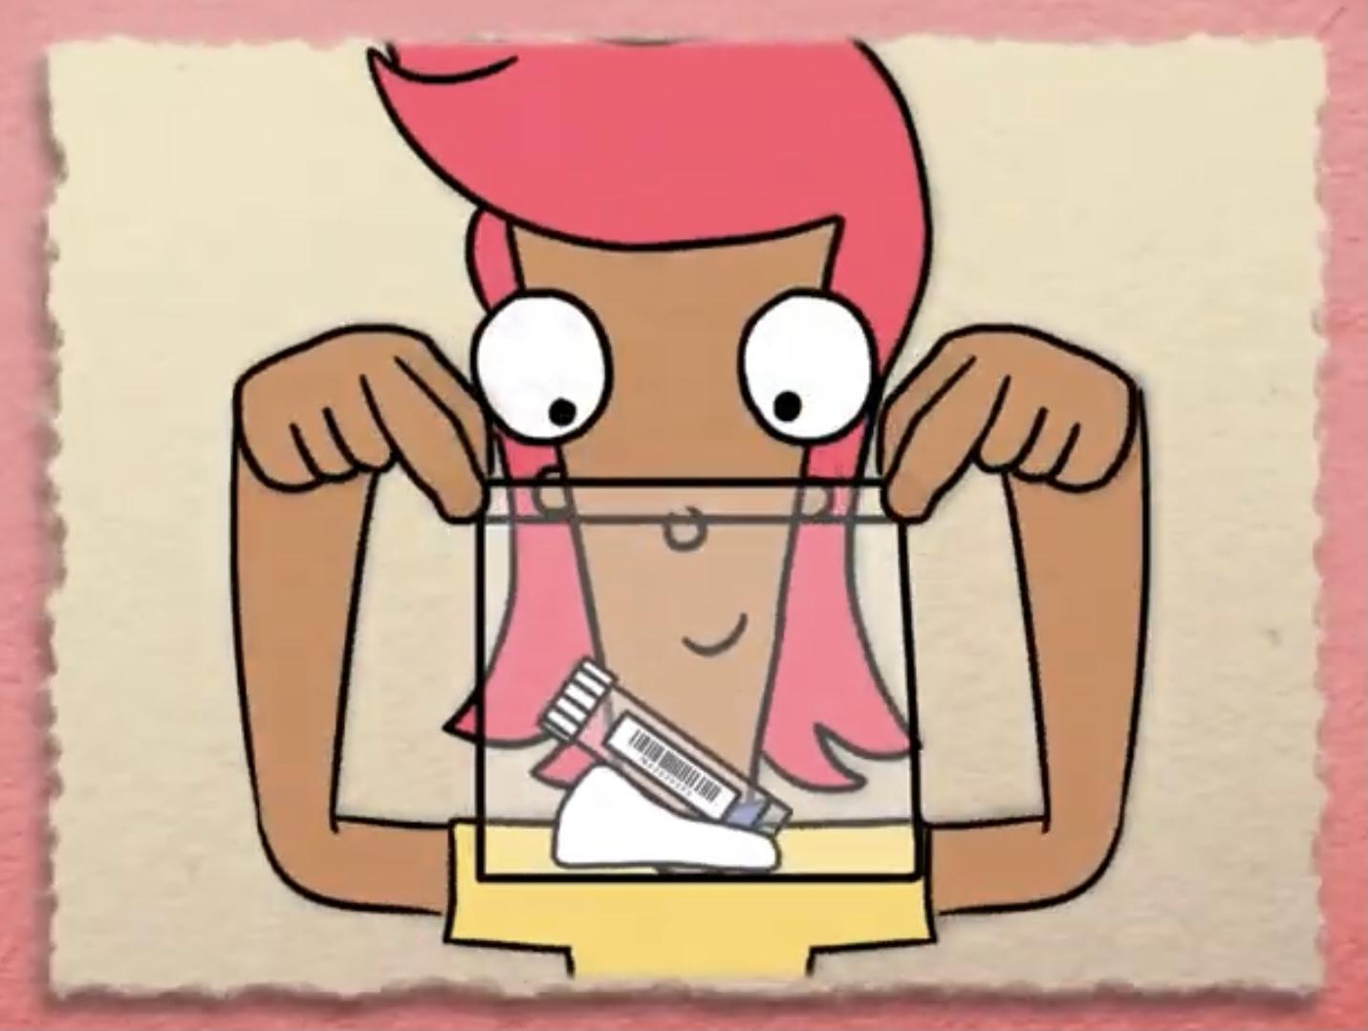
Main Activity
1. Wash your hands.
2. Spit on a spoon.
3. Pour spit in the pot.
4. Screw the lid on.
5. Stick the label on.
6. Place in the bag and seal.
Can you remember any more steps?

Slide 4
Can you put the main steps of the saliva test process in order?
Pour spit in the pot.
Place in the bag and seal.
Spit on a spoon.
Stick the label on.
Wash your hands.
Screw the lid on.
Wash your hands.

Slide 5
What have we learnt?
What new words have you learnt today?
Can you tell a friend how to do a saliva test at home?

Slide 6
Well done for learning about saliva testing - one of the tools to fight COVID-19!

Slide 7
Extension Activities
Find out what happens to
your saliva in the lab. https://bit.ly/3c0tsk4

Slide 8
Bye,
see you soon!

