Slide 1
Eco Worries
Objectives:
To explain how our actions affect our environment giving specific examples.
To discuss how we can reduce waste related to the pandemic.

Slide 2
Video Introduction
Watch COVID-19 Warriors Video Introduction.

Slide 3
Main Activity
What can you see in the picture?

Slide 4
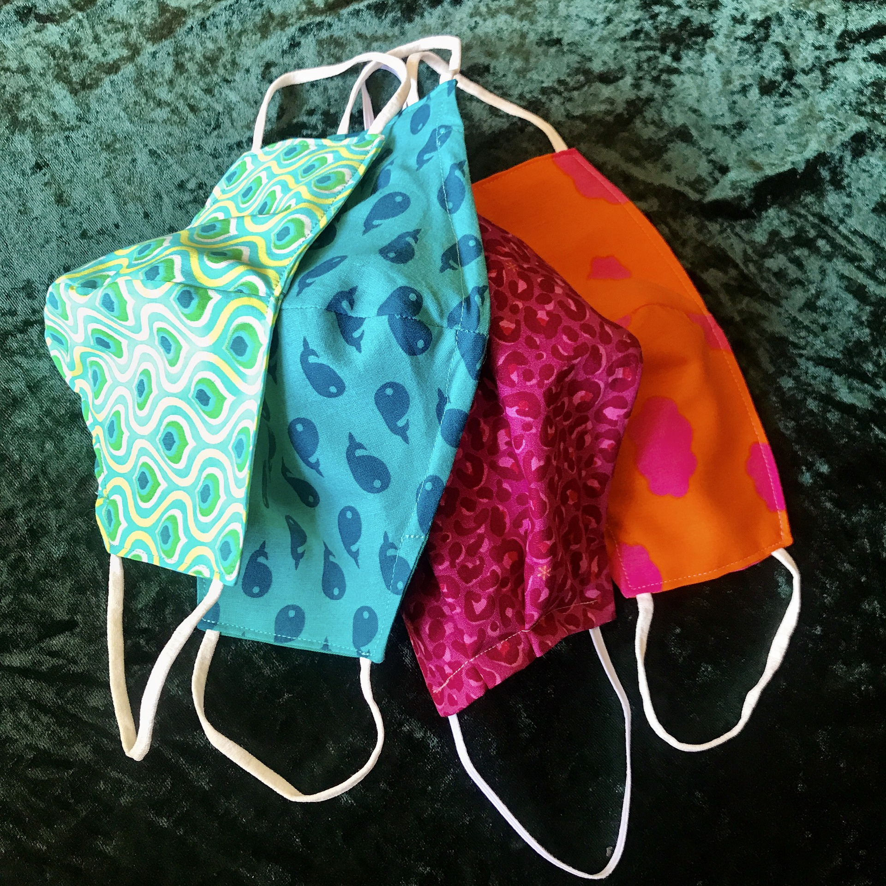
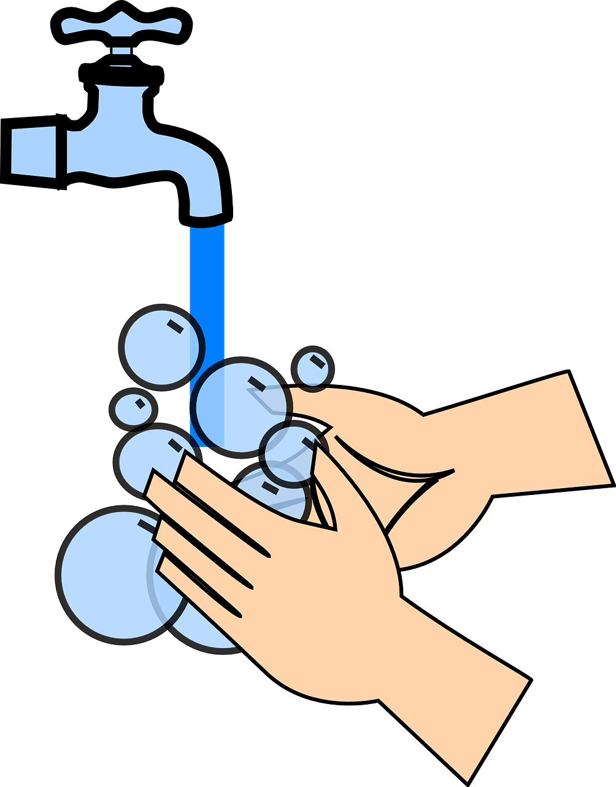
What can we all do to reduce waste?
reusable masks
refillable hand gel
use soap and water
recycle

Slide 5
Help us reduce waste!
Wear a reusable mask!
Refill your handwash!
Recycle what you can!
Use soap and water!

Slide 6
What have we learnt?
Who should look after our world?
Why is it important to look after our world?
What can we do to cut down on COVID-19 waste?

Slide 7
When you have questions that worry you ask a grown up at home or school to help!

Slide 8
Extension Activities
Go litter-picking in the School playground Do not touch any rubbish, and let your teacher bag it and throw it away safely!
Make a class pledge- what we will do to help to improve our School environment.

Slide 9
Bye,
see you soon!

