Slide 1
Worries
Objectives:
To understand that everyday things affect our feelings.
To understand that everyone has worries.
To understand the importance of expressing our feelings & supporting others who express their feelings.
To identify strategies that can help themselves feel better.

Slide 2
Video Introduction
Watch COVID-19 Warriors
Video Introduction

Slide 3
Main Activity
Read the book “Ruby’s Worry”
Everyone has worries sometimes...
How does worry manifest itself in our bodies?
Think about how you might feel physically and emotionally...

Slide 4
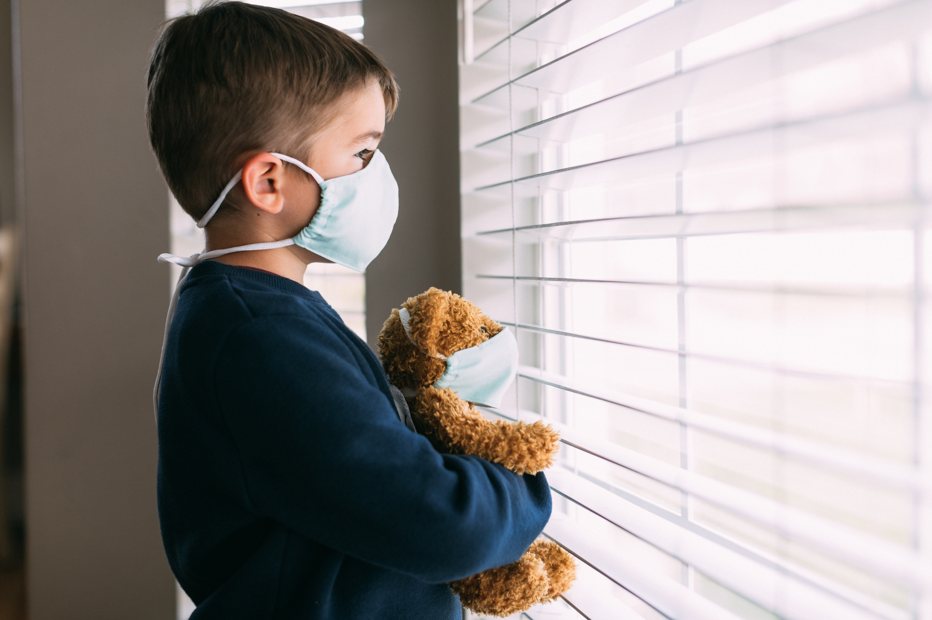
Main Activity
Coronavirus made many people worried…
Have you got worries about Coronavirus?
What can you do when you are feeling worried?
List all the things you can do to help you when you are feeling worried. You can include some pictures too!

Slide 5
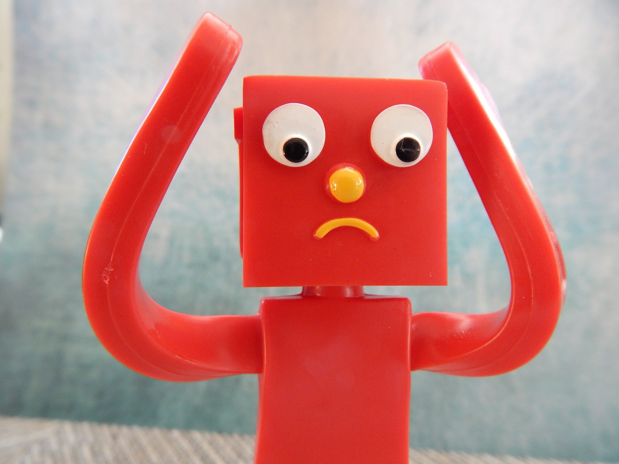
What have we learnt?
How do you know if someone might be feeling anxious or worried?
Share some of your ideas for dealing with worries.

Slide 6
Don’t forget - it’s good to chat to someone if you are feeling worried, so don’t keep your worries to yourself!

Slide 7
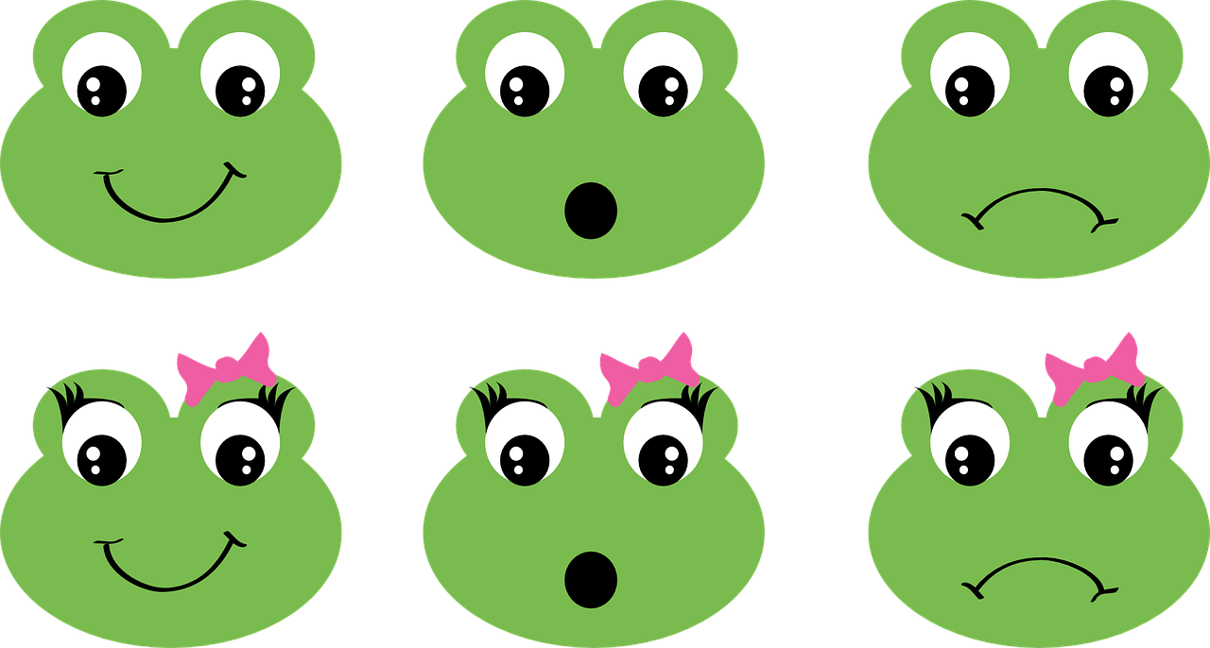
Extension Activities
Create a Class Worry box from an empty shoe box or tissue box.
Create a Self Soothe Box - collect some items that help you relax and take your mind off your worries in a small box and decorate the box.
​
WORRY BOX

Slide 8
Bye,
see you soon!

