Slide 1
Module 4 : Health Heroes- Healthy Teeth
Health Heroes
Health Heroes- Healthy Teeth

Slide 2
Module 4 : Health Heroes- Healthy Teeth
Health Heroes
Watch the
Meet the Warriors video.

Slide 3
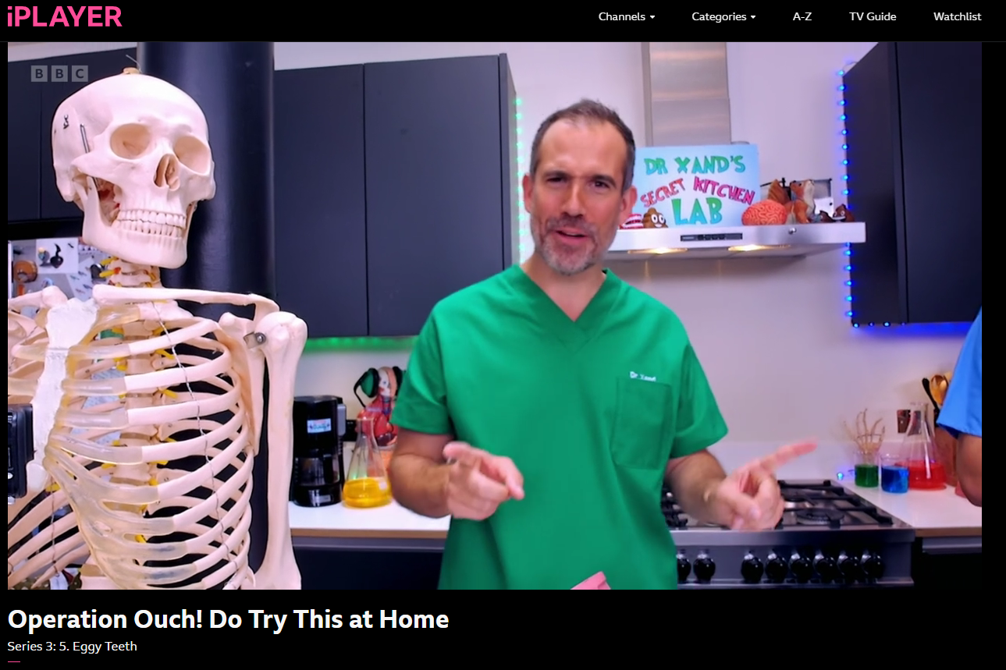
Module 4 : Health Heroes- Healthy Teeth
Session 1 : Tooth Care
Watch Operation Ouch video clip (1:28- 5:16)

Slide 4
Module 4 : Health Heroes- Healthy Teeth
Session 1 : Tooth Care
Quiz Time!

Slide 5
Module 4 : Health Heroes- Healthy Teeth
Session 1 : Tooth Care- Quiz
32
How many teeth does a fully grown adult have?
51
23
How many baby teeth do you have?
10
32
20

Slide 6
Module 4 : Health Heroes- Healthy Teeth
Session 1 : Tooth Care- Quiz
What is the outer coating on your teeth called?
shell
plaque
enamel
A kind of minty toothpaste.
What is plaque?
A slimy mixture of saliva, bacteria and food.
A painful cavity in a tooth.

Slide 7
Module 4 : Health Heroes- Healthy Teeth
Session 1 : Tooth Care- Quiz
How often and for how long should you brush your teeth?
Once a day for half a minute
Twice a day for two minutes
Twice a day for thirty minutes
Because the fluoride in toothpaste can help to rebuild the enamel surface of your teeth.
Why should you avoid rinsing your mouth after brushing?
Because you will just be washing the food particles around your mouth.
Because you must swallow the toothpaste.

Slide 8
Module 4 : Health Heroes- Healthy Teeth
Session 1 : Tooth Care- Quiz
What dissolves the enamel on your teeth?
Forgetting to clean every tooth
Too much tooth brushing
Acid caused by a mixture of bacteria and sugary food
Hardened plaque
What is tartar?
The magic toothpaste ingredient
The outer covering of your teeth

Slide 9
Module 4 : Health Heroes- Healthy Teeth
Session 1 : Tooth Care- Leaflet
Make a leaflet for younger children in your school.
You could include:
Toothbrushing instructions
Healthy eating and drinking tips
Fun facts about teeth
Tooth care hints
Make sure you make your leaflet colourful with pictures to help understanding.

Slide 10
Module 4 : Health Heroes- Healthy Teeth
Session 2 : Eggsperiment!
Which foods do you think are better or worse for your teeth?

Slide 11
Module 4 : Health Heroes- Healthy Teeth
Session 4 : Health Heroes
Watch the
Healthy Teeth
video.

Slide 12
Module 4 : Health Heroes- Healthy Teeth
Session 4 : Health Heroes
Watch the
Health Warrior Promise
video.

Slide 13
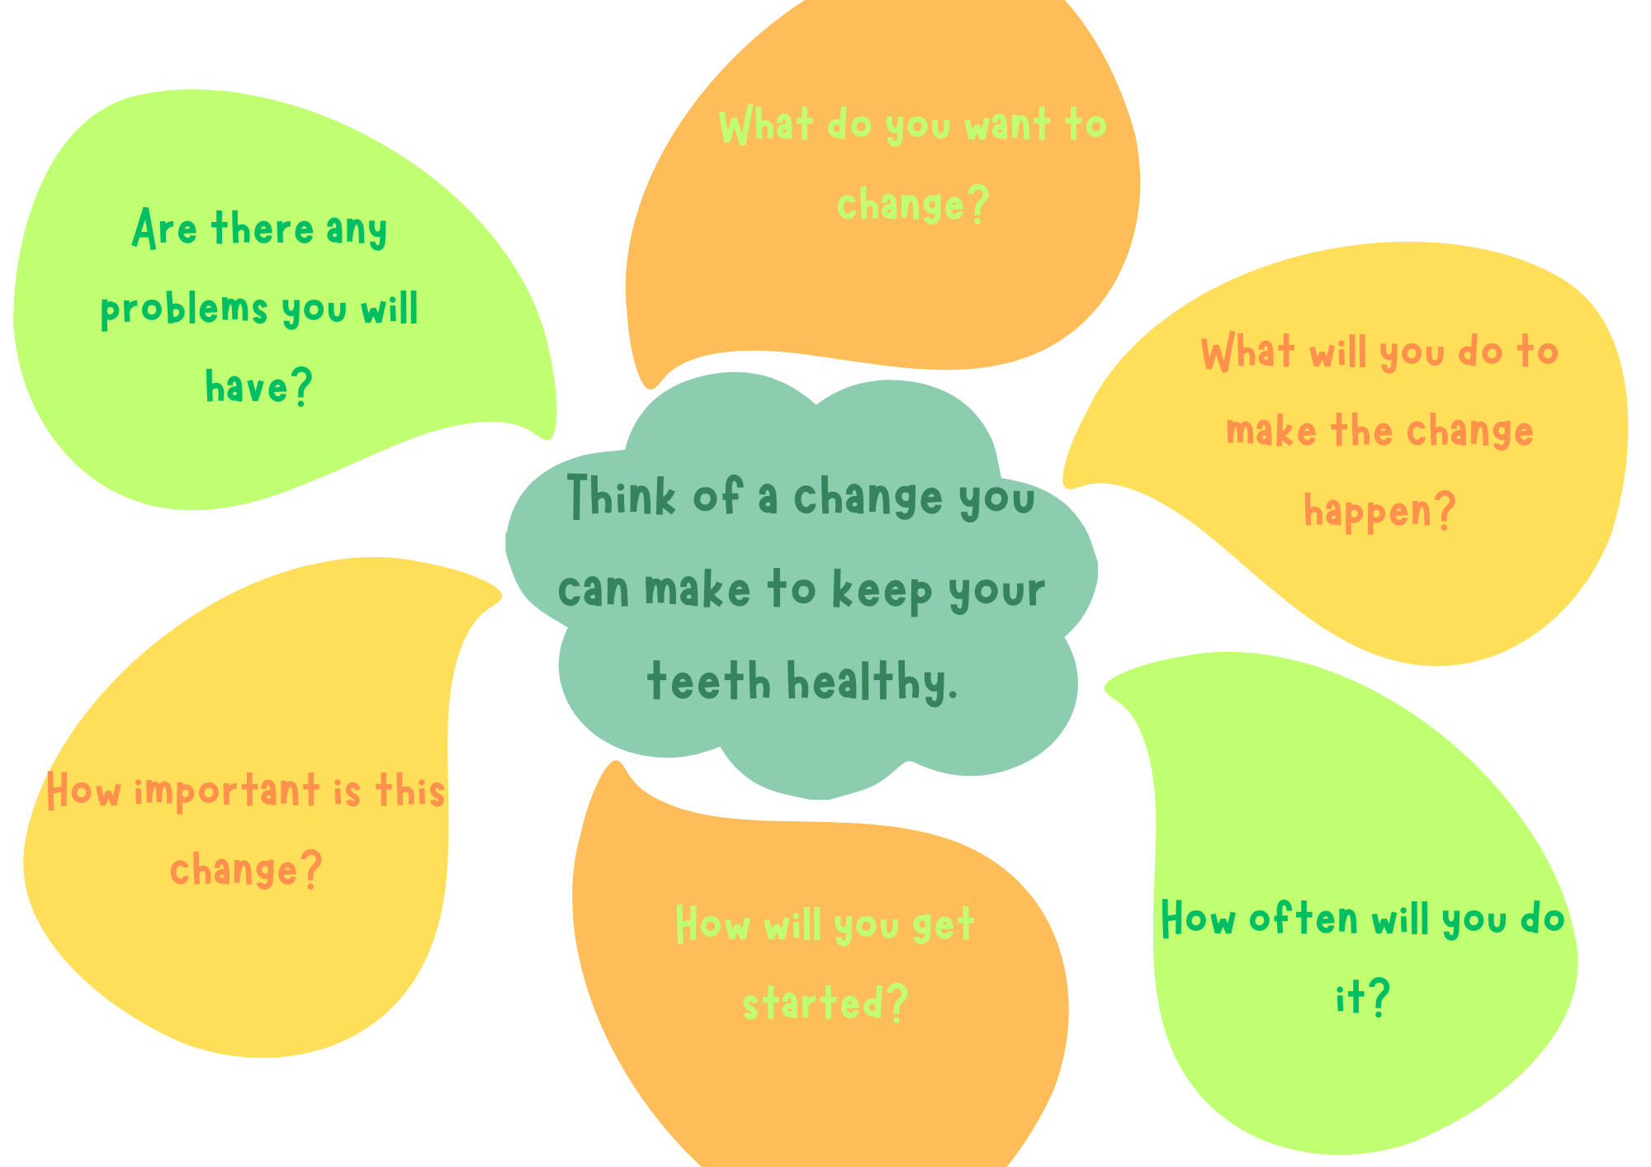
Module 4 : Health Heroes- Healthy Teeth
Session 3 : Health Promise

Slide 14
Module 4 : Health Heroes- Healthy Teeth
Health Heroes
Watch the
You are a Health Warrior
video.

Slide 15
Module 4 : Health Heroes- Healthy Teeth
Glossary
acid- An acid is a chemical substance, usually a liquid, which contains hydrogen. Some acids burn or dissolve other substances, such as tooth enamel.
adult teeth- Adult teeth are the 32 bigger teeth that replace milk teeth when they fall out. Adult teeth include incisors, canines, premolars, and molars.
bacteria- Bacteria are microscopic living organisms, usually one-celled, that can be found everywhere. They can be dangerous when they cause infection, or useful when they help us to break down food and absorb nutrients.
blood vessels- Blood vessels are channels that carry blood throughout your body.
calcium- The most common mineral in the body, needed for healthy teeth and bones.
canines- Canines are slightly pointed teeth either side of the incisors at the front of the mouth. We use them for biting and talking.
cavity- A hole in a tooth caused by decay.
decay- To gradually become damaged, rotten.
dentine- Dentine is directly under the tooth enamel. It protects the innermost part of the tooth, called the pulp. The pulp is where each tooth's nerve endings and blood supply are found.

Slide 16
Module 4 : Health Heroes- Healthy Teeth
Glossary
dissolve- To dissolve is to break something up so that it disappears or is destroyed.
flossing- Dental flossing is when you clean between your teeth using a thread. It helps to reach pieces of food unreached by a toothbrush.
fluoride- A chemical compound sometimes added to water and toothpaste to keep teeth healthy.
gum disease- An infection of the gums causing pain and swelling. Often caused by poor brushing habits.
healthy- Being strong and well.
incisors- Incisors are the teeth at the front of the mouth used for cutting food when you bite. There are 2 on the top and 4 on the bottom.
milk teeth- Also known as baby teeth, they are the first set of teeth that grow and are eventually replaced by adult teeth.
minerals- A mineral is a nutrient that is needed in small amounts to keep the body healthy.
molars- The larger flatter teeth at the back of your mouth used for grinding and crushing food. We have 12.

Slide 17
Module 4 : Health Heroes- Healthy Teeth
Glossary
nerves- Nerves carry messages between your brain and the rest of your body. They help you to feel sensations and move your muscles.
nutrition- Nutrition includes everything that's in your food, such as vitamins, protein, fat, and more.
oral hygiene- The practice of keeping your mouth clean by brushing your teeth and gums regularly.
plaque- A sticky substance on teeth that encourages bacteria.
pre molars- The teeth in front of molars and behind canines. Used for grinding and breaking down food.
rinse- To wash lightly with water.
root canal- Root canal is a treatment for removing an infection from inside a tooth.
saliva- A liquid created by the body to moisten the mouth and help food digestion.
tartar- A hard, yellowish substance that forms on your teeth and can cause decay if not removed.
tooth- The hard bony structures in your mouth used for chewing food.

Slide 18
Module 4 : Health Heroes- Healthy Teeth
Glossary
tooth enamel- The protective outer coating of your teeth.
toothbrush- A small brush used for cleaning your teeth.
toothpaste- A paste used for cleaning teeth.

