Slide 1
Germs
Objectives:
To use information from observation to describe how a virus can spread.
To be able to take precautions to avoid the spread of the virus by being able and knowing how to:
use a tissue to catch coughs
wash hands frequently
keep the 2-metre rule
To understand why we need to keep the 2 metre rule
To explain in simple terms, and based on observation why the virus cannot be seen.

Slide 2
Video Introduction
Watch COVID-19 Warriors Video Introduction.

Slide 3
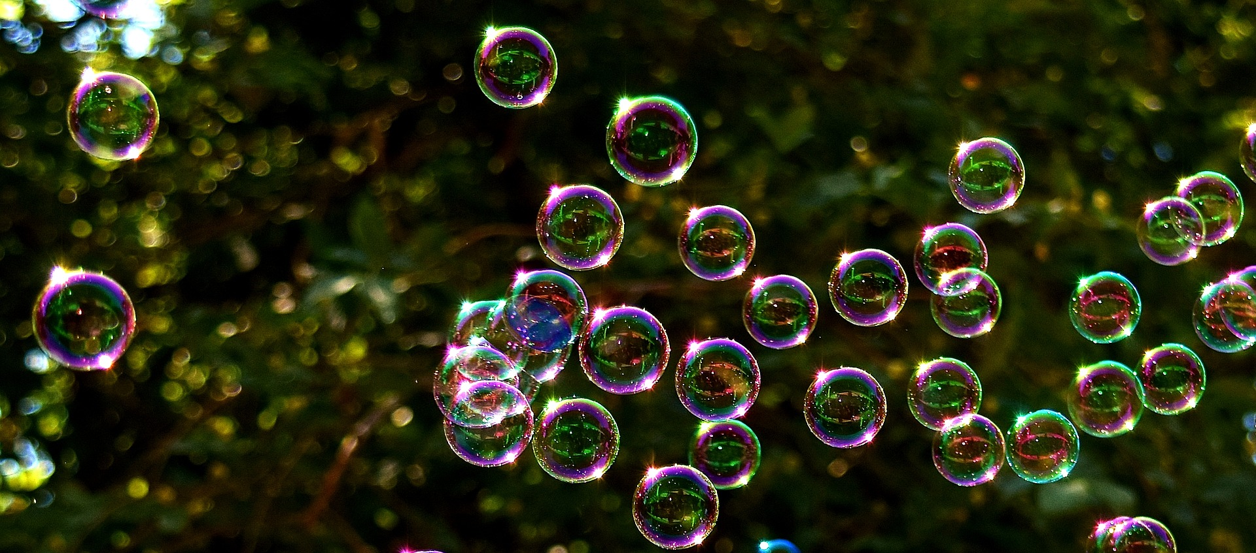
Main Activity
Teddy has a bubble cough…
What happens when he coughs?
Where do the bubbles go?
Go outside and watch the bubbles move!

Slide 4
What have we learnt?
How did you stay away from teddy’s ”bubble cough”?
How did you help teddy to keep everyone safe?
What should you do if you need to cough?
What should you do after coughing into a tissue or touching surfaces?

Slide 5
Stretch says… “Remember to stay at least 2 metres away from anyone not in your bubble!”

Slide 6
Extension Activities
Measure how far the bubbles travel indoors and outdoors and compare.
Watch this video to show importance of fresh air: https://youtu.be/qYZMOG2kUWg​

Slide 7
Bye,
see you soon!

