Slide 1
Lesson 8: Resilience
Objectives:
To recognise that your actions can make a difference
To accept that some things are out of your control

Slide 2
Video Introduction
Watch COVID-19 Warriors Video Introduction.

Slide 3
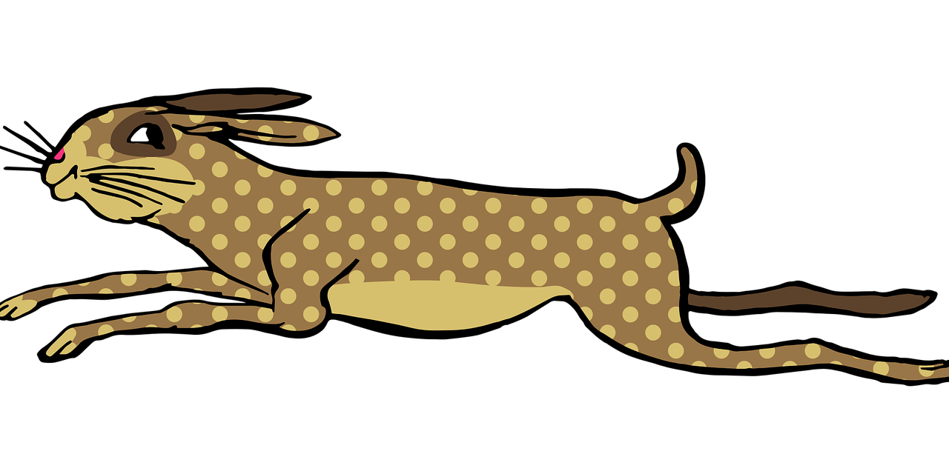
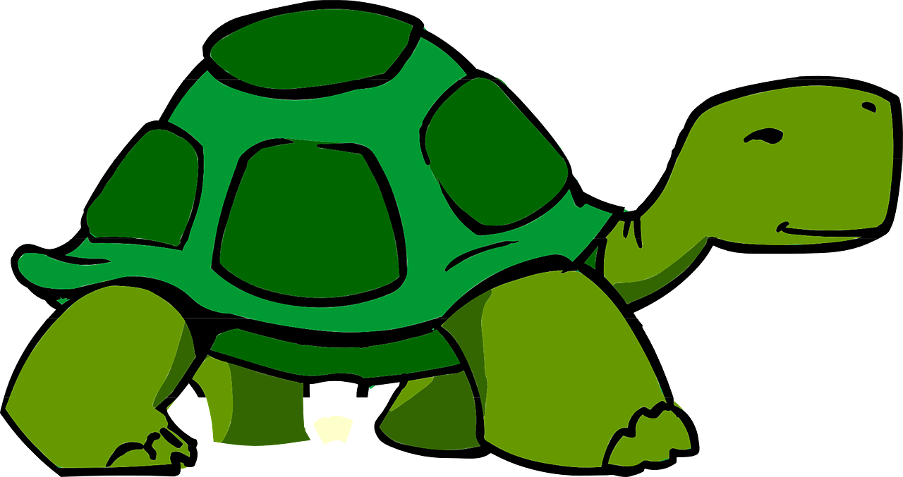
Main Activity
Watch the story of the Hare and the Tortoise.
https://www.bbc.co.uk/programmes/p011syc1

Slide 4
Main Activity
What did the tortoise need to win the race?
What do you need to get through Coronavirus?

Slide 5
Resilience

Slide 6
What have we learnt?
How can you make a difference?
Remember that every little difference counts!

Slide 7
Buddy says…. “Remember to keep following the rules to keep your friends and family safe”.

Slide 8
Extension Activities
Write a list of all the things you can do to help defeat the virus.
Make a card for a friend, relative or neighbour who is isolating.

Slide 9
Bye,
see you soon!

