Slide 1
Worries
Objectives:
To understand that everyday things affect our feelings.
To understand that everyone has worries.
To understand the importance of expressing our feelings & find ways of supporting others who express their feelings.
To identify strategies that can help themselves feel better.

Slide 2
Video Introduction
Watch COVID-19 Warriors Video Introduction

Slide 3
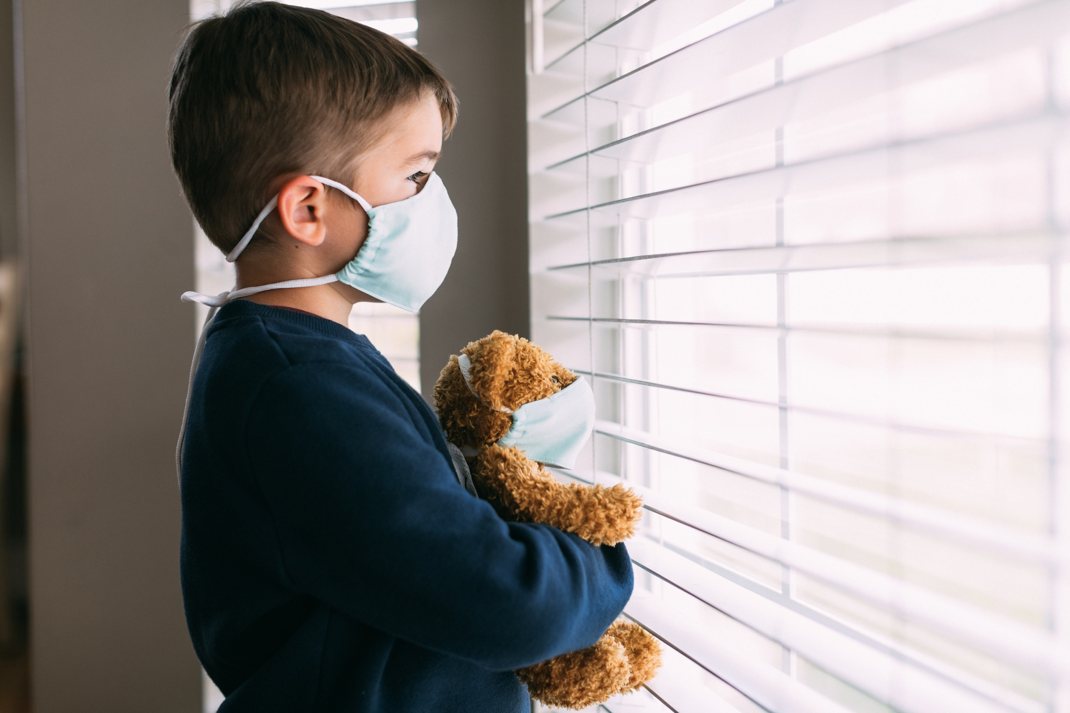
Main Activity
Everyone has worries sometimes...
How does worry manifest itself in our bodies?
Think about how you might feel physically and emotionally...
What can we do to help ourselves and help others who might be feeling worried?

Slide 4
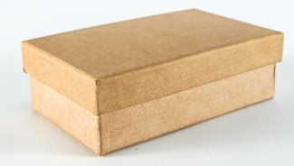
Main Activity
Make a “Self Soothe Box”
Think of some things you could put into a small box – something to read, something to make, something to listen to, etc...
Make a list of these items (you can include pictures too), and make the box at home.

Slide 5
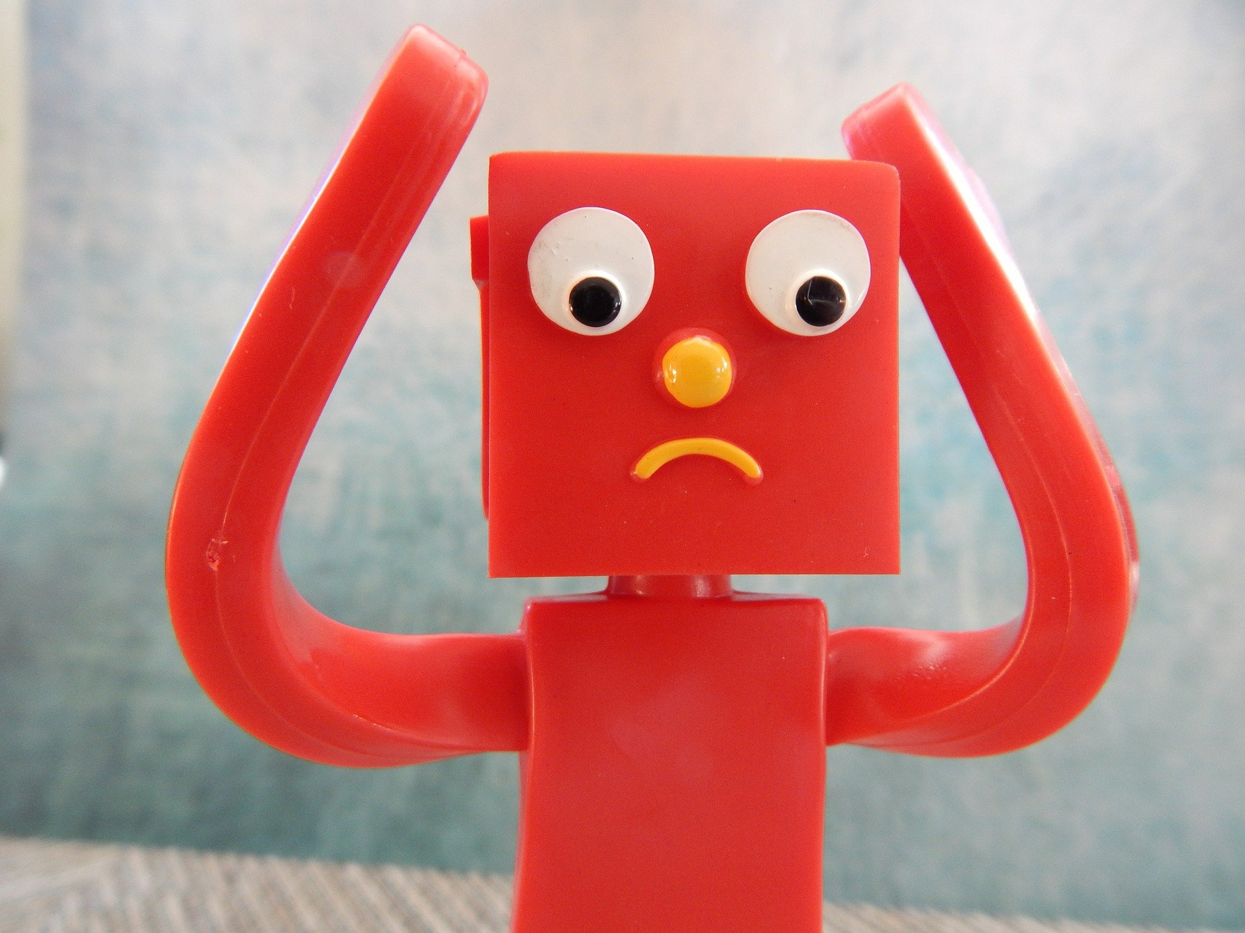
What have we learnt?
How do you know if someone might be feeling anxious or worried?
Share some of your ideas for dealing with worries.

Slide 6
Don’t forget - it’s good to chat to someone if you are feeling worried, so don’t keep your worries to yourself!

Slide 7
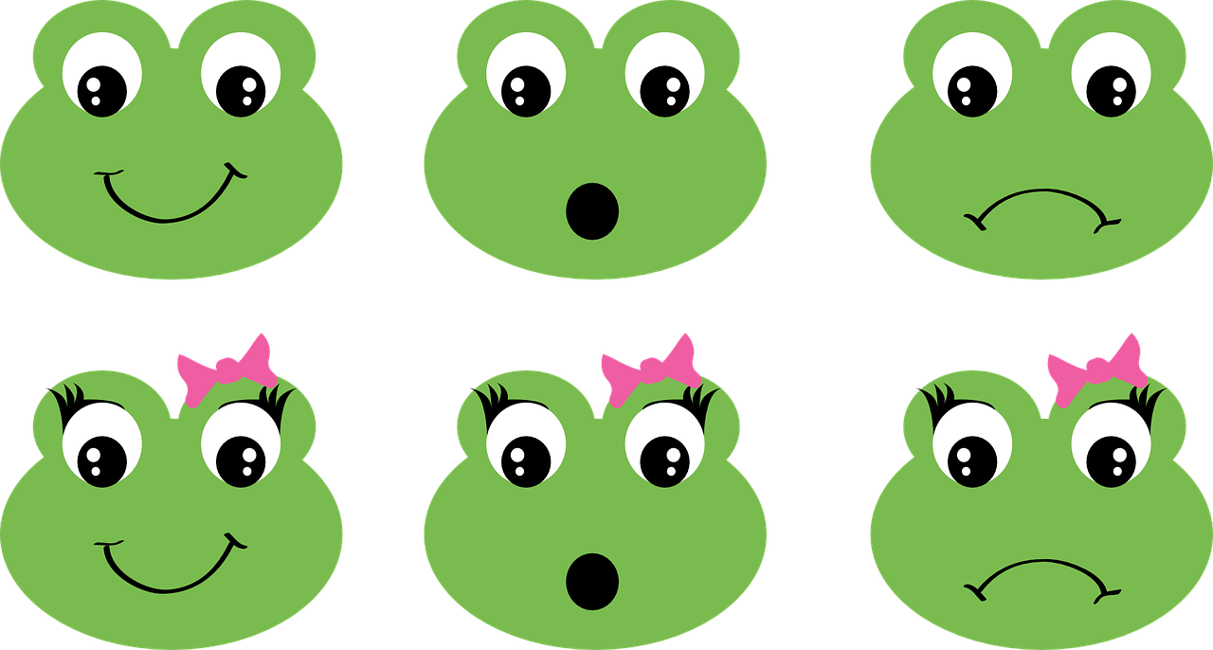
Extension Activities
Create a Class Worry box from an empty shoe box or tissue box.
​
WORRY BOX

Slide 8
Bye,
see you soon!

