Slide 1
Testing for Coronavirus
Objectives:
To recognise that tests can be used to detect Coronavirus.
To use language connected to testing.
To talk about how transmission to others can be limited by identifying people who are infectious.

Slide 2
Video Introduction
Watch COVID-19 Warriors Video Introduction

Slide 3
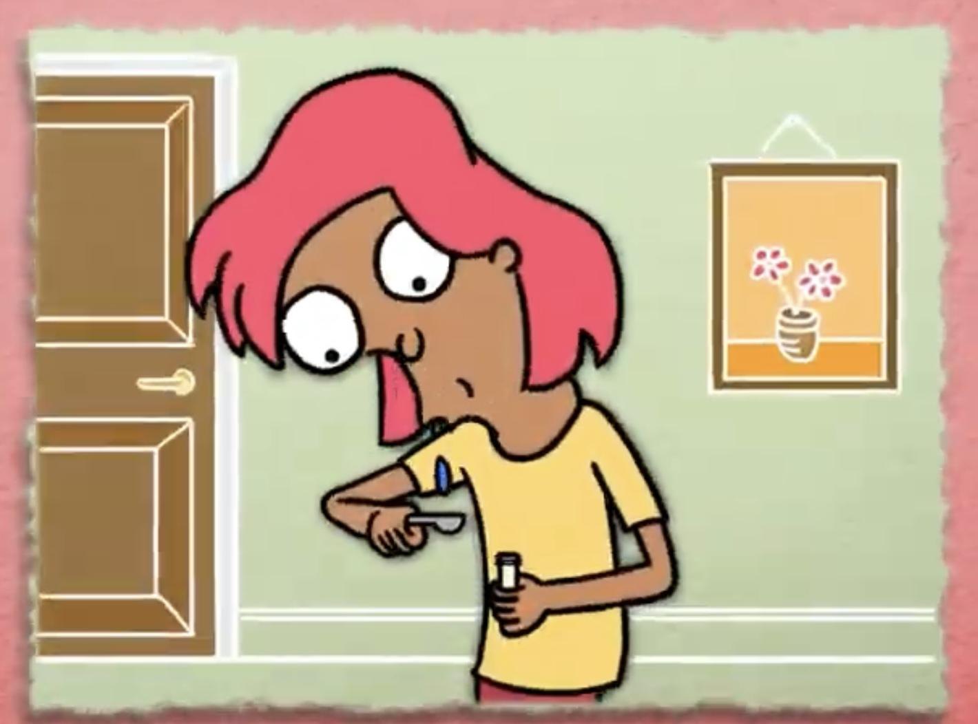
Main Activity
What do you remember about each test?
Saliva Test
PCR
Lateral Flow

Slide 4
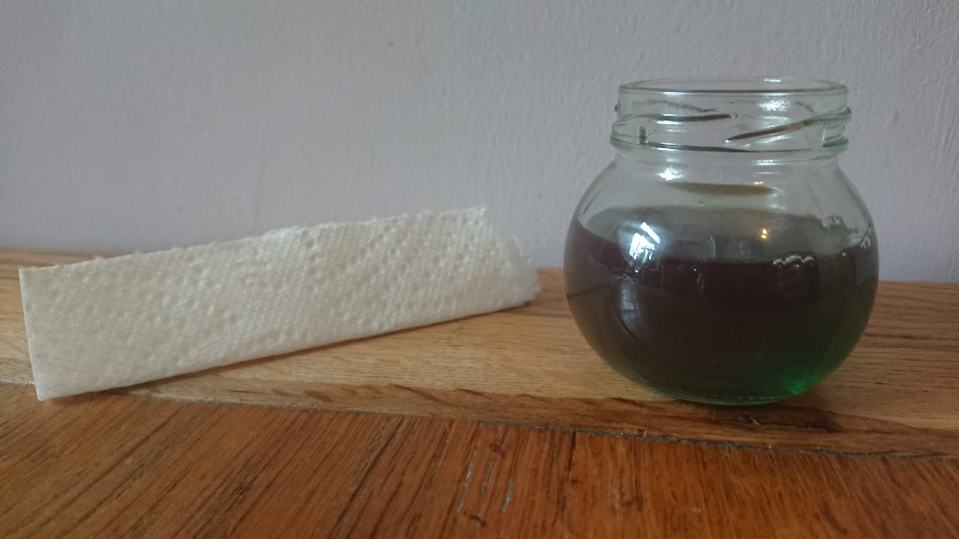
See how a Lateral Flow test works
1
Fill a small jar with coloured water, and fold a piece of kitchen roll.
2
Put the kitchen roll into the jar.
Watch the liquid travel up the paper… this is how a sample is absorbed by a Lateral Flow device.
3

Slide 5
COVID-19 Tests
Saliva Test | PCR | Lateral Flow
Taken
To a
Lab
Taken
To a
Lab
Use a swab
Home
Device
Spit in a
spoon
Use a swab

Slide 6
What have we learnt?
Why do people need to get a test when they have COVID-19 symptoms?
What are the differences between a lateral flow test, a PCR and a Saliva test?

Slide 7
Well done for learning about testing - one of the tools to fight COVID-19!

Slide 8
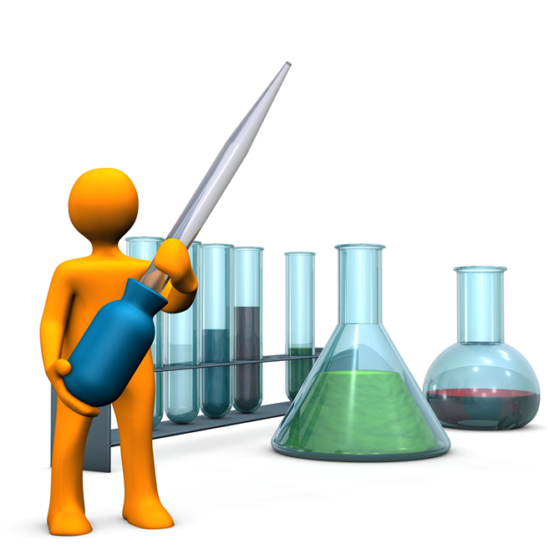
Extension Activities
Make a model of a Lab - think about the robots that might be used.
Role play a drive-through testing centre using toy cars and a garage.
Spot the difference in the Lab:
https://static1.squarespace.com/static/5fa5248fcb87d6680ec908e6/t/5fd933e450d96b1a1c6412bb/1608070119474/Storicise-Key-Stage-3-Activity-SPOT-THE-DIFF.pdf

Slide 9
Bye,
see you soon!

