Slide 1
Saliva testing
Objectives:
To recognise that our saliva can be used to detect Coronavirus
To describe in simple words the testing process
To order in the right sequence the steps followed during a saliva test
To talk about how transmission to others can be limited by identifying people who are infectious

Slide 2
Video Introduction
Watch COVID-19 Warriors Video Introduction.
(*Optional)
Watch a short clip about saliva testing
https://www.youtube.com/watch?v=DvVUqWR4qgw

Slide 3
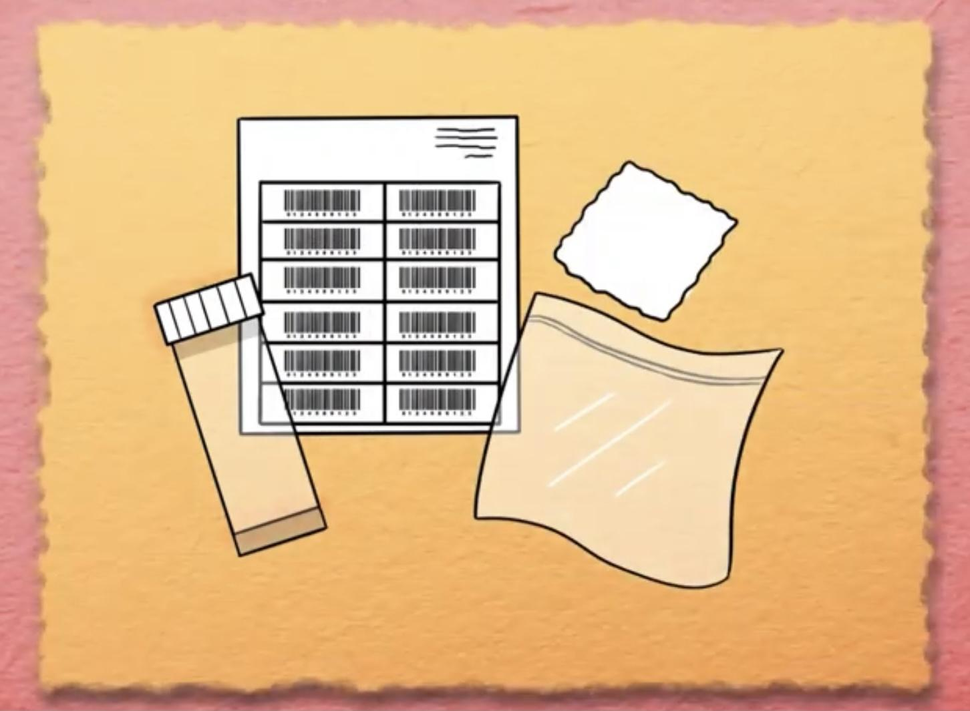
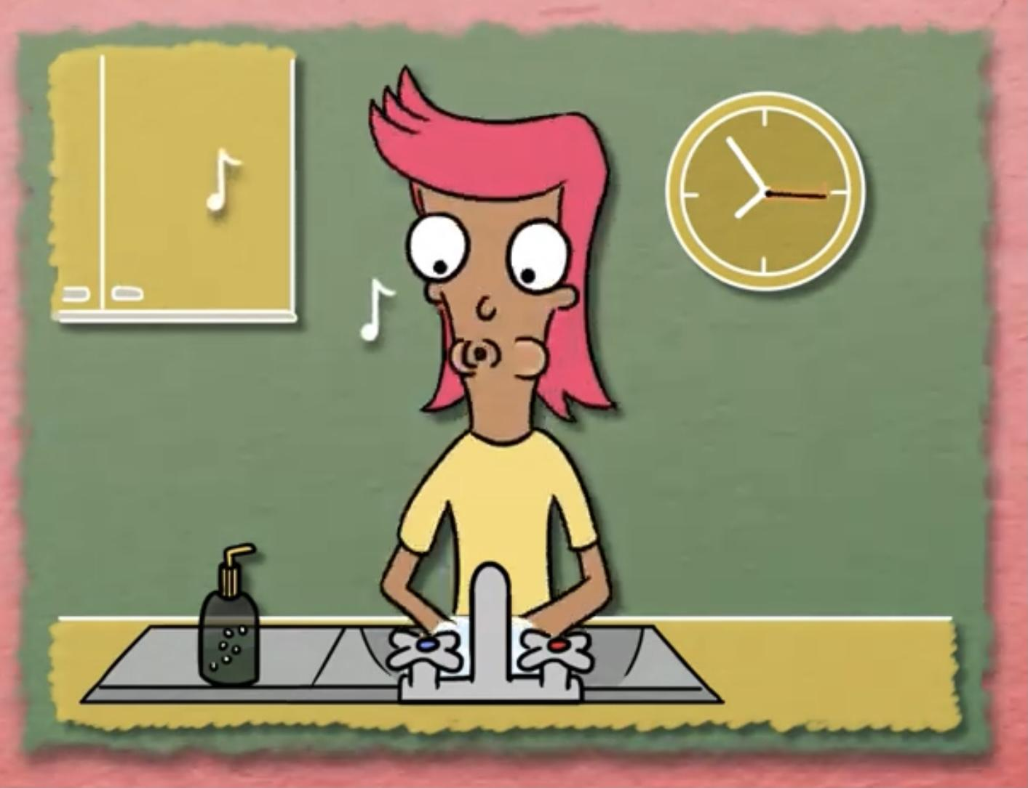
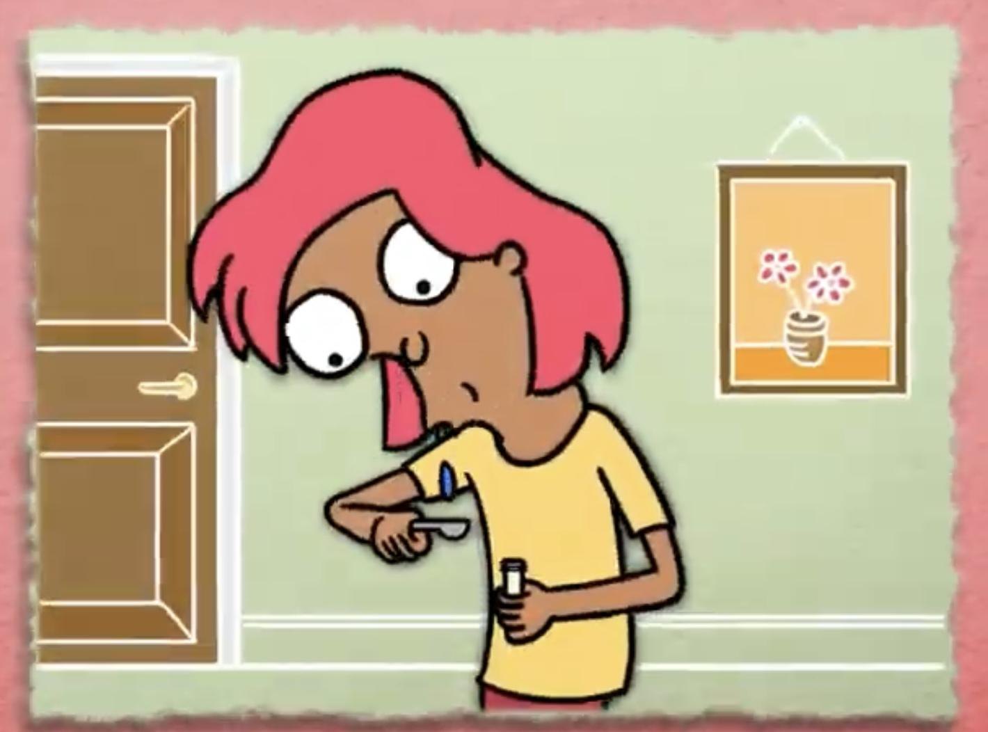
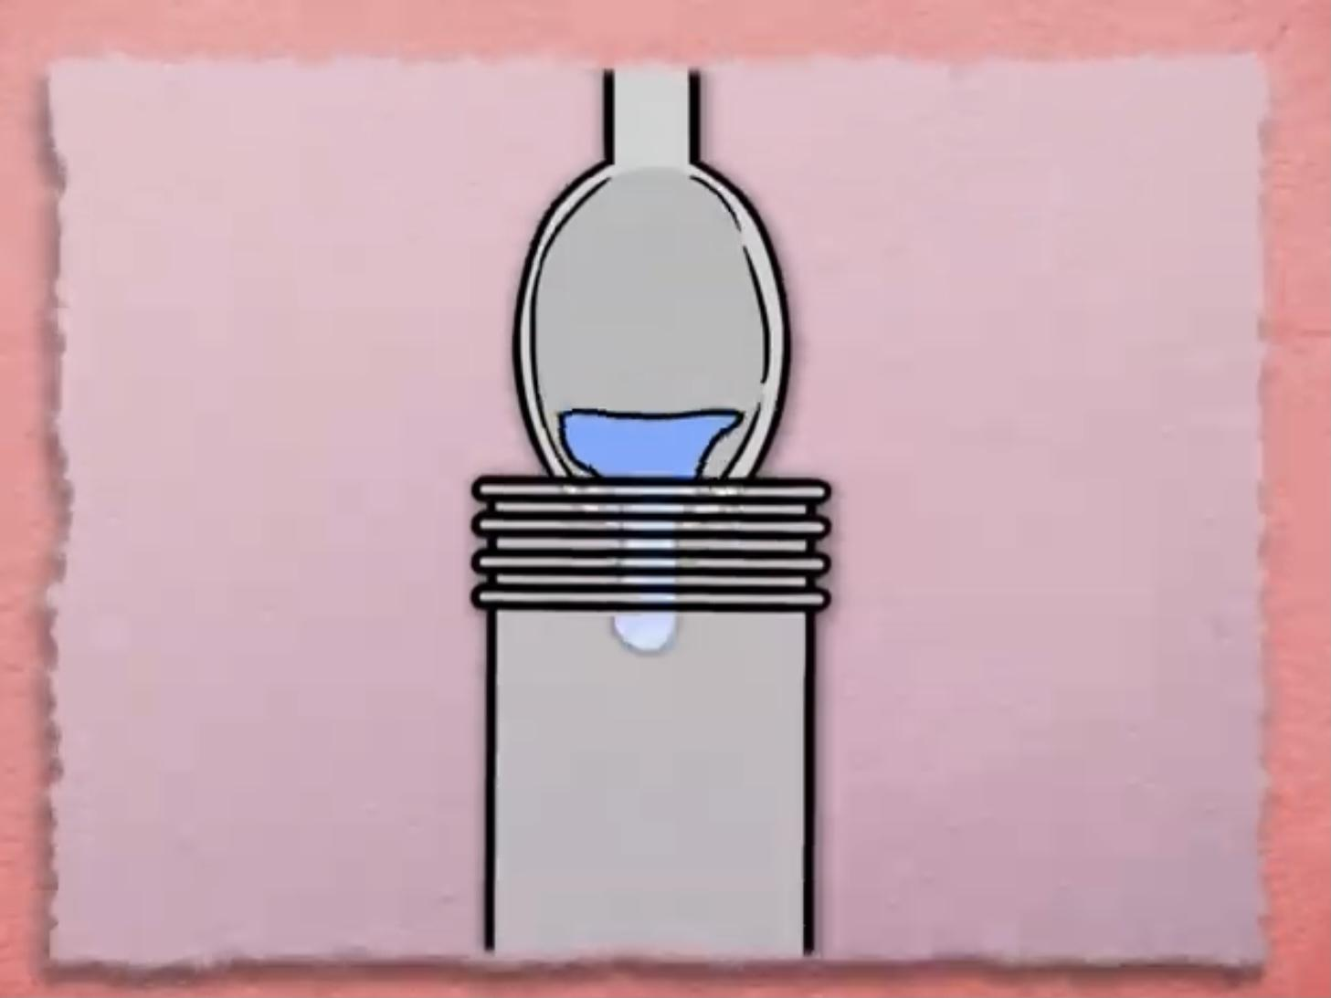
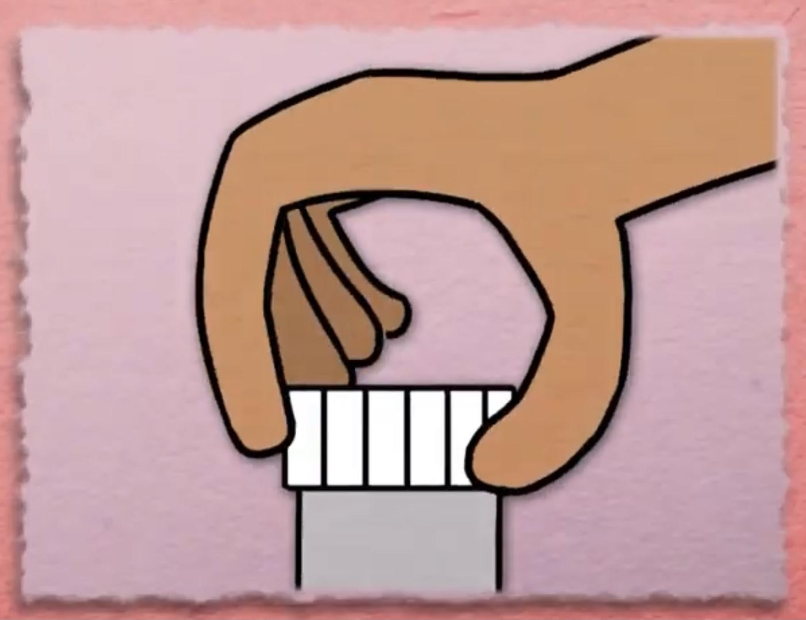
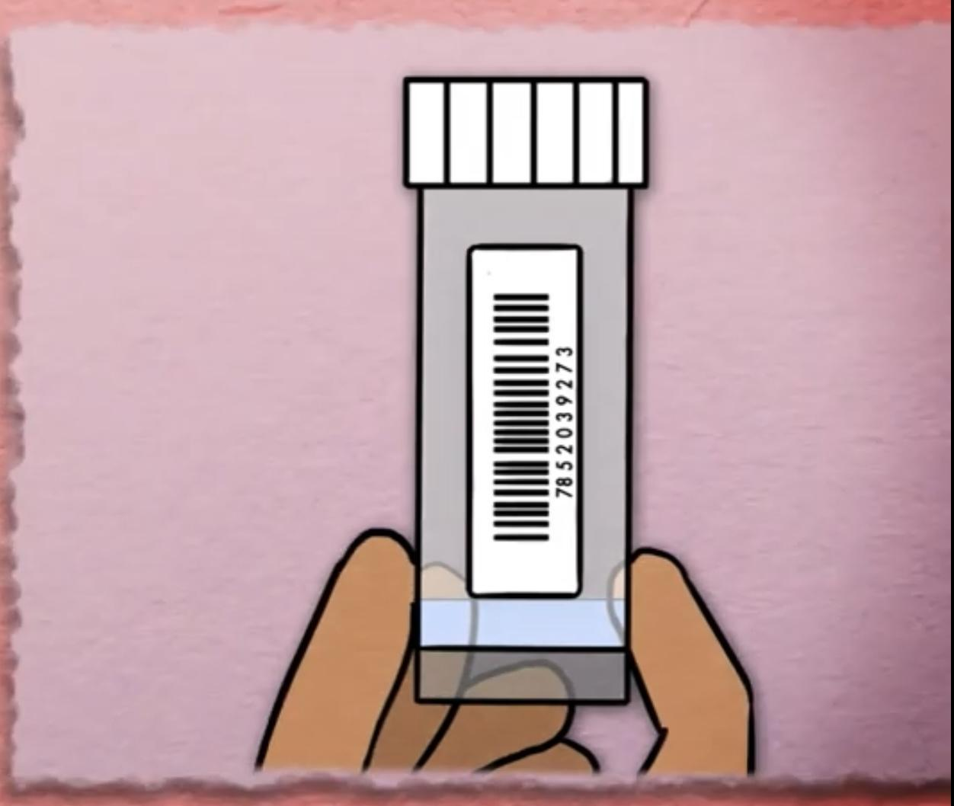
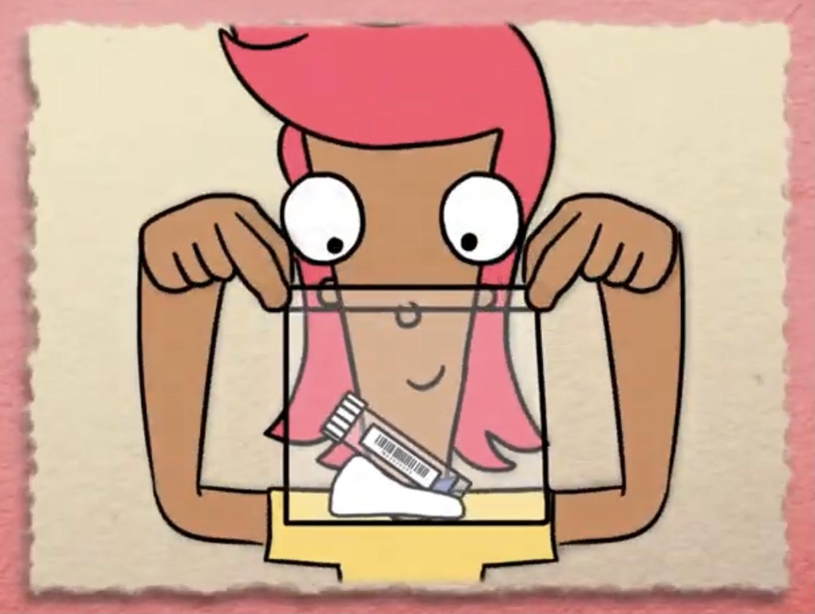
Main Activity
1. Wash your hands.
2. Spit on a spoon.
3. Pour spit in the pot.
4. Screw the lid on.
5. Stick the label on.
6. Place in the bag and seal.
7. Now wash your hands again!

Slide 4
Key vocabulary
test pot
label
saliva
test
laboratory

Slide 5
Can you put these steps of
saliva test process in order?
Pour spit in the pot.
Place in the bag and seal.
Spit on a spoon.
Stick the label on.
Wash your hands.
Screw the lid on.
Wash your hands.

Slide 6
What have we learnt?
What new words have you learnt today?
Can you tell a friend how to do a saliva test at home?

Slide 7
Well done for learning about saliva testing - one of the tools to fight COVID-19!

Slide 8
Extension Activities
Make a model of a Lab- think about the robots that might be used.
Role play a drive-through testing centre using toy cars and a garage.
Spot the difference in the Lab:
https://static1.squarespace.com/static/5fa5248fcb87d6680ec908e6/t/5fd933e450d96b1a1c6412bb/1608070119474/Storicise-Key-Stage-3-Activity-SPOT-THE-DIFF.pdf

Slide 9
Bye,
see you soon!

