Slide 1
Testing for Coronavirus
Objectives:
To explain how tests can be used to detect Coronavirus.
To explain the differences between the tests using key vocabulary
To discuss how transmission to others can be limited by identifying people who are infectious, linking this to the importance of testing
​

Slide 2
Video Introduction
Watch COVID-19 Warriors Video Introduction
Watch Questions and Answers with Dr Kate Glyn-Owen covering the importance of testing.​
https://www.youtube.com/watch?v=q38ZRrFbz7s&feature=youtu.be​

Slide 3
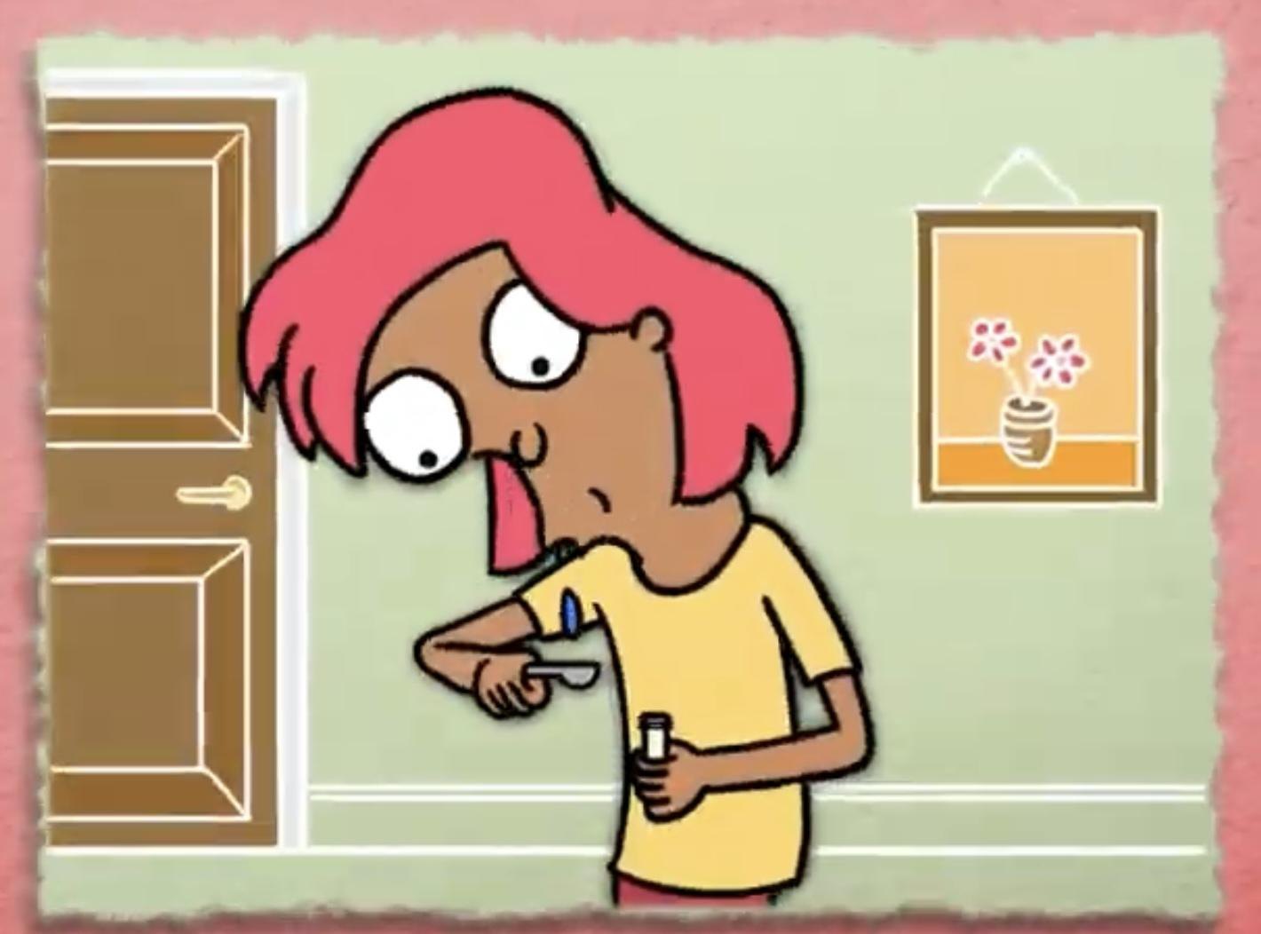
Main Activity
What do you remember about each test?
Saliva Test
PCR
Lateral Flow

Slide 4
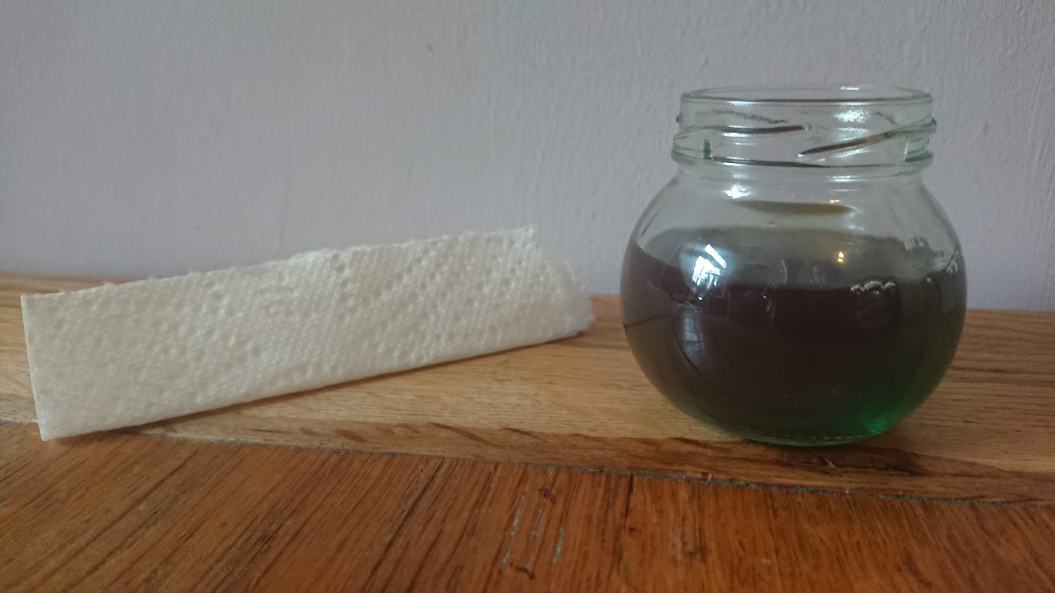
See how a Lateral Flow test works
1
Fill a small jar with coloured water, and fold a piece of kitchen roll.
2
Put the kitchen roll into the jar.
Watch the liquid travel up the paper… this is how a sample is absorbed by a Lateral Flow device.
3

Slide 5
COVID-19 Tests
Saliva Test | PCR | Lateral Flow
Use a swab
Result in 30
minutes
Taken
To a
Lab
Result in
1-2 days
Home
Device
Result in
1-2 days
Taken
To a
Lab
Use a swab
Spit in a
spoon

Slide 6
Key Vocabulary
PCR
scientist
swab
home device
result
Laboratory
saliva
Lateral Flow
sample

Slide 7
What have we learnt?
Why do people need to get a test when they have COVID-19 symptoms?
What are the differences between a lateral flow test, a PCR and a Saliva test?

Slide 8
Well done for learning about testing - one of the tools to fight COVID-19!
Remember to colour in your next Warrior!

Slide 9
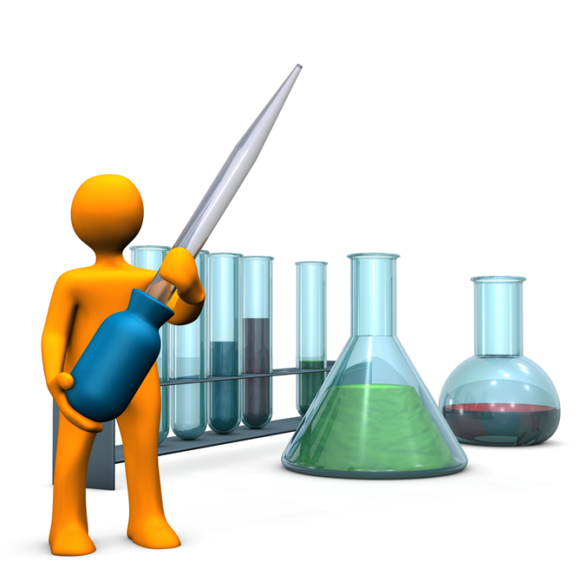
Extension Activities
Find out what happens to saliva in the lab​
https://bit.ly/3c0tsk4​
Spot the difference in the Lab:
https://static1.squarespace.com/static/5fa5248fcb87d6680ec908e6/t/5fd933e450d96b1a1c6412bb/1608070119474/Storicise-Key-Stage-3-Activity-SPOT-THE-DIFF.pdf

Slide 10
Bye,
see you soon!

