Slide 1
Me, My Health and My Children's Health
Lesson 5: Making Choices

Slide 2
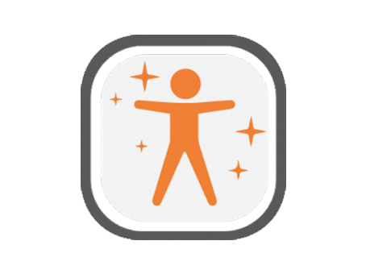
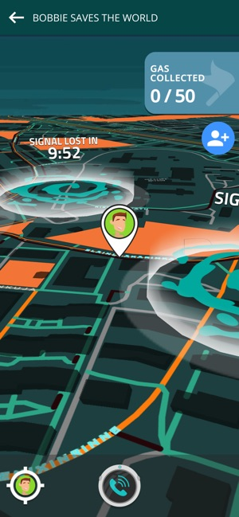
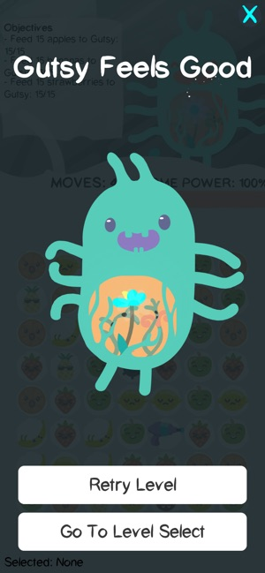
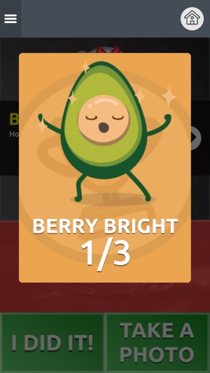
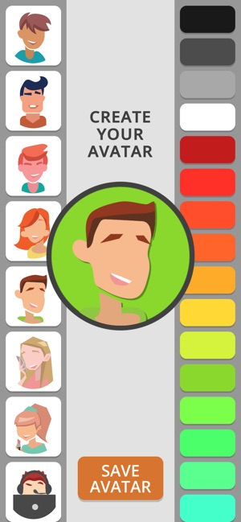
How are you getting on with the LifeLab App?

Slide 3
Objectives
At the end of this lesson you should be able to:
Analyse health data and health risks
Review progress made with health pledge
Evaluate marketing strategies

Slide 4
Can you name them?
Notes:
Starter task: The next 4 slides contains advertising slogans and information from manufacturers and sellers. Play as a quiz with students.

Slide 5
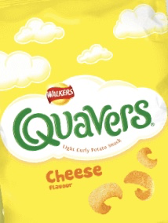
How well did you do?

Slide 6
How about these slogans?
‘Finger lickin’ good’ at ……………
It’s a ‘bit of an animal’ ………….
‘Taste the rainbow’ with ………..
What drink ‘gives you wiiings’? …………
‘Have a break have a ………..’
‘It’s the real thing’ …………
‘Once you pop, you can’t stop’ ………….
‘I’m lovin it’ at …………….
‘Every little helps’ at ………………
‘Kids and grown ups love it so, the happy world of ………’
‘That’s why mums go to ……………’

Slide 7
How about these slogans?
‘Finger lickin’ good’ at ……KFC
It’s a ‘bit of an animal’ ……Peperami
‘Taste the rainbow’ with ……Skittles
What drink ‘gives you wiiings’? ……Red Bull
‘Have a break have a ……KitKat’
‘It’s the real thing’ ……Coca-Cola
‘Once you pop, you can’t stop’ ……Pringles
‘I’m lovin it’ at ……McDonald’s
‘Every little helps’ at ………Tesco
‘Kids and grown ups love it so, the happy world of …..Haribo’
‘That’s why mums go to ……Iceland’

Slide 8
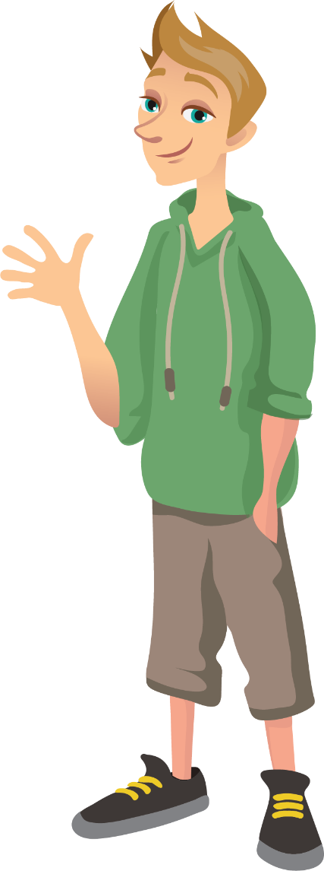
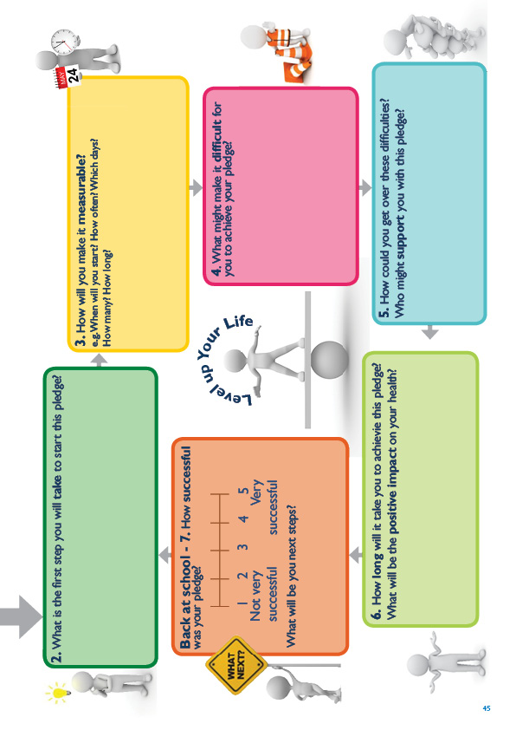
Activity 1
Risk Checker
Complete the How Are You Quiz and think about how important your health is to you. www.nhs.uk/oneyou/how-are-you-quiz/
How are you getting on with your goal?
Notes:
Activity 1: Thinking about your health.
Students can either enter Chris’s or their own data into online ‘How Are You Quiz’. (Chris’s information is in teacher resources). We recommend that you do the quiz first yourself in order to judge its suitability for your class. Class discussion after quiz: How would you rate Chris’s or your own health? How important is your health to you? Suggest ways in which either themselves or Chris could change their/his behaviour to reduce the risk of developing and NCD. How could you/Chris reduce your/his risk? How does your health pledge help you improve your health?

Slide 9
Who controls what you eat?
^{The facts:}
• There is a conclusive link between the diet of children and teenagers and their mental and emotional health and wellbeing
• Our environment has slowly changed, making it harder for children and teenagers to make healthy choices
• Efforts to help children eat healthily are being undermined by sophisticated promotions for unhealthy foods
• Unhealthy foods are three times cheaper than healthy food
• Half of breakfast cereals marketed to children and teenagers are high in sugar and a single portion would make up a third of their daily allowance
Notes:
Class discussion.
To Animate

Slide 10
Who controls what you eat?
Activity 2
How do you think companies encourage you to buy junk food?
Look at the pictures can you identify the different marketing tactics used?
Notes:
Activity 2: Are you aware of the marketing tactics used? How do you think companies encourage you to buy junk food? Student discussion task of all the possible methods that you can think of with a partner/within a small group.

Slide 11
Who controls what you eat?
^{Did you know?}
• Children and teenagers are particularly susceptible to advertising of unhealthy food and drink. See it, want it, buy it, eat it!
• Marketing techniques used to target children and teenagers are increasingly sophisticated, and often work at a subliminal level that is not recognised.
Notes:
Class discussion.
To animate

Slide 12
Activity 3
How aware are you of the marketing tactics used?
How many have you experienced?
Have a look at examples of the different marketing tactics used on the cards.
Now match the tactic to its description.
Notes:
Activity 3: Are you aware of the marketing tactics used?
Working in small groups, students look at the images on the cards showing examples of different marketing methods used and ask the following questions – What are the different methods used? Which ones have you experienced yourself? Where are they used? How do you think they work? Share a summary of their key ideas with the whole class, question and answer through discussion.
See teacher guide for further information on the governments Childhood Obesity Strategy.

Slide 13
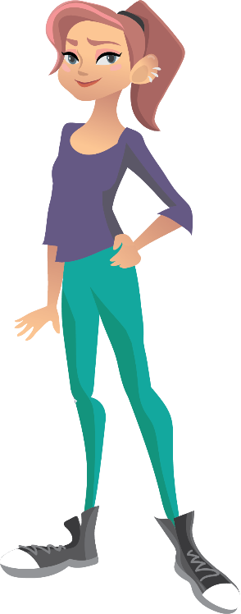
Activity 4
Who is feeding teenagers junk food habits?
Location of where you are targeted? | What tactics do they use? How do they work? | How do these make you feel? What do you think should be done about this?
If you had the power, what would be your priority?
Notes:
Activity 4: Describe 3 different examples of marketing tactics you have experienced in the table – discussion based task.
Students choose three examples of the marketing strategies that they have experienced to complete the table describing in more detail what the marketing strategies are and what are the students opinions about them.
Teacher booklet has a URL to a website mapping tool that can tell you how many and what type of fast food outlets are in your area.

Slide 14
Are you aware?
Biteback2030 Video
https://youtu.be/TLf2gOrL1iM
Notes:
Video from NGO Biteback2030
I would just like to finish by showing a short video which has been created by an NGO called Biteback which is aiming to encourage healthier environments for young people. Even though this ‘experiment’ was conducted with a very small number of teenagers, it demonstrates how much of an influence food marketing can have on our choices.

Slide 15
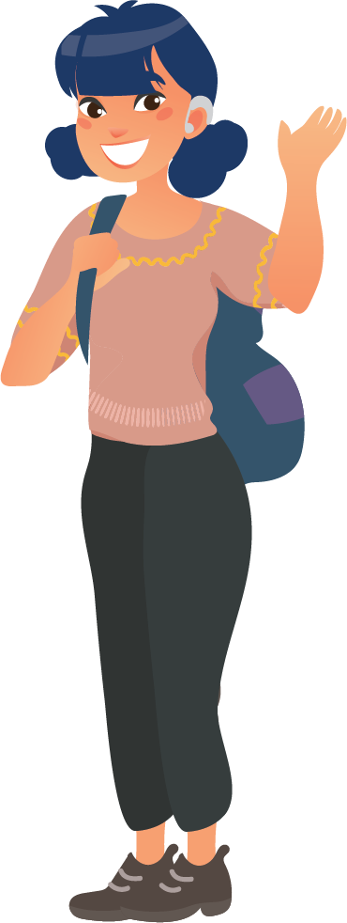
Extension activity
What ‘healthy’ adverts that you have seen?
How did they make you feel?
Were you as enticed by them as the unhealthy adverts?
How might people feel differently about them?
Notes:
Examples of healthy ads:
ALDI: Kevin the Carrot adverts for Christmas 2020
https://www.google.com/search?client=firefox-b-d&q=colin+the+carrot+advert+2020
Eat them to defeat them avert campaign:
https://www.youtube.com/watch?v=C68TQ4uPcgg
Quaker Oats current add campaign:
https://www.youtube.com/watch?v=DhuMKvoiEks&feature=youtu.be
California Almond 2020 advert:
https://www.youtube.com/watch?v=tD_uQ6FFbtk
Quorn adverts:
https://www.youtube.com/watch?v=EdezK6HifvI
Weetabix advert:
https://youtu.be/X4qHoSgyQqc

Slide 16
Homework task
Discuss with the rest of your family to find out how aware they are of these marketing strategies.
Get your family involved!
Then you should decide upon a possible health related question you might want to investigate, linked to what you have learned about health.
Think about what data you will need and how you will collect it. Be as open and inventive as possible with your investigations!

Slide 17
Objectives
At the end of this lesson you should be able to:
Analyse health data and health risks
Review progress made with health pledge
Evaluate marketing strategies

Slide 18
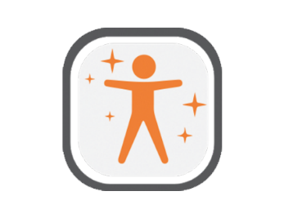
Reflection
What new things have you learnt today?
What will you make sure you remember from today?
What steps have you made towards ‘Levelling Up Your Life’?
What does your avatar look like?
Have you been on a mission with Doug yet?
Notes:
Students refer back to the lesson objectives and complete the assessment for learning activity in the orange boxes, feedback and share an interesting fact they have found out from the lesson. Remind students about the EACH-B APP.

Slide 19
This work is funded by the Department of Health and Social Care (DHSC) and the National Institute for Health Research (NIHR). The views expressed are those of the authors and not necessarily those of DHSC or NIHR

