Slide 1
Glitter Hands
Objectives:
To recognise that a virus spreads through touch.
To identify washing hands with soap as an effective measure of preventing the spread of the virus.

Slide 2
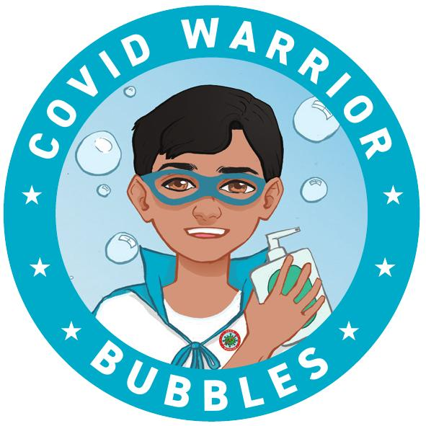
Video Introduction
Watch COVID-19 Warriors Video Introduction.

Slide 3
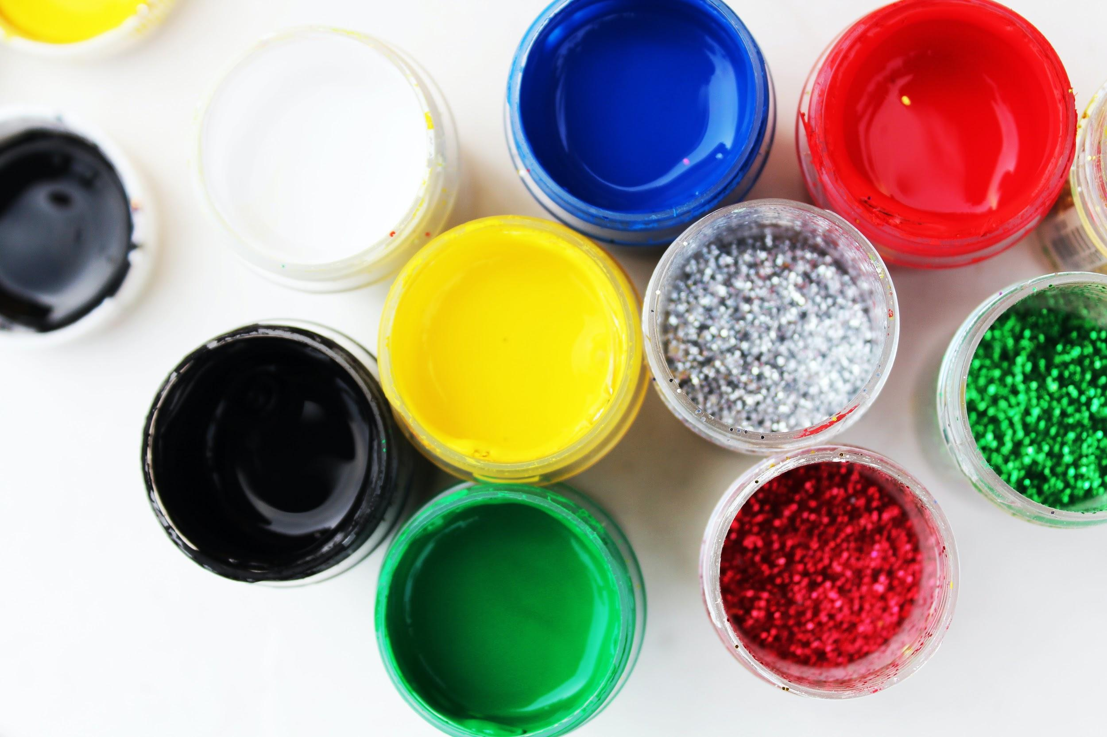
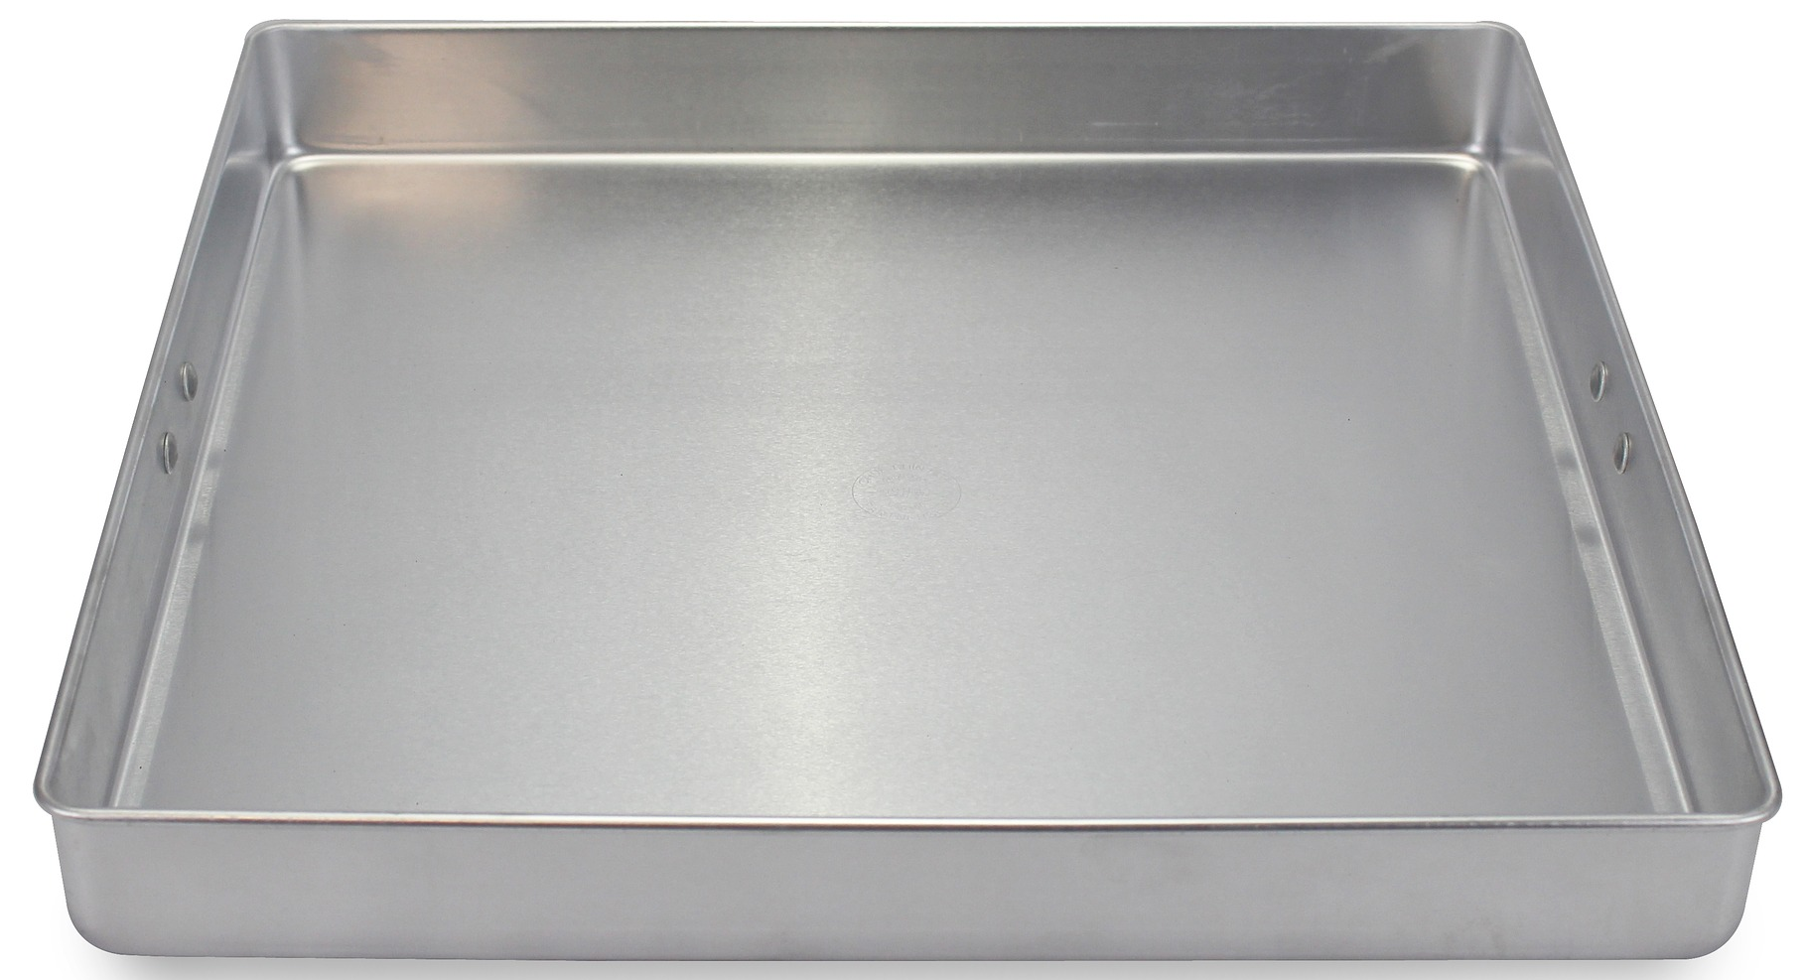
Main Activity
Can you test what happens when you dip your finger in the tray with water and glitter if you:
don’t use soap
use soap
use something else instead of the soap - like paint or PVA glue?

Slide 4
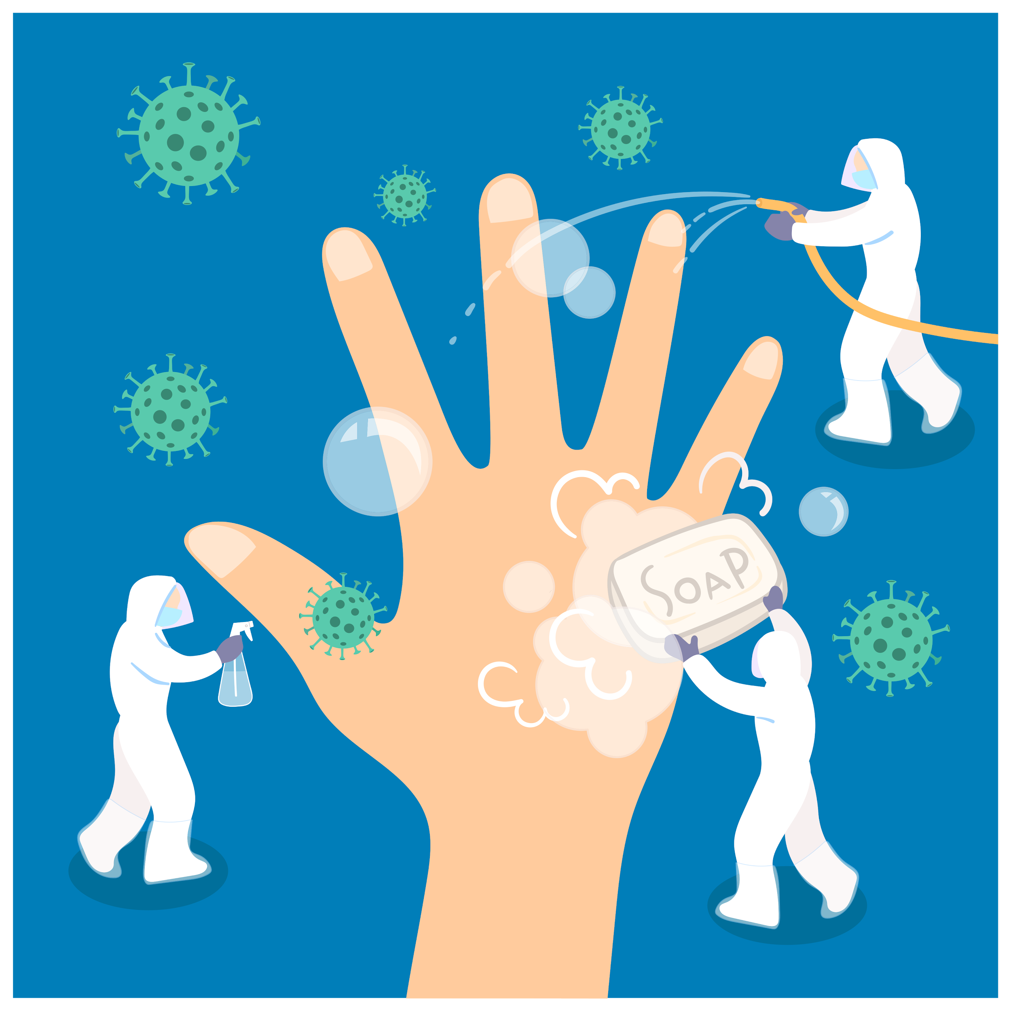
What have we learnt?
What have you found out?
Can you explain how soap works?

Slide 5
Remember to wash your hands often, using soap and warm water.

Slide 6
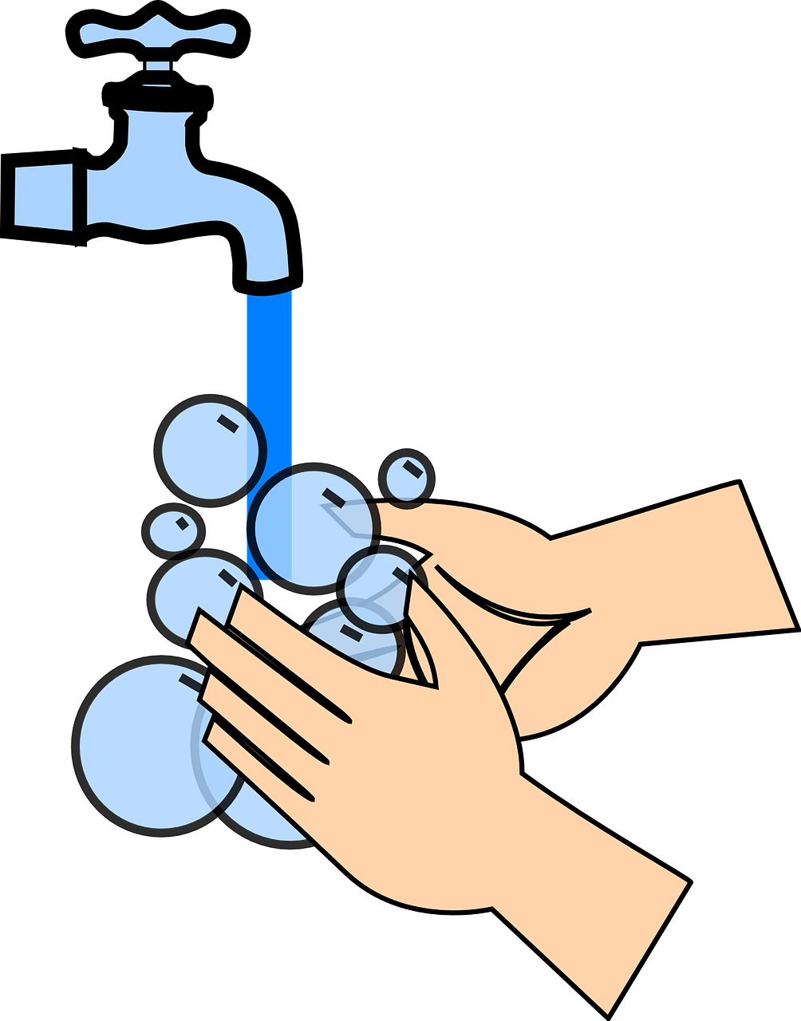
Extension Activities
In a small groups or a pair, get some vegetable oil your fingers, then have a race and see who washes the oil off first:
washing up bowl with just water
washing up bowl with soapy water

Slide 7
Bye,
see you soon!

