Slide 1
What is research?

Slide 2
Video
Show LifeLab video 'What is research?'
Notes:
Students are starting on the ‘Young Researcher Training Programme’ – ask for their ideas about what research is first before revealing the four bullet points.
If you are a researcher, what do you do? What is your aim? What is it all about?

Slide 3
What is research about?
Research is all about asking questions and testing theories.
It lets you discover information for yourself and it helps you to get your ideas out there.
Research lets you answer questions to make people’s lives better – and the answers can improve your understanding of the world.
Doing research helps you develop key skills.
Notes:
To sum up ideas seen in the video

Slide 4
Why is research important?
Which of these headlines result from someone’s research?
Connection between light levels and mental health
Parental engagement positively associated with safer driving among young people, study finds
Exercise can boost brain health!
NASA analysis confirms warmest year on record
Vaping could cloud your thoughts, new studies suggest
Notes:
All of them! Researchers have studied, eg for the exercise headline how much exercise people do and whether doing more can improve how your brain performs. Researchers record temperatures from weather stations across the world and analyse that data, comparing it to previous data. Researchers look at statistics on accidents involving young drivers, and find data about how much involvement parents have or had in that young person when they were learning to drive and their first months/years of driving.
Vaping could cloud your thoughts, new studies suggest | ScienceDaily
Connection between light levels and mental health -- climate change could also have an impact in the future | ScienceDaily
Exercise can boost brain health | ScienceDaily
NASA analysis confirms 2023 as warmest year on record | ScienceDaily
Parental engagement positively associated with safer driving among young people, UGR study finds | ScienceDaily

Slide 5
Why is research important?
Research helps us makes sense of our world!
We can …
ask questions
discover answers
test hypotheses (ideas or explanations that haven’t yet been proved)
share the conclusions with the rest of the world
improve people’s lives - young, old, men, women, non-binary, those from different cultures – because research and its results are there for everyone.
Notes:
Explain that research can improve life on a range of scales (both small and large). For instance, research can impact small groups (e.g. a mental health focus group) but also the entire population (e.g. a census helps give us information that helps focus resources and funding in the right places).

Slide 6
What does your future look like?
What is important to you in life right now?
Do you think your priorities may change as you get older? What might be important to you in 10 or 20 years’ time?
What barriers might there be to getting where you want to be?
How can you remove those barriers to achieve your dreams?
Notes:
This is a ‘Plausible Futures’ exercise. PRINT OUT slide 5 as A3 or use large sheets of paper with headings on – students move round and write on them, or divide into four small groups to have a go at adding ideas on to them under the four bullet points from the slide.

Slide 7
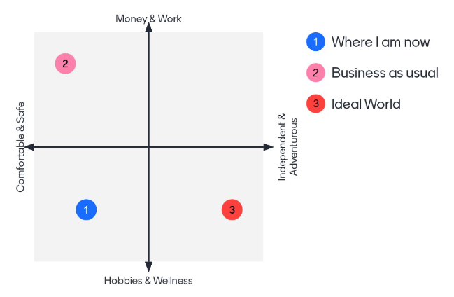
What does your future look like?
On the ‘Futures’ grid, plot:
Where are you now?
Where will you be in 15 years' time if nothing changes?
Where would you want to be on this grid, in an ideal world?
Notes:
Students should each use a different coloured pen and plot the following on to the grid:
where they are now
where they expect to be in 15 years time if nothing changes, and
where they would like to be.
Use the patterns to have a group discussion about what the barriers and opportunities are for them – what is stopping them getting to where they want to be, what needs to change to enable that to happen? Possible ideas that could be mentioned - health / mental health / lack of or presence of training opportunities / location of opportunities / finances / vision / having contacts or lack of contacts or role models / mindset / peer pressure / exam pressures / internet & online training opportunities / developing skills. Finish with the importance of skills to help you get where you want to be … YRTP!

Slide 8
What does your future look like?
NEED VERSION OF GRID WITHOUT THE NUMBERS COMPLETED ON THE GRID AS WELL
Notes:
Print off this slide on A3 to use with students marking their own 1, 2 and 3 in different coloured pens.

Slide 9
Who can do research?
You may be imagining a researcher as an old, frail alchemist in a laboratory …
That's not true.
Anyone can do research!
Notes:
Having skills (such as how to do research) can be one way of breaking down barriers identified in the Plausible Futures exercise

Slide 10
Who can do research?
Even you!
All you need is …
a question
some passion
a pinch of willpower
Notes:
Encourage students that research really is that simple – anyone can do it, no matter their age/intelligence etc. It's achievable and as said in the video (Maddie + Vishaan), it shouldn’t be restricted to the stereotype of scientists.

Slide 11
Choosing your research question
Subject: What overall subject are you interested in or passionate about?
Theme: Is there a theme within that subject that interests you?
Context: Who / where could you investigate?
Topic: Can you narrow down even more?
Questions: What questions could you ask?
Notes:
Introduce the Independent work, which is to decide what they want to research – what is their research question going to be? Using a framework such as ‘PICO’ helps to structure the question in more detail – see next slides.
Go through the example on the next slide to help illustrate how to narrow down.

Slide 12
An example of a research question
PICO
Subject: What overall subject are you interested in?
Theme: Is there a theme within that subject that interests you?
Context: Who / where could you investigate?
Topic: Can you narrow down even more?
Questions: What questions could you ask?
Vaping
Dangers of vaping
Young people at my school / in my community
Harmful effects of vaping on 11-16 year olds
Are harmful effects of vaping more likely if you start vaping younger?
Notes:
Introduce the Independent work, which is to decide what they want to research – what is their research question going to be? Using a framework such as ‘PICO’ helps to structure the question in more detail – see next slide

Slide 13
Using PICO to focus in on your research question
PICO
Population:
WHO are you asking this question about? Which group of people?
Intervention:
WHAT is the specific issue or problem that you're interested in researching?
Comparison:
HOW does the group’s experience of this problem compare with other people's?
Outcomes:
HOW would people's experiences change if we sorted out this problem?
Notes:
Use PICO to help students focus in more clearly.

Slide 14
Your independent work for next week
Watch the short YRTP video ‘What is research?’
Spend time thinking about what research you might do – discuss it with family and friends – what issues and topics are you concerned about or passionate about? Can you link your research with action that needs taking to improve your life and the lives of others in your community?
Complete the independent work sheet to help you focus in on possible research questions using the upside-down triangle and PICO to help you.
PICO

