Slide 1
Sneeze Test
Objectives:
To recognise that sneezes can spread viruses.
To recognise that using simple actions like using a tissue when sneezing can lower the spread of a virus.

Slide 2
Video Introduction
Watch COVID-19 Warriors Video Introduction

Slide 3
Main Activity
Imagine that the spray bottles are filled with a sneeze - a horrible mixture of snot and saliva…
What happens when you put your hand or a tissue in front of the sneeze?
Record your results on the table.

Slide 4
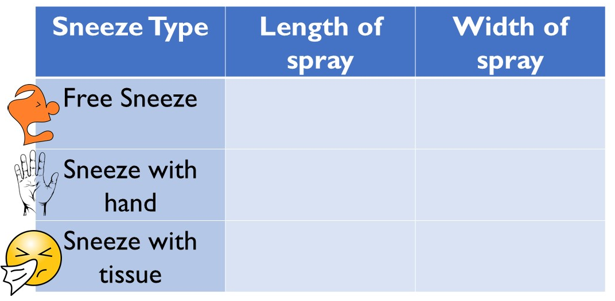
How far do droplets of snot and saliva spread when you sneeze?
Look at the results and think about how you should sneeze to keep others safe.

Slide 5
What have we learnt?
You can see that germs can’t spread so far when you block your sneeze.
Look at the hand… What can you see?
The safest ways to sneeze are into a tissue or into your elbow.
Remember to throw your tissue away and wash your hands!

Slide 6
Bubbles says… “Remember to wash your hands with soap and water as often as you can!”
Remember to colour in the next Warrior picture!

Slide 7
Extension Activities
Have a go at making a poster to show others how to sneeze safely.

Slide 8
Bye,
see you soon!

