Slide 1
Sneeze Test
Objectives:
To explain how sneezes can spread viruses, using evidence from their experiments.
To evaluate if their tests are ‘fair’ and suggest ways of improving them.
To explain how actions such as using a tissue can help lower the spread of a virus.

Slide 2
Video Introduction
Watch COVID-19 Warriors Video Introduction

Slide 3
Main Activity
Imagine that the spray bottles are filled with a sneeze - a horrible mixture of snot and saliva…
What happens when you put your hand or a tissue in front of the sneeze?
Record your results on the table.

Slide 4
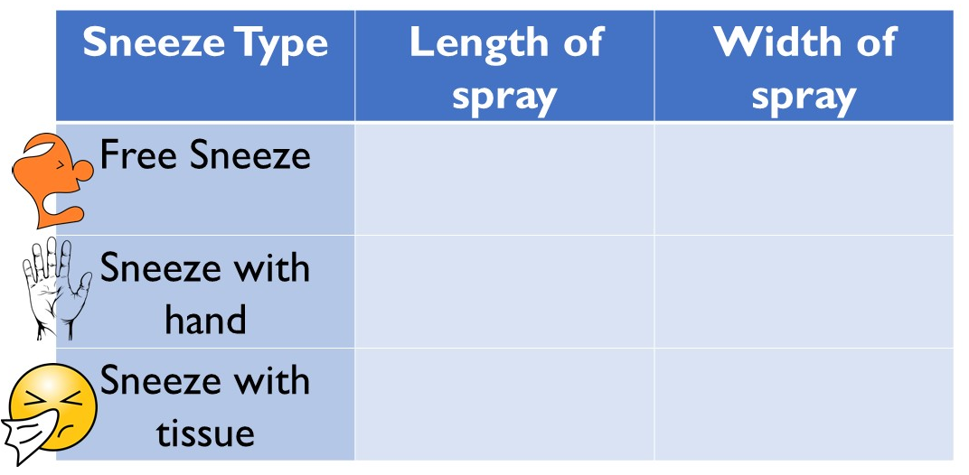
How far do droplets of snot and saliva spread when you sneeze?
Look at the results and think about how you should sneeze to keep others safe.

Slide 5
What have we learnt?
You can see that germs can’t spread so far when you block your sneeze.
Look at the hand… What can you see?
The safest ways to sneeze are into a tissue or into your elbow.
Remember to throw your tissue away and wash your hands!

Slide 6
Bubbles says… “Remember to wash your hands with soap and water as often as you can!”

Slide 7
Extension Activities
Can you make a graph to show your results?
You could also repeat the experiment outside – what is the difference?
Have a go at making a poster to show others how to sneeze safely.

Slide 8
Bye,
see you soon!

