Slide 1
What is research?
Session 1

Slide 2
Starter Activity:
Has green eyes | Has an unusual pet | Is doing or did A Level Psychology | Has met someone famous | Has ever walked more than 15,000 steps per day
NAME: | NAME: | NAME: | NAME: | NAME:
Favourite colour is blue | Has a TikTok account | Plays a musical instrument | Has been on TV | Has been to the cinema this year
NAME: | NAME: | NAME: | NAME: | NAME:
Has ever been on a zipwire | Has an unusual hobby | Read a book in the last month | Likes rain | Plays for a sports team
NAME: | NAME: | NAME: | NAME: | NAME:
Is left-handed | Has met a member of the Royal Family | Can speak more than one language | Is vegetarian | Is a dancer
NAME: | NAME: | NAME: | NAME: | NAME:
Has taken a cooking class | Has been to a music concert this year | Wears contact lenses | Has a favourite castle | Likes chocolate
NAME: | NAME: | NAME: | NAME: | NAME:
Whilst we settle in, grab a Bingo card and find people who hit the brief(s)!

Slide 3
My pronouns are…
Starter Activity 2:
Tell the group your name and your pronouns, then pick someone you found with an interesting bingo element, share with the group, and pass it onto them.
My name is…

Slide 4
Let’s discuss what our ground rules should be.
Notes:
General usual discussion about group rules:
Be respectful of other people’s opinions
Listen
Be on time
Contribute
Keep what is said in the sessions confidential – respect people’s privacy

Slide 5
Ask questions – don’t worry about anything or anyone
Be respectful
Be on time
Collaborate with the group
Let’s discuss what our ground rules should be.
Complete self-directed tasks
Post it feedback – and we’ll listen and action!
Contribute to the discussions
Listen
Notes:
Be respectful of other people’s opinions – this is one of privileges of this programme, hearing all sorts of opinions. So, no-one should feel they can’t share, and we should all respect that we may have different opinions
Be on time – we have lots to get through, so please try to be on time. If you’re going to be late, or you can’t come one session, then please let us know
Ask questions – this is really important. It’s really important anyway, we want to encourage you to be involved, but also, when you get into your data collection and your ‘out there’ in the world talking to people, then we really want to know if there is anything of any concern to you. Also, if you’re worried about someone else – please let us know. We are always learning with this programme and we can only learn through hearing from you
Collaborate with the group – you’ll get more out of each session if we’re all working together
Post-it notes – this is as much about us making a commitment to you as well – we’ll ask for feedback for every session and will try to put suggestions into action
Listen – goes back to being respectful – listen to each other, allow everyone that chance to share their thoughts and opinions. This research programme is about finding out new things, so there aren’t ‘right’ and ‘wrong’ answers, so we all need to listen and learn from each other
Contribute to the discussions – again – the more you put in, the more you and everyone else will get out of it
Self-directed tasks – as you know there are some tasks for you to complete between sessions – sometimes not much, when you’re doing data collection and analysis, it’s more. Please try to keep on top of the tasks – but again, please just chat to us if you have any challenges, we want this to be a programme that is enjoyable and manageable for everyone
Finally, please respect people’s privacy and keep what is said in the sessions confidential – don’t share personal information outside of these sessions

Slide 6
Learning outcomes:
LO1: Describe what research is and why it is important
LO2: Discuss aspirations for the future, considering challenges and opportunities
LO3: Devise own appropriate research question

Slide 7
What does your future look like?
Activity 1:
Insert QR code / Mentimeter link with the title: "Name one future aspiration you have for yourself.
Scan the Mentimeter QR code and contribute your answer!
Notes:
[Set up a Mentimeter question if you want to use technology and capture everyone’s thoughts together.
(www.Mentimeter.com)]

Slide 8
What does your future look like?
Activity 1:
Name one future aspiration you have for yourself.
Write it on a post-it note and stick it up on the wall
Notes:
[Use this slide if you don’t have access to Mentimeter]

Slide 9
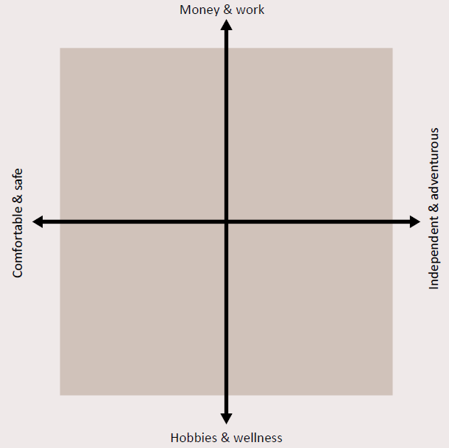
Activity 2:
Looking at the ‘Futures’ grid, discuss which quadrant should have which name:
STABLE WORLD
PRIORITISING LIFE WORLD
‘FULFILLING LIFE’ WORLD
ENTREPRENUERIAL AND MONEY-MAKING WORLD
Notes:
We’re going to do an exercise called ‘Plausible Futures’. This is an exercise that was originally developed as a strategic planning tool to support discussions with communities in low- and middle-income countries. Its purpose is to stimulate discussions about how to allocate limited resources effectively. We’re using it, to get us thinking about our futures, or the futures we want to see for our communities.
It starts with creating 2 axes which represent different approaches to life or decision-making. These axes, when combined, create a grid with four quadrants [click for image to appear]
The four quadrants formed by the axes represent distinct "possible worlds" or future scenarios – which quadrant do you think should have which name?

Slide 10
Notes:
What is research

Slide 11
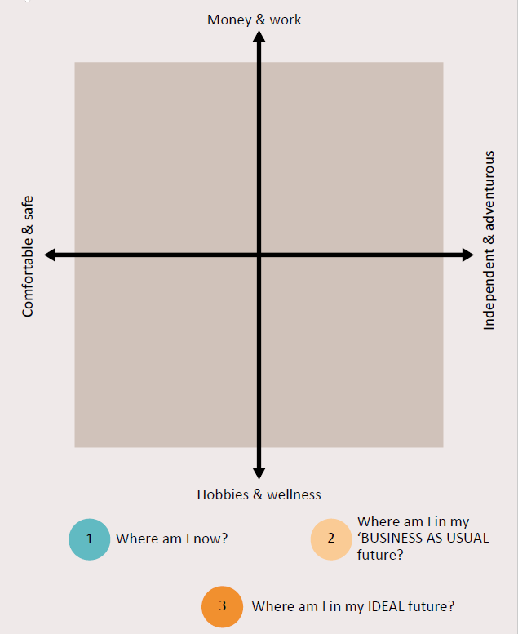
What does YOUR future look like?
Activity 3:
Now, we need to plot – choose a coloured pen and:
1) Where you think you are now (use an ‘N’ and your initials)?
2) Where you think you will be in 15 years' time if nothing changes (use a ‘B’ and your initials)?
3) Where you would like to be in an ideal world (use an ‘I’ and your initials)?
Notes:
[Researchers should use a different coloured pen and plot the following on to the grid. Pause at each stage to discuss…..
where they are now
where they expect to be in 15 years time if nothing changes, and
where they would like to be.
Use the patterns to have a group discussion about what the barriers and opportunities are for them – what is stopping them getting to where they want to be, what needs to change to enable that to happen?
Possible ideas that could be mentioned - health / mental health / lack of or presence of training opportunities / location of opportunities / finances / vision / having contacts or lack of contacts or role models / mindset / peer pressure / exam pressures / internet & online training opportunities / developing skills. Finish with the importance of skills to help you get where you want to be … YRTP!]

Slide 12
Choosing your research question
Activity 4:
What subjects and themes interest you?
Thought-shower using post it notes!
Notes:
Keeping in mind that discussion we’ve just had, we now need to think about what you are going to research. You self-directed tasks this week, will be focused on you choosing your research topic and defining your research question.
Let’s start of by thinking about what broad topics you’re interest in – have a chat on your table and jot down any themes that are of interest.
[Share on a whiteboard or by just sharing them out loud. Some examples are given on this slide too.]

Slide 13
Example:
Theme
Is there a theme within that subject that interests you?
Context
Who / where could you investigate?
Topic
Can you narrow down even more?
Subject
What overall subject are you interested in?
Vaping
Dangers of vaping
Young people
What are the harmful effects of vaping on teenagers
Possible research questions
Notes:
When we’re coming up with research questions, we have to frame them in a way which means they can be answered effectively.
So, they have to be specific and at the same time broad enough to have interest to others.
We can use a framework, like this to start us off, and this is what you’ll be doing in your self-directed tasks.
So, the overall subject might be something like ‘Vaping’ [click]
Then, within that, we might be interested in the dangers of vaping [click]
But the specific context might be to consider that for young people – we know that vaping is safer than smoking, so for adults using vaping to quit smoking it’s a great tool, but what does it mean for young people? [click]
And so our specific question within this broad topic is ‘what are the harmful effects of vaping on teenagers’ [click]
And this is how we narrow down to our possible research questions

Slide 14
P.I.C.O.
Population:
WHO are you asking this question about? Which group of people?
Intervention:
WHAT is the specific issue or problem that you're interested in researching?
Comparison:
HOW does the group’s experience of this problem compare with other people's?
Outcomes:
HOW would people's experiences change if we answered this question?
PICO
Notes:
We have another acronym to help us frame our research questions – PICO [click]
P – population – who are you asking this question about? [click]
I – intervention – what is the specific issue or problem you are looking at or evaluating? [click]
C – comparison – who are you comparing against, how are you adding in some robustness?
O – outcomes – how would people’s experiences change if we answered this question [click]

Slide 15
Example 1:
O
P
What is the impact on prevalence of disease in young children of taking
vitamin C supplements, when compared to no supplements?
I
C
Example 2:
P
O
I
What impact on teenagers’ self-confidence does participating in sport have?
Notes:
Not all questions have every element: very often questions wont have a comparison, especially in qualitative work.

Slide 16
Self-directed tasks:
Watch the YRTP video ‘what is research?’
Spend time thinking about what research you might do – discuss it with family and friends – what issues and topics are you concerned about or passionate about? Can you link your research with action that needs taking to improve your life and the lives of others in your community?
Complete the triangle and PICO worksheet to help you focus in on possible research questions
Watch the 'Reflective and Reflexive researcher' video

Slide 17
Feedback:
On one post-it note per statement, please:​
​
Tell us one thing you enjoyed today / learnt / found interesting ​
Tell us one thing we can improve on for next week​
Notes:
One of our commitments to you, is to learn from you about what is working well each week, and find things we can improve – so please let us know what you think!

