Slide 1
Hands, Face, Space
Objectives:
To find out what we know about COVID-19.
To know the measures we need to take to limit the spread of the virus.
To think of ways we can we encourage others around us to follow the rules.

Slide 2
Video Introduction
Meet COVID-19 Warriors!
Watch COVID-19 Warriors Video Introduction

Slide 3
Main Activity
Make up a simple rhyme or rap to help everyone remember the
Hands, Face, Space rule.
Here is an example:
To the tune of “Row, row, row your boat”.
Wash, wash, wash your hands
Stay 2 metres apart
Wear a mask if you’re old enough
And keep your family safe

Slide 4
Think of ways you can encourage others to follow the rules.

Slide 5
What have we learnt?
Can you remember each Warrior’s tool and how it helps to defeat COVID-19?

Slide 6
What have we learnt?
Can you remember each Warrior’s tool and how it helps to defeat COVID-19?

Slide 7
By following the rules, we help to protect our friends and family

Slide 8
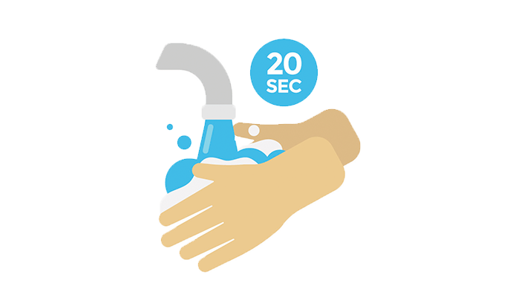
Extension Activities
Can you make a poster or PowerPoint presentation of your Rules Rhyme?
OR
Record a video of reading/rapping your rhyme and show to your teacher or your parent?

Slide 9
Bye,
see you soon!

