Slide 1
Glitter Hands
Objectives:
To describe using information from simple observations how a virus spreads through touch.
To identify washing hands with soap as an effective measure of preventing the spread of the virus.
To explain in simple terms why using soap when washing hands is important for limiting the spread of the virus.

Slide 2
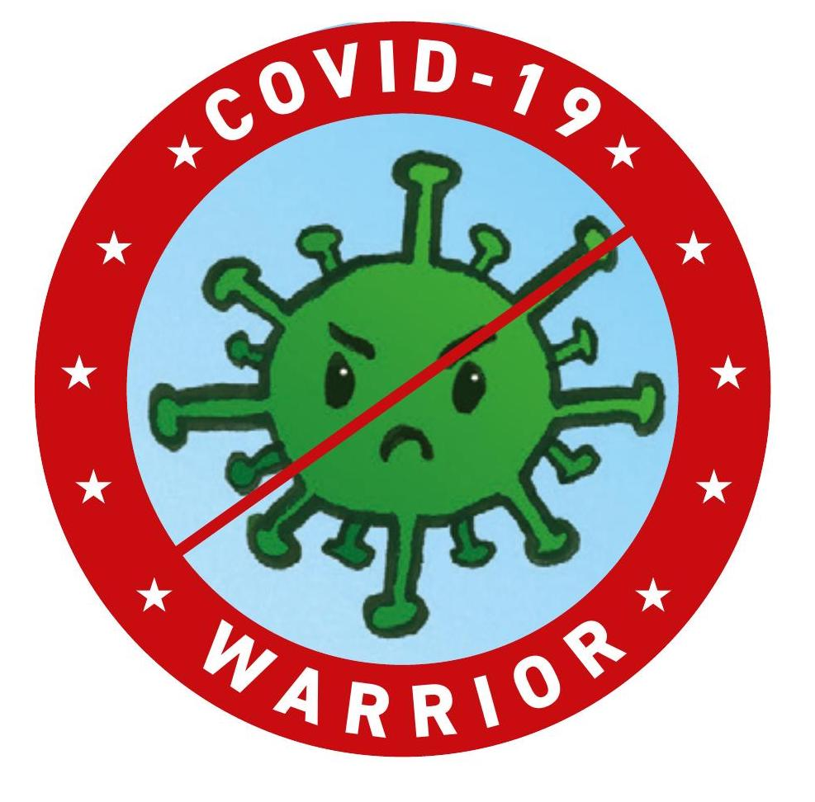
Video Introduction
Watch COVID-19 Warriors Video Introduction.

Slide 3
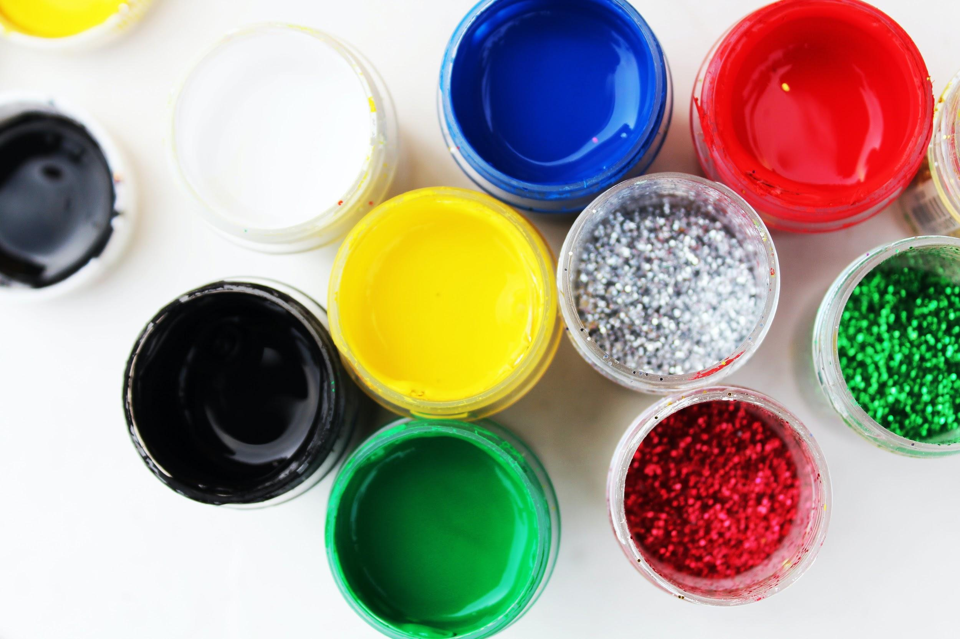
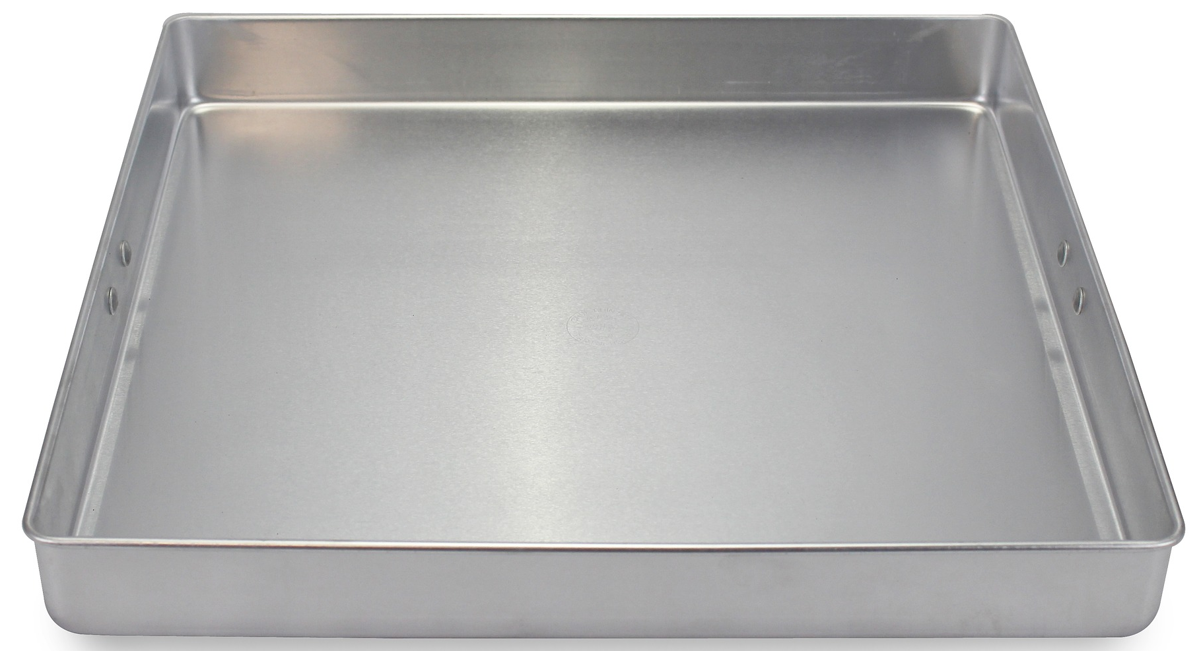
Main Activity
Can you test what happens when you dip your finger in the tray with water and glitter if you:
don’t use soap
use soap
use something else instead of the soap - like paint or PVA glue?

Slide 4
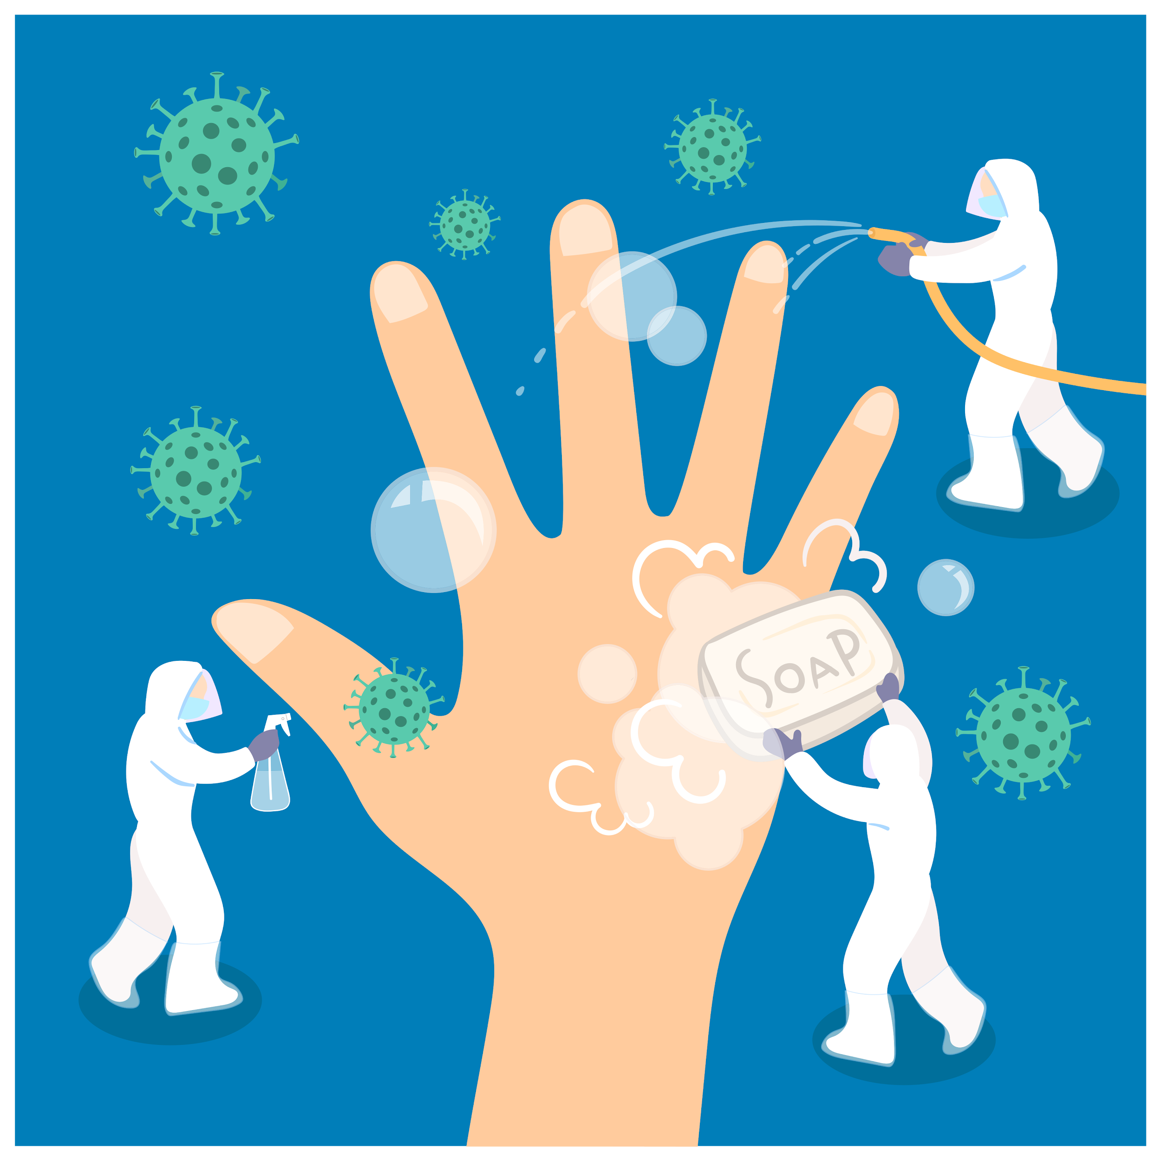
What have we learnt?
What have you found out?
Can you explain how soap works?

Slide 5
Remember to wash your hands often, using soap and warm water.

Slide 6
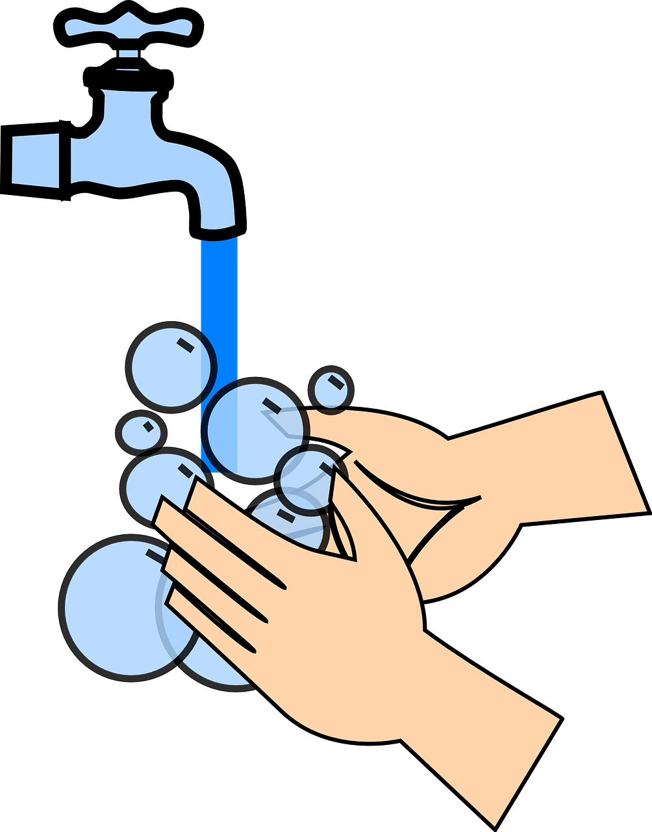
Extension Activities
In a small groups or a pair, get some vegetable oil your fingers, then have a race and see who washes the oil off first:
washing up bowl with just water
washing up bowl with soapy water

Slide 7
Bye,
see you soon!

