Slide 1
Me, My Health and My Children’s Health
Your Scientific Health Investigation

Slide 2
Objectives
At the end of this lesson you should be able to:
Formulate your own question to investigate health
Design and construct a plan for your own health investigation
Safely carry out your health investigation
Record reliable, precise, and accurate data
Make a conclusion based on the evidence collected

Slide 3
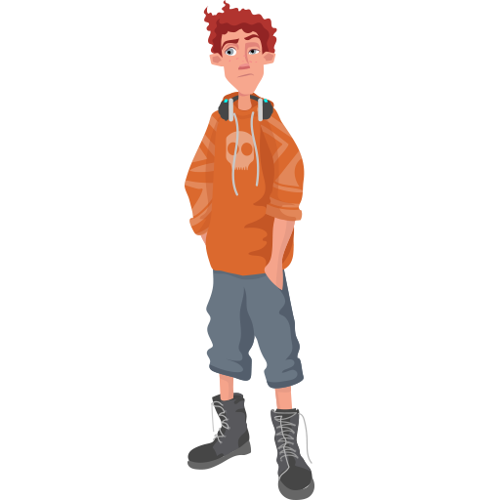
How could you investigate health?
Your investigation

Slide 4
^{What are your ideas?}
You could measure height and weight of an individual/ group of people
You could measure muscle strength of an individual/ group of people
You could measure pulse rate or breathing rate of an individual/ group of people
You could look at the daily diet of an individual/ group of people

Slide 5
Some previous health investigations…..
Does birth weight affect your height at year 8?
Is laughing good for our health?
Does an energy drink affect our heart rate?
How does mass affect a students’ grip strength?

Slide 6
What question on health are you going to investigate?

Slide 7
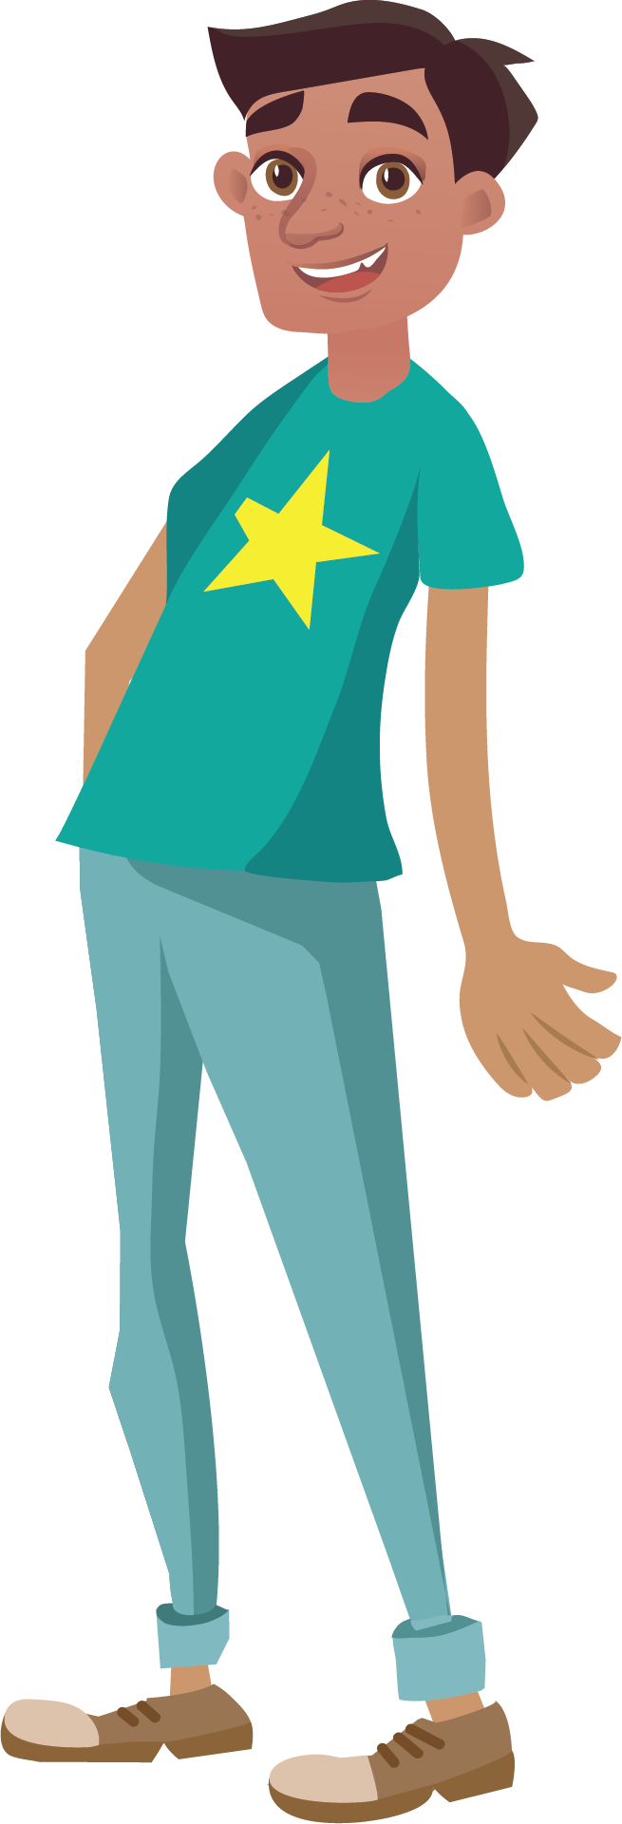
^{Your question…}
^{What will be your method?}
What measurements or data will you need?
^{How will you collect}
^{your data?}
How about you measure something or carry out a survey or questionnaire?
What resources will you need to be able to carry
^{out your investigation?}
^{How will you make sure}
^{it is safe?}
How will you know your results are trustworthy?

Slide 8
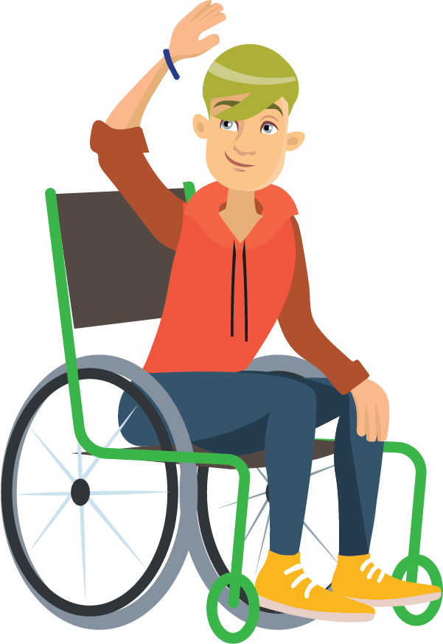
Planning your own scientific health investigation
Plan and carry out your own investigation, collecting and recording data.
Use your planning notes…
Analyse and draw conclusions based on you results

Slide 9
Have you done enough to get your CREST Award?
CREST Award Checklist
Have you done enough in your Scientific Investigation to get your CREST Award?
Refer to the checklist on p.54 of your booklet to check.
Notes:
See teacher resources for checklist.

Slide 10
TITLE:
What was your enquiry question?
What was the aim of your investigation?
Your school name
and logo here
PREDICTION:
THE RESEARCH TEAM:
METHOD:
What did you predict would happen?
What made you think that?
What science ideas did you base your prediction on?
What are your names?
What are the reasons you choose to carry out this investigation?
Describe the steps you took to investigate your prediction.
What were your independent, dependent and control variables?
What equipment did you need to use?
What measurements did you plan to take?
How did you ensure your results were accurate, precise, and repeatable?
RESULTS:
What were your results?
Use diagrams, graphs and photos to illustrate your results.
CONCLUSION:
What did you ﬁnd out?
What did your investigation show?
How did your results agree with your hypothesis?
If not, how do you need to re-think your hypothesis and write a new one?
How could you investigate this new hypothesis?
EVALUATION:
REFERENCES:
What errors are there in your investigation?
What would you change if you could do your investigation again and why?
Do your results give you more questions to answer?
What would you investigate next?
List any websites or books that you used to help form your prediction.
How did other people’s ideas help you decide how to carry out your investigation?

Slide 11
Objectives
At the end of this lesson you should be able to:
Formulate your own question to investigate health
Design and construct a plan for your own health investigation
Safely carry out your health investigation
Record reliable, precise, and accurate data
Make a conclusion based on the evidence collected

Slide 12
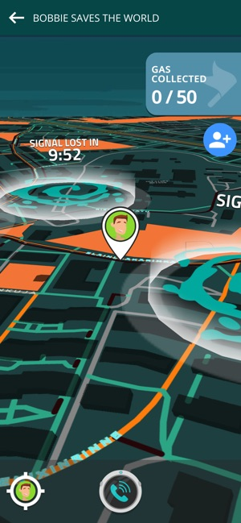
Reflection
What new things have you learnt today?
What skills have you used today?
What skills did you find difficult today?
How well did your group work together to create your health investigation?
How many people have you saved from procrastination gas?
Notes:
Students refer back to the lesson objectives and complete the assessment for learning activity in the orange boxes, feedback and share an interesting fact they have found out from the lesson. Remind students about the EACH-B APP.

Slide 13
Me, My Health and My Children’s Health
Presenting Your Health Data

Slide 14
Objectives
At the end of this lesson you should be able to:
Present your results from my investigation as a scientific health research poster
Evaluate your scientific health investigation poster

Slide 15
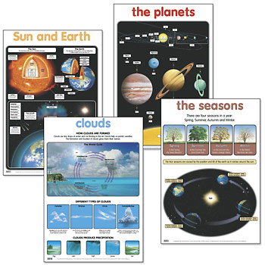
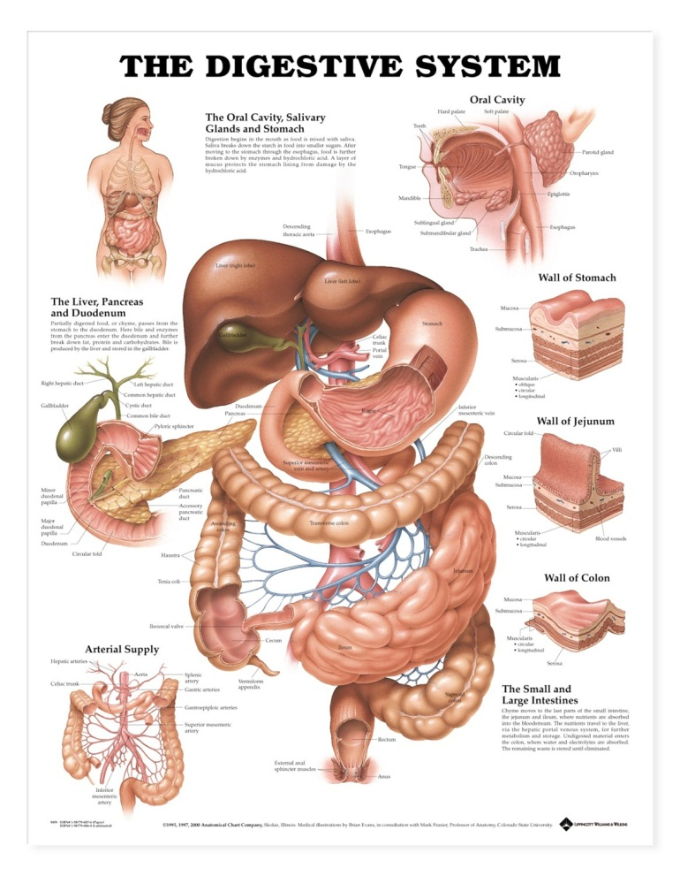
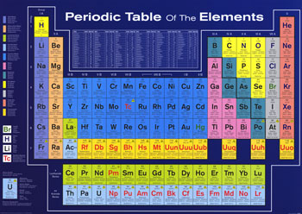
Science Posters

Slide 16
Scientific Research Posters

Slide 17
Scientific Research Posters

Slide 18
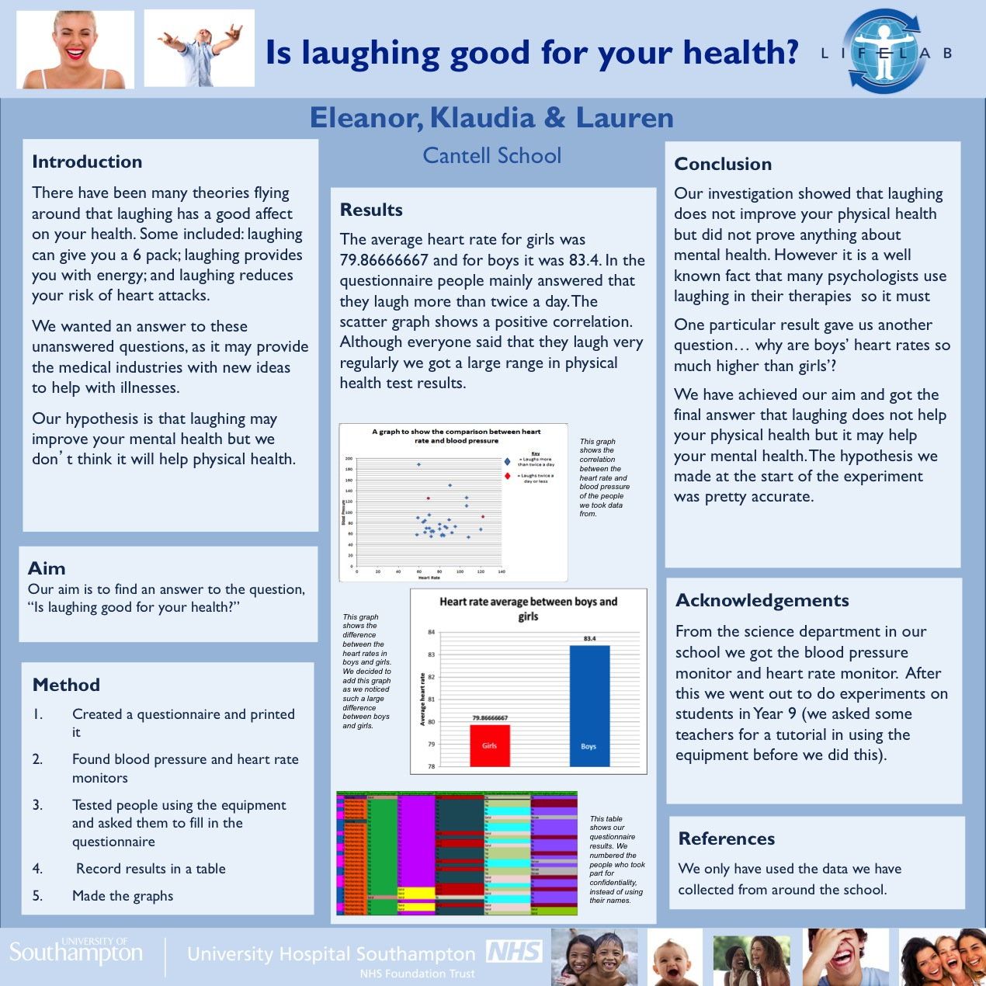
Scientific Research Posters

Slide 19
Scientific Research Posters

Slide 20
Your Scientific Poster
In groups, using the PowerPoint template files, produce your own scientific poster showing the results of your scientific investigation.
Notes:
Activity 1: Design your own health research poster to show your health investigation. PPT template slides follow this…

Slide 21
TITLE:
What was your enquiry question?
What was the aim of your investigation?
Your school name
and logo here
PREDICTION:
THE RESEARCH TEAM:
METHOD:
What did you predict would happen?
What made you think that?
What science ideas did you base your prediction on?
What are your names?
What are the reasons you choose to carry out this investigation?
Describe the steps you took to investigate your prediction.
What were your independent, dependent and control variables?
What equipment did you need to use?
What measurements did you plan to take?
How did you ensure your results were accurate, precise, and repeatable?
RESULTS:
What were your results?
Use diagrams, graphs and photos to illustrate your results.
CONCLUSION:
What did you ﬁnd out?
What did your investigation show?
How did your results agree with your hypothesis?
If not, how do you need to re-think your hypothesis and write a new one?
How could you investigate this new hypothesis?
EVALUATION:
REFERENCES:
What errors are there in your investigation?
What would you change if you could do your investigation again and why?
Do your results give you more questions to answer?
What would you investigate next?
List any websites or books that you used to help form your prediction.
How did other people’s ideas help you decide how to carry out your investigation?

Slide 22
TITLE:
What was your enquiry question?
What was the aim of your investigation?
Your school name
and logo here
PREDICTION:
THE RESEARCH TEAM:
METHOD:
What did you predict would happen?
What made you think that?
What science ideas did you base your prediction on?
What are your names?
What are the reasons you choose to carry out this investigation?
Describe the steps you took to investigate your prediction.
What were your independent, dependent and control variables?
What equipment did you need to use?
What measurements did you plan to take?
How did you ensure your results were accurate, precise, and repeatable?
RESULTS:
What were your results?
Use diagrams, graphs and photos to illustrate your results.
CONCLUSION:
What did you ﬁnd out?
What did your investigation show?
How did your results agree with your hypothesis?
If not, how do you need to re-think your hypothesis and write a new one?
How could you investigate this new hypothesis?
EVALUATION:
REFERENCES:
What errors are there in your investigation?
What would you change if you could do your investigation again and why?
Do your results give you more questions to answer?
What would you investigate next?
List any websites or books that you used to help form your prediction.
How did other people’s ideas help you decide how to carry out your investigation?

Slide 23
TITLE:
What was your enquiry question?
What was the aim of your investigation?
Your school name
and logo here
PREDICTION:
THE RESEARCH TEAM:
METHOD:
What did you predict would happen?
What made you think that?
What science ideas did you base your prediction on?
What are your names?
What are the reasons you choose to carry out this investigation?
Describe the steps you took to investigate your prediction.
What were your independent, dependent and control variables?
What equipment did you need to use?
What measurements did you plan to take?
How did you ensure your results were accurate, precise, and repeatable?
RESULTS:
What were your results?
Use diagrams, graphs and photos to illustrate your results.
CONCLUSION:
What did you ﬁnd out?
What did your investigation show?
How did your results agree with your hypothesis?
If not, how do you need to re-think your hypothesis and write a new one?
How could you investigate this new hypothesis?
EVALUATION:
REFERENCES:
What errors are there in your investigation?
What would you change if you could do your investigation again and why?
Do your results give you more questions to answer?
What would you investigate next?
List any websites or books that you used to help form your prediction.
How did other people’s ideas help you decide how to carry out your investigation?

Slide 24
TITLE:
What was your enquiry question?
What was the aim of your investigation?
Your school name
and logo here
PREDICTION:
THE RESEARCH TEAM:
METHOD:
What did you predict would happen?
What made you think that?
What science ideas did you base your prediction on?
What are your names?
What are the reasons you choose to carry out this investigation?
Describe the steps you took to investigate your prediction.
What were your independent, dependent and control variables?
What equipment did you need to use?
What measurements did you plan to take?
How did you ensure your results were accurate, precise, and repeatable?
RESULTS:
What were your results?
Use diagrams, graphs and photos to illustrate your results.
CONCLUSION:
What did you ﬁnd out?
What did your investigation show?
How did your results agree with your hypothesis?
If not, how do you need to re-think your hypothesis and write a new one?
How could you investigate this new hypothesis?
EVALUATION:
REFERENCES:
What errors are there in your investigation?
What would you change if you could do your investigation again and why?
Do your results give you more questions to answer?
What would you investigate next?
List any websites or books that you used to help form your prediction.
How did other people’s ideas help you decide how to carry out your investigation?

Slide 25
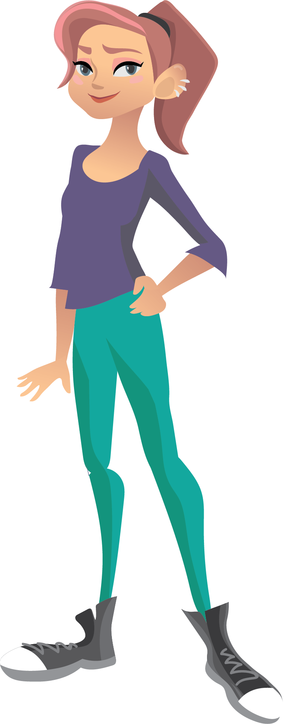
Judging the Posters
What are you going to give marks for?
What are you looking for?
How will you decide which poster/s should go to the LifeLab Schools’ Conference?
Notes:
Activity 2: Judging your health research posters.
Group discussion on how you are going to judge the posters and agree the criteria.

Slide 26
Science Conferences
Notes:
What is a scientific health conference? Page 56 in student booklet where they can find out more about DOHaD.

Slide 27
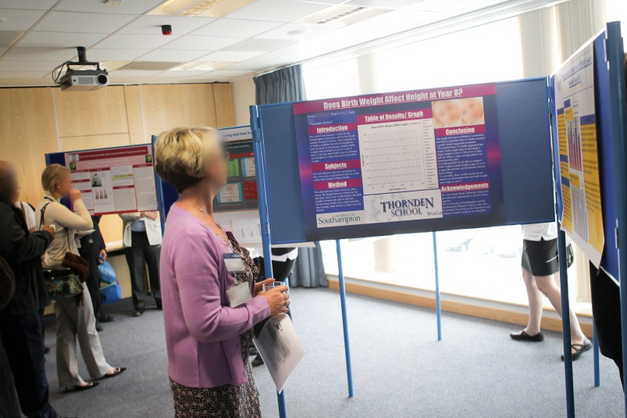
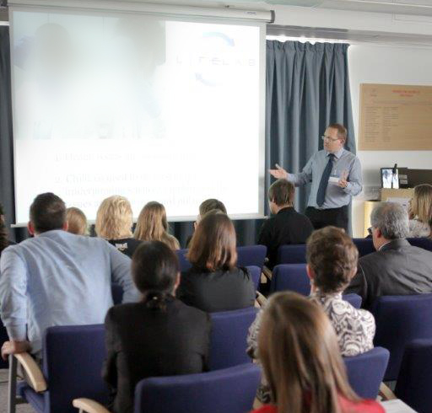
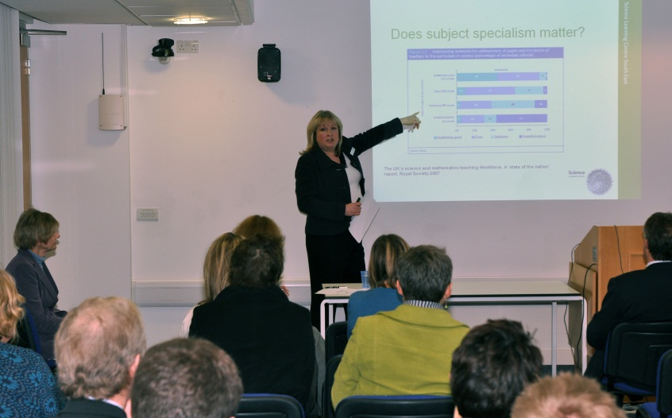
Holding Your Scientific Health Conference
Notes:
Holding your scientific health conference

Slide 28
Objectives
At the end of this lesson you should be able to:
Present your results from my investigation as a scientific health research poster
Evaluate your scientific health investigation poster

Slide 29
Reflection
What new things have you learnt today?
What skills have you used today?
What skills did you find difficult today?
How well did your group work together to create your health investigation?
How many people have you saved from procrastination gas?
Notes:
Students refer back to the lesson objectives and complete the assessment for learning activity in the orange boxes, feedback and share an interesting fact they have found out from the lesson. Remind students about the EACH-B APP.

Slide 30
This work is funded by the Department of Health and Social Care (DHSC) and the National Institute for Health Research (NIHR). The views expressed are those of the authors and not necessarily those of DHSC or NIHR

