Slide 1
Coronavirus
Reducing the Spread

Slide 2
What do you remember about the ?​
What can we do to stop the corona virus from spreading and help keep ourselves and our families and friends safe?

Slide 3
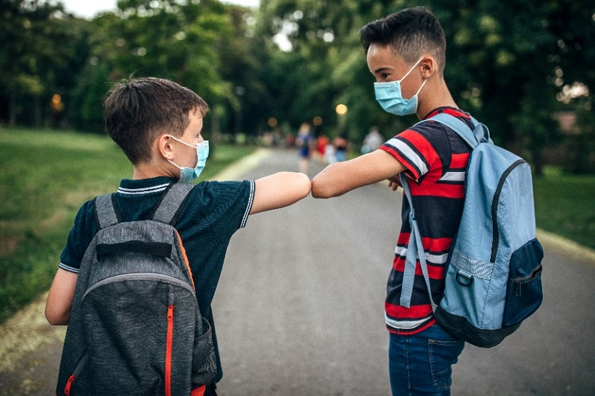
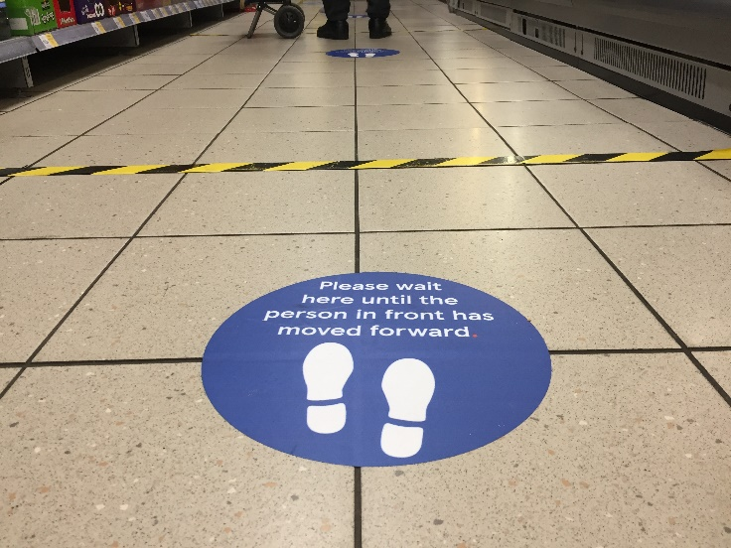
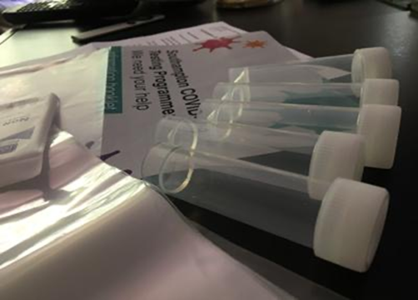
What are the health messages? https://www.youtube.com/watch?v=1CUrxdTd1bc&feature=youtu.be​ (2mins 30sec)

Slide 4
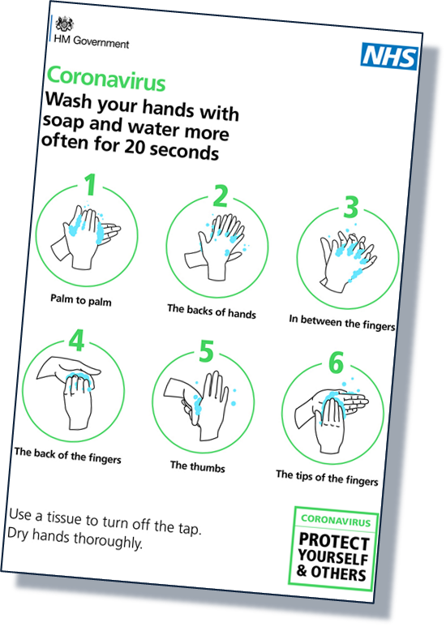
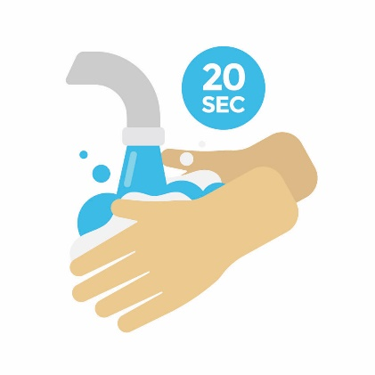
Hands
How can washing our hands stop the virus?

Slide 5
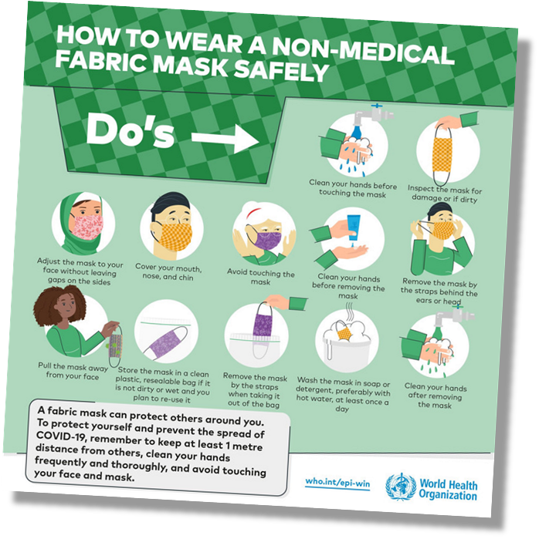
Face
How do face coverings help stop the virus spreading?
https://youtu.be/tVQi8vDvI64 (3min 54sec)

Slide 6
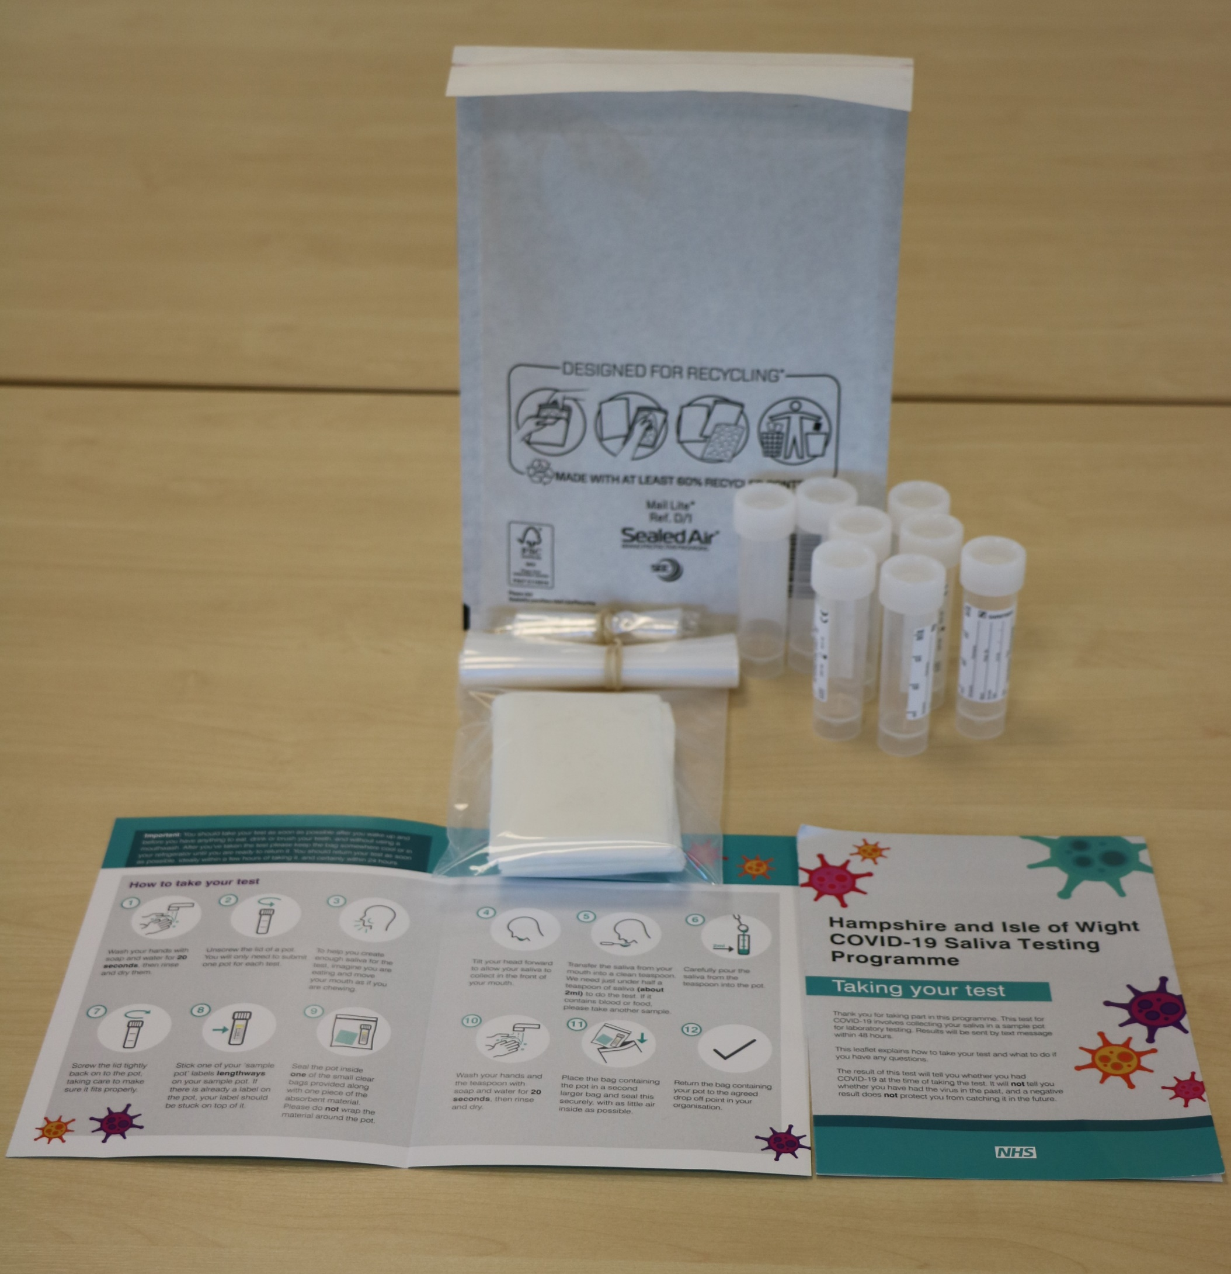
#BePartOfTheSolution
Please remember to do a test!
You are helping to stop the spread.
This work is funded by the Department of Health and Social Care and the National Institute for Health Research (NIHR). The views expressed are those of the authors and not necessarily those of the Department of Health and Social Care or NIHR.

Slide 7
Master slide: 1 custom design = with footer
Notes:
NB. Layout master slide: 2 custom design = without footer

