Slide 1
Coronavirus
Introduction to Testing
Notes:
Layout using master slide: 2 custom design = without footer

Slide 2
What do you know about the ?​
What can we do to stop the corona virus from spreading and help keep ourselves and our families and friends safe?
How does the virus spread?

Slide 3
What do you know about the ?​
What can we do to stop the corona virus from spreading and help keep ourselves and our families and friends safe?
How does the virus spread?

Slide 4
What is the Coronavirus?
COVID-19 is thought to be a zoonotic disease caused by the Sars-CoV-2 virus, otherwise known as the coronavirus.
Zoonotic diseases are caused by bacteria and viruses that spread between animals and humans.
Coronavirus is highly transmissible and whilst most people who catch it have a mild illness and recover quickly some can become very ill requiring hospital treatment.
This is why preventing the spread is vital and the Government has put measures in place to do this.

Slide 5
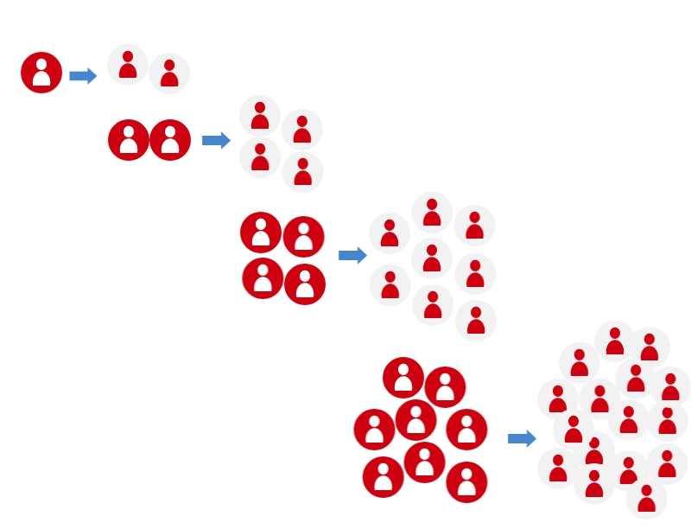
How does the coronavirus spread through a population?

Slide 6
How does testing help?
TEST, TRACE and ISOLATE
If these people are contacted by NHS Test and Trace, then they self-isolate and cannot infect others
These people remain virus-free
So, the first infection only passes on the virus to 2 people

Slide 7
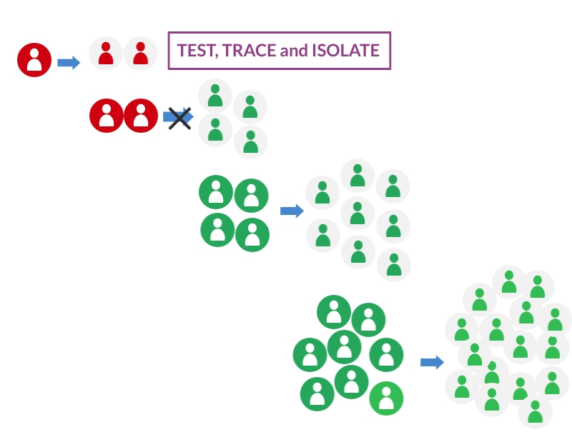
How does test, trace and isolate reduce the spread?
So if we test, trace and isolate, we can stop the virus from spreading

Slide 8
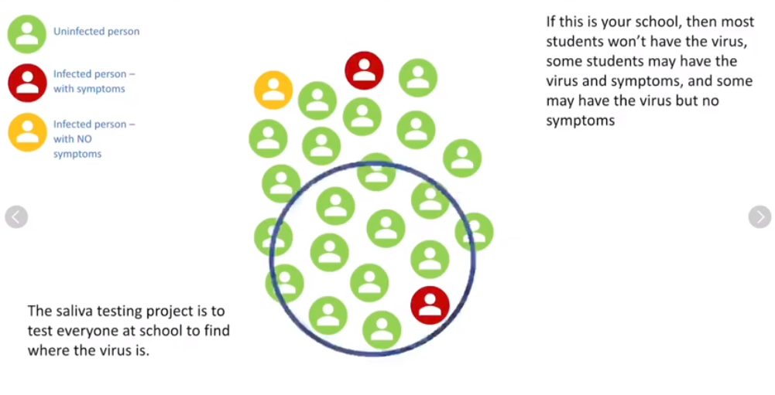
Why is it important to test as many teachers and students as possible?
Many people who may be infected don’t display any symptoms of coronavirus
Find out how asymptomatic testing can help keep your school safer: https://youtu.be/mqMrxaFbEHA
(1min 44secs)

Slide 9
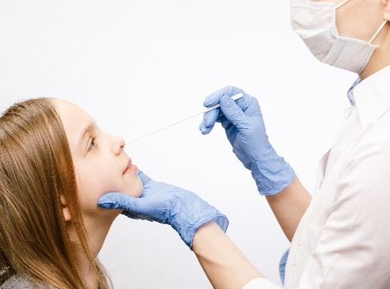
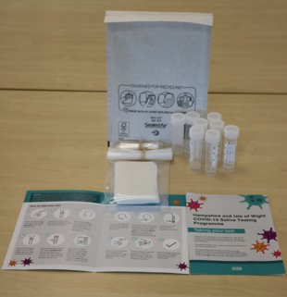
What type of tests are used?
NHS PCR Test – used when someone has symptoms of coronavirus, e.g. at a testing centre
Direct RT LAMP Saliva Test – used for mass asymptomatic testing, e.g. in some schools/colleges
Lateral Flow Device (LFD) - used for mass asymptomatic testing, e.g. in schools/colleges

Slide 10
What are the advantages and disadvantages of the different tests?
 | PCR Test | Saliva Test | LFD Test
Advantages
Disadvantages

Slide 11
#BePartOfTheSolution
This work is funded by the Department of Health and Social Care and the National Institute for Health Research (NIHR). The views expressed are those of the authors and not necessarily those of the Department of Health and Social Care or NIHR.

Slide 12
Master slide: 1 custom design = with footer
Notes:
NB. Layout master slide: 2 custom design = without footer

