Slide 1
2 Metre Rule
Objectives:
To explain in simple terms how the 2 metre rule can limit the spread of the virus.
To recognise how long 2 metres is as a distance.

Slide 2
Video Introduction
Watch COVID-19 Warriors Video Introduction.

Slide 3
Main Activity
How far is 2 metres?
Use a 2 metre ribbon to find out…
What can you see around you that is about 2 metres long?

Slide 4
What have we learnt?
How far apart do we have to stay from others?
What can help you to remember this distance?
We can still have fun and be friends when we are 2 metres apart.

Slide 5
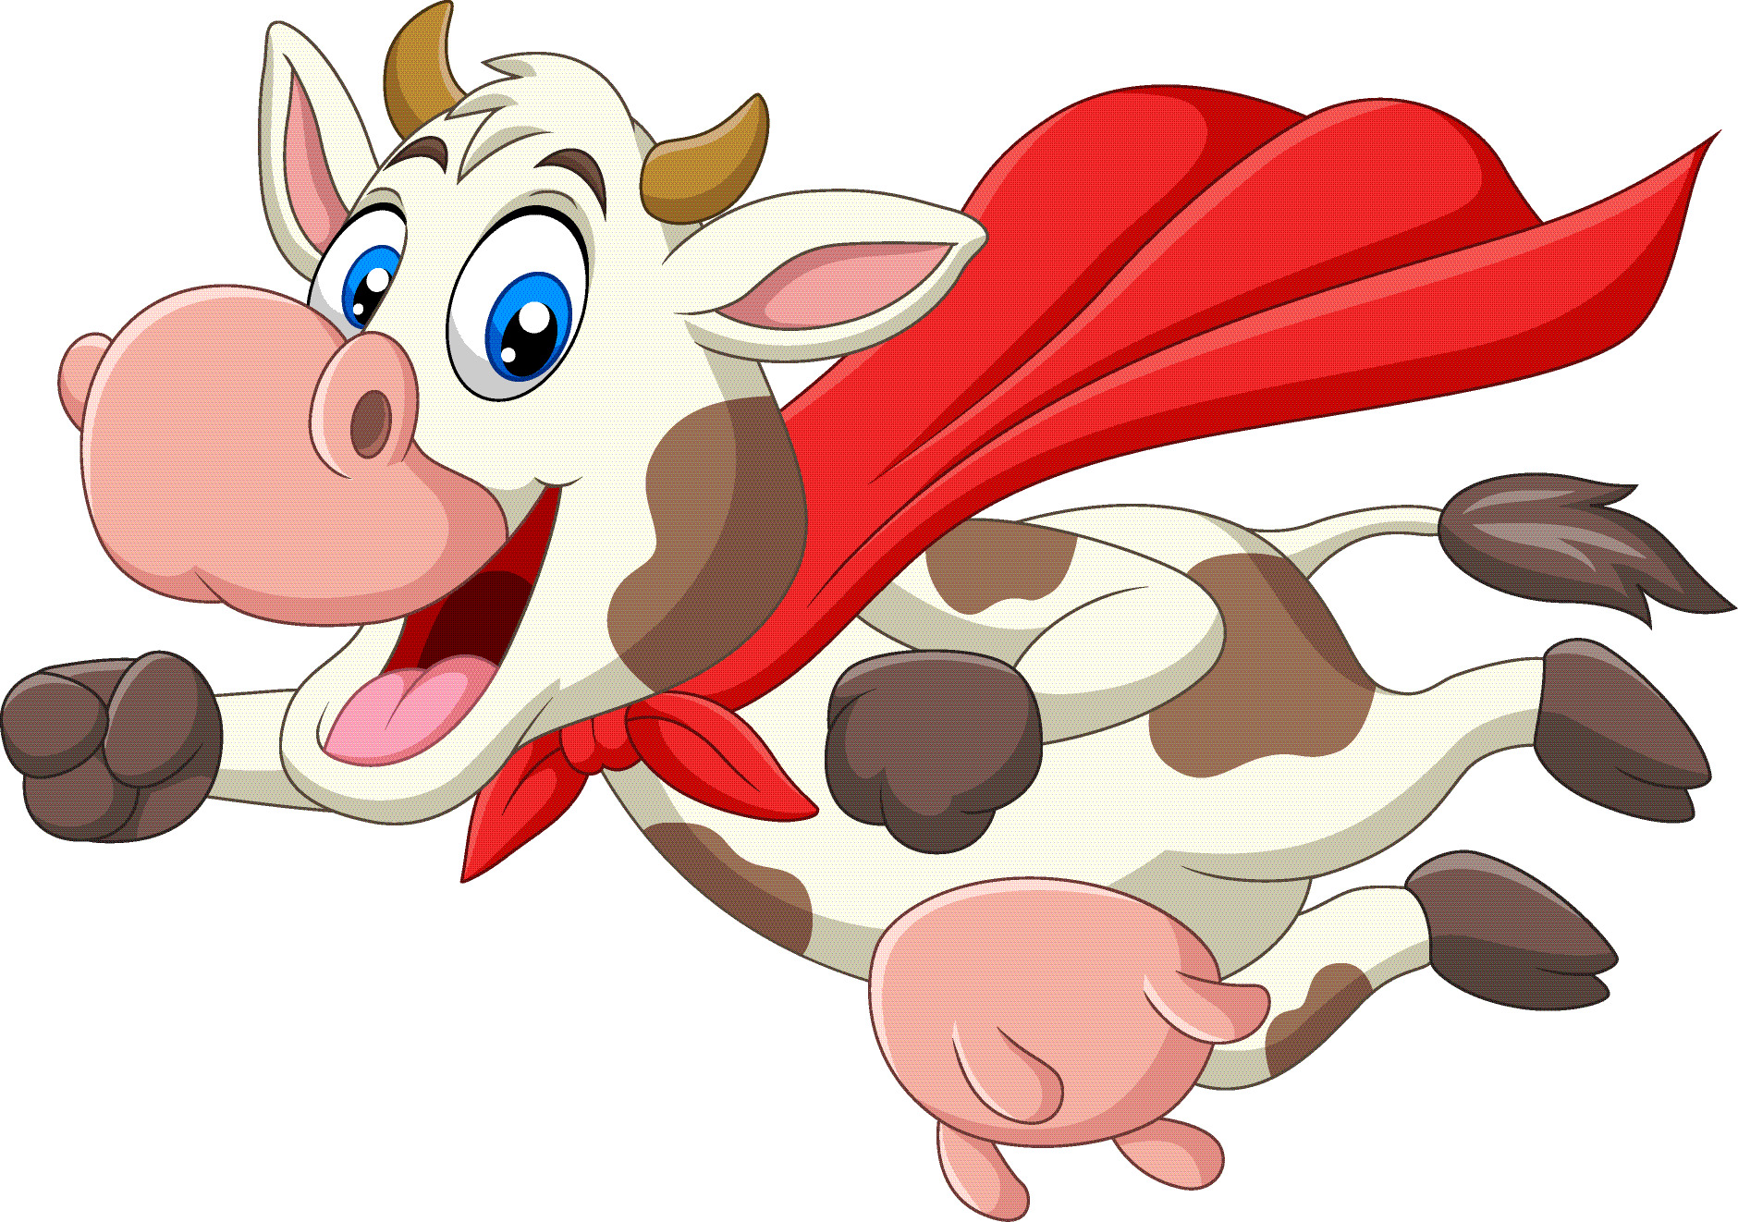
Stretch says…. “Remember to stay at least 2 metres away from anyone not in your bubble!”

Slide 6
Extension Activities
Measure the size of the classroom and calculate how many children would fit in if they had to stay 2 metres apart from each other.
Look for 2 metre objects at home or on your journey home from school.

Slide 7
Bye,
see you soon!

