Slide 1
Resilience
Objectives:
To understand that your actions can make a difference.
To accept that some things are out of your control.

Slide 2
Video Introduction
Watch COVID-19 Warriors Video Introduction.

Slide 3
What is difficult about living in a world with Coronavirus?
What can you do to make things better?

Slide 4
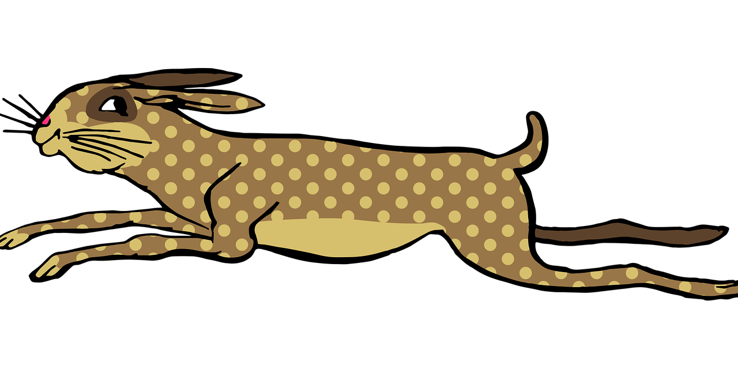
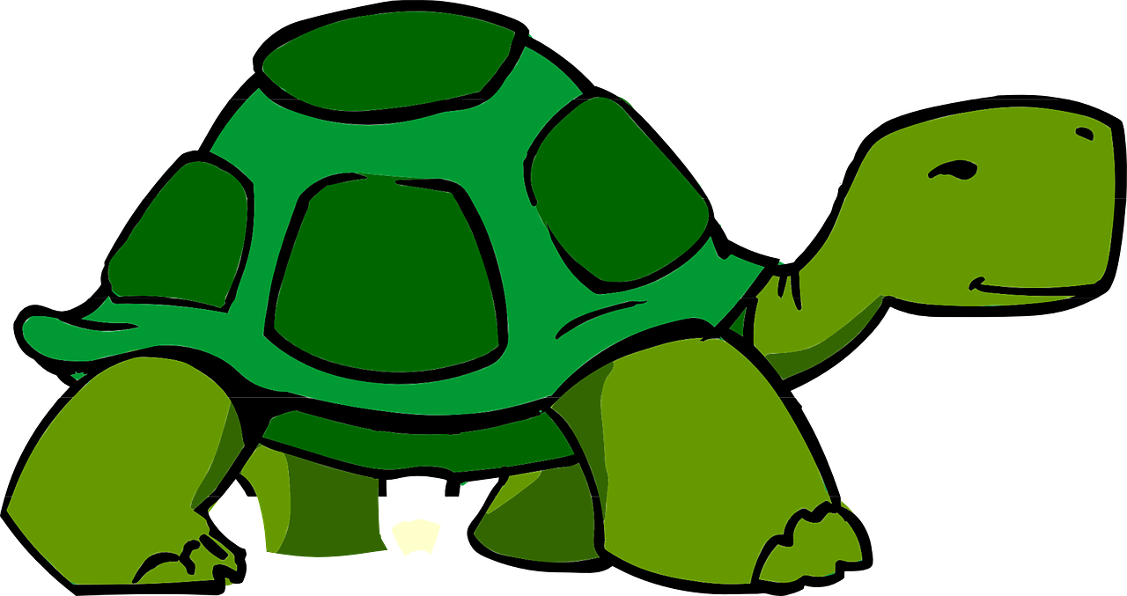
Main Activity
Watch the story of the Hare and the Tortoise.
https://www.bbc.co.uk/programmes/p011syc1

Slide 5
Main Activity
What did the tortoise need to win the race?
What has helped you to get through difficult times?
What do you need to get through Coronavirus?

Slide 6
Resilience

Slide 7
What have we learnt?
How can you make a difference?
Remember that every little difference counts!

Slide 8
Buddy says…. “Remember to keep following the rules to keep your friends and family safe”.

Slide 9
Extension Activities
Write a list of all the things you can do to help defeat the virus.
Write a list of things you can do to help others.
Make a card for a friend, relative or neighbour who is isolating.

Slide 10
Bye,
see you soon!

