Slide 1
Glitter Hands
Objectives:
To explain how a virus spreads through touch drawing on evidence from their observations.
To understand how the transmission of the virus can be limited by washing hands with soap.
To explain how soap kills the virus.

Slide 2
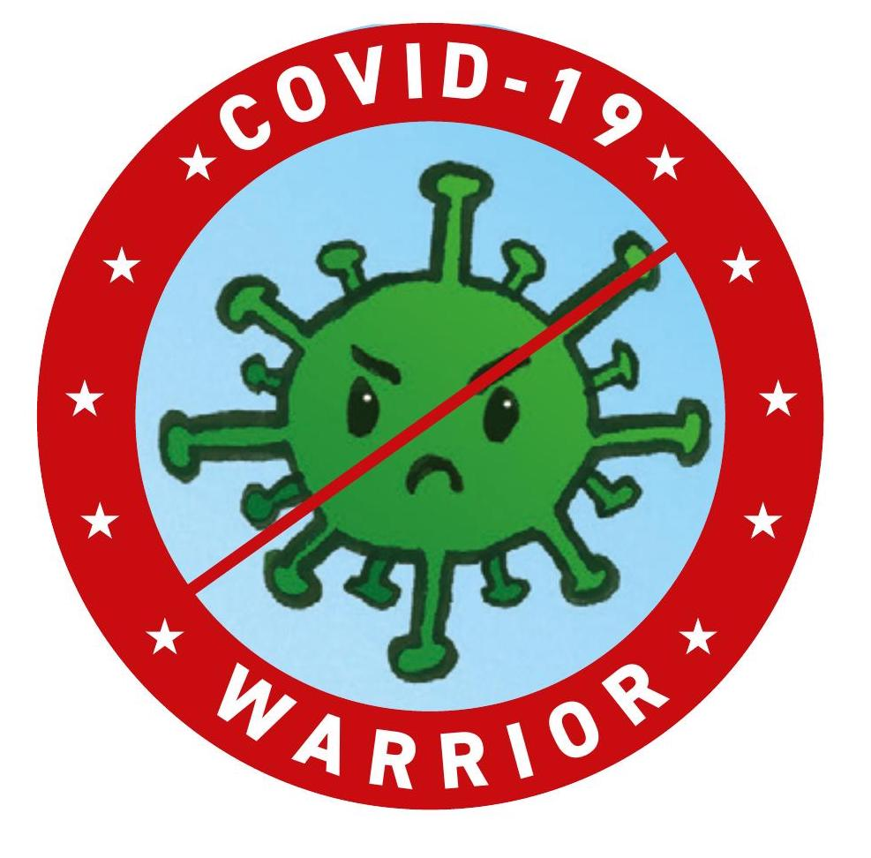
Video Introduction
Watch COVID-19 Warriors Video Introduction.

Slide 3
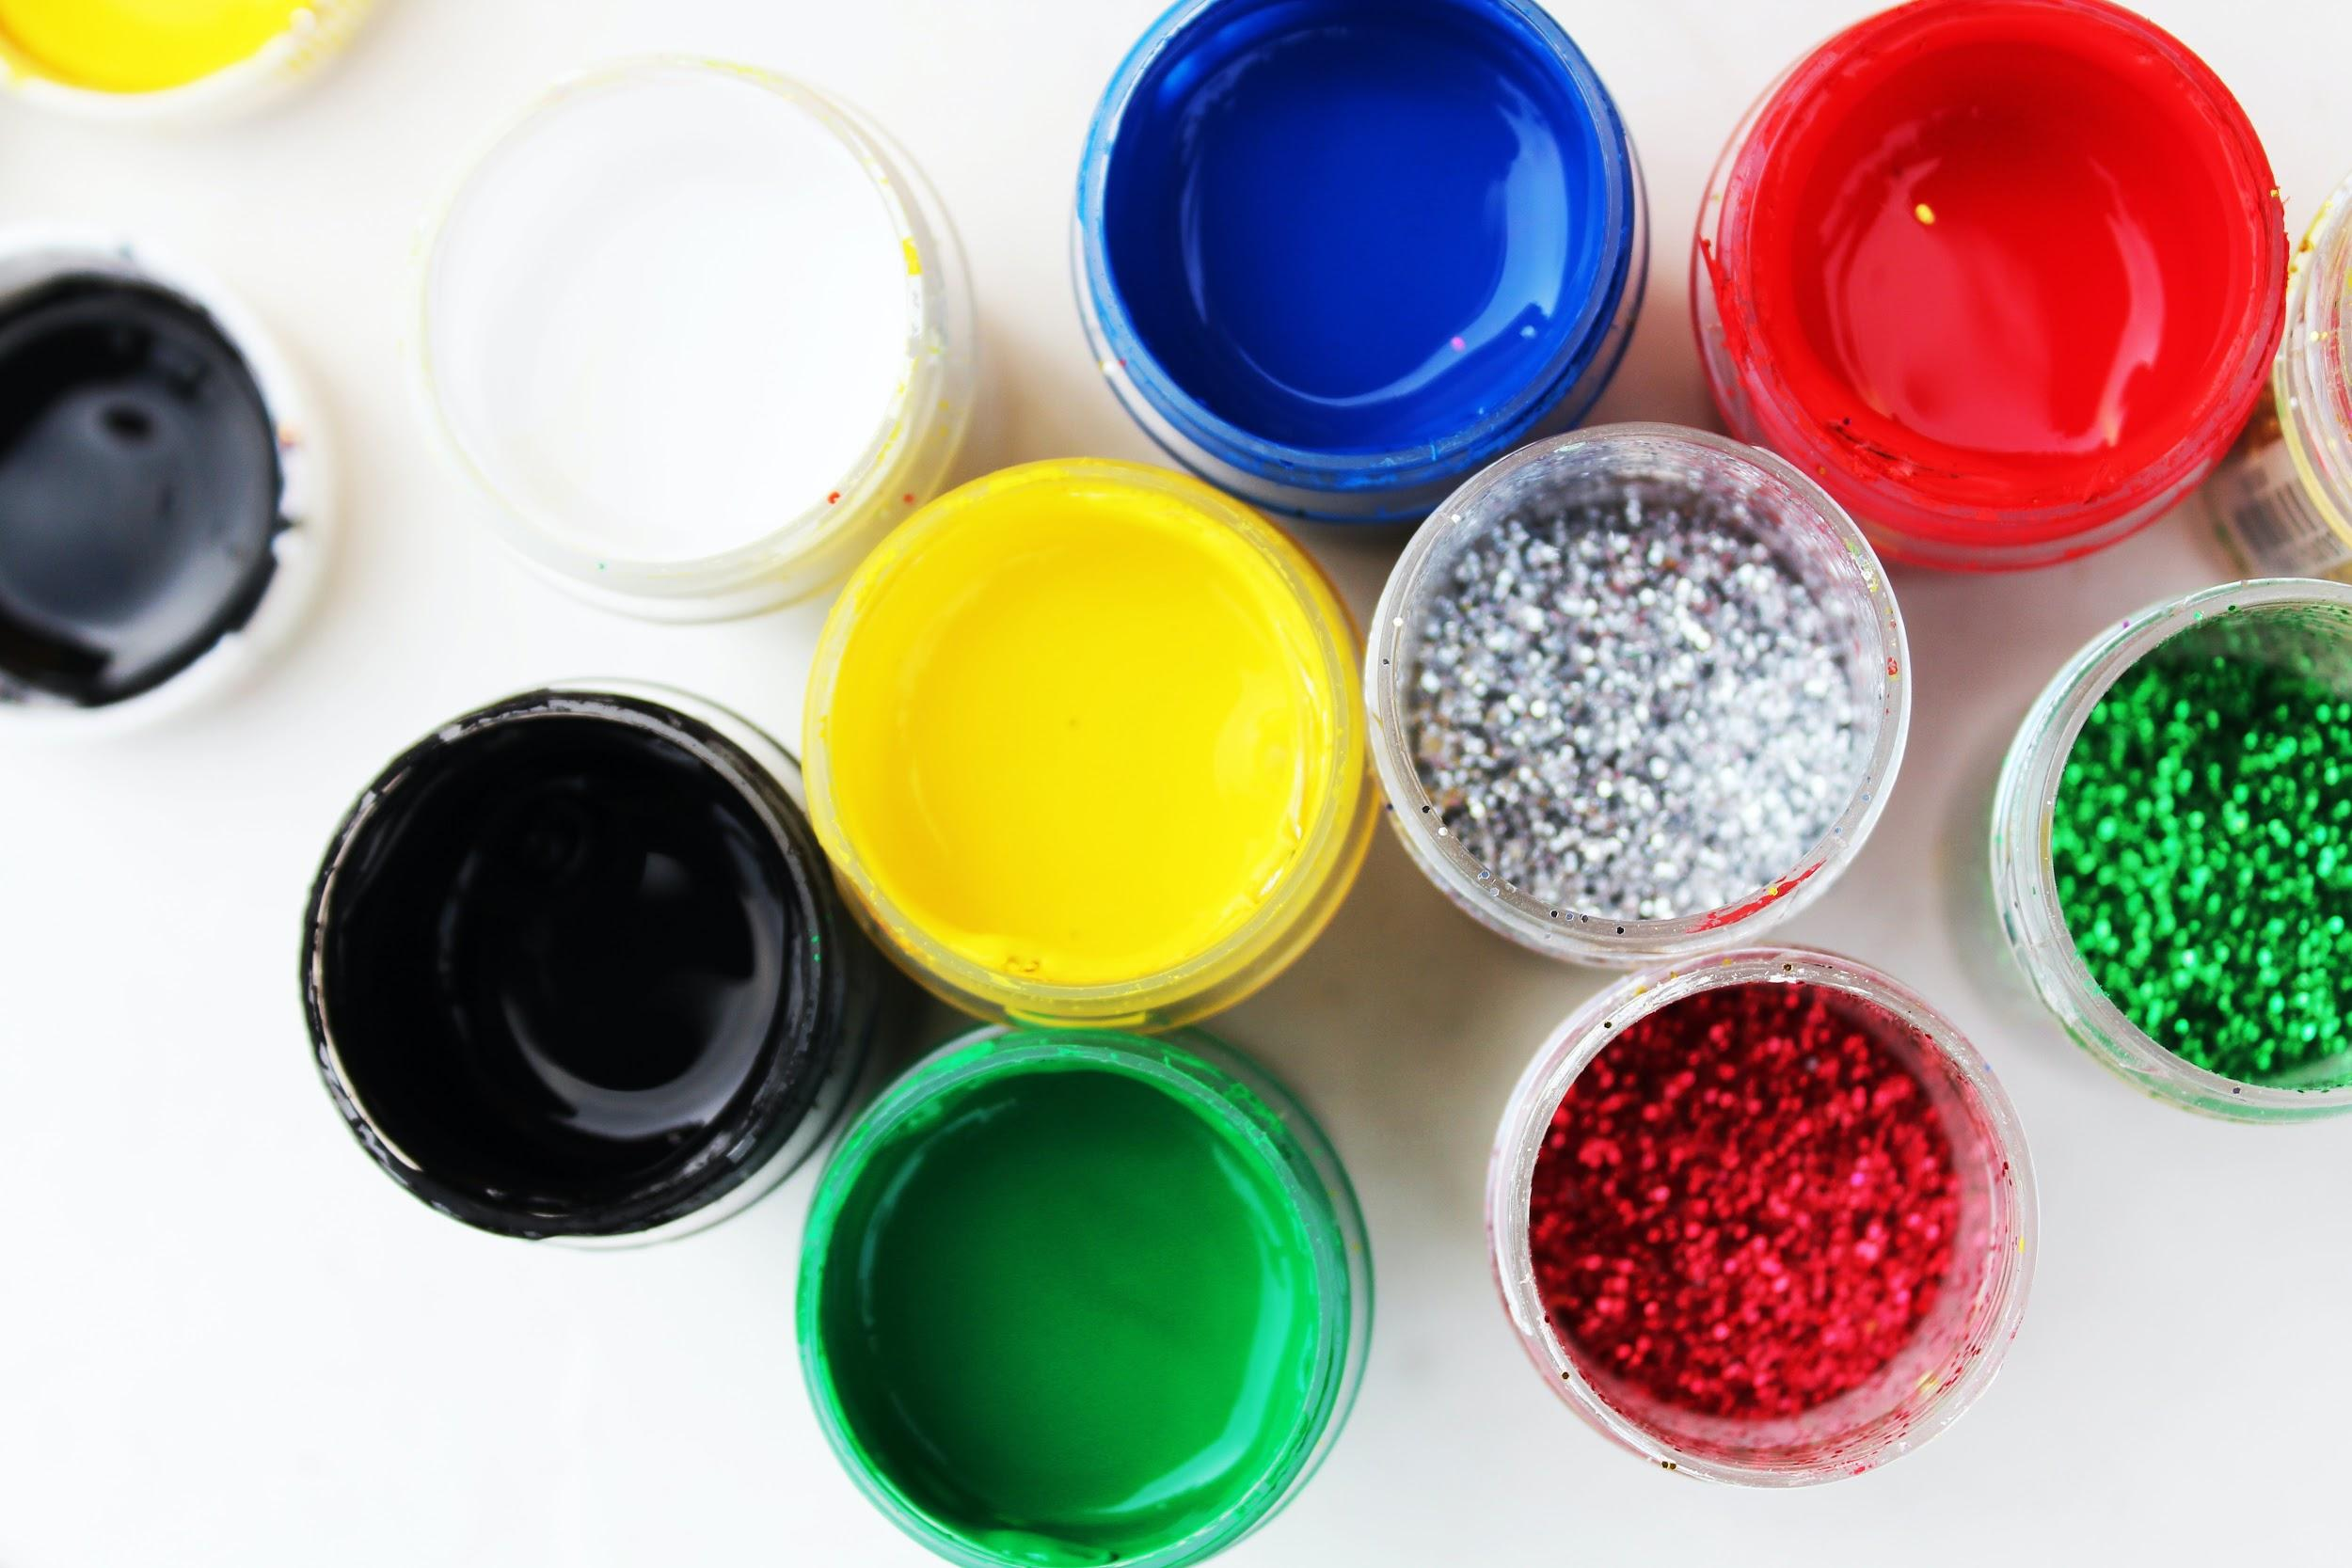
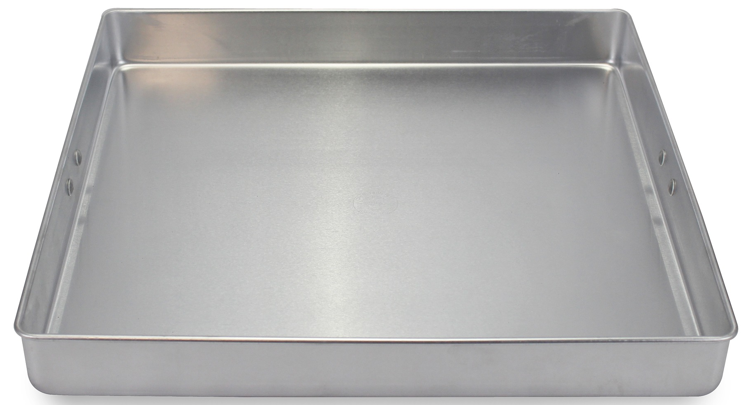
Main Activity
Can you test what happens when you dip your finger in the tray with water and glitter if you:
don’t use soap
use soap
use something else instead of the soap - like paint or PVA glue?

Slide 4
Our experiment results
We tested how the soap works.
We used glitter as a representation of the “germs”
Tray 1 - Glitter in water, dipped clean finger | Tray 2 - Glitter in water, dipped finger in _____ first | Tray 3 - Glitter in water, covered finger in soap first
What happened? | What happened? | What happened?

Slide 5
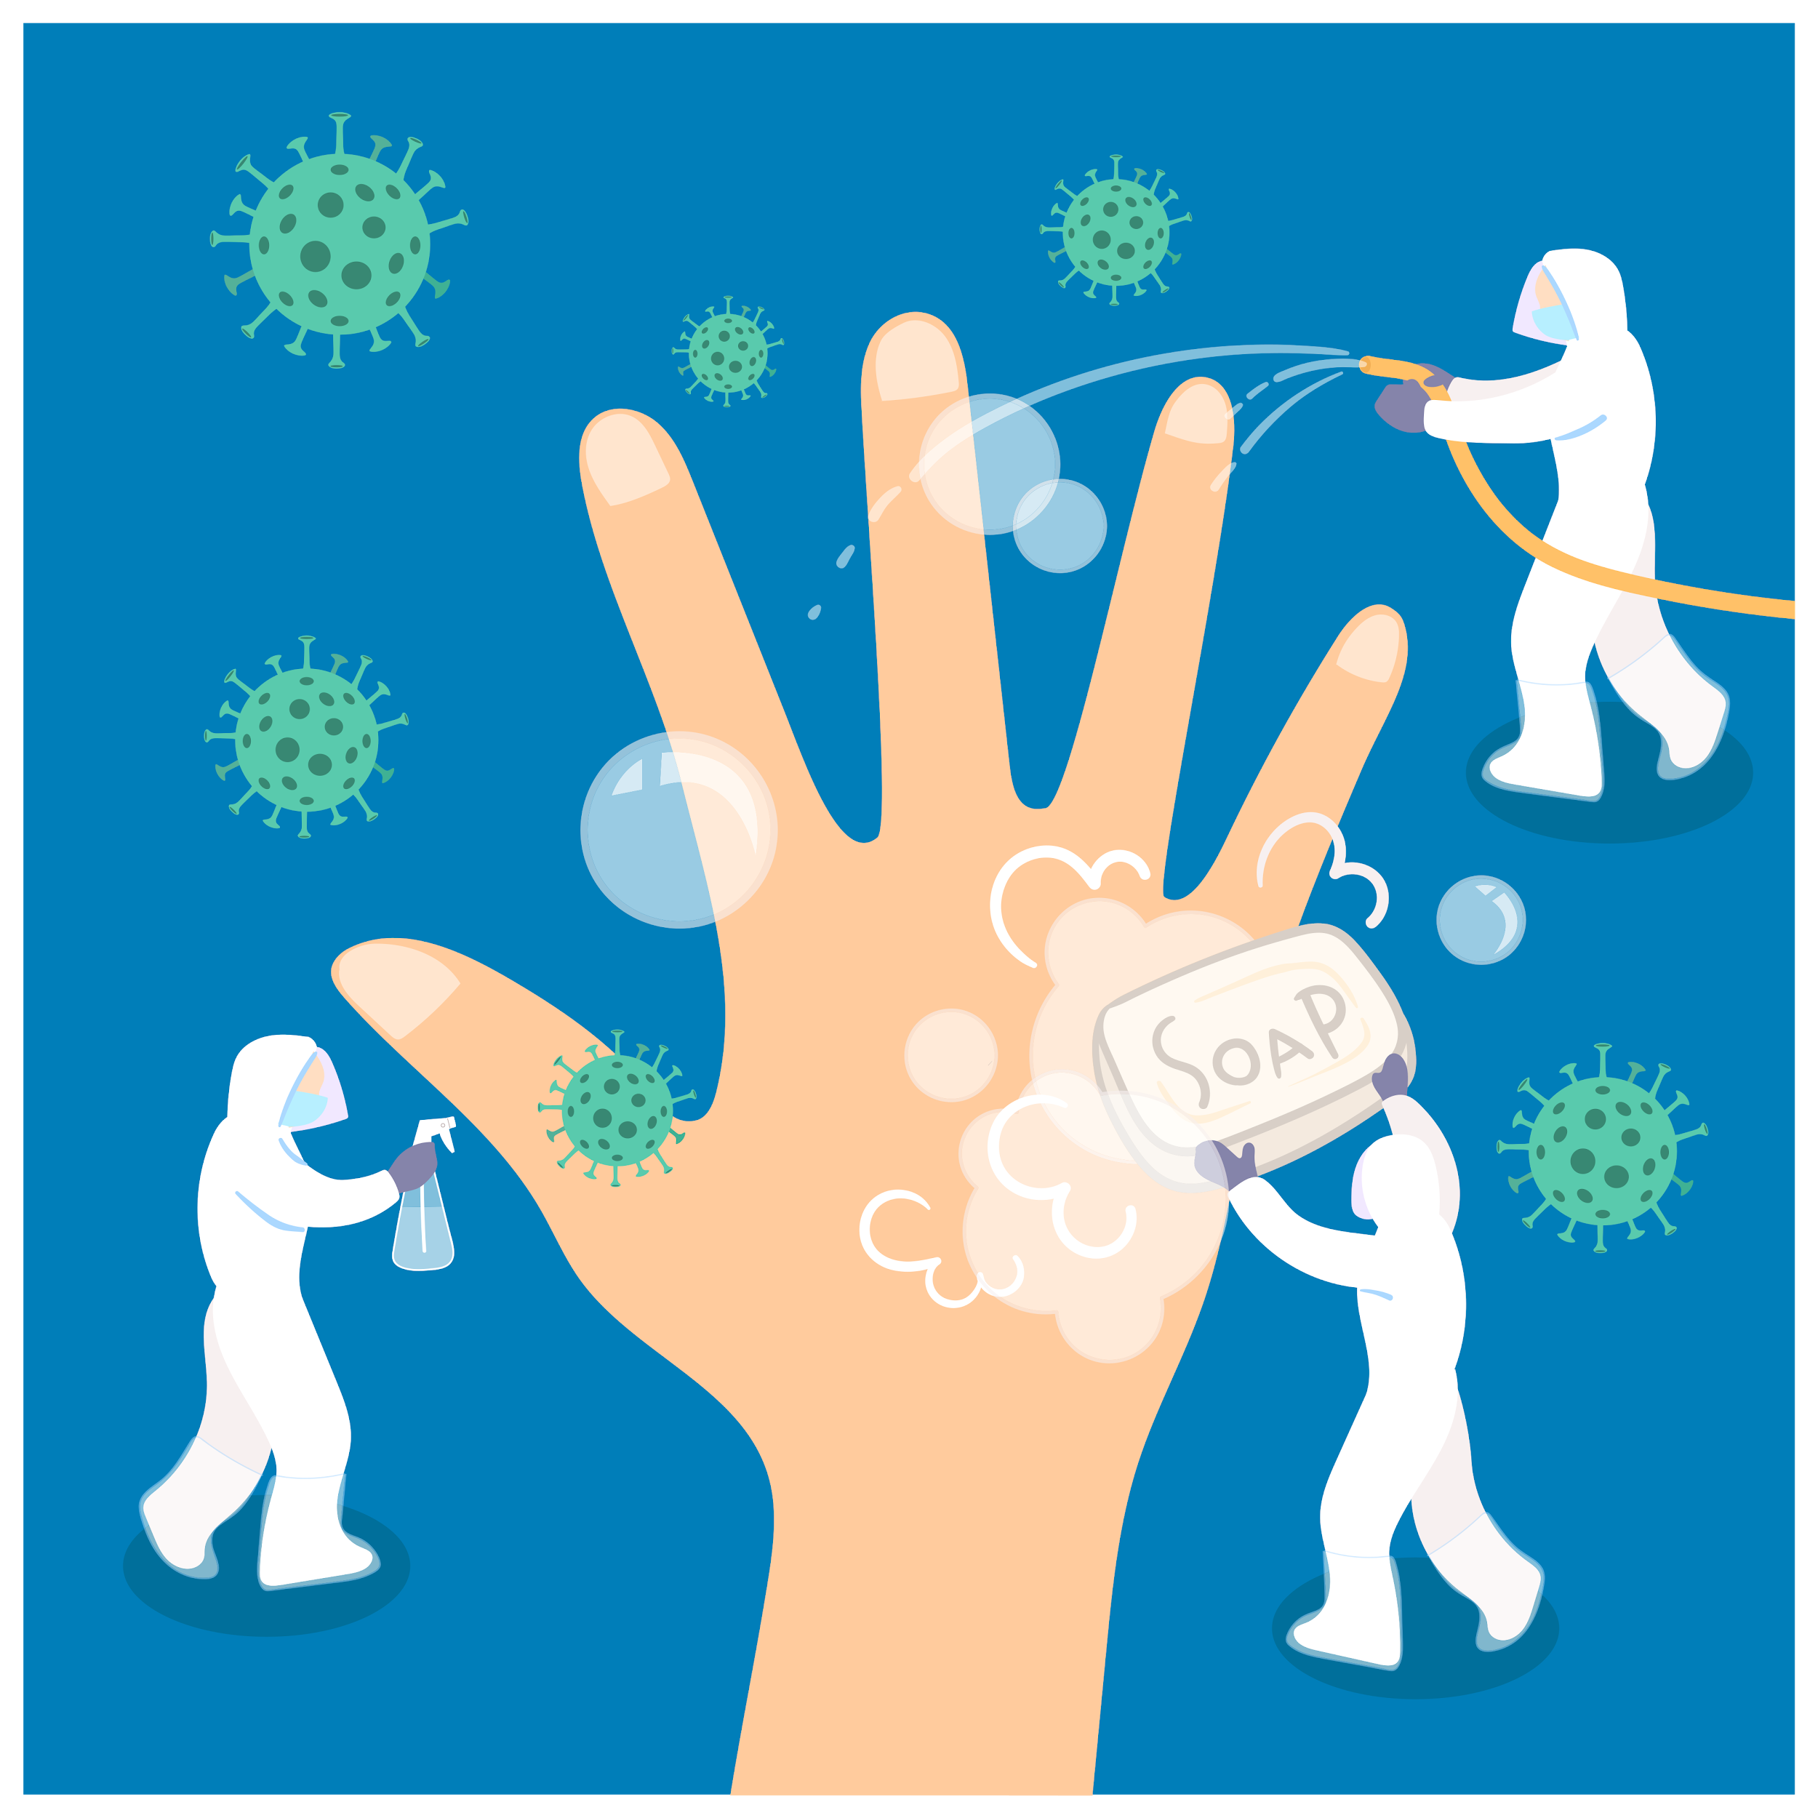
What have we learnt?
Can you explain how soap works?
How does washing hands limit spread of the virus?

Slide 6
Remember to wash your hands often, using soap and warm water.

Slide 7
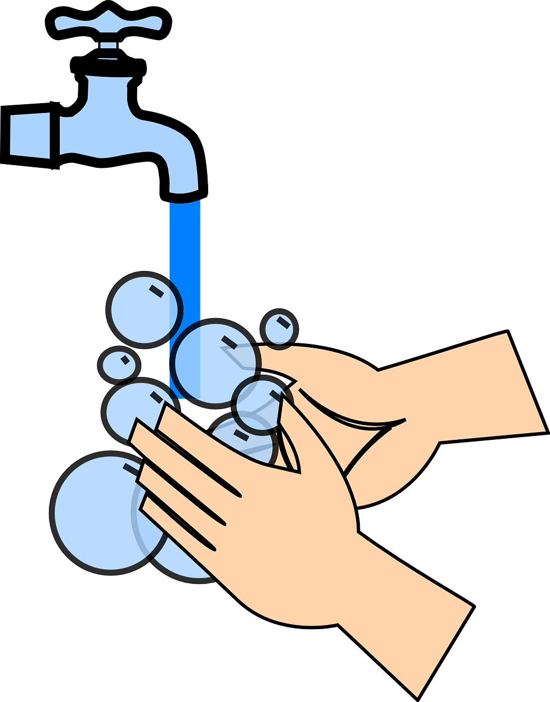
Extension Activities
In a small groups or a pair, get some vegetable oil your fingers, then have a race and see who washes the oil off first:
washing up bowl with just water
washing up bowl with soapy water

Slide 8
Bye,
see you soon!

