Slide 1
Coronavirus
Making Choices

Slide 2
Where do you stand on topical issues?
The pandemic has thrown up quite a few controversies, most notably around people following, or not following the guidelines!
How much do you agree or disagree with the following statements?

Slide 3
‘Face coverings should still be compulsory for everyone in all indoor public spaces’
Do you agree or disagree?
Why?
Notes:
Where do you stand on current health issues? Activity 1: Set up a class line and have students position themselves along the line as to whether they agree or disagree with the statement on each slide. This opens the activity up to discussion in the classroom around the ideas. Students can be asked to justify their decision. ‘What is the reason for your position?’

Slide 4
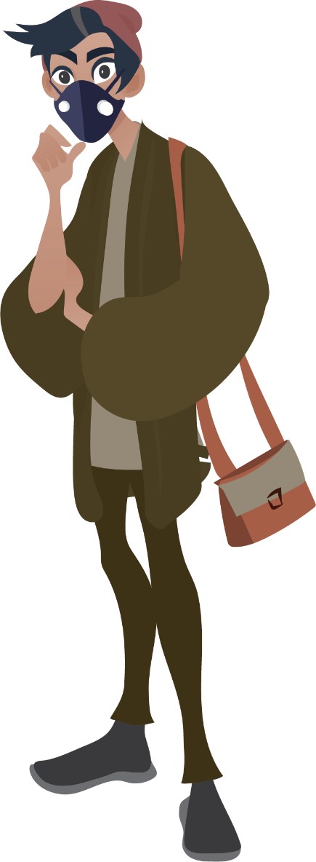
‘I’m not in a vulnerable group so I don't need to be careful anymore’
Do you agree or disagree?
Why?

Slide 5
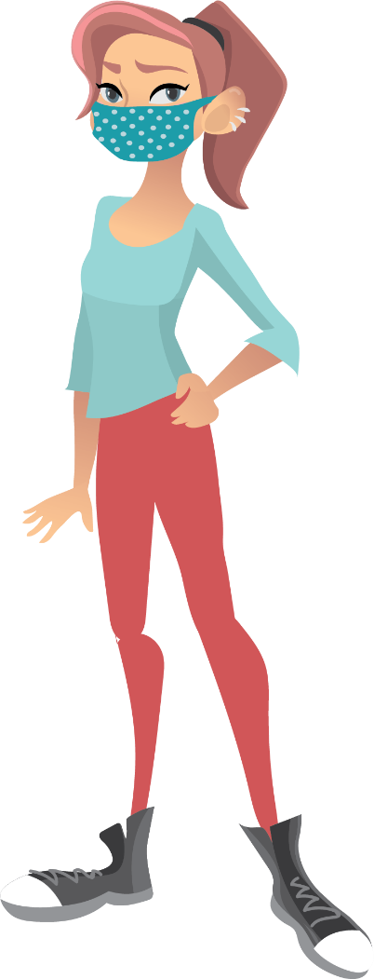
‘Young people are spreading the virus’
Do you agree or disagree?
Why?

Slide 6
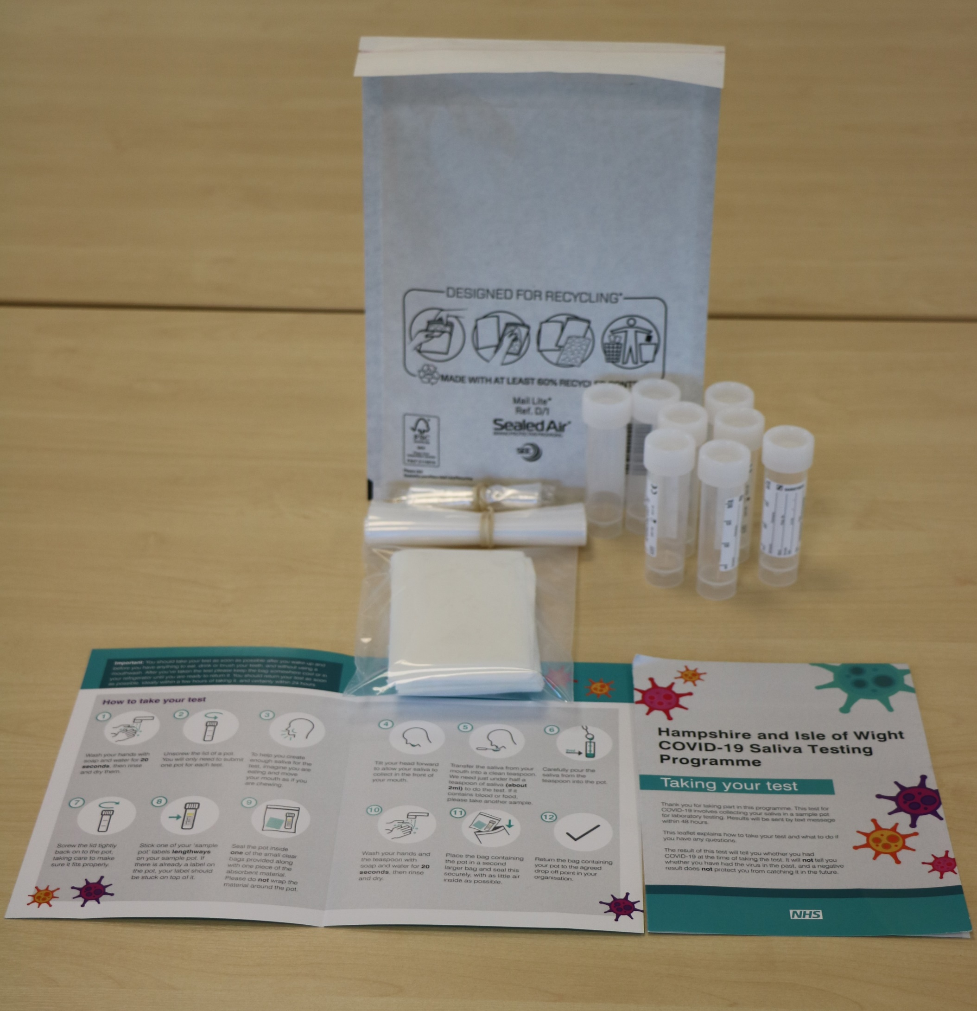
#BePartOfTheSolution
Please remember to do a test!
You are helping to stop the spread.
This work is funded by the Department of Health and Social Care and the National Institute for Health Research (NIHR). The views expressed are those of the authors and not necessarily those of the Department of Health and Social Care or NIHR.

Slide 7
Master slide: 1 custom design = with footer
Notes:
NB. Layout master slide: 2 custom design = without footer

