Slide 1
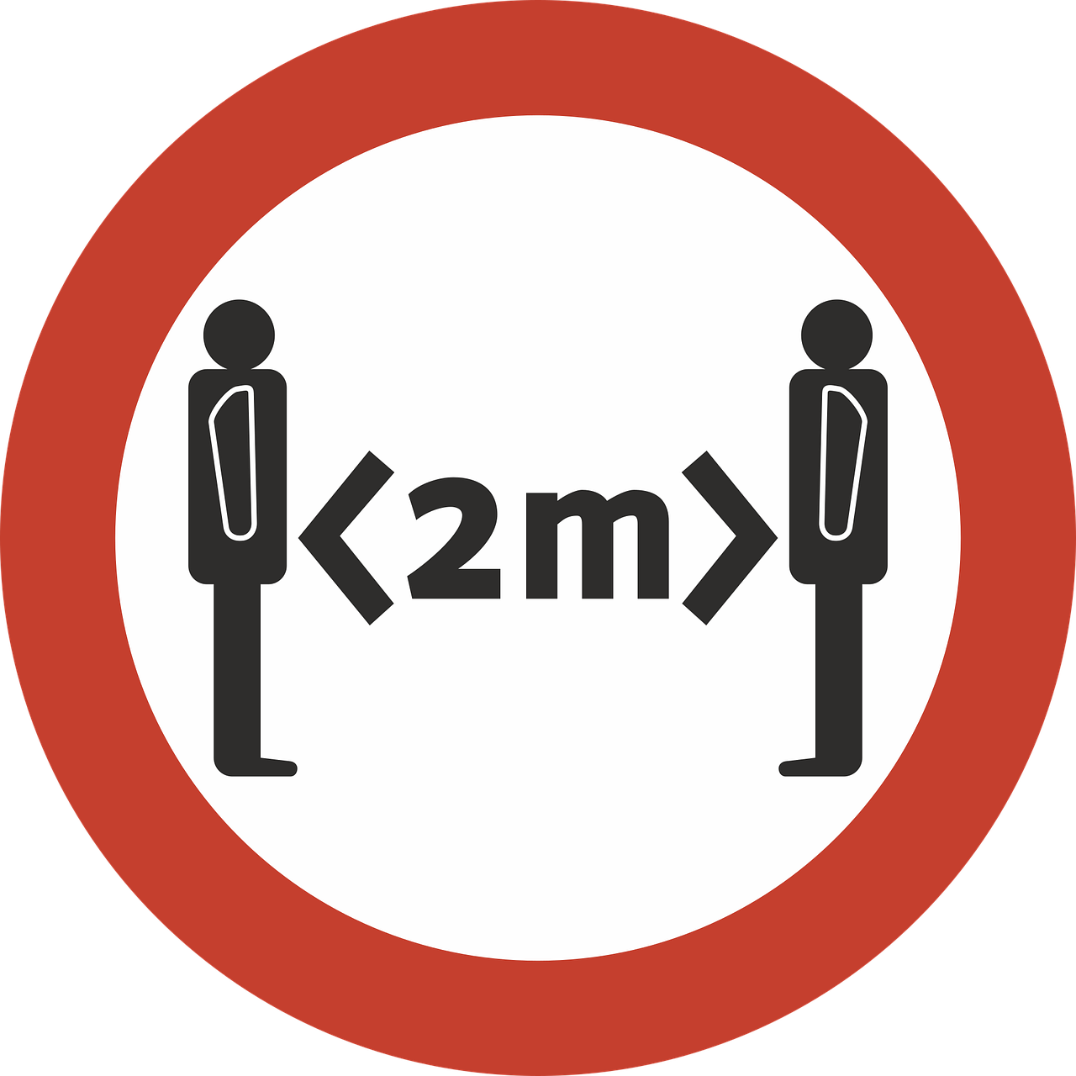
2 Metre Rule
Objectives:
To identify 2 metres as a safe distance for limiting the spread of the virus.
To recognise how long 2 metres is as a distance.

Slide 2
Video Introduction
Watch COVID-19 Warriors Video Introduction.

Slide 3
Main Activity
How far is 2 metres?
Use a 2 metre ribbon to find out…
What can you see around you that is about 2 metres long?

Slide 4
What have we learnt?
How far apart do we have to stay from others?
What can help you to remember this distance?
We can still have fun and be friends when we are 2 metres apart.

Slide 5
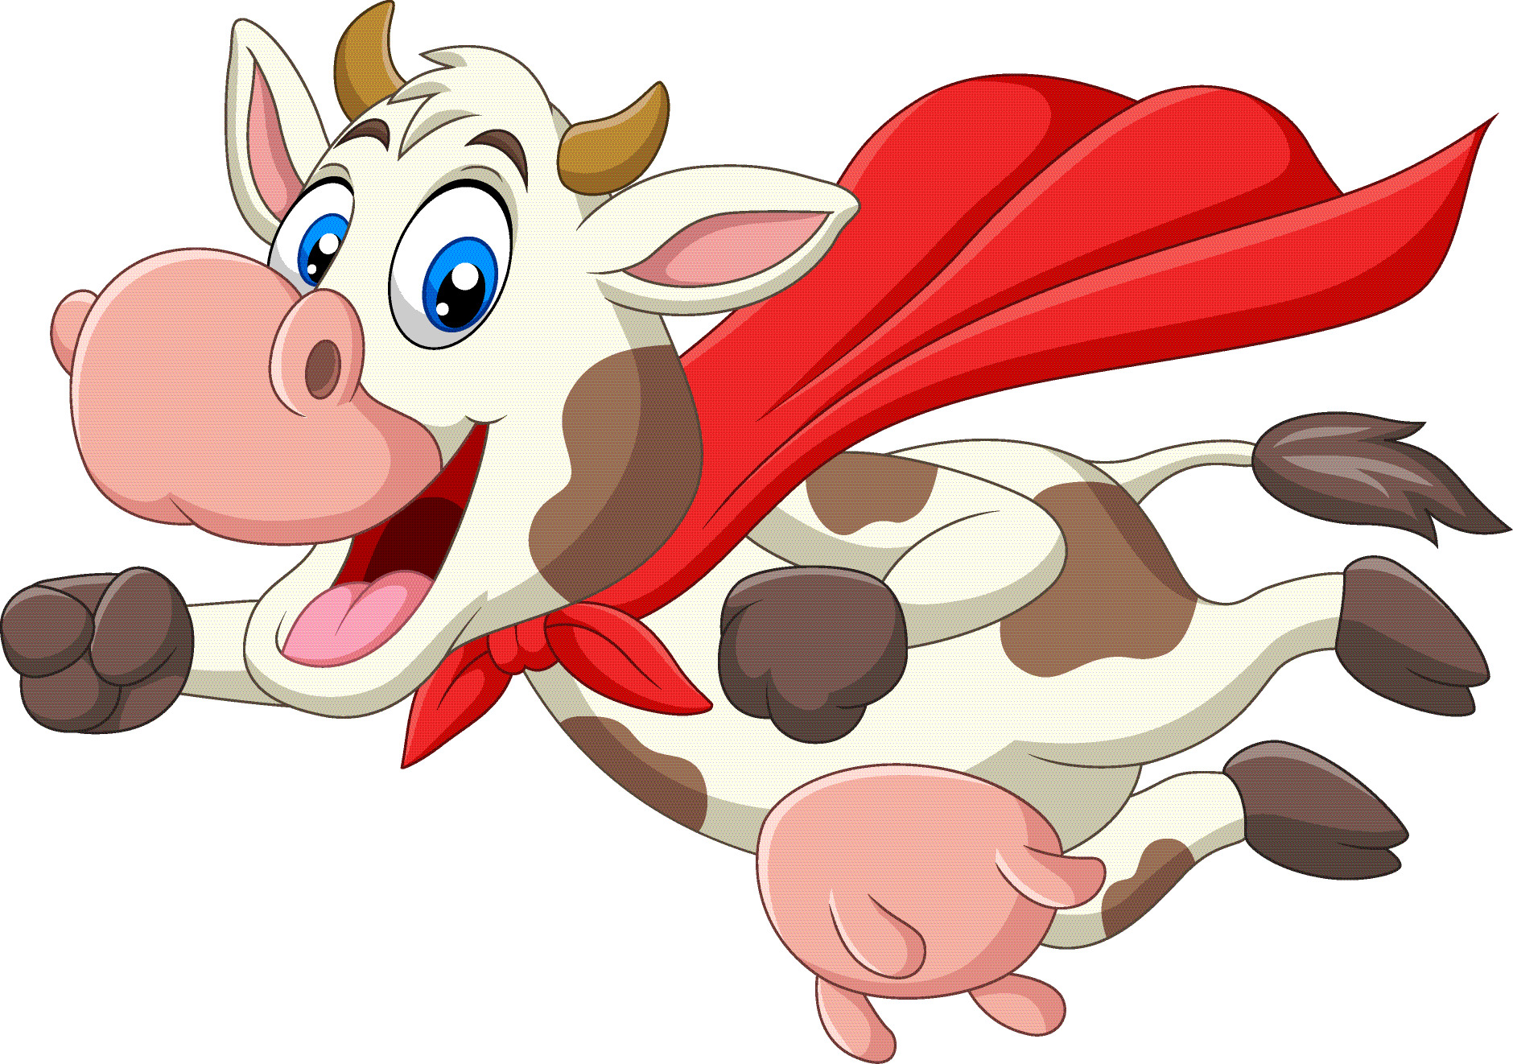
Stretch says… “Remember to stay at least 2 metres away from anyone not in your bubble!”

Slide 6
Extension Activities
Try lining up in the playground with 2 metre gaps between you.
What can you see around your house or on your journey to school that are 2 metres long.

Slide 7
Bye,
see you soon!

