Slide 1
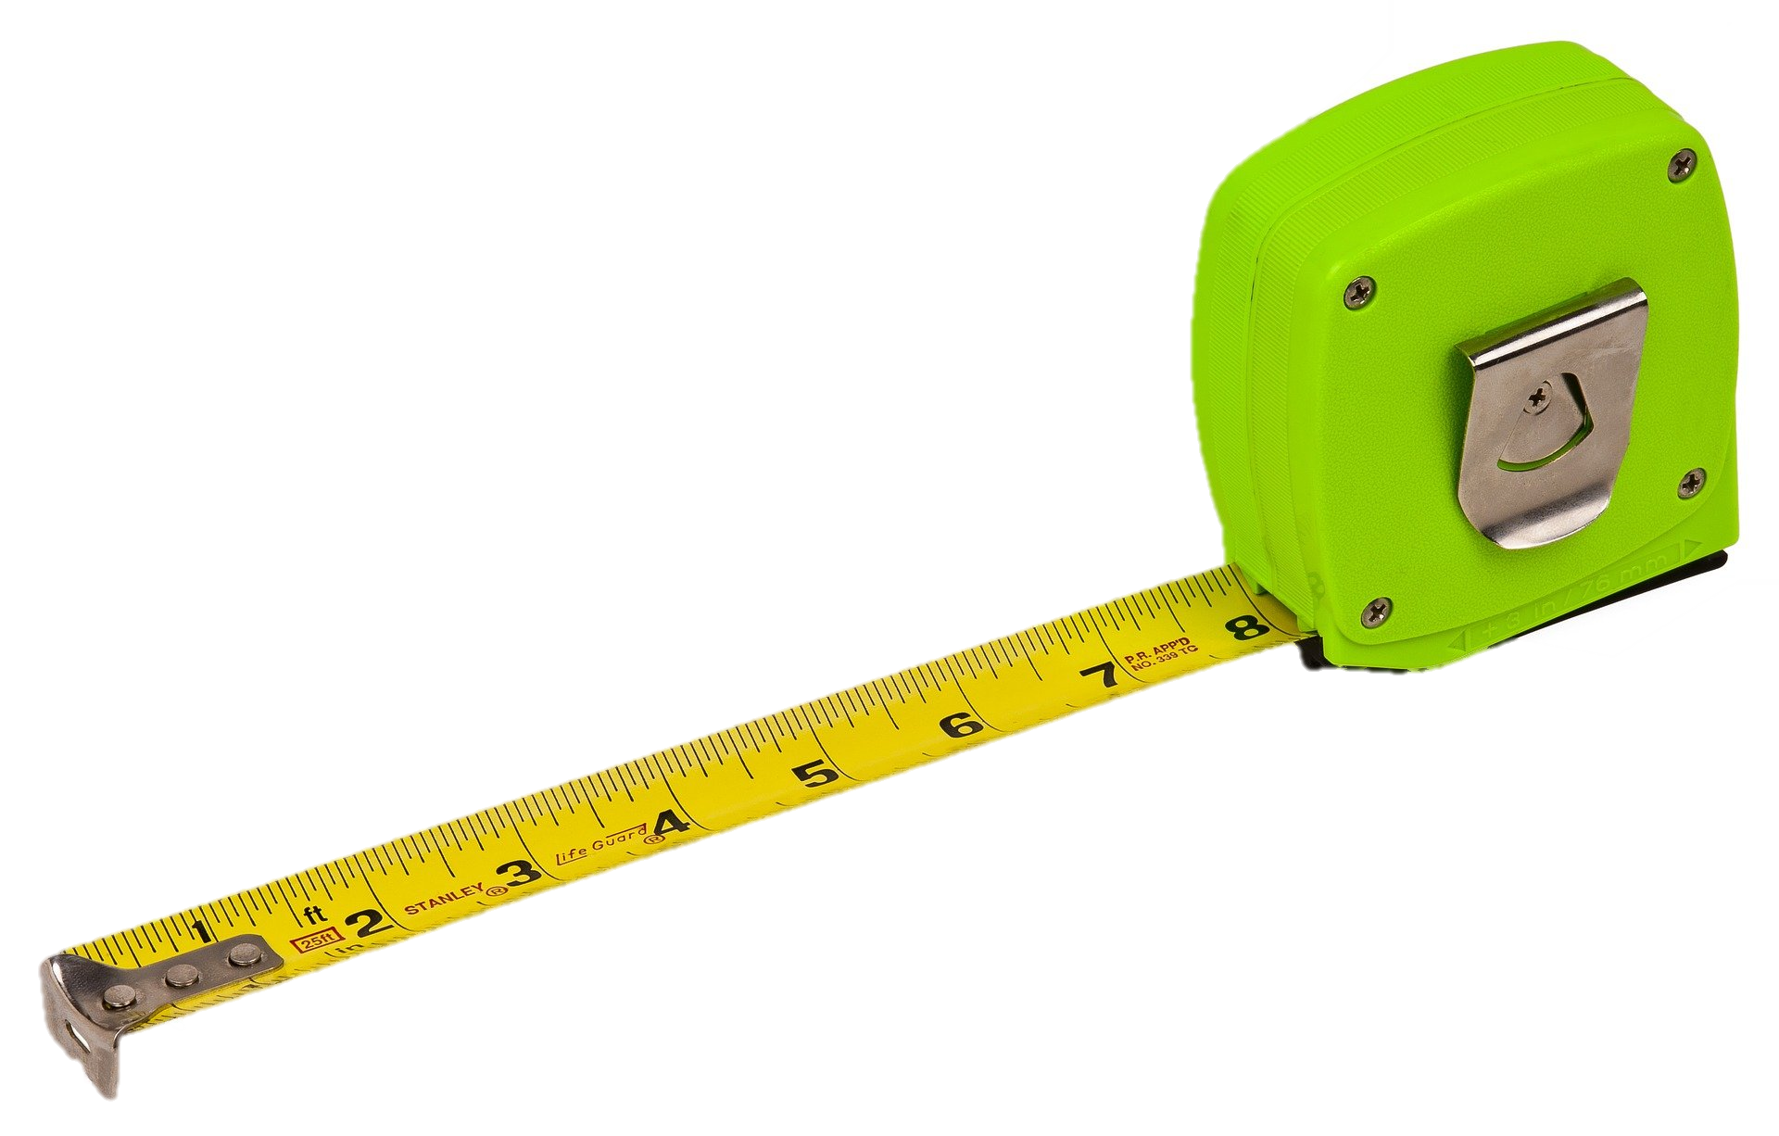
Space
Objectives:
To identify 2 metres as a safe distance for limiting the spread of the virus.
To recognise 2 metres as a distance.

Slide 2
Video Introduction
Watch COVID-19 Warriors Video Introduction.

Slide 3
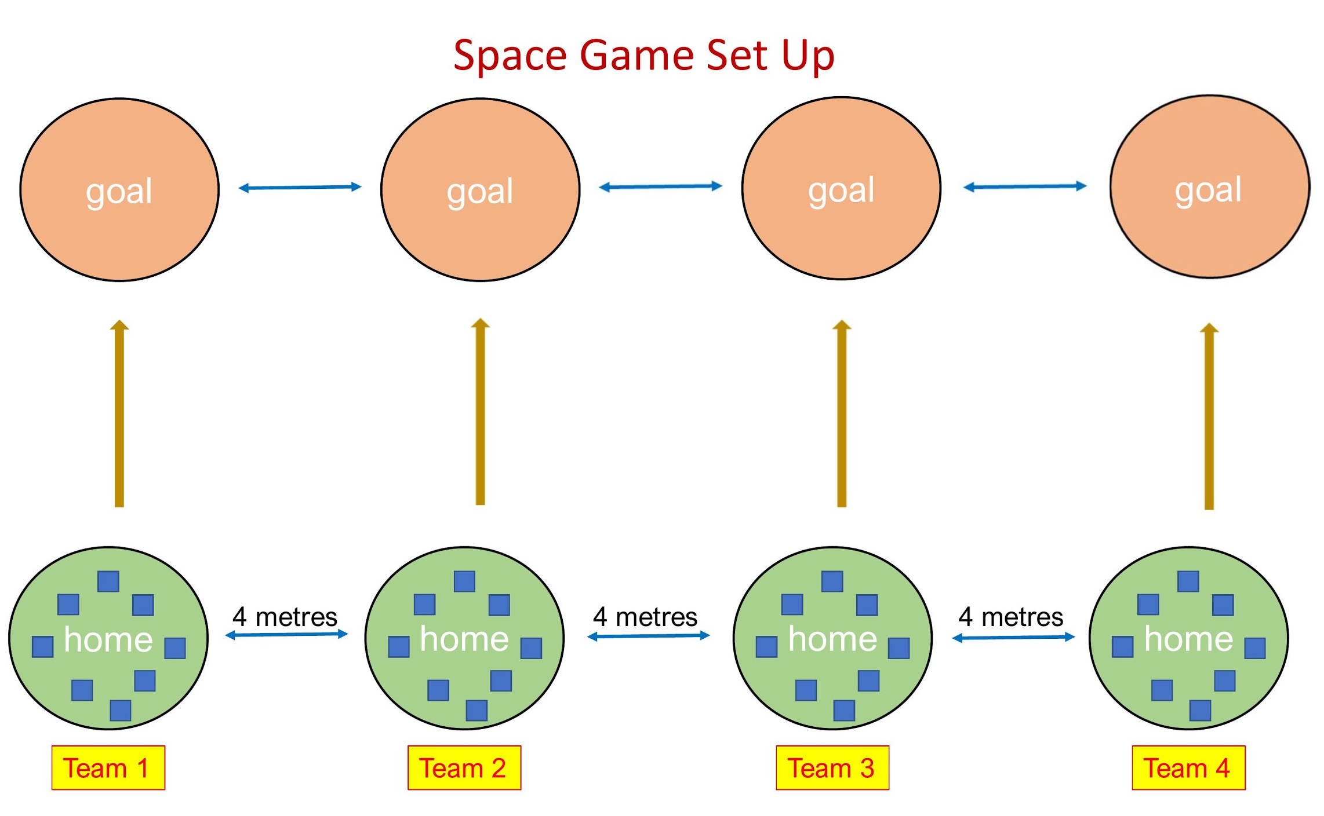
Main Activity

Slide 4
What have we learnt?
How far do we need to stay from those outside of our bubble?
How far is 2 metres?

Slide 5
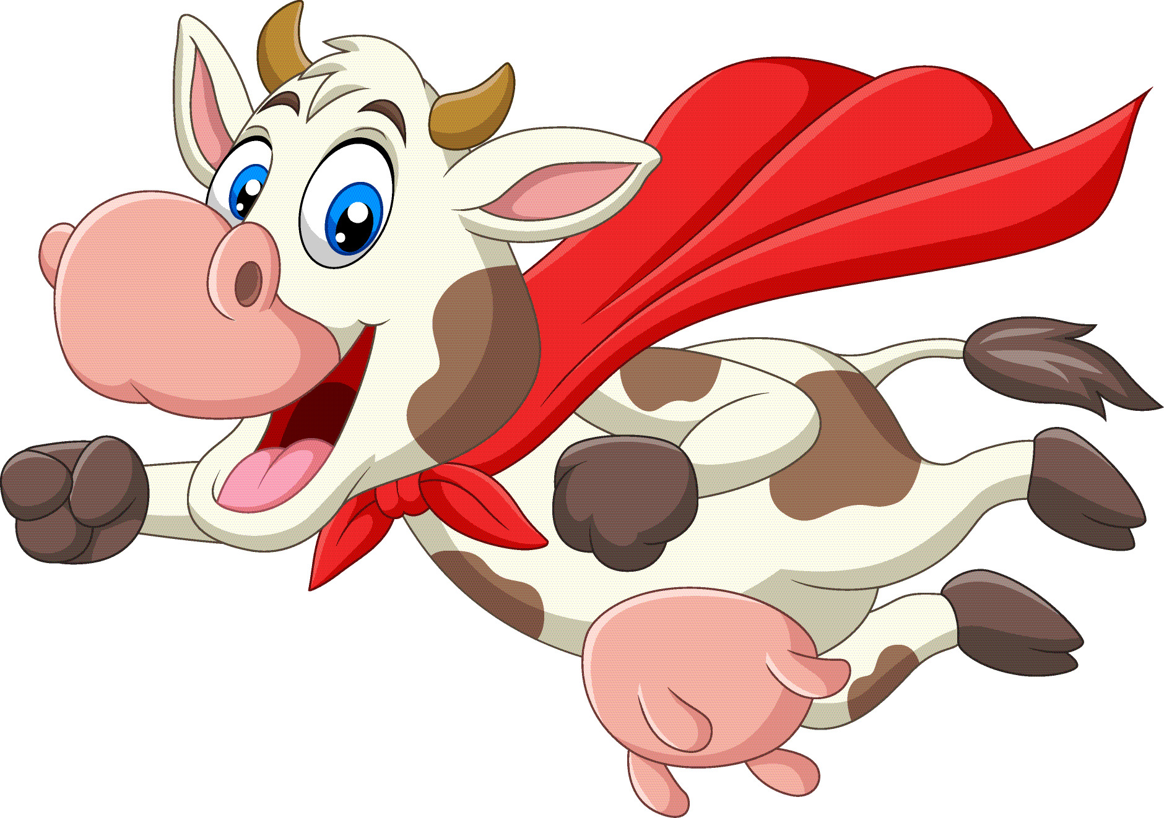
Remember to stay at least 2 metres away from anyone not in your bubble!

Slide 6
Extension Activities
Have a go at throwing bean bags into hoops 2 metres away from you.
Can you estimate 2 metres?
-How many chairs in a line make 2 metres?
-How many rulers?

Slide 7
Bye,
see you soon!

