Slide 1
Me, My Health and My Children’s Health
Delivering a COVID-19 Health Message

Slide 2
Objectives
At the end of this lesson you should be able to:
Understand why peer advice is important for the delivery of messages around COVID-19
Carry out preparations for delivering a message around COVID-19
Deliver a message around COVID-19
Evaluate the delivery of your COVID-19 message

Slide 3
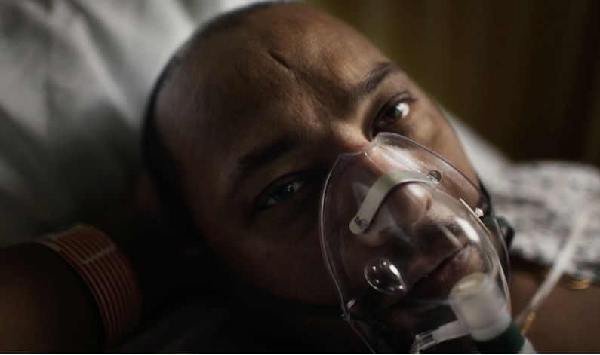
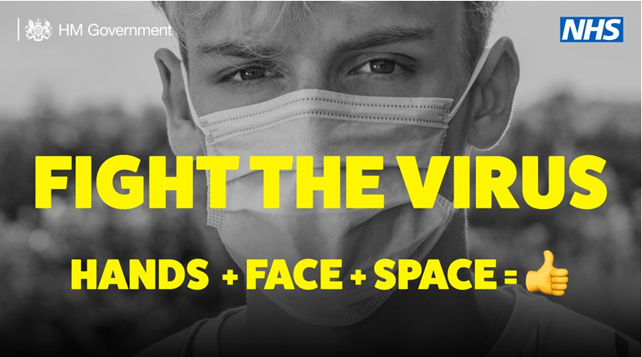
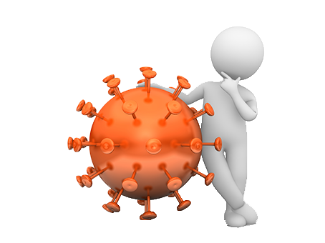
What makes a good message?
Have a look at some of the messages that have been used during the COVID-19 pandemic
Uk Government look into my eyes video campaign https://www.youtube.com/watch?v=ThkLdlwFdZA

Slide 4
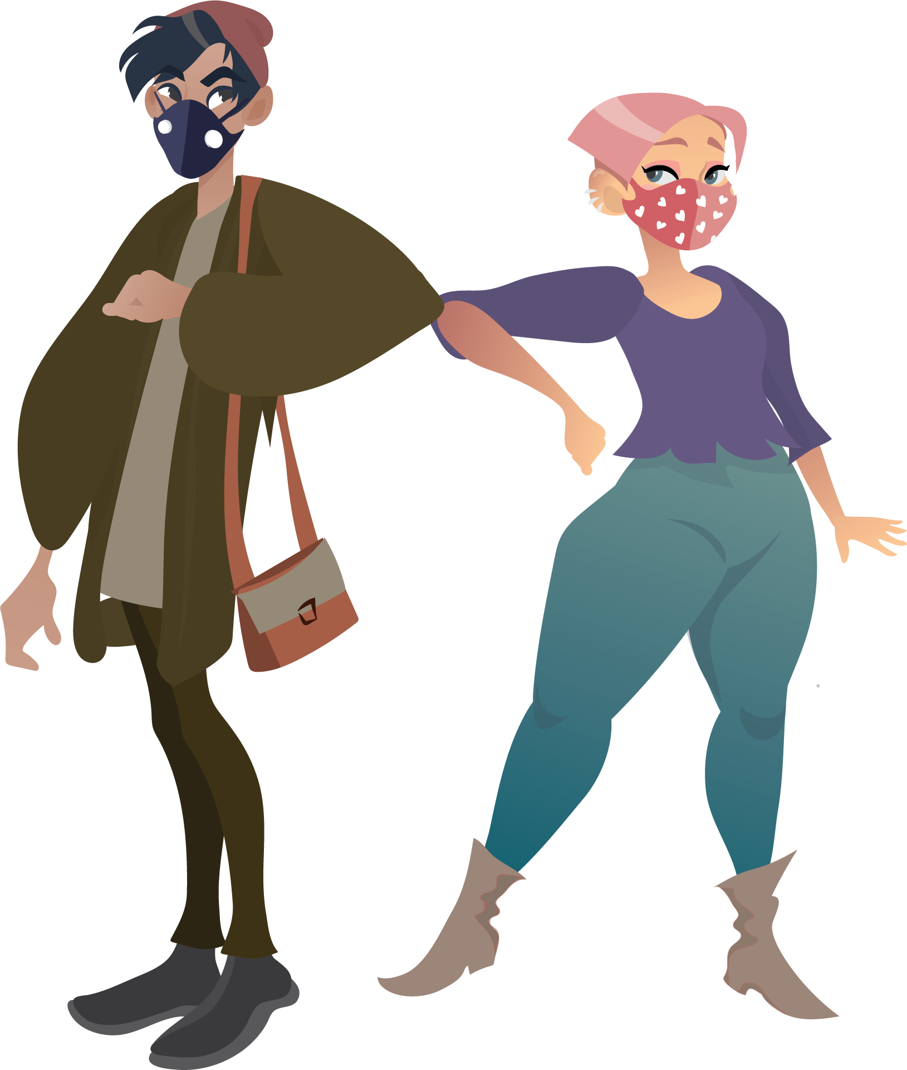
Activity 1
What Role can Young People Play?
Sort the statements into true or false
and give your reason

Slide 5
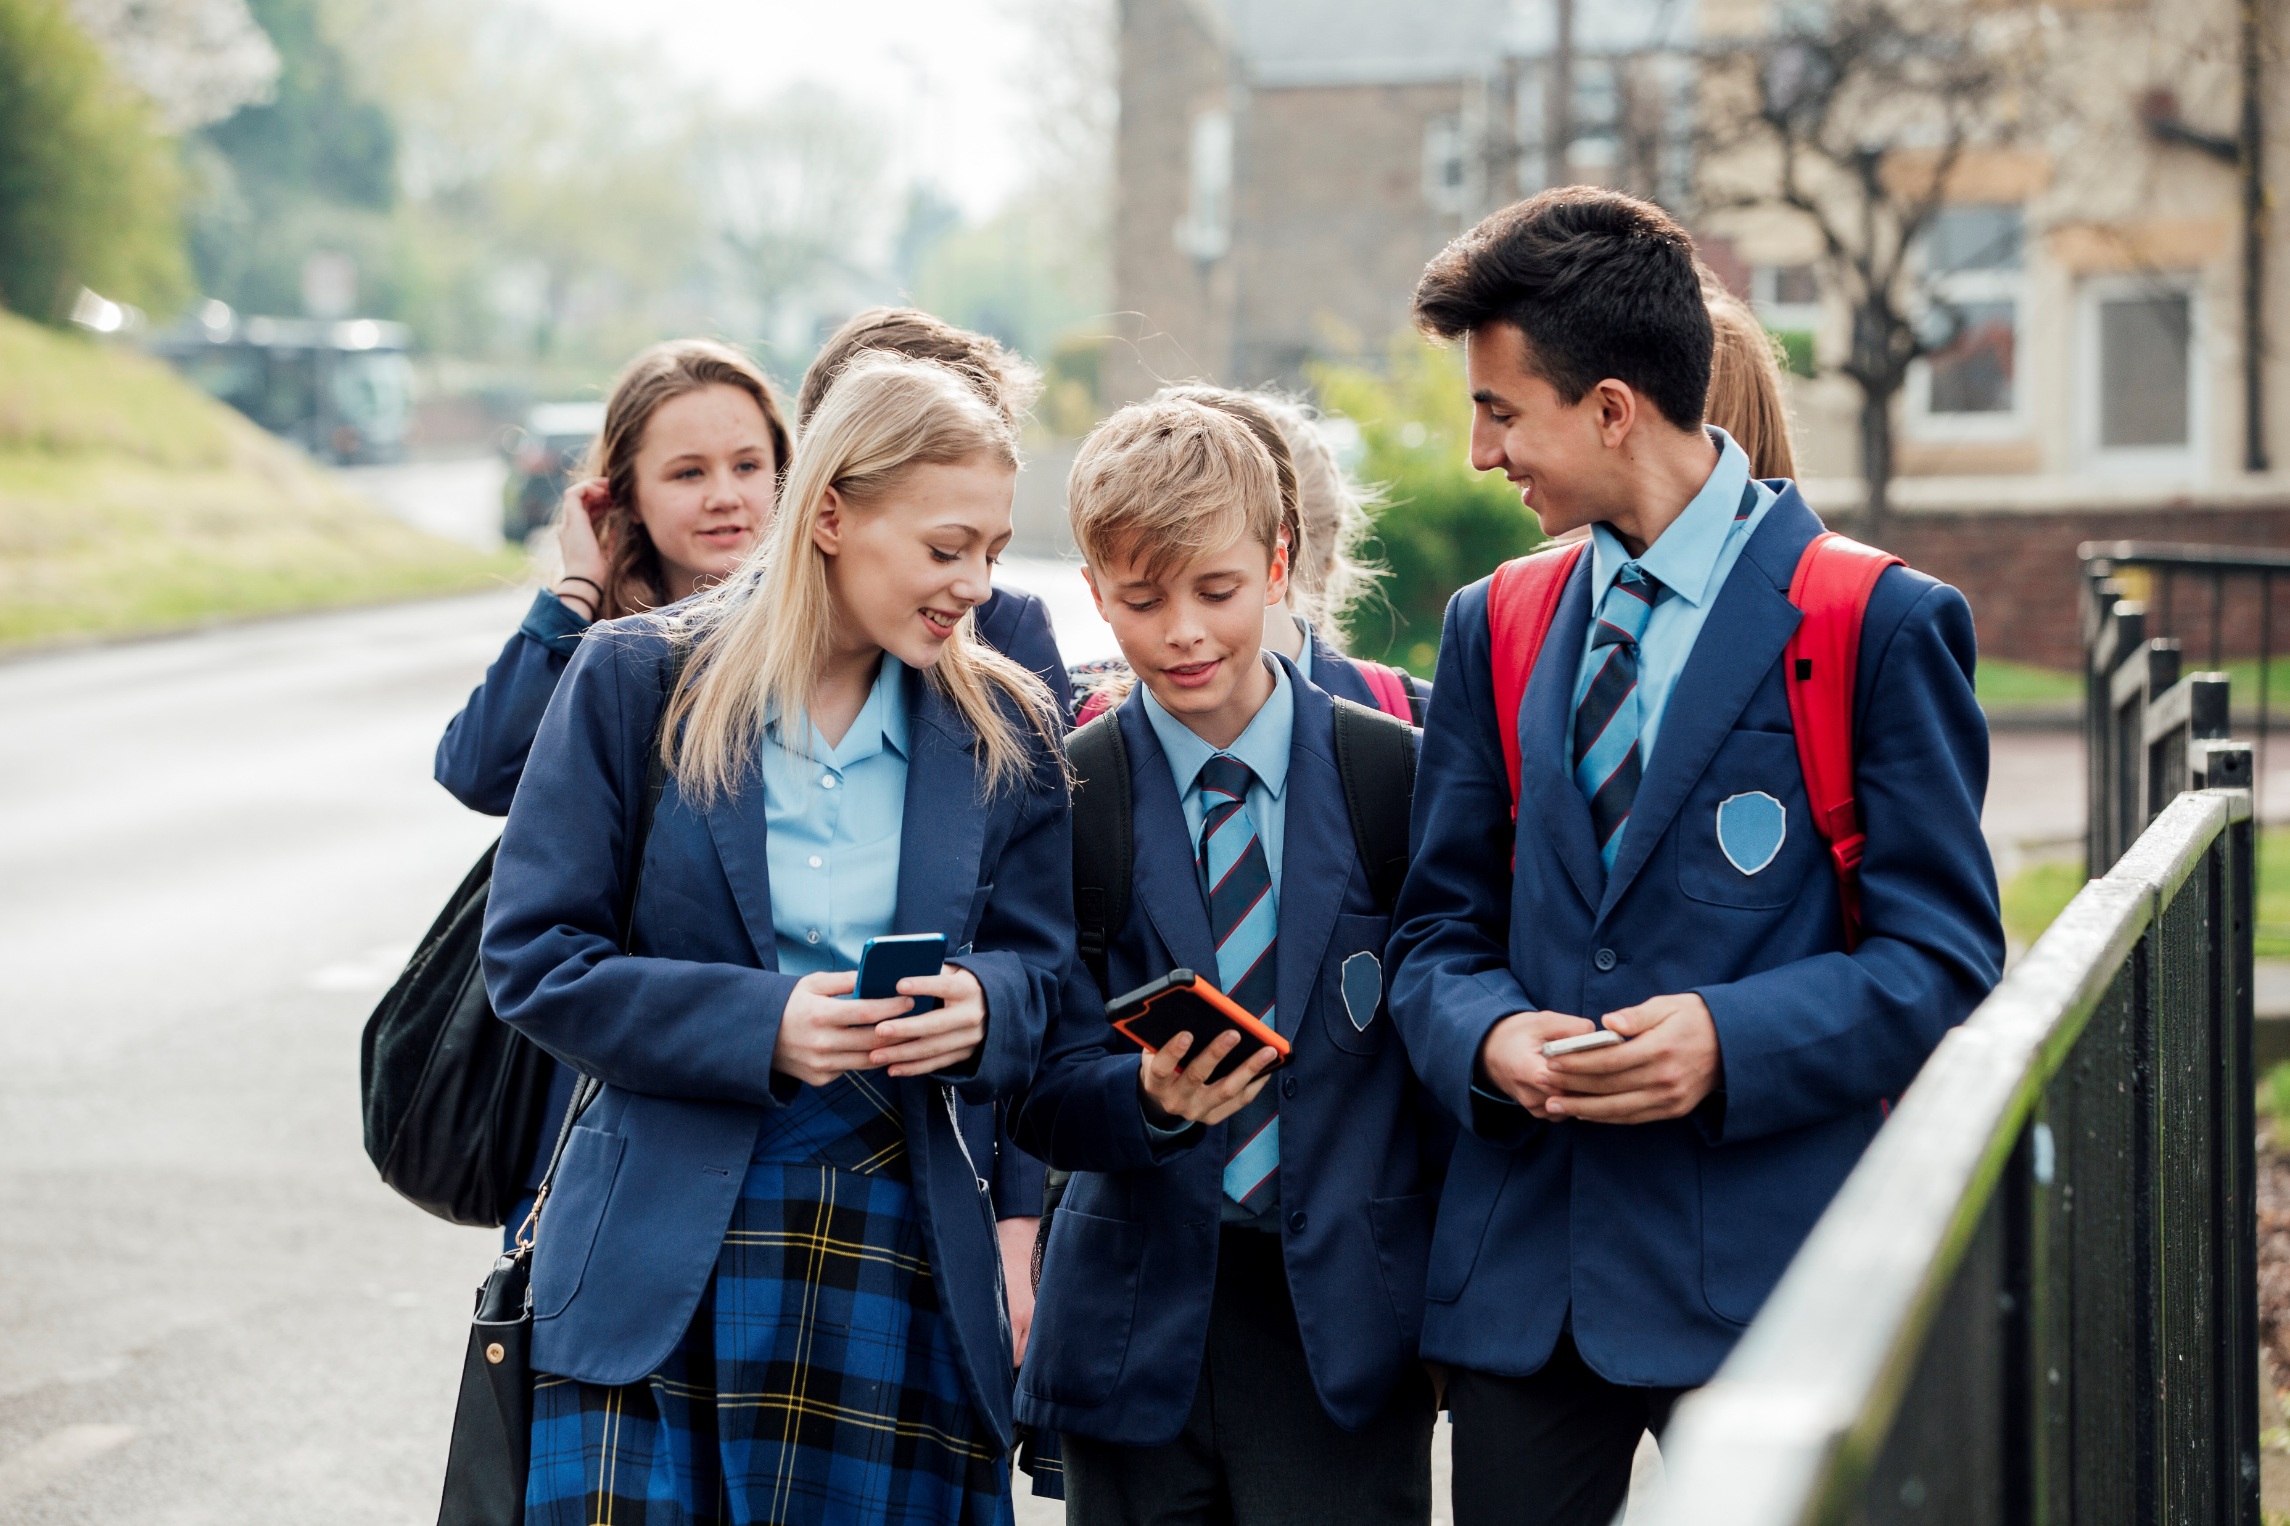
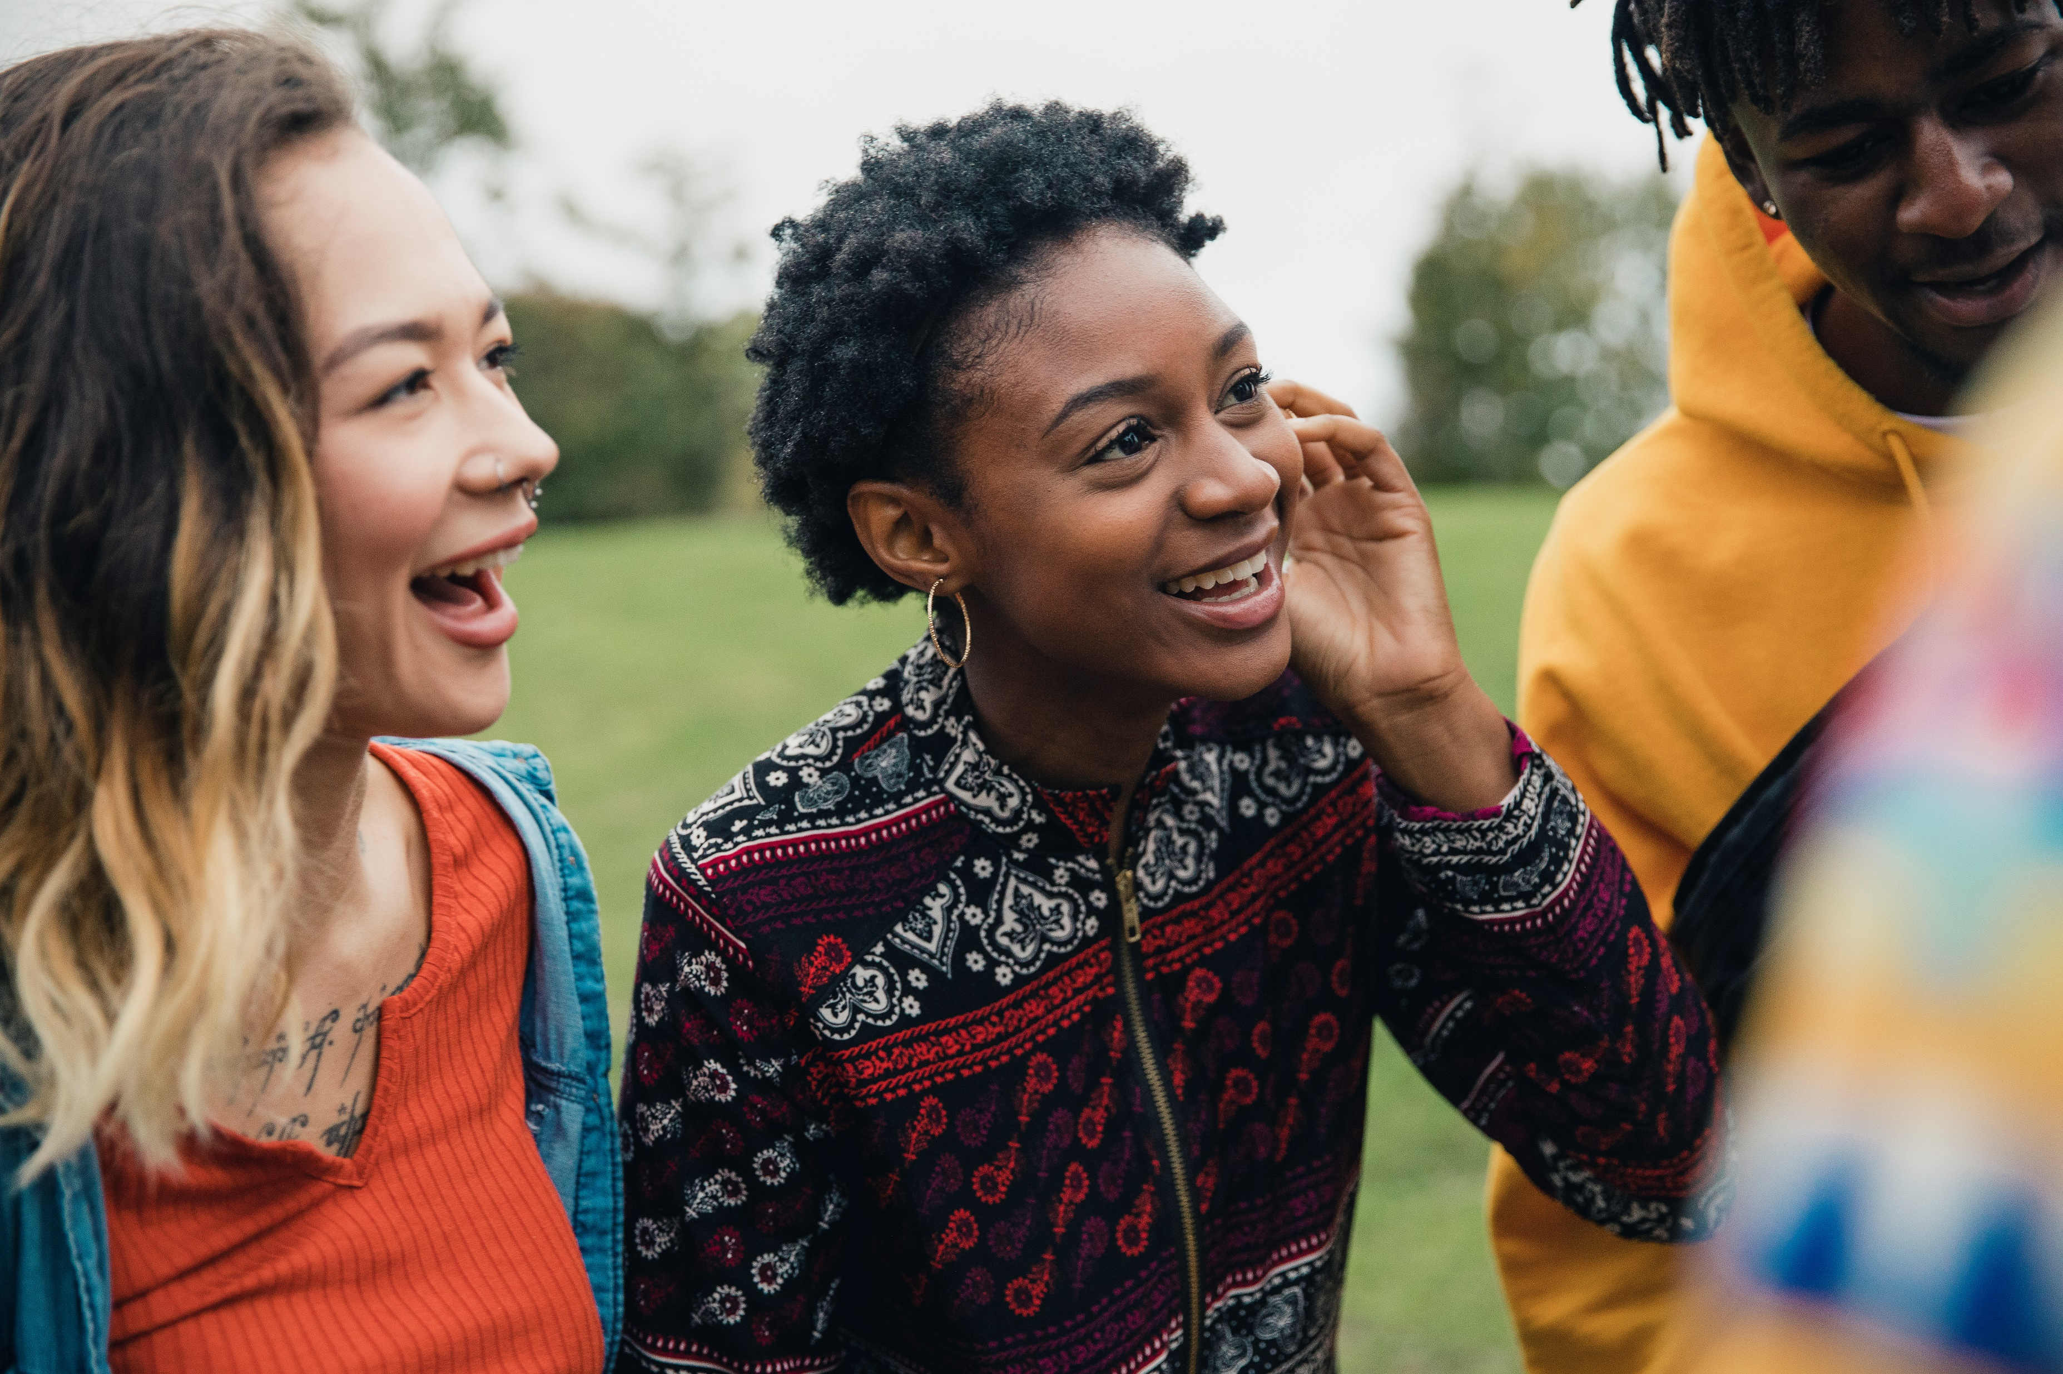
Activity 2
Who’s advice would you listen to?
Peers = people of a similar age or status to us, such as friends
Authority figures = people who are in a position or job roles that give them a specialist insight into the subject they are talking about

Slide 6
Activity 2
Who’s advice would you listen to?
Easy to talk to
What do you think would be the different advantages and disadvantages of receiving the same piece of health advice from a peer and from an authority figure?
Relatable
Available
Reassuring
Impartial
Expertise

Slide 7
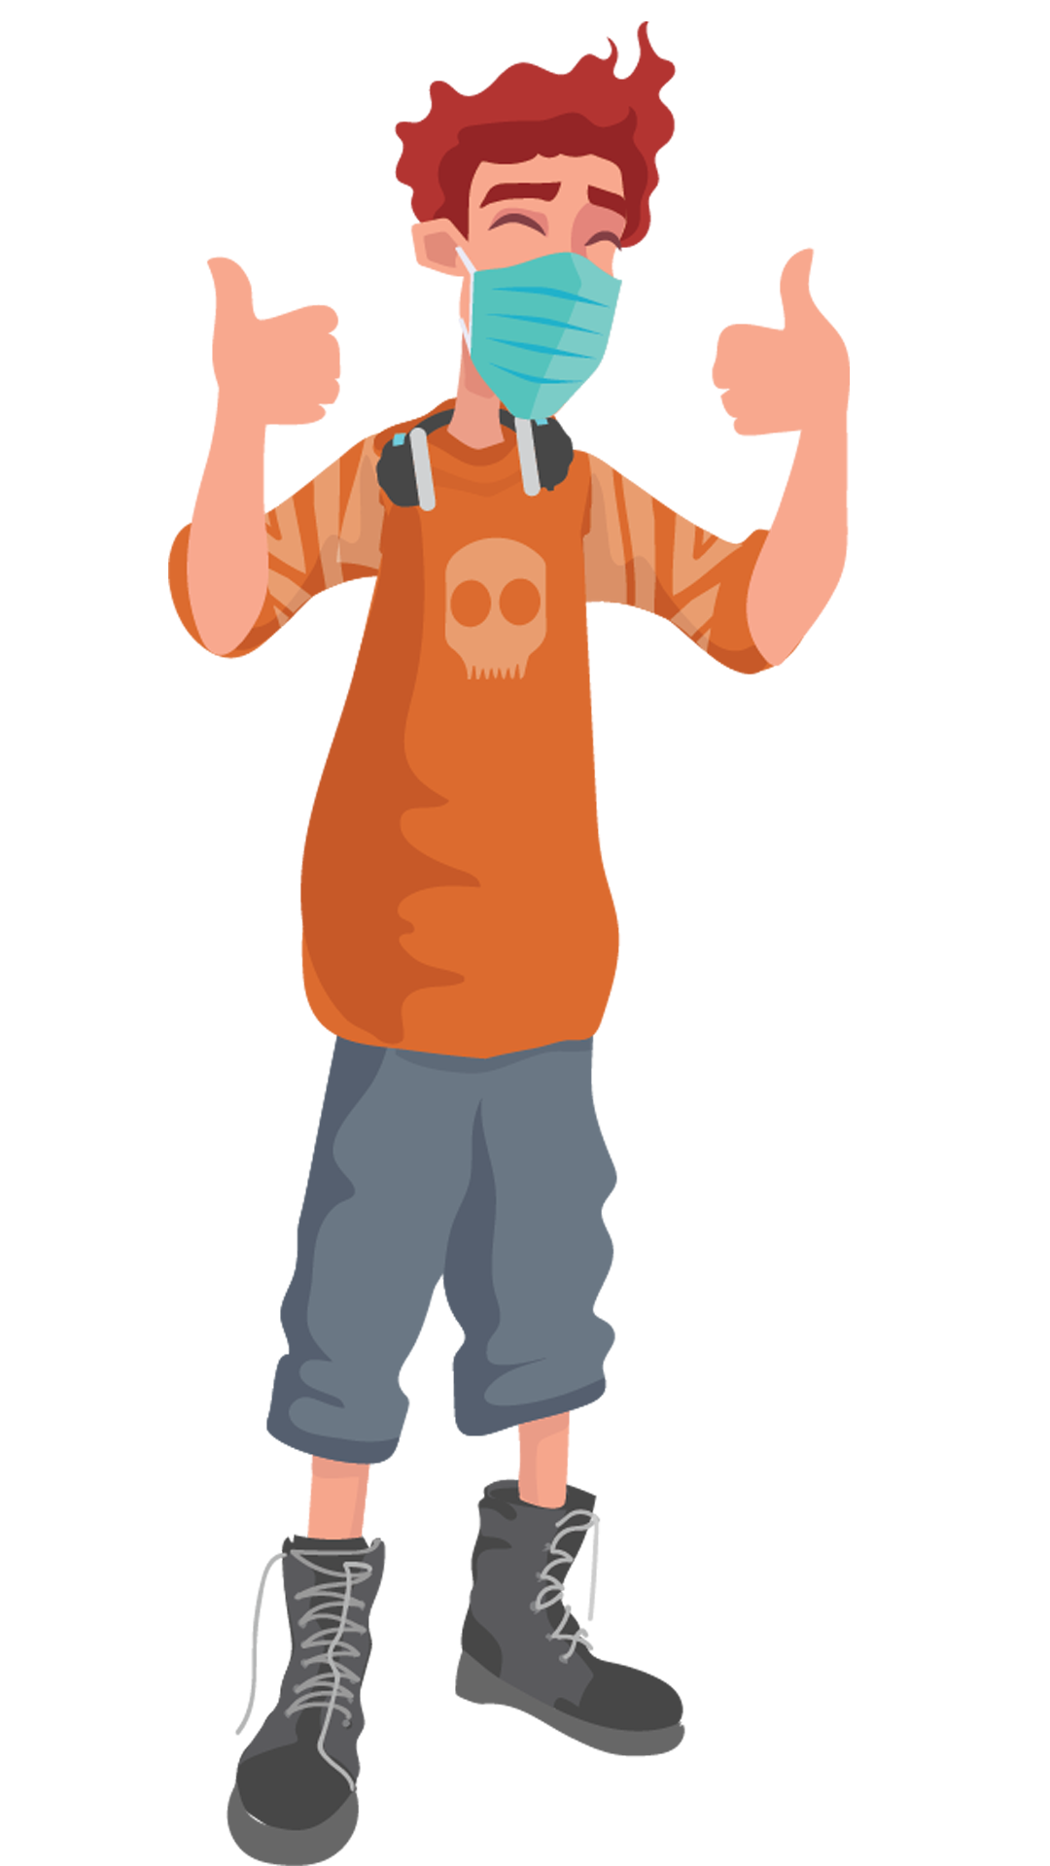
Activity 3
What is the role of a COVID-19 Young Health Champion?
What can you do as part of your role of a COVID-19 Young Health Champion?
What you cannot do as part of your role?
Look at the statements in your booklet and decide which ones you believe are activities that are covered by your roles and responsibilities as a COVID-19 Young Health Champion.

Slide 8
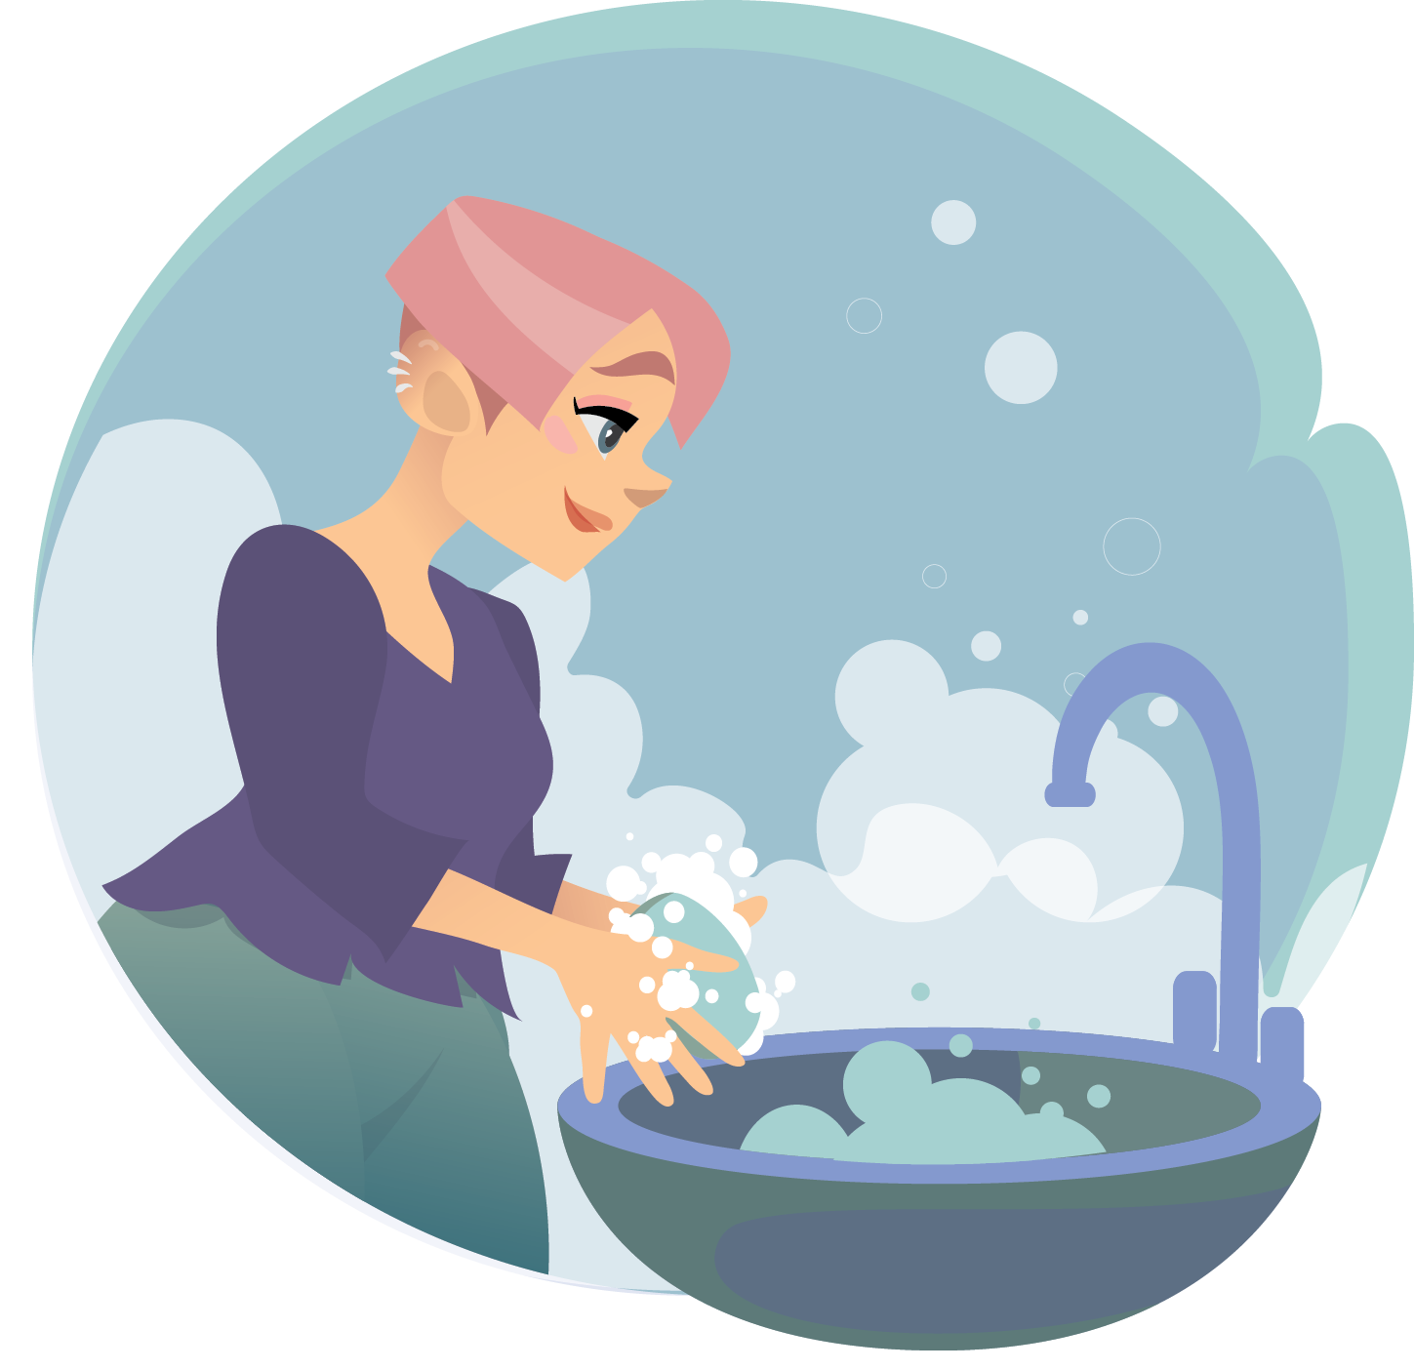
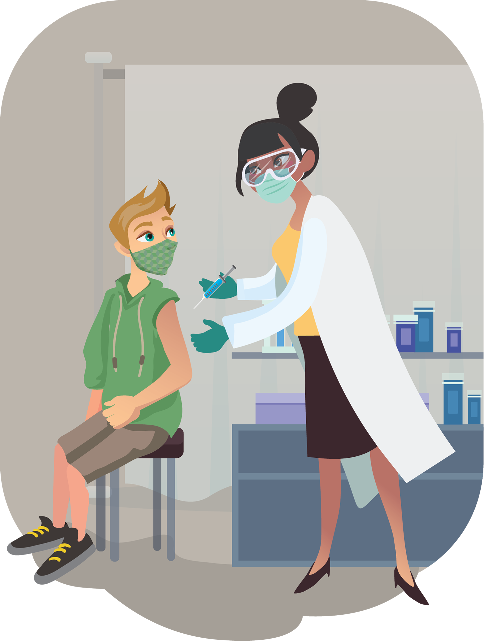
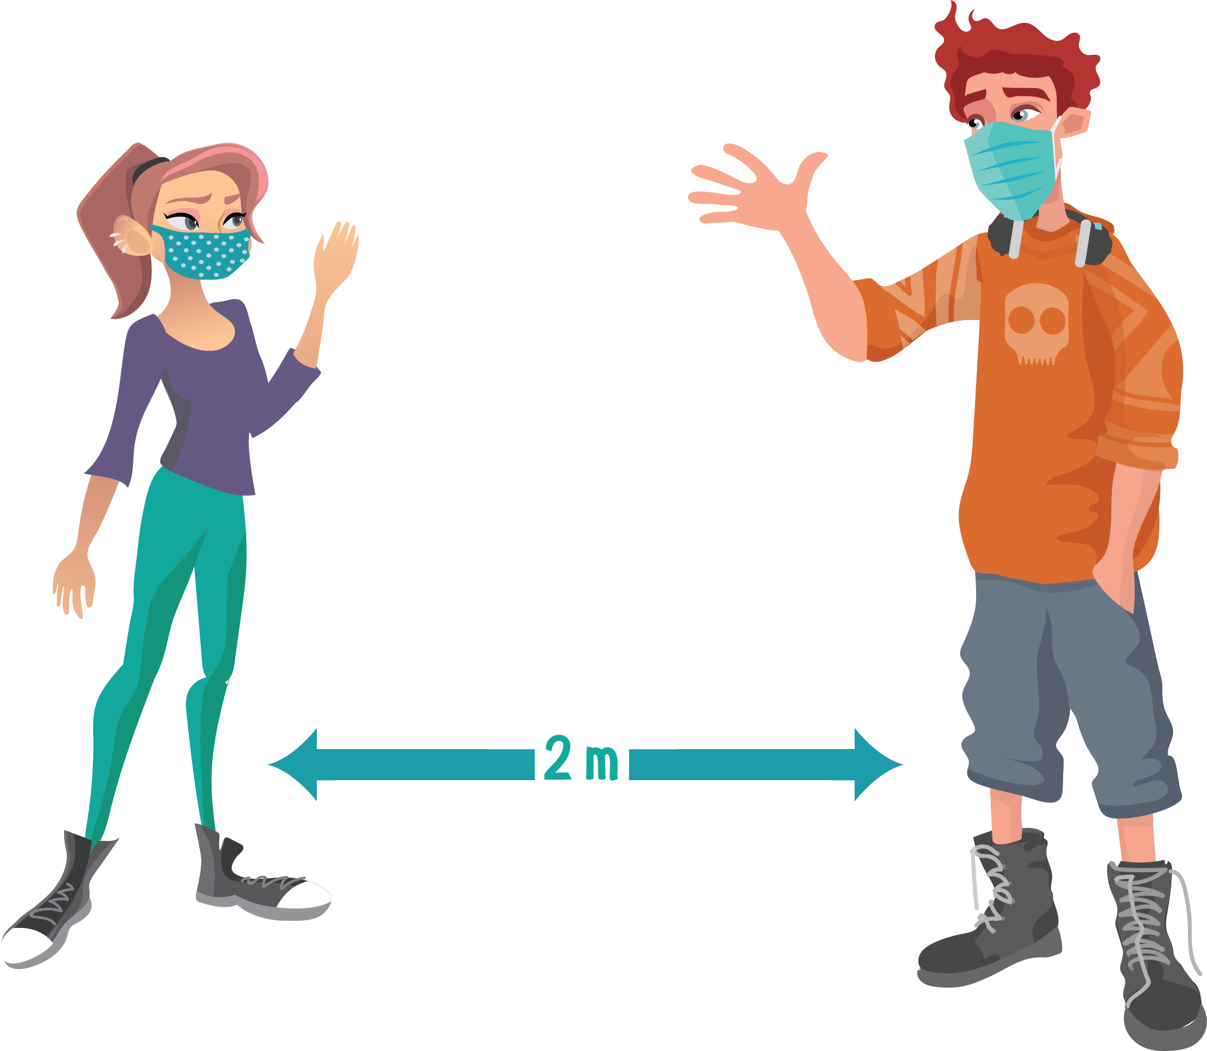
Activity 4
Choosing your COVID-19 message
Example 2
You could base your message on the importance of making sure that peers self-isolate for the required length of time, should they be asked to do so.
You could accompany this with a self-care guide for looking after their physical and mental health during their time in self-isolation.
Example 1
You could focus your message on encouraging young people to not attend parties or other social gatherings that break COVID-19 guidelines.
This could be accompanied by suggestions for ways in which people could stay in touch online and activities they could do together to have fun.

Slide 9
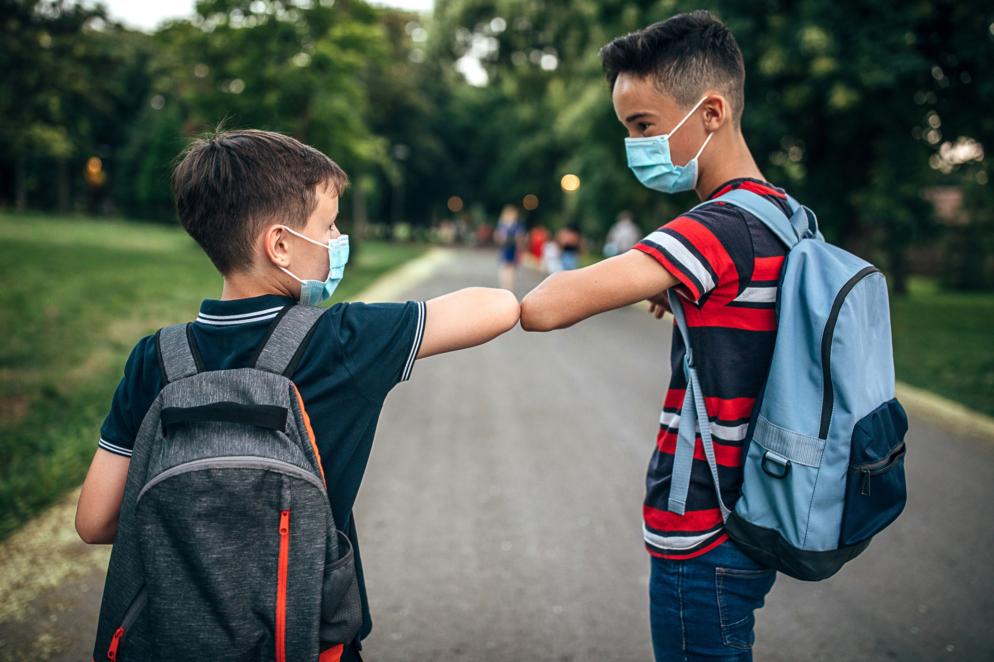
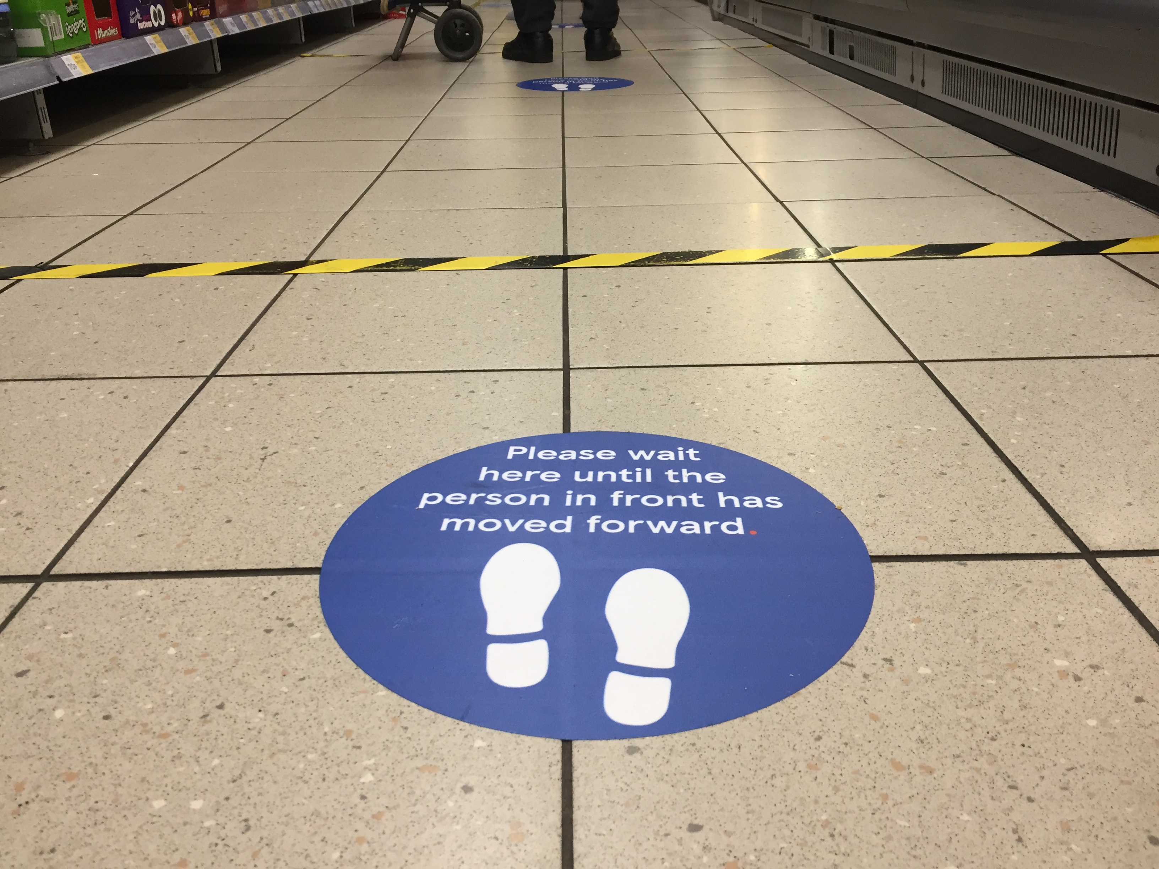
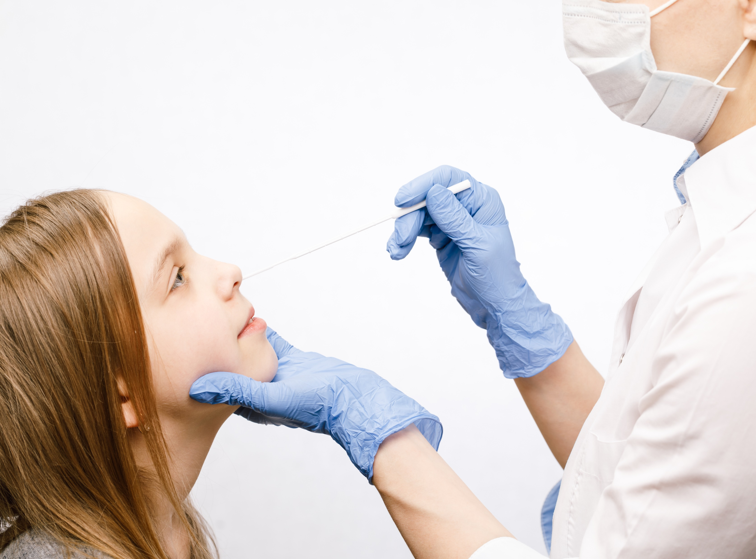
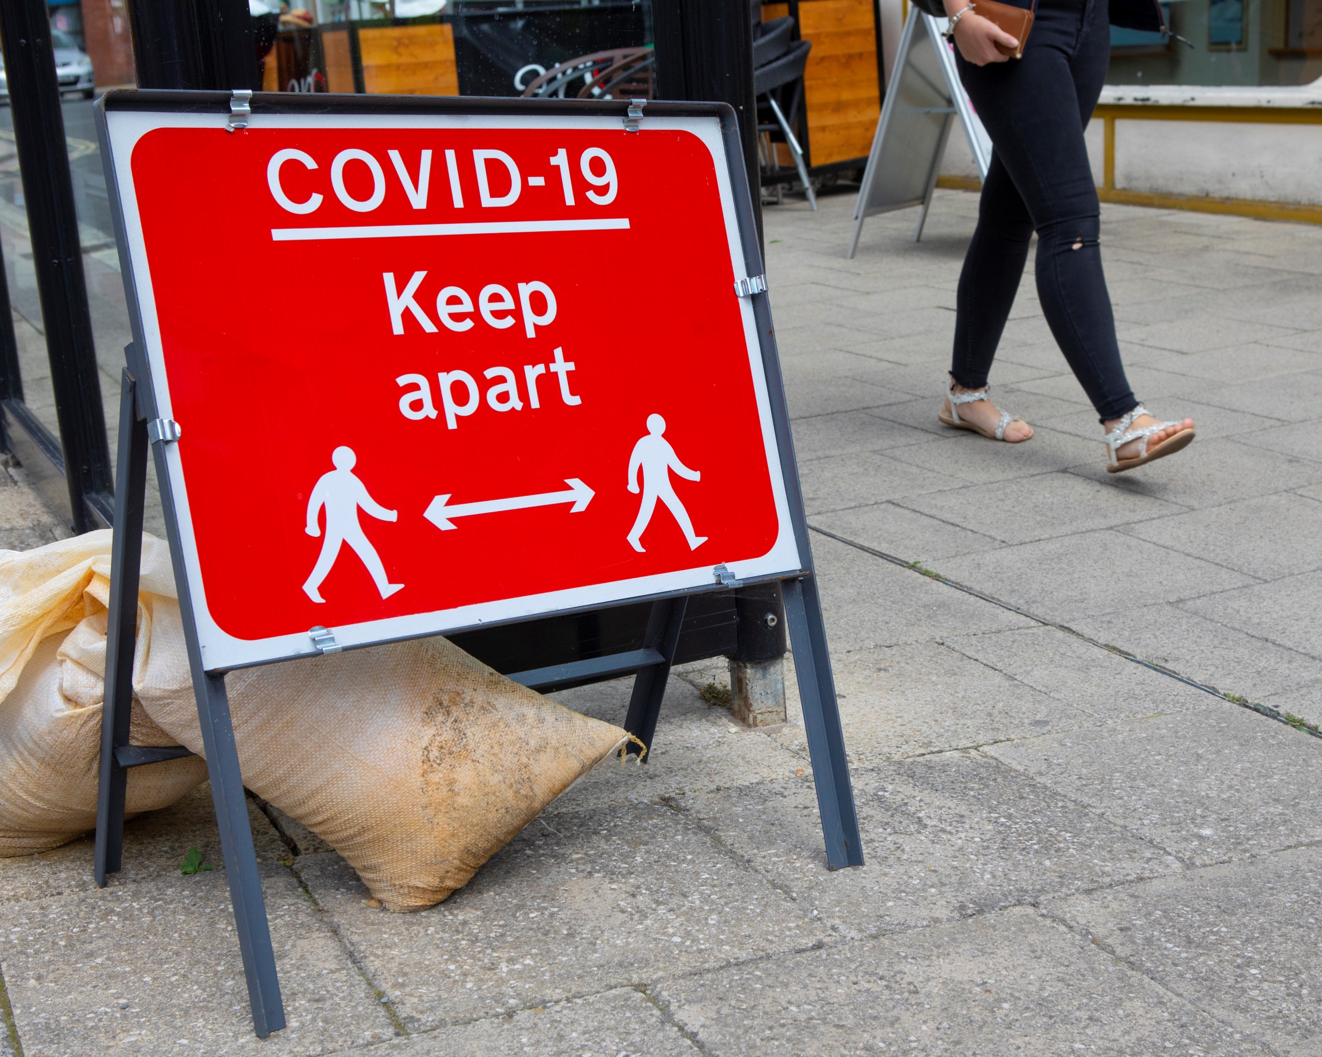
Activity 4
Planning your COVID-19 message
1. The are the key points you are covering in your message:
These could include:
The guideline or the measure that you are encouraging your peers to follow
Why this measure or guideline is important in reducing the spread of COVID-19
The relevance of this guideline or measure to the lives of young people
Suggestions for how your peers could approach any difficulties they may encounter in following the guideline or measure

Slide 10
Activity 4
How are you going to deliver your message?
2. Identify the delivery method best suited to reaching the intended audience and the advantages and disadvantages associated with it
In choosing which method to use, you should think about:
The suitability of your chosen method in helping you to reach your target audience
How easy or difficult it is for people to ask questions or provide feedback when using that method
The different ways in which you can present information using that method

Slide 11
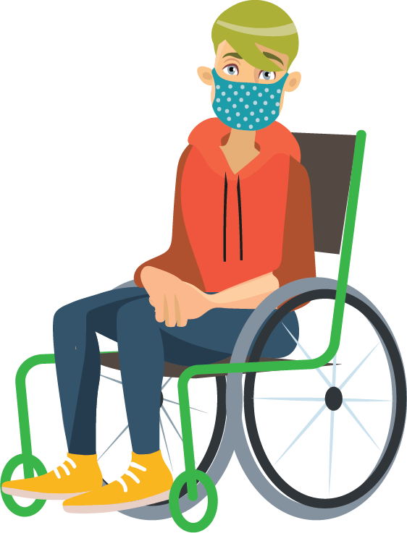
Activity 4
What resources are you going to use to help you prepare your COVID-19 message?
3. Obtaining resources relevant to the chosen message around COVID-19 and its audience
You should consider:
How you can make sure that the resources you use provide reliable and accurate information
Ways in which you can check that the resources are regularly updated by their publisher
How you can ensure that the resources contain information that is relevant to your audience

Slide 12
Activity 4
What materials are you making for your COVID-19 message?
4. Preparing materials suitable for the chosen message around COVID-19
You should think about:
How you can ensure that the materials you develop are easy for your target audience to understand
Whether the information you’ve included is relevant to the interests of your target audience
How easily the resources you create can be used and shared through your chosen delivery medium

Slide 13
Activity 4
Are you prepared for questions from your audience?
5. Prepare for anticipated questions and feedback from the audience
You should consider:
The most common questions or feedback that you think you might receive and how you could respond to them
Any sources of reliable information that you could signpost individuals towards, should you not feel able or comfortable to respond to any questions or feedback
How you might respond to any comments or feedback that could be upsetting, or which might raise concerns around the wellbeing of the person making them
Whether you think that the nature and the frequency of the questions and the feedback you receive might be different if you use social media, rather than other delivery methods

Slide 14
Activity 5
Delivering your COVID-19 message
Your teacher will be assessing your performance against these five key areas as you deliver your message, so forget to:
1. Explaining the role of the COVID-19 Young Health Champion
2. Use of positive and appropriate language
3. Appropriate style of delivery
4. Considering and responding to questions, comments and feedback
5. Signpost to additional sources of reliable information and support

Slide 15
Activity 6
Evaluating your COVID-19 message
There are two essential elements to this; getting feedback and deciding what you want to change.
Collect feedback from at least two of the three different sources listed below:
A fellow COVID-19 Young Health Champion
A member of the audience for your message (if possible)
Your teacher or tutor

Slide 16
Objectives
At the end of this lesson you should be able to:
Understand why peer advice is important for the delivery of messages around COVID-19
Carry out preparations for delivering a message around COVID-19
Deliver a message around COVID-19
Evaluate the delivery of your COVID-19 message

Slide 17
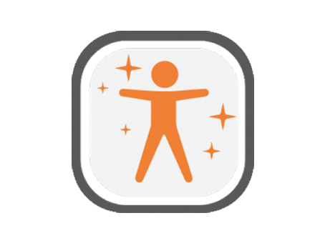
Reflection
What new things have you learnt today?
What skills have you used today?
What skills did you find difficult today?
What steps have you made towards ‘Levelling Up Your Life’?
Have you taken the food challenge? Which one are you going to do next?

Slide 18
This work is funded by the Department of Health and Social Care (DHSC) and the National Institute for Health Research (NIHR). The views expressed are those of the authors and not necessarily those of DHSC or NIHR

