Slide 1
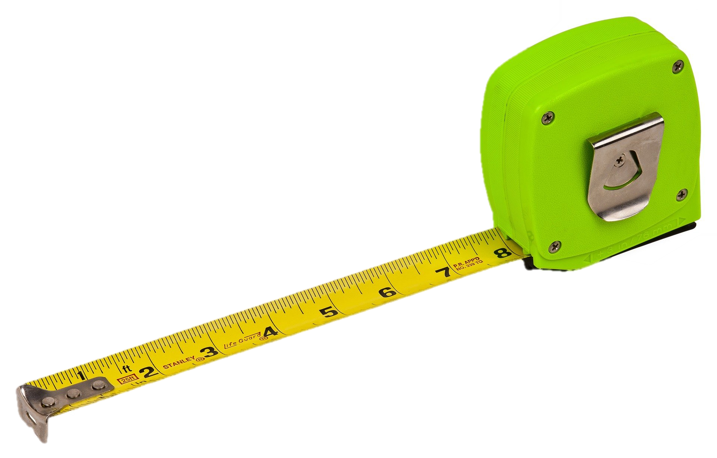
Lesson 10: Space
Objectives:
To explain how transmission of the virus can be limited by keeping a safe distance.
To accurately measure 2 metres.

Slide 2
Video Introduction
Watch COVID-19 Warriors Video Introduction.

Slide 3
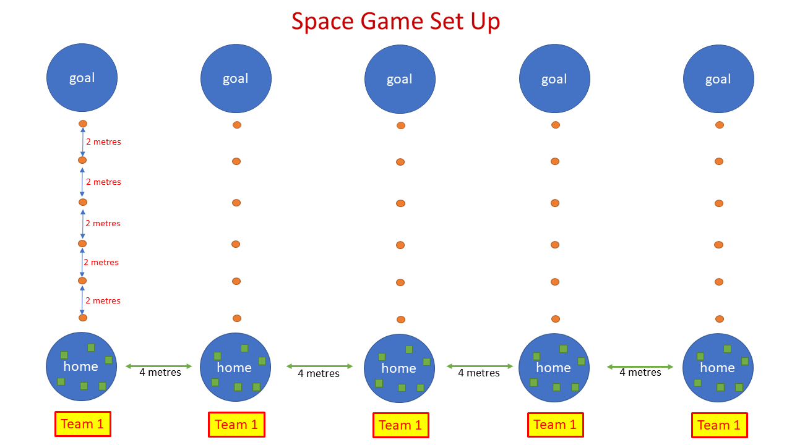
Main Activity

Slide 4
What have we learnt?
How far do we need to stay from those outside of our bubble?
How far is 2 metres?

Slide 5
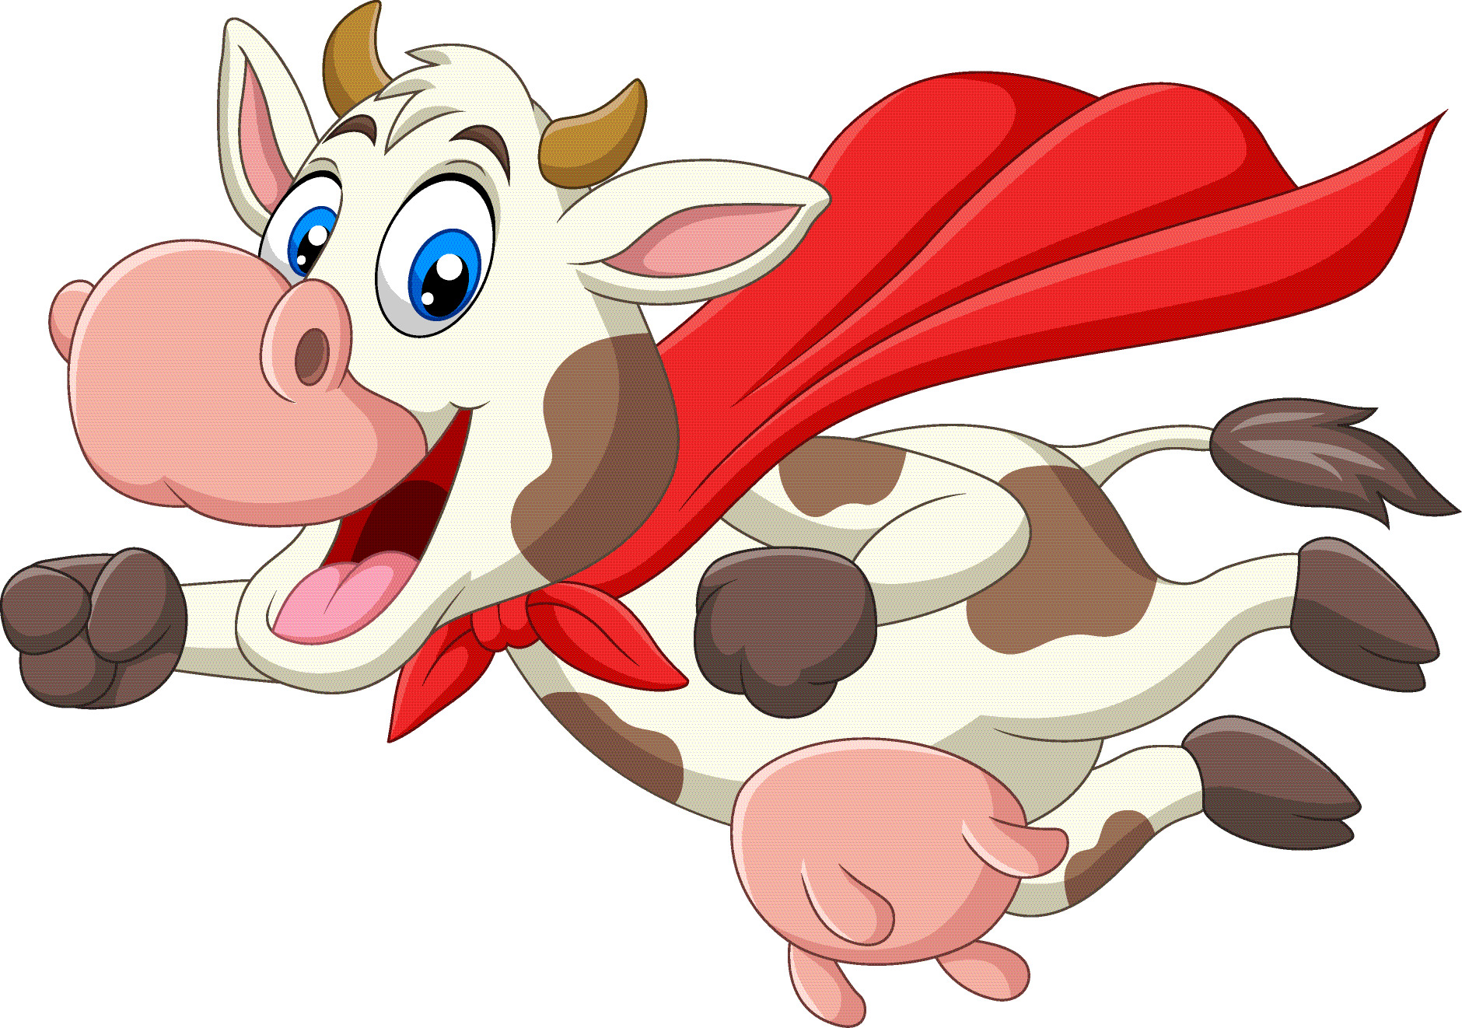
Remember to stay at least 2 metres away from anyone not in your bubble!

Slide 6
Extension Activities
Can you design a game that would help you to stay at least 2 metres apart?

Slide 7
Bye,
see you soon!

