Slide 1
Coronavirus
How to do your Saliva Test
Notes:
Layout using master slide: 2 custom design = without footer

Slide 2
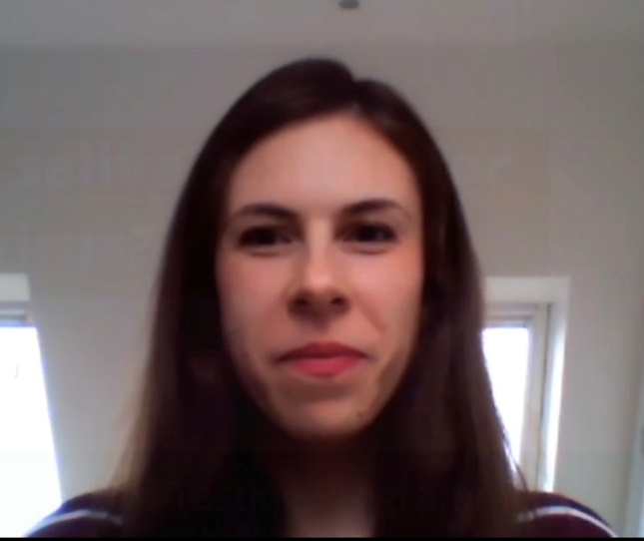
Meet the Scientist
You can play a big part in helping your community.
Here’s Grace on video to explain why the test is such a good thing.
https://youtu.be/a6tWSoM6mOE (2mins 5secs)

Slide 3
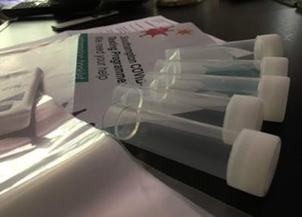
How to do your saliva test
https://youtu.be/DvVUqWR4qgw (2mins)

Slide 4
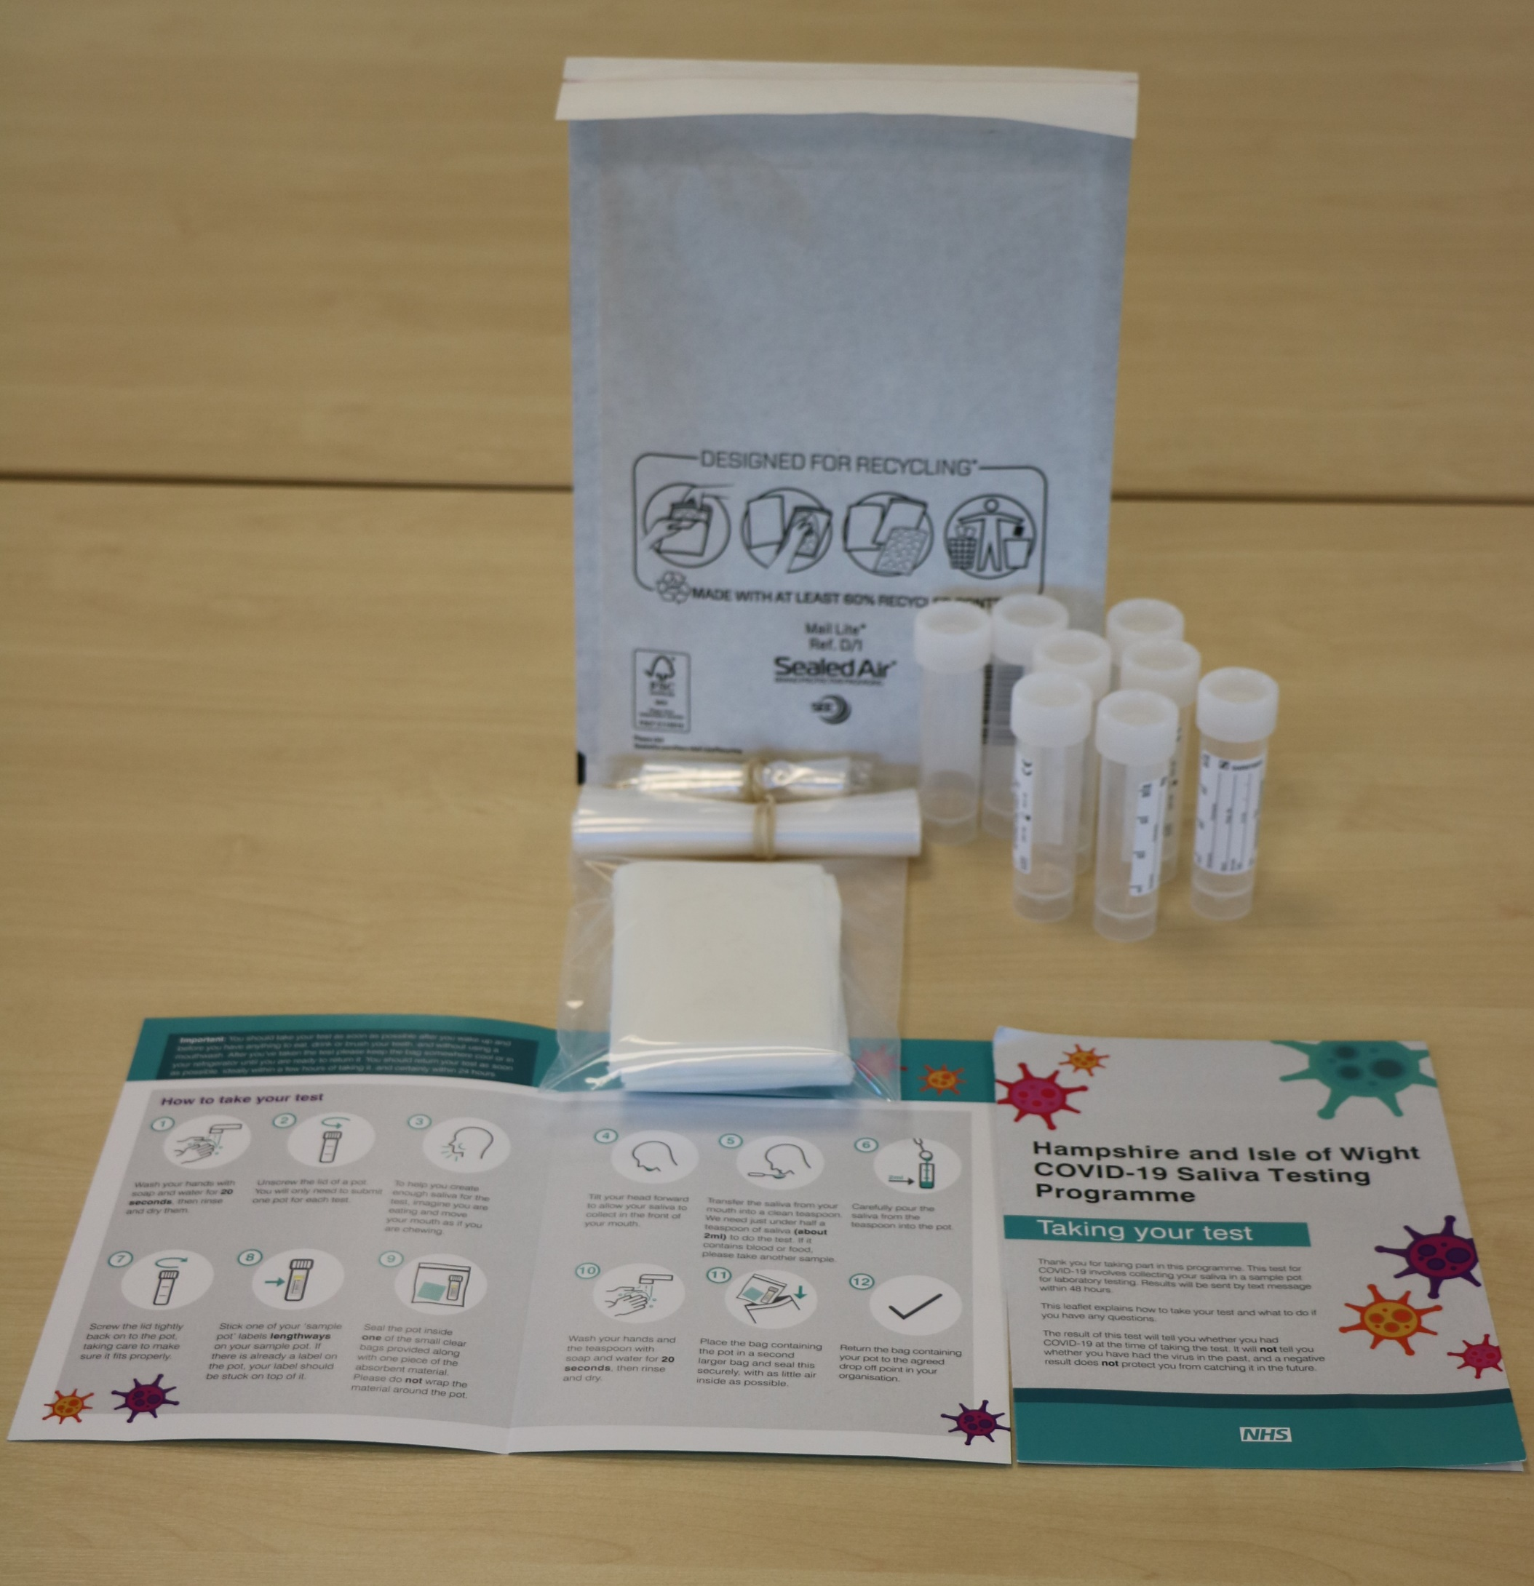
#BePartOfTheSolution
Administer packs and instructions
This work is funded by the Department of Health and Social Care and the National Institute for Health Research (NIHR). The views expressed are those of the authors and not necessarily those of the Department of Health and Social Care or NIHR.

Slide 5
Master slide: 1 custom design = with footer
Notes:
NB. Layout master slide: 2 custom design = without footer

