Slide 1
Saliva testing
Objectives:
To recognise that our saliva can be used to detect Coronavirus
To explain the testing process using key vocabulary - how to submit a sample and what happens during the test
To discuss how transmission to others can be limited by identifying people who are infectious, linking this to the importance of testing

Slide 2
Video Introduction
Watch COVID-19 Warriors Video Introduction.
(*Optional)
Watch a short clip about saliva testing
https://www.youtube.com/watch?v=DvVUqWR4qgw

Slide 3
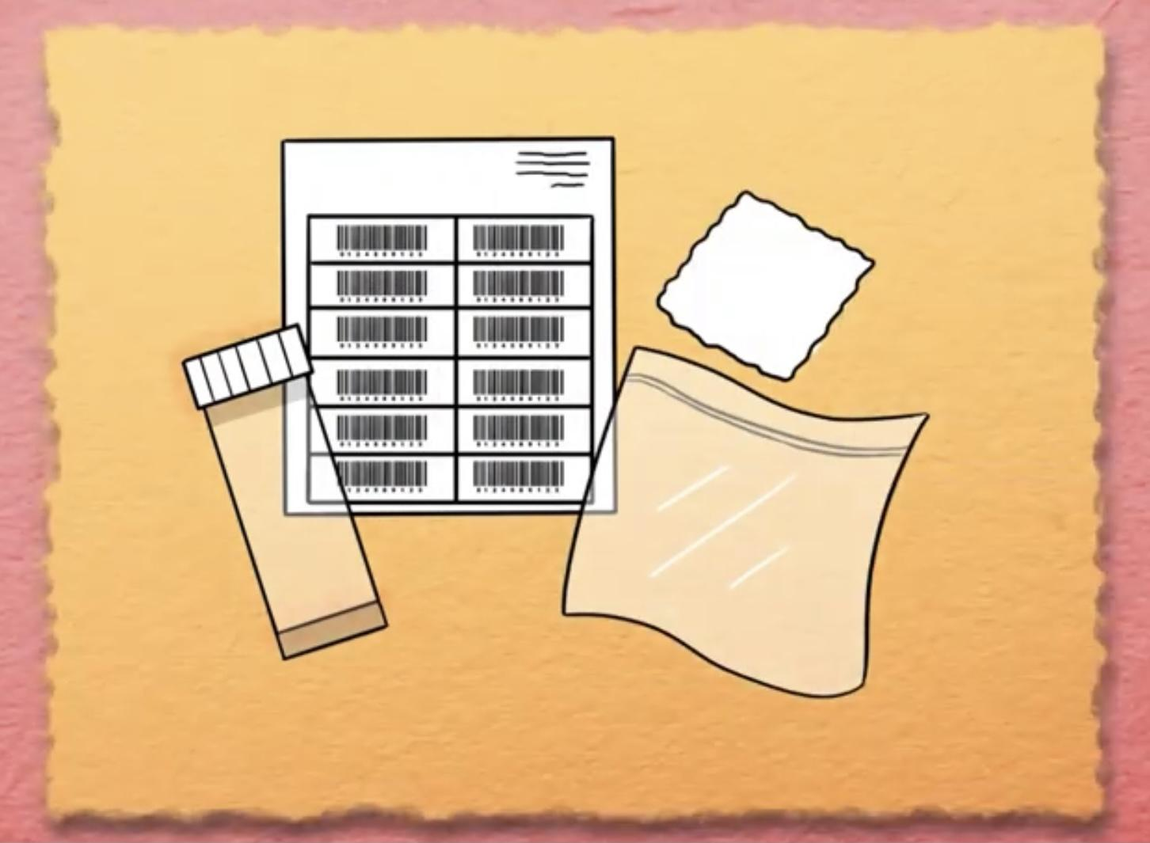
Key Vocabulary
test
test pot
testing process
equipment
saliva
laboratory
lab technician

Slide 4
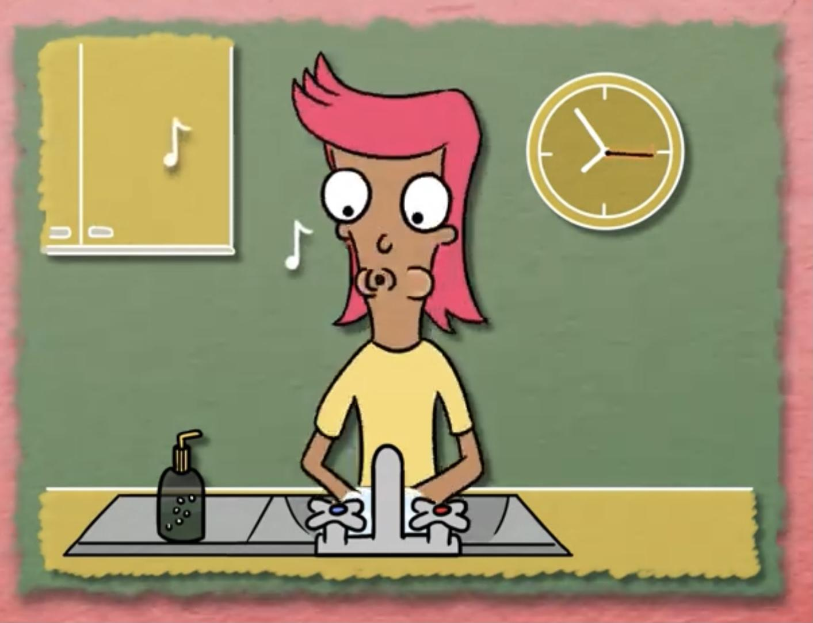
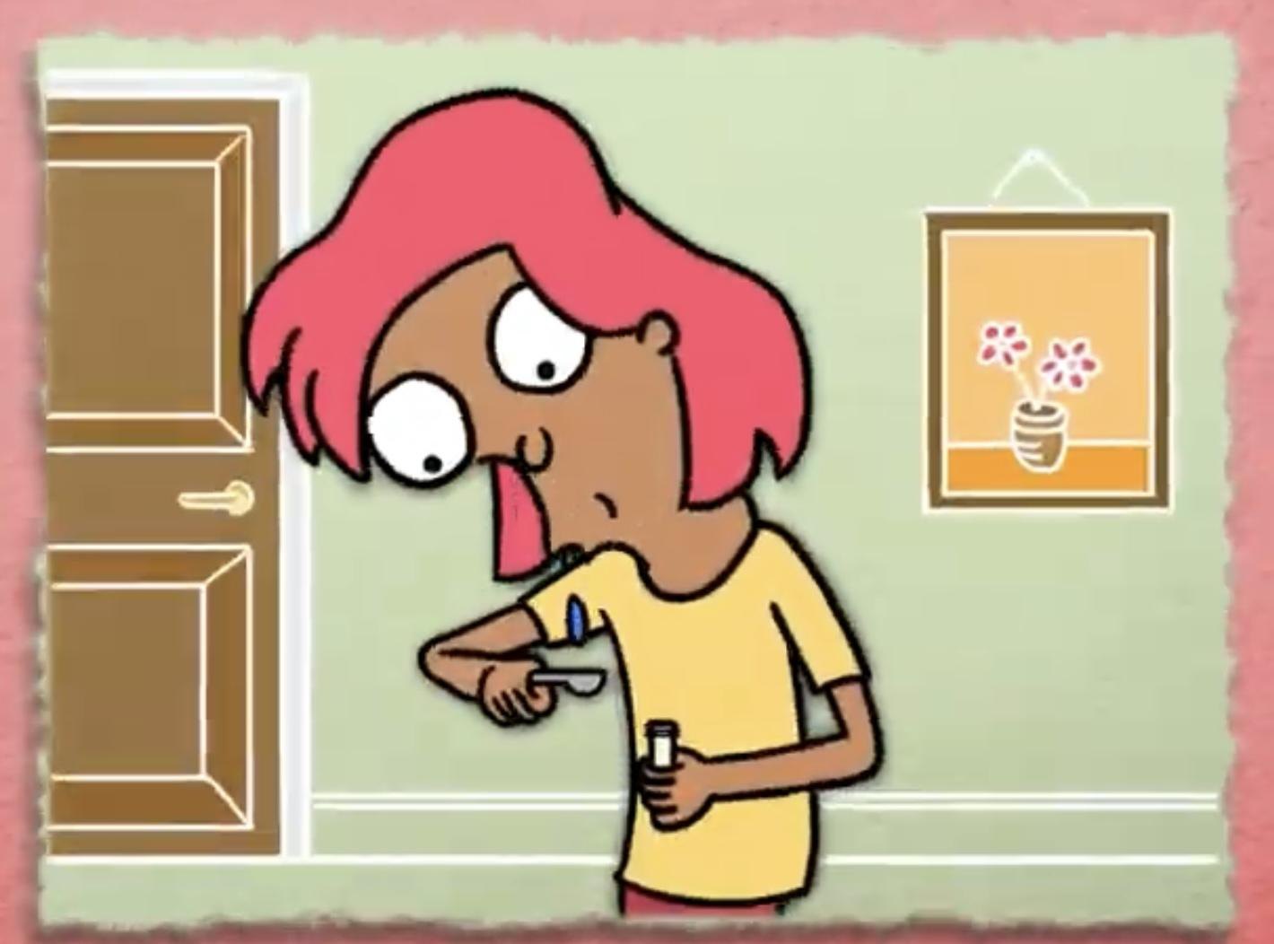
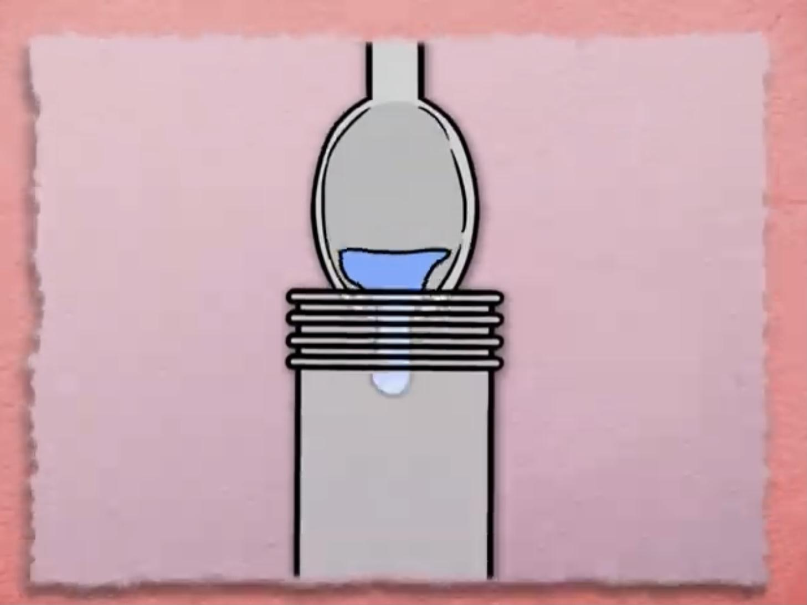
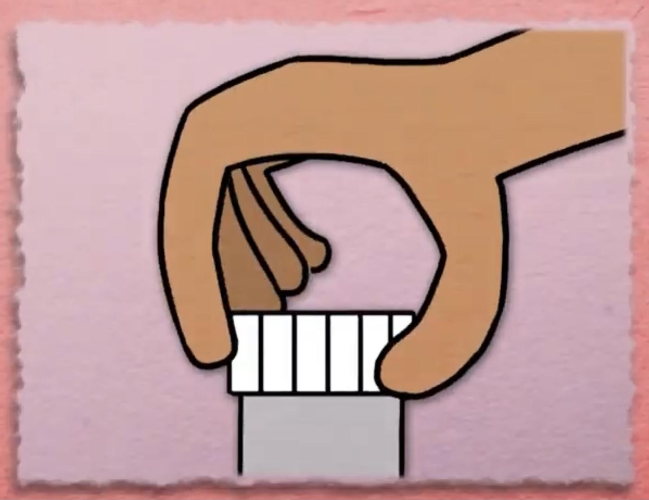
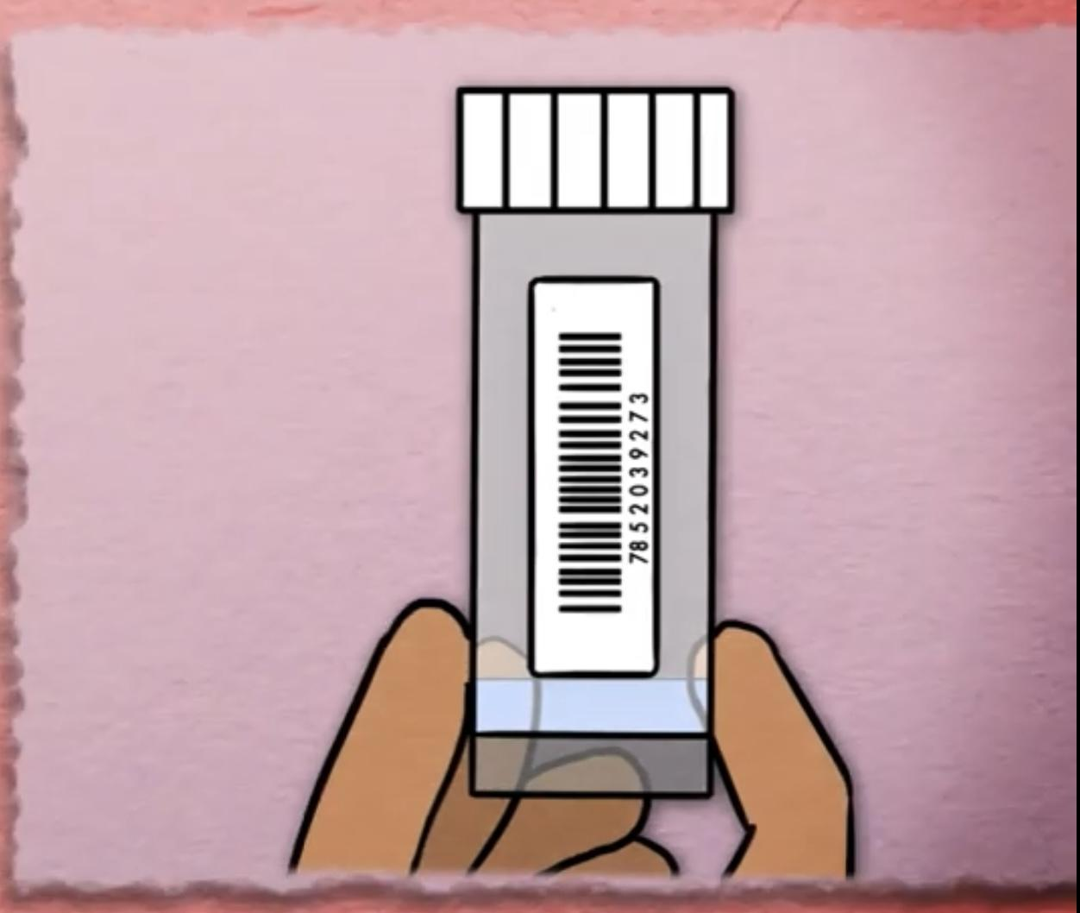
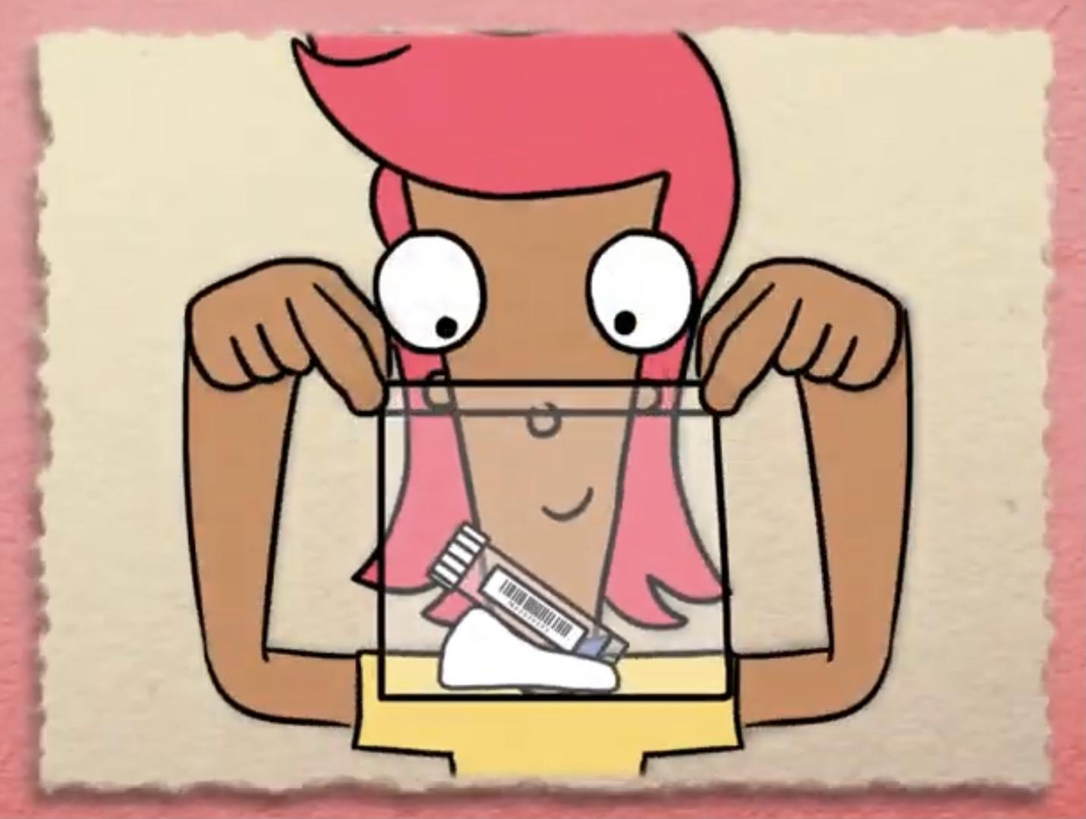
Main Activity
1. Wash your hands.
2. Spit on a spoon.
3. Pour spit in the pot.
4. Screw the lid on.
5. Stick the label on.
6. Place in the bag and seal.
These are some of the steps - Can you remember any more steps?

Slide 5
Can you make an instruction booklet for children who will be doing the saliva test?

Slide 6
What have we learnt?
Can you tell a friend how to do a saliva test at home?
What are some tips you could give them?

Slide 7
Well done for learning about saliva testing - one of the tools to fight COVID-19!

Slide 8
Extension Activities
Find out what happens to your saliva in the lab.
https://bit.ly/3c0tsk4

Slide 9
Bye,
see you soon!

