Slide 1
Coronavirus
New Variants

Slide 2
Variants of COVID-19
Where do they come from?
Why are we worried about them?
When a virus infects someone, it makes lots and lots of copies of itself to increase the number of virus particles present. Every time a virus copies itself, mistakes can be made in the virus's DNA - these are called mutations. These happen very frequently and most of the time, a mutation doesn't make any changes to how the virus works. However, sometimes, a mutation can give the virus an advantage, it could:
make it more infectious
help it escape the antibodies produced by a vaccine
make the symptoms more severe

Slide 3
What causes a virus to change?
Notes:
WHO animation ‘What causes a virus to change?’​
https://youtu.be/qD8dAbov5JU (1.25 mins)​

Slide 4
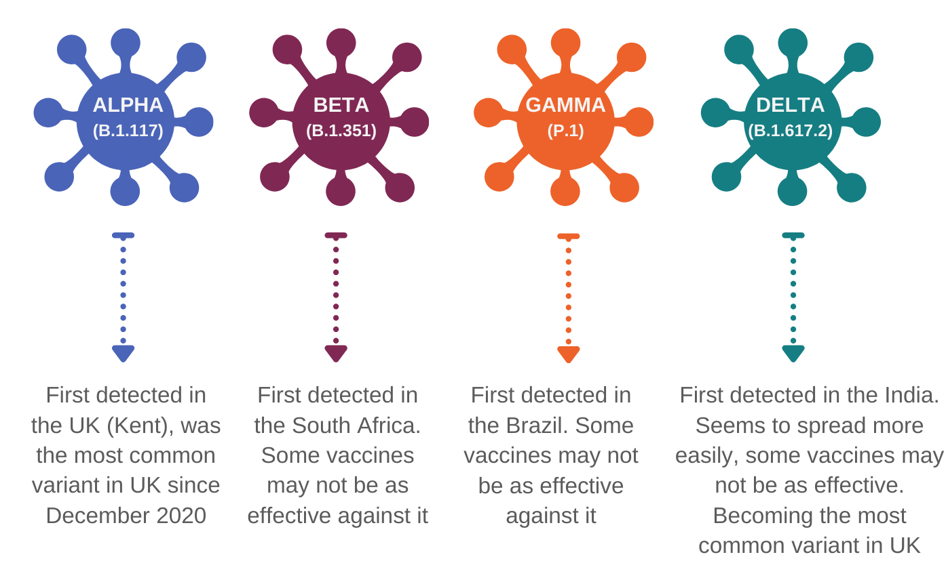
Variants of Concern
These are variants where mutations have given the virus an advantage. There have been a number of them discovered over the past year. They are being named by letters in the Greek alphabet, so no stigma is attached to a place.
Notes:
The Kent variant– now called the Alpha strain – was the first serious “variant of concern”
that changed the maths of fighting the pandemic. Researchers at UCL have possibly identified why in a working paper: they exposed lung tissue cells to the virus, and found that – compared to the garden-variety virus – the cells seemed to make little interferon, a protein that triggers a series of defence responses.
Their theory is that the Alpha variant creates a protein that blocks the interferon production. This only creates a temporary lull – but enough to allow the virus to get a head-start. This will mean, among other things, that patients are more pathogen-laden before they show symptoms, allowing them to be much more virus-laden when the coughing and spluttering starts.
Their research suggests that Delta, too, suppresses the interferon production mechanism – although not through the same mechanism. This is all preliminary research, but it may offer a clue as to why the variant is so potent. The UK has had weeks of growth in Delta-driven case numbers: from 2,000 cases a day in early May to 5,700 now. Still low numbers – but growing.”
This really makes the case for why asymptomatic/pre-symptomatic testing is so important – it might be something of interest to the secondary school session??

Slide 5
So why is testing so important?
Knowing how these variants can occur shows us just how vital testing remains.
Being able to identify where cases are and break the spread of the virus is one of the most important things that we can all do and will help our communities stay safe and your school open.
Here are a few more reasons why testing is still important:
Not everyone will be vaccinated
People need 2 doses of the vaccine for it to be most effective, there is a gap between doses. So, people who have only had only one vaccine are not as well protected.
No vaccine is 100% effective, so some people who are vaccinated may still become ill
It may be some time until children and young people are vaccinated
Identifying and isolating infections in our communities to prevent spreading is as important as ever.
Weekly testing can help to identify infections in school and prevent it spreading. The more people who take part every week, the more chance we have of stopping the spread of new variants.
Notes:
WHO animation stopping the spread of variants https://youtu.be/01b-74ljqWc (40secs)

Slide 6
Why we need to stop the spread
Notes:
(38 secs)

Slide 7
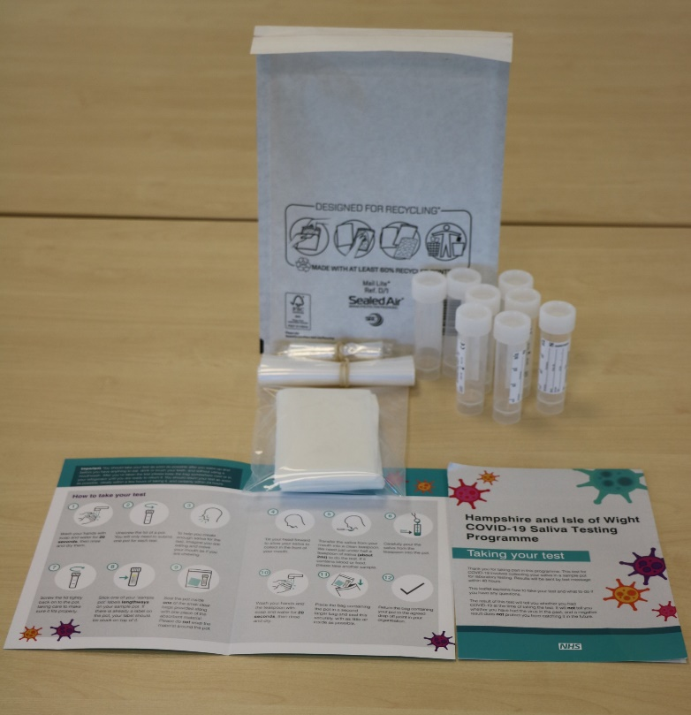
#BePartOfTheSolution
Please remember to do a test!
You are helping to stop the spread.
This work is funded by the Department of Health and Social Care and the National Institute for Health Research (NIHR). The views expressed are those of the authors and not necessarily those of the Department of Health and Social Care or NIHR.

