Slide 1
Feeling Cool
Objectives:
To understand how worries affect us.​
To use different coping techniques.​
To recognise our own resilience.

Slide 2
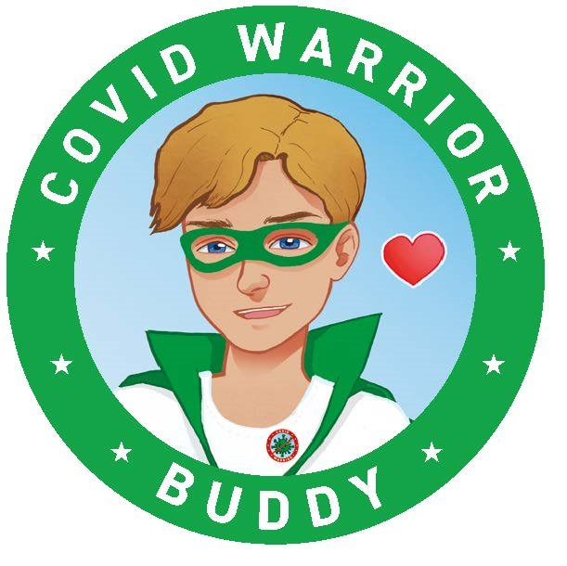
Video Introduction
Watch COVID-19 Warriors Video Introduction.

Slide 3
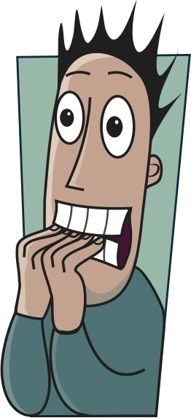
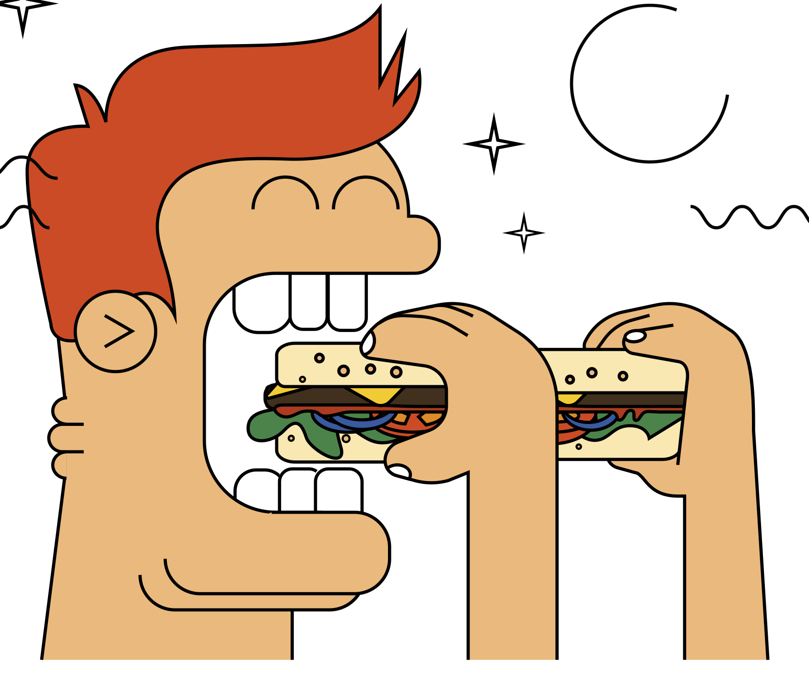
Main Activity
How we behave when we are worried
angry
scared
tired
bite nails
eat too much
shouty
feel sick
quiet

Slide 4
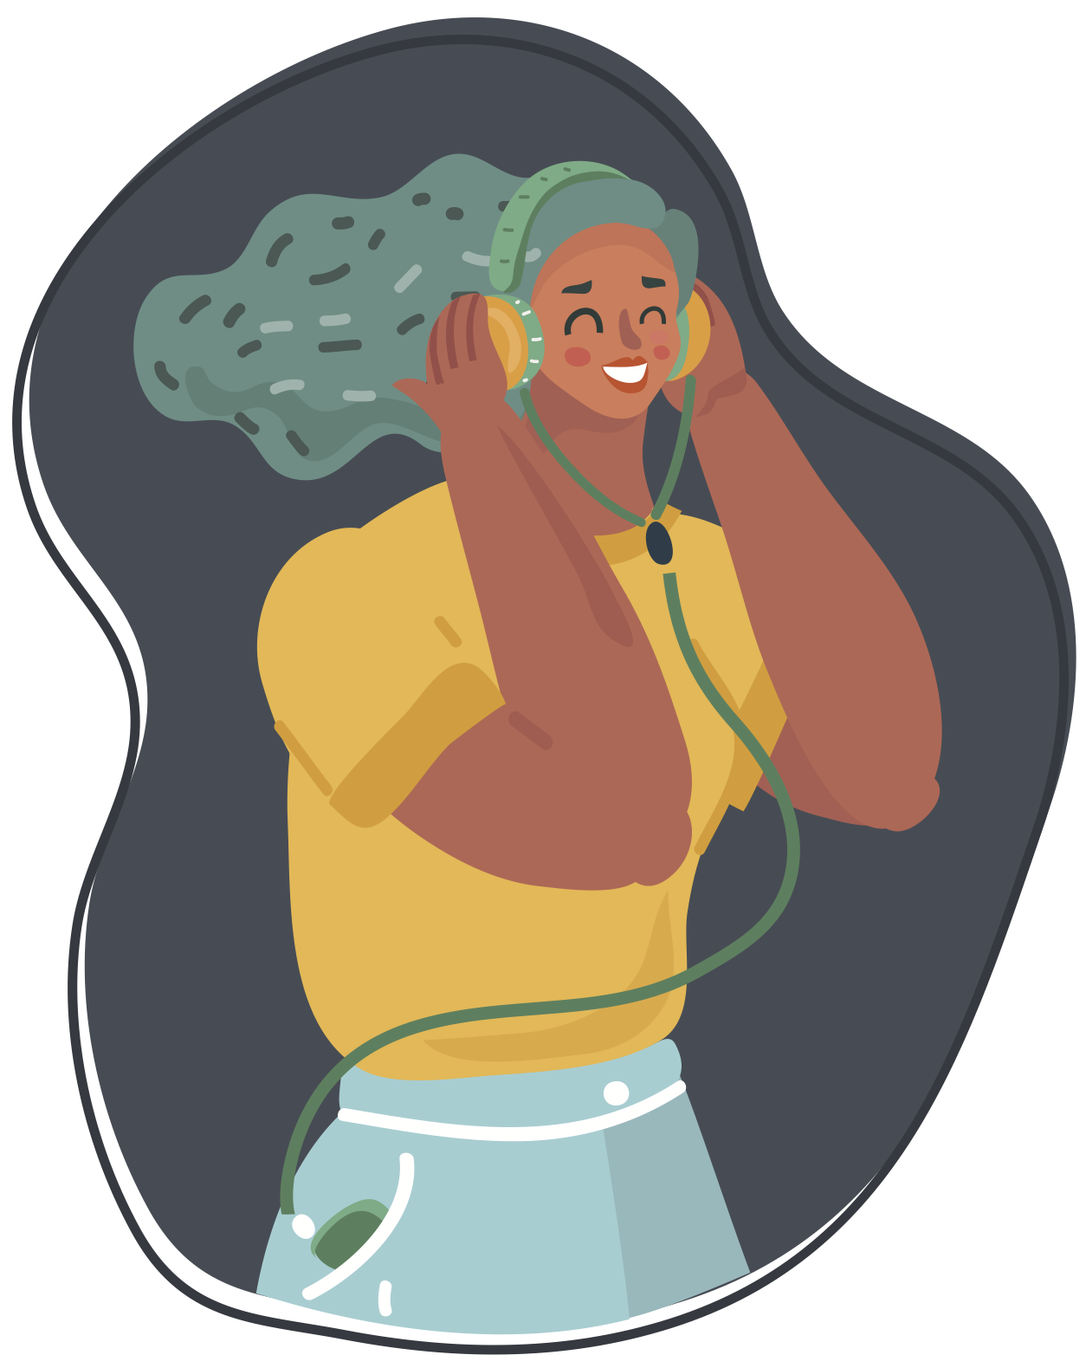
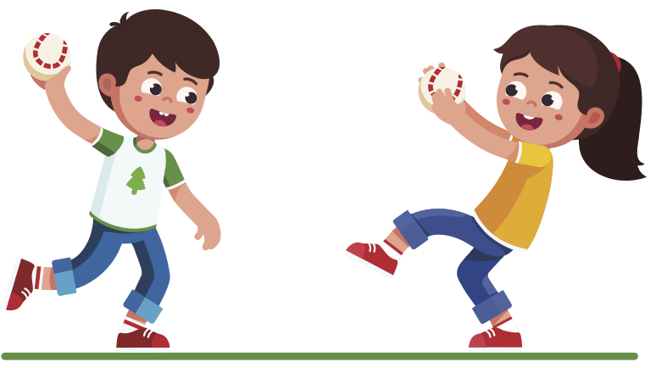
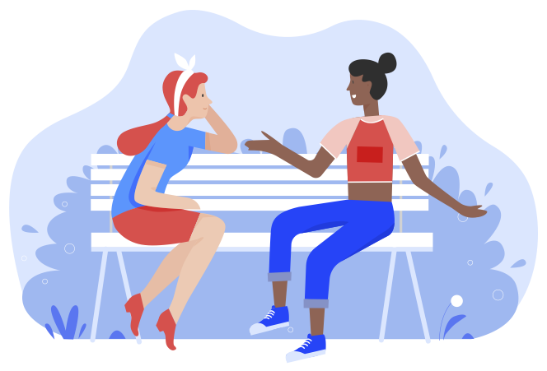
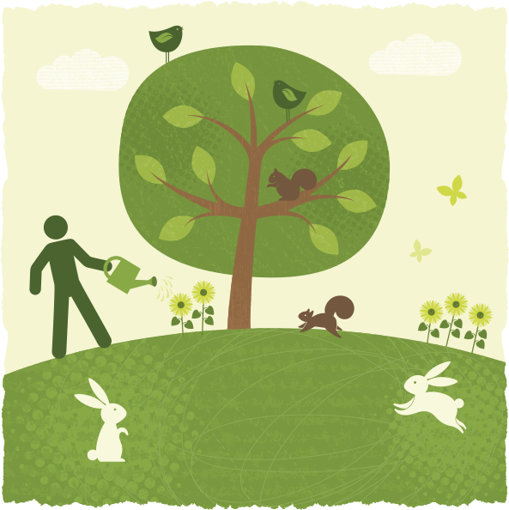
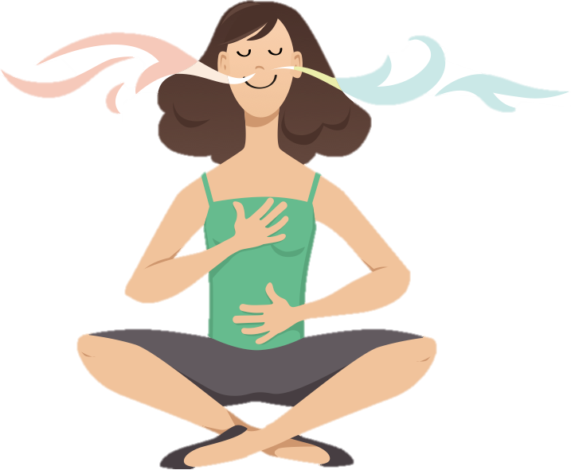
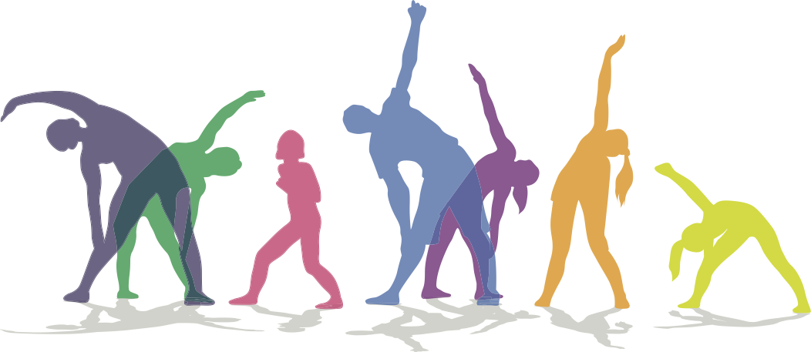
Main Activity
How to feel calm
talk to someone
throw & catch a ball
listen to music
breathe deeply
do yoga
smile

Slide 5
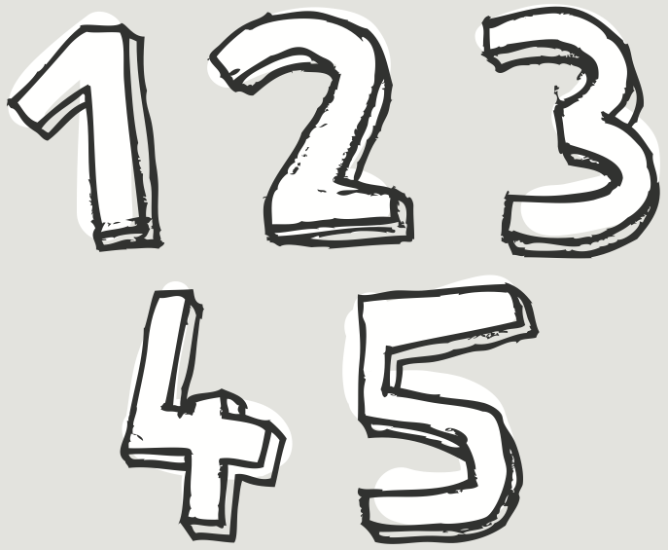
Breathing Exercises
Counting breaths
Focus on your breathing by counting the number of ‘in’ breaths and ‘out’ breaths. “I am breathing in 1, I am breathing out 1, I am breathing in 2, I am breathing out 2…”. Continue until you reach number 10.
Colour breathing
Sit or stand in a comfortable position. Close your eyes. Imagine your favourite colour, or a colour which helps you to feel calm. Now take a breath in and imagine that you are breathing in your colour. As you breathe out, imagine blowing a bubble made of your colour. You can repeat this for a few minutes and see if you can take longer, slower, deeper breaths (both in and out) and blow larger imaginary bubbles.
Slimy Hands
Imagine that you have a ball of slime in the palm of each hand. Squeeze the slime as hard as you can as you breathe in. Then breathe out and open your hands, imagining that the slime has spread across your hands. Repeat this a few times.
Birthday cake breathing
Sit in a chair and place your hands on your tummies. Make your left hand into a fist and imagine that this is a cake. Breathe in, pretending to smell the cake. Breathe out, pretending to blow out the candle. Continue this for a few minutes.

Slide 6
yoga
Tree Pose
Start in mountain pose.
Lift your left foot, turn the knee out and rest your foot on the inside of your leg below your right knee.
Press your hands together at your chest then lift them slowly up above your head.
Try to look up at your hands.
Bring your hands down and lower your foot to the ground.
Repeat with your right foot.
Mountain Pose
Stand tall and balance your weight on both feet.
Make your thighs firm and pull your tummy in and up.
Push your shoulders back and hold your arms straight near your sides.
Breathe deeply and hold the pose for at least two long breaths.
Downward-facing Dog
Start on your hands and knees with toes tucked under.
Breathe out, straighten your legs and lift your hips up to the sky.
Let your head hang down and breathe.
To release, breathe out and bring your knees back down.
Child’s Pose
Kneel down with your toes out behind you.
Stretch your arms on the floor in front.
Try to put your forehead on the floor.
Relax and breathe.

Slide 7
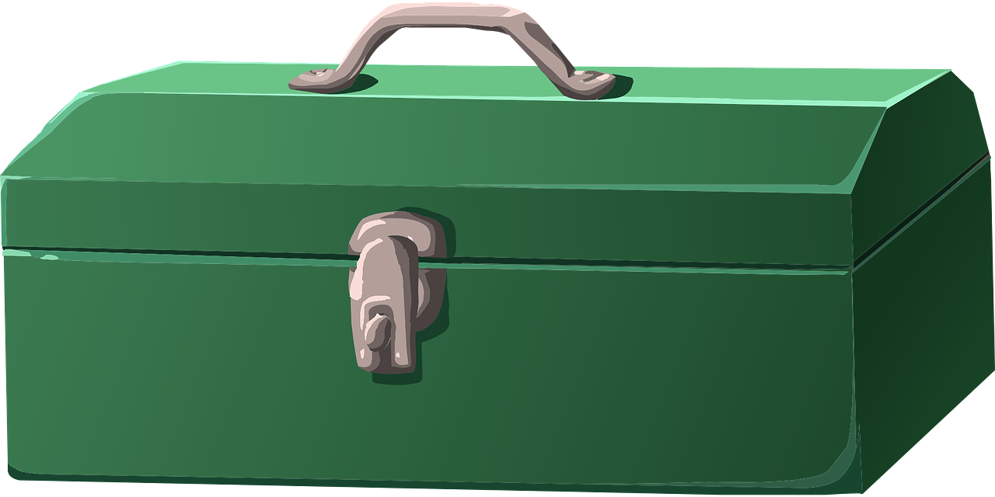
COVID-19 Coping Toolbox
Online learning skills
Imagination
Independence
Resilience
Caring for others
Dealing with change and uncertainty

Slide 8
Buddy says…. “Breathe deeply and remember how many amazing skills you have!”

Slide 9
Extension Activities
Have a go at trying to do something relaxing everyday:
​https://www.mentallyhealthyschools.org.uk/media/2026/mindfulness-calendar-daily-5-minute-activities.pdf
Have a go at these calming activity ideas: https://www.childline.org.uk/toolbox/calm-zone/

Slide 10
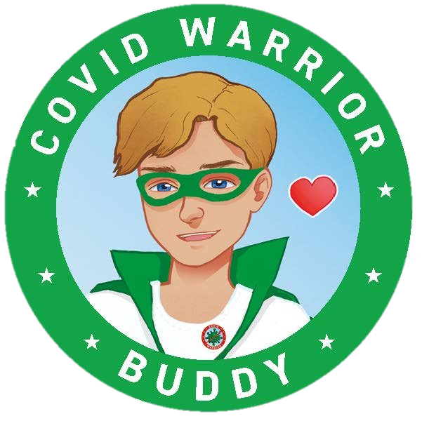
Bye,
see you soon!

