Slide 1
Introduction to research methods (and what can I do from my desk?)

Slide 2
What do we mean by ‘research methods’?
Research methods are the different techniques or strategies we use to collect information.
There are LOTS of different ones!
Why do we need so many different methods?
An infinite number of research topics so we need a variety of data collection methods.
Different methods allow researchers to collect a wider range of data.
Different methods mean that research is more likely to be accessible to different audiences.

Slide 3
Can you think of any examples of research methods?
Looking at photos or videos
Interviewing people
Giving people questionnaires to complete
Observation tasks
Carrying out a survey
Internet research
Story completion
Reading books or scientific papers
Using a case study
Action research (research and action to solve a problem at the same time)
Using focus groups to find out information

Slide 4
Key terms we need to know
Primary data
Qualitative data
Secondary data
Quantitative data

Slide 5
Key terms we need to know
Primary research – you collect the data yourself so it’s called primary data
Secondary research – someone else has collected the data eg maps, census data, anything you read in a scientific paper or book – these are all secondary data
Quantitative data – anything you can show in numbers eg. the percentage of students who vape, the number of children who cycle to primary school, the average height of an 11 year old …
Qualitative data – non-numerical data eg the words that people say in interviews, people’s opinions, photos, videos …
More about all these key terms next session …

Slide 6
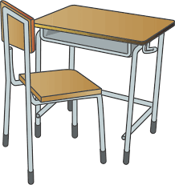
Desk research – what is it?

Slide 7
Desk research – what is it?
Desk research involves looking at data or information collected by someone else. It is secondary data as you are looking for information that someone else’s primary data.
Desk research means you can make a summary and put together existing research or information about your topic or theme.
You can then use it to learn more – desk research might help you decide what data you want to collect.

Slide 8
What is your favourite type of cake?!
FIRST, write down on a piece of paper which type of cake you think is best!
SECOND, let’s work out our results. We have just collected some primary data to answer the research question – What is the favourite cake of this group of students?
THIRD, let’s do some quick desk research and see if we can find out what the world’s favourite type of cake is. Use your phone and see what you can find out in three minutes! Once you have some answers, keep the web page open and note the source/website/author/name of article.

Slide 9
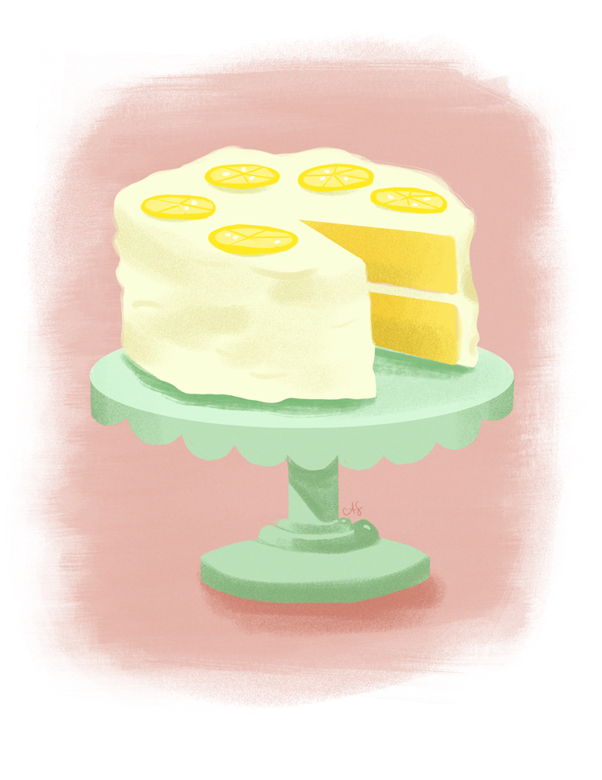
Sharing ideas about cake!
Which type of cake did you find is the world’s favourite cake?
Where did you find the information? Which website? Who is the author of the web page or article?
Discuss whether this research is reliable. Are the answers we have found based on any real research or are they just opinions of those writing the articles?
How do we know if they are based on research?

Slide 10
Finding reliable results – academic databases
Don’t go through millions upon millions of findings that you can’t fully trust!
Ideally, use a database specifically for research, for example, Google Scholar, Scopus or Embase (Scopus and Embase are focused on medical / biomedical research).
These databases will give you more reliable findings but may not be open to everyone.
Let’s look at the best ways of finding reliable information, whichever search engine or database you are using.

Slide 11
Finding reliable results – possible sources
Internet searches
Libraries
and books
(may be online)
Newspapers or news outlets
eg. the BBC
Surveys
eg. The Census

Slide 12
Stage 1 of desk research – what’s the question?
FIRST you need to have your research question ready, so you know what you want to find out.
For example, “How does smoking affect your chance of developing dementia?”

Slide 13
Stage 2 of desk research – keywords / phrases
SECOND, you need to break down your question or topic into keywords.
For example, with our question “How does smoking affect your chance of developing dementia?”, can you pick out the key words or phrases from that question?
“smoking” “dementia”
“affect” “developing”
Notes:
Get students to write down key words / phrases taken out of the question

Slide 14
Stage 2 of desk research – synonyms & plurals
NEXT, you can create synonyms for your keywords and phrases, and also think about plurals and singulars of the words.
“smoking” “dementia” “affect” “developing”
Add more words and plurals to your list:
dementia + Alzheimer’s, senile dementia
smoking + smoker, smokers
affect + affects, influence, influences, cause, causes
developing + develop, causing to grow,
Notes:
Ask for contributions before revealing the bullet points

Slide 15
Stage 3 of desk research – codes to add detail
THIRDLY, there are codes you help get even more detailed results:
Truncation: Words with similar meanings and the same beginning can be searched for all at the same time. For example, instead of writing teen, teens, teenage, teenager, teenagers, you can use an asterisk and change it to teen*
Wild card: Spellings vary from one country to another, in particular from the UK to the USA, with words being very similar but not completely the same. If researching about cancer, the word ‘tumour’ in British English is spelled ‘tumor’ in American English. Use a question mark to solve this when you search, so you would write ‘tumo?r’
Phrases: Use ”” around keywords that are more than one word e.g. ”Climate change”
Boolean operators: Use these for searching several words or terms at the same time. You can use ‘AND’ to search a term alongside another, and ‘OR’ to search a term in comparison with another e.g., “smoking AND teen*” or “youngster OR teen*”

Slide 16
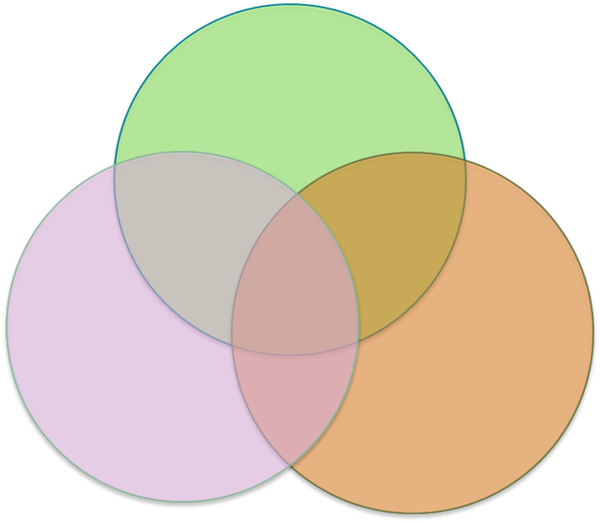
Using the Boolean operator 'AND'
Children
Use AND to find the research results with most relevance to your topic.
Physical activity
Socioeconomic status
The section in the middle will contain information relating to all three

Slide 17
Word to Word – desk research activity
Use the worksheet … you have 8 minutes this time!

Slide 18
Stage 4 of desk research – referencing
FINALLY, wherever you found some information, you must say where it came from by giving details about the writer/journalist/scientist who wrote the article or paper that you have read. This is called ‘citation’ or ‘referencing’, eg the Harvard Method is one way to standardise how you reference your sources.
Harvard Method -->
Author, Year. Title. [medium] Name of organisation / publisher. Volume / Issue. (Available at: <link> [accessed DD/MM/YYYY])
e.g.,
Russell, J, 2023. The implications of pasta shape and size on children between ages 4 and 8. [article] Oxford Press. Volume 94: 48-52

Slide 19
Stage 4 of desk research – referencing
There are different ways of referencing – you will need to know about these towards the end of your research, when you write your results up and will need to say where information gathered during your desk research came from.
Vancouver Method -->
.
Number of citation. Last name First Name Initial (et al). Title: Subtitle. Journal Name. Year. Volume / Issue: page numbers.
e.g.,
27. Russell J. The implications of pasta shape and size on children between ages 4 and 8. Oxford Press. 2023. Volume 94: 48-52

Slide 20
Independent tasks
The main task this week is to complete your own independent desk research!
Watch the ‘Desk research’ video made by young researchers.
Read through the information on how to make the most of your desk research.
Recap on the top tips you have heard today about searching effectively on the internet or on databases.
Write out your own list of keywords and phrases, using * and ? and “ “ and the Boolean operators.
Spend at least an hour finding as much information as possible, completing the table on the worksheet, or noting down information in whatever format you will find useful.
Complete an entry in your production log.

Slide 21
Knowledge check – in pairs/threes
1: What is primary research?
2: What is secondary research?
3. Is desk research primary or secondary?
4. Give an example of how you might use an asterisk in your desk research?
5. Which words are Boolean operators?
6. Name one reliable database you could use for your search.
Notes:
If there is time at the end of the session, carry out this quick knowledge check to reinforce learning during this session. Answers on the next slide.

Slide 22
Knowledge check – in pairs/threes
1: What is primary research? Research you do yourself
2: What is secondary research? Research that someone else has done
3. Is desk research primary or secondary? Secondary
4. Give an example of how you might use an asterisk in your desk research? To help search for several similar words eg. Teen* instead of teenage, teenager, teenagers, teens
5. Which words are Boolean operators? AND, OR
6. Name one reliable database you could use for your search. Google Scholar
Notes:
If there is time at the end of the session, carry out this quick knowledge check to reinforce learning during this session. Answers on the next slide.

