Slide 1
Me, My Health and My Children’s Health
Lesson 2: Health and Scientific Data

Slide 2
Objectives
At the end of this lesson, you should be able to:
Compare methods scientists use to study health in our communities
Describe the types of evidence different data sources can give us
Evaluate your own diet

Slide 3
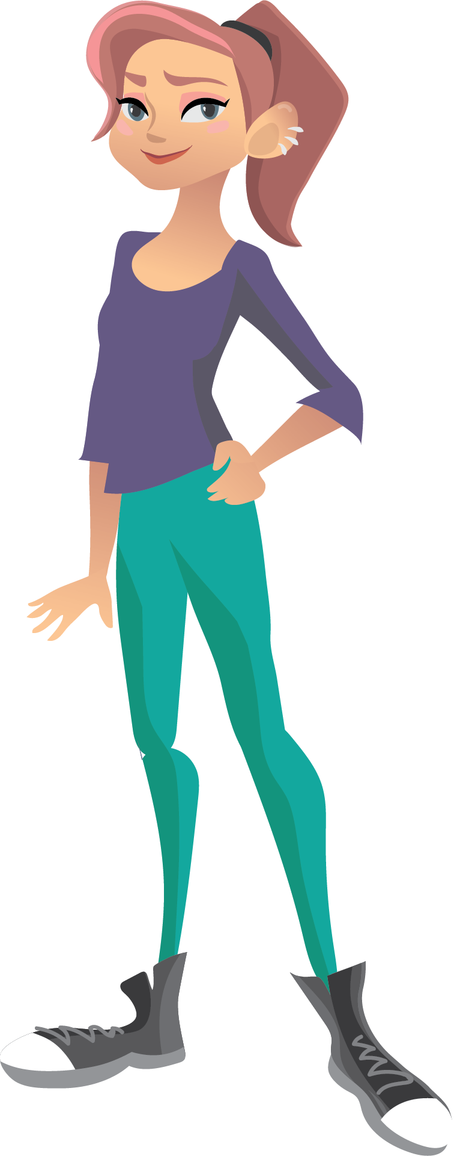
What are the different methods or sources which we could use to collect data about people's health?

Slide 4
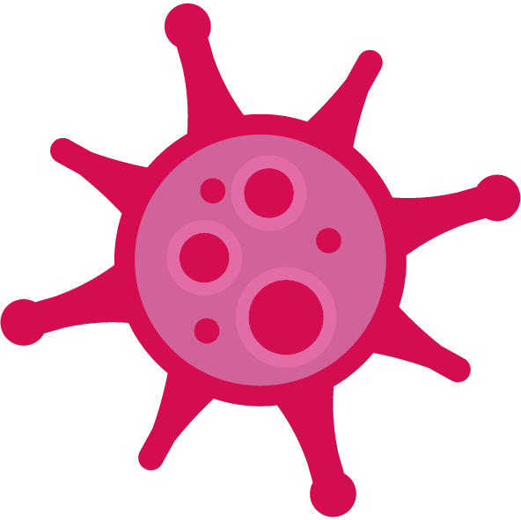
Comparing Scientific Research Studies
Activity 1
Look at the information from these two different studies which are both carrying out research on young people's health.
Notes:
Two Audio records available from TeC-19 focus group discussions
TeC-19in the news:
Research aims to support ‘lost and anxious’ young people during pandemic - University of Southampton – YouTube https://www.youtube.com/watch?v=sn_SRSVl2hs
Young people urged to 'find purpose' during lockdown to aid mental health | Meridian | ITV News First 2mins https://www.itv.com/news/meridian/2020-05-20/young-people-urged-to-find-purpose-during-lockdown-to-aid-mental-health

Slide 5
Comparing Scientific Research Studies
Activity 1
Compare and contrast the two research studies
^{What was the aim of the study?}
Who is taking part in the study?
^{How was the data collected?}
^{What data did they collect?}

Slide 6
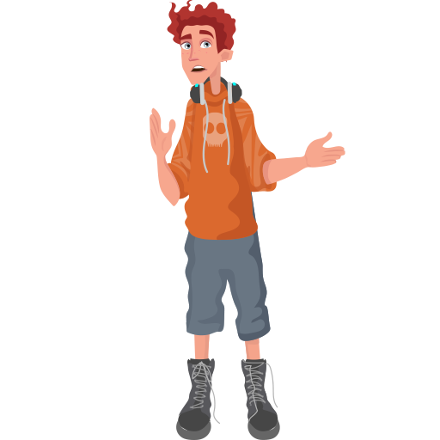
Activity 1
‘So what are the different methods used to collect information to measure health?'
 | ^{words or text} | ^{numbers}
Describe what type of information these sources give us?
^{Give some examples}
‘How does the different information help draw conclusions about health?’

Slide 7
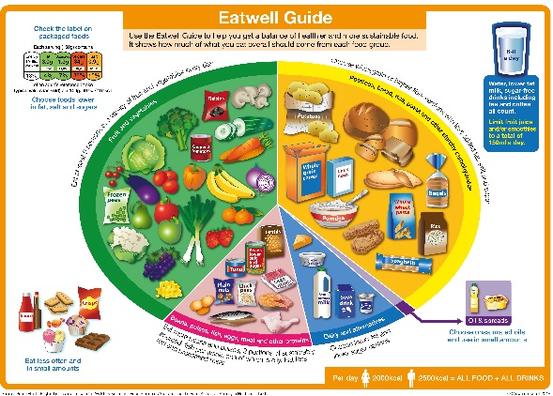
Activity 2
How can I eat well to support my health?
Using your food diary or fridge photo to input your data into the “My Eatwell Guide” Excel spreadsheet.
Evaluate your Eatwell Guide, how does it compare it to the official Eatwell Guide?
Suggest ways it could be improved.

Slide 9
Activity 3
How Healthy is my diet?
Compare your Eatwell Guide to the official Eatwell Guide
What are the similarities?
What are the differences?
What surprised you about your Eatwell Guide?
Describe how this pandemic has affected your diet?
How do you think you could improve your diet?

Slide 11
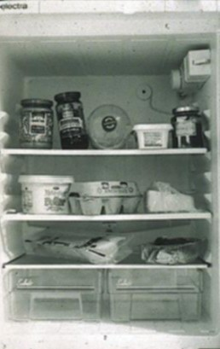
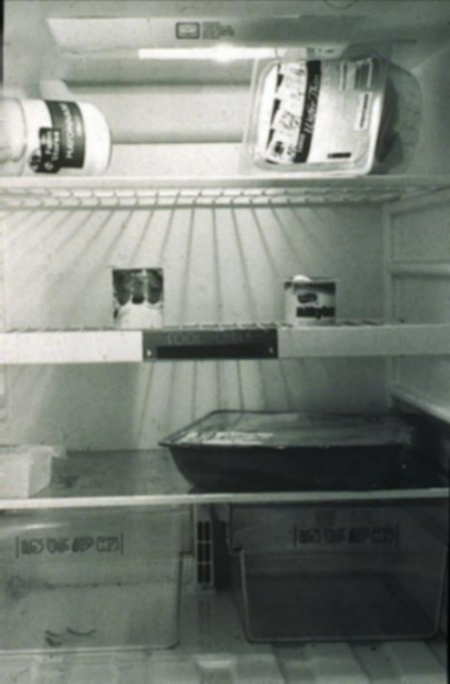
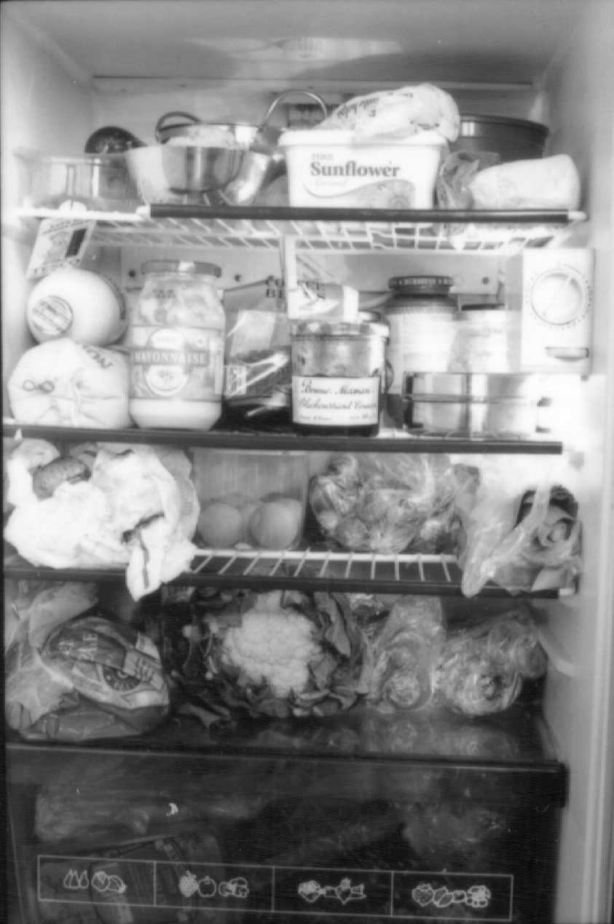
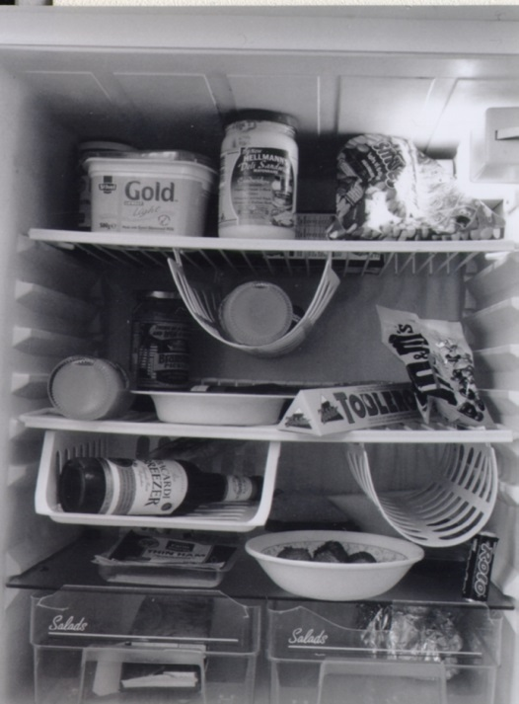
What's in your fridge?
These fridge pictures are from some of the women who took part in the Southampton Women’s Survey. The photos provide a snapshot for the scientists, collecting information on what the women ate.
Would it
represent all
the different
foods that you
eat? If not, why not?
What would a photo of your fridge reveal about your family’s eating habits?
How might it change during the week?

Slide 12
So thinking again about the question at the start of this lesson, what new ideas have you now of how we can collect health data ?
Activity 4
How can we collect health data?

Slide 13
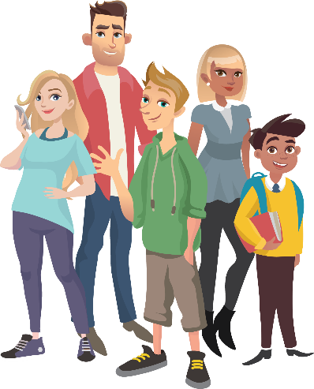
Homework task
Homework task
Questions you can discuss at home:
How healthy do you think your family diet is across a few days or a week?
How did the pandemic affect your family’s diet?
How well does it compare to the Eatwell Guide?
How do you and your family aim to eat your 5-a-day fruit and vegetables?
What differences could you suggest to improve your family’s diet?

Slide 14
Objectives
At the end of this lesson, you should be able to:
Compare methods scientists use to study health in our communities
Describe the types of evidence different data sources can give us
Evaluate your own diet

Slide 15
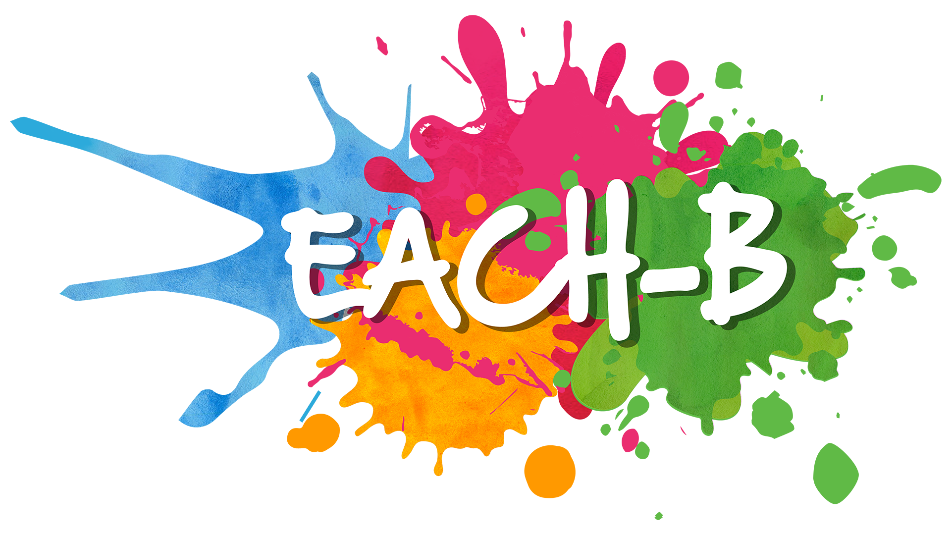
Reflection
What new things have you learnt today?
What skills have you used today?
What skills did you find difficult today?
What will you make sure you remember from today?
Notes:
Students refer back to the lesson objectives and complete the assessment for learning activity in the orange boxes, feedback and share an interesting fact they have found out from the lesson. Remind students about the EACH-B APP.

Slide 16
This work is funded by the Department of Health and Social Care (DHSC) and the National Institute for Health Research (NIHR). The views expressed are those of the authors and not necessarily those of DHSC or NIHR

