Slide 1
Feeling Cool
Objectives:
To recognise feelings of worry.​
To understand that worries are normal and that everybody has them.​
To recognise the effect of calming activities.

Slide 2
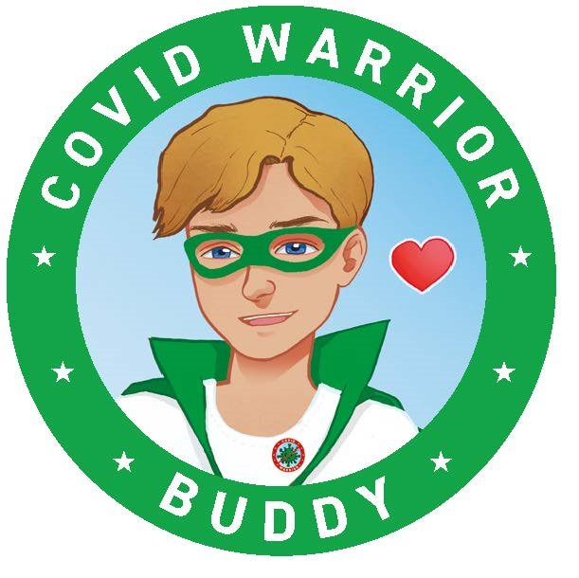
Video Introduction
Watch COVID-19 Warriors Video Introduction.

Slide 3
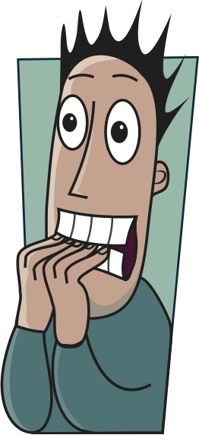
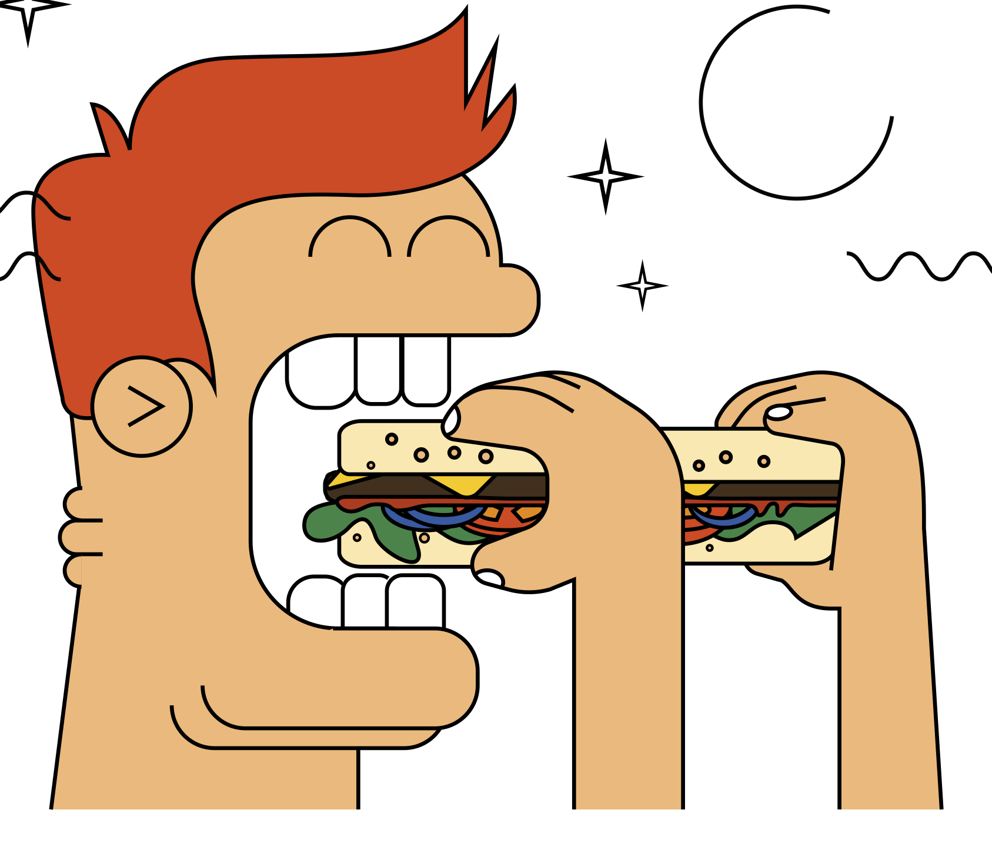
Main Activity
How we behave when we are worried
angry
scared
tired
bite nails
eat too much
shouty
feel sick
quiet

Slide 4
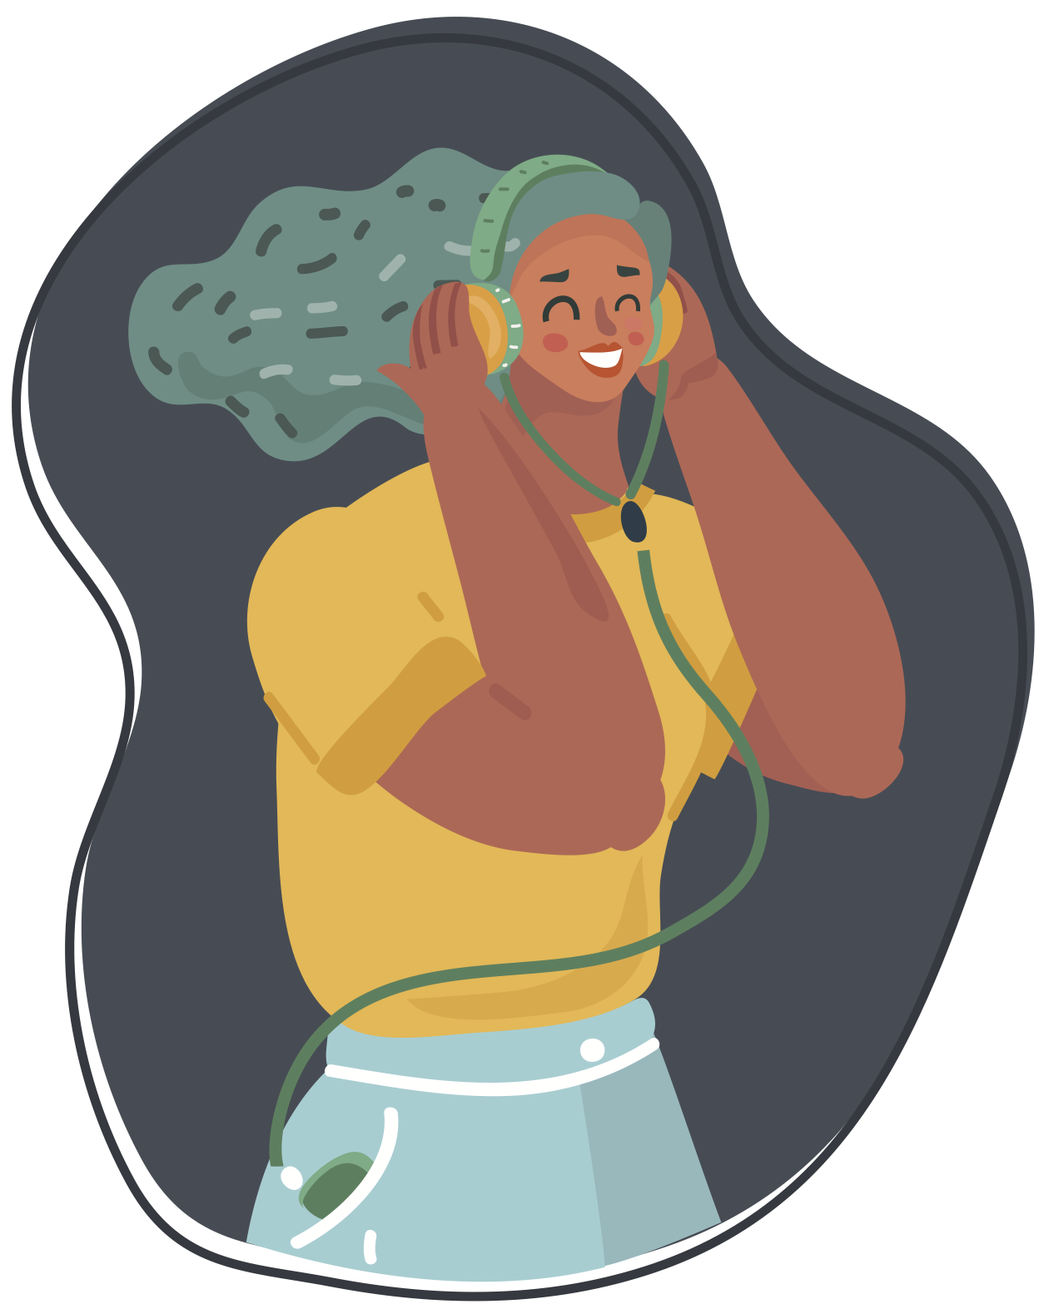
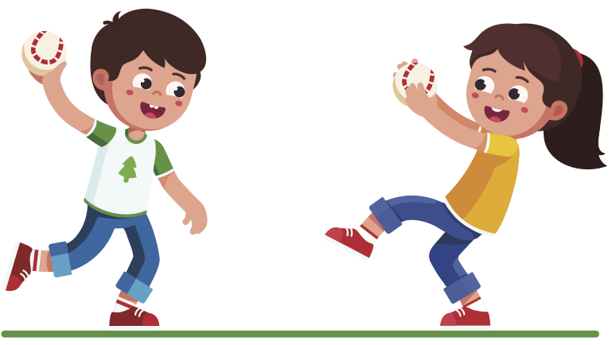
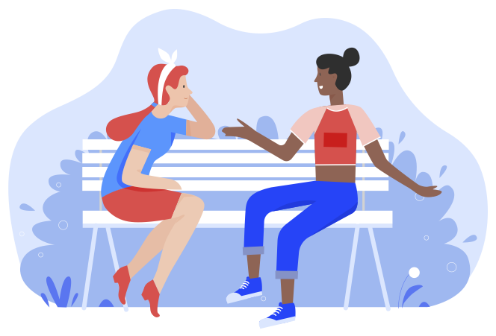
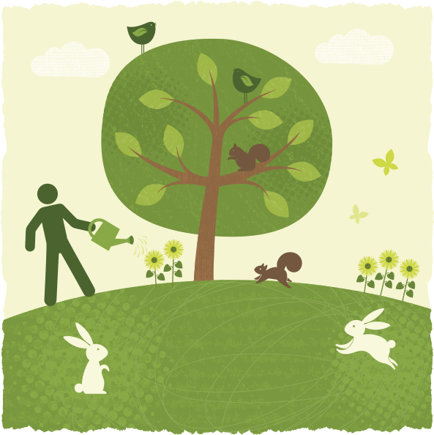
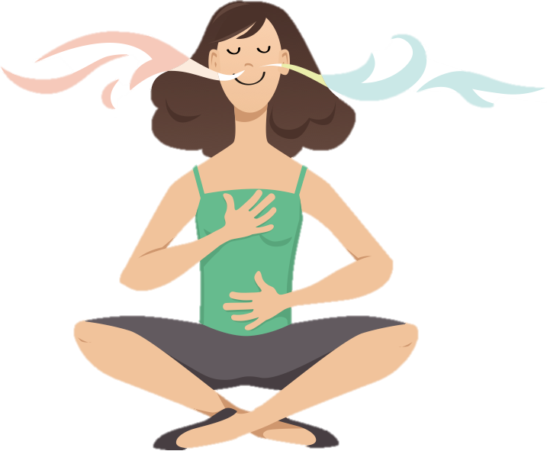
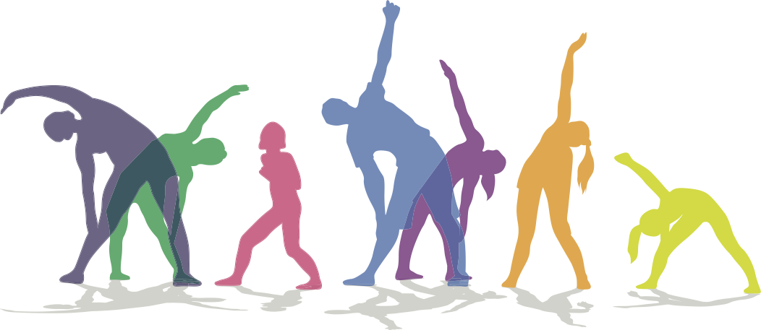
Main Activity
How to feel calm
talk to someone
throw & catch a ball
listen to music
breathe deeply
do yoga
smile
watch nature

Slide 6
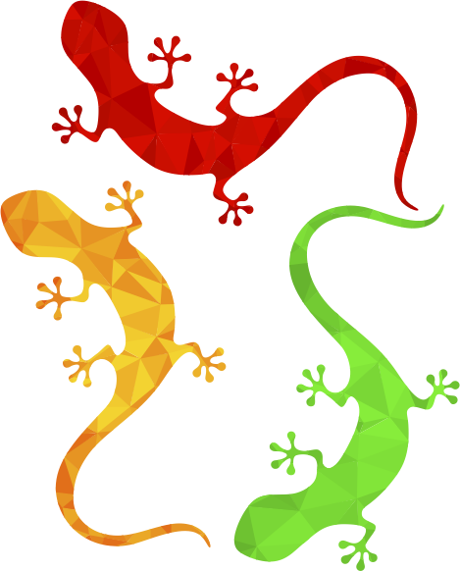
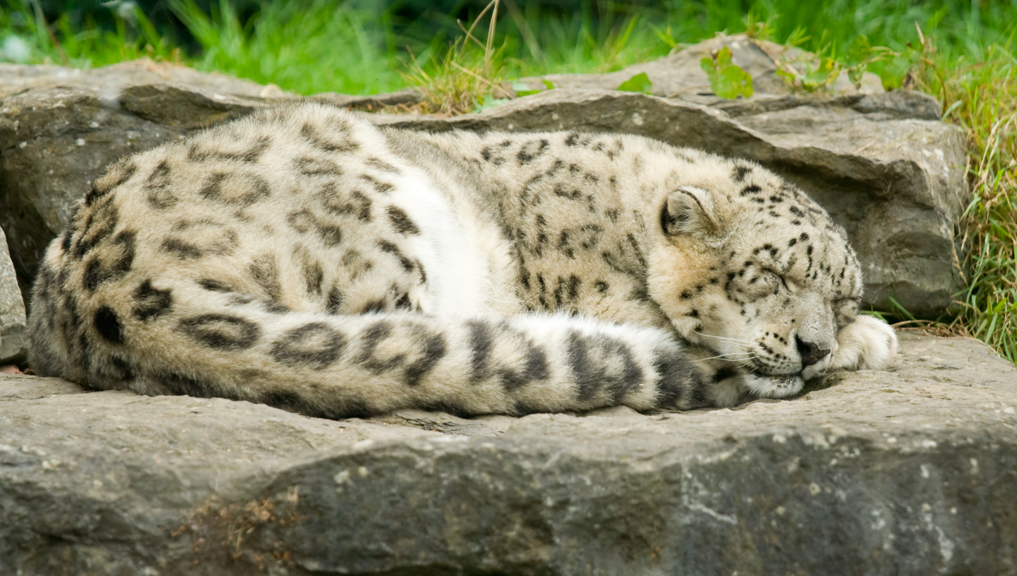
Now you are probably feeling a little more relaxed you can think about your body, making different parts tense and then relaxed. This will help you relax even more.
You are having a lovely dream about chasing lizards but you need to get your claws out so you can catch them. Pretend your hands are claws and make them as tense as you can, making them into a tight claw shape that is good for catching lizards. Keep them all tense, feel your hands getting tighter and tighter as you clench your muscles.
Then let your hands relax, the lizard has slipped away. Feel the tightness drain away as your hands get more and more relaxed.
Then you dream you see another lizard, so tense your hands up into claws again as you get ready to pounce on it. Feel all the muscles in your hands as they tighten into a claw shape. Clench them as tight as you can, and then let them relax again.
Feel all the tightness drain away from the muscles in your hands – let the lizard get away for today.

Slide 7
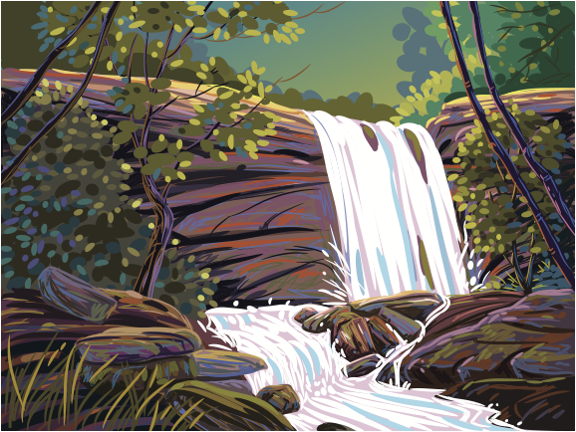
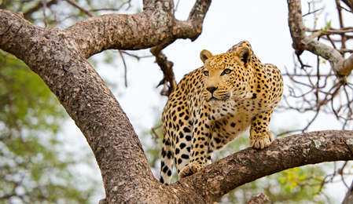
Stretch up with both your arms raised high above your head towards the birds in the sky overhead. Stretch as high as you can, feeling the tightness in the muscles of your arms.
Then let your arms flop to your sides, letting the muscles relax. Stretch up again, reaching up to the sky, then let your arms flop to your sides again.
Now the warm sun has risen high in the clear blue sky. It is shining on your face, and you are ever so slowly starting to wake up from your dream. You yawn and take a big stretch just like a leopard.
You are thirsty, luckily you are right next to a lovely clear stream. Raise your shoulders up and sink your head down into your neck to reach your face down towards the water for a drink. Tense your shoulders and make your neck feel all tight with the effort.
Now you can relax your shoulders and neck. Feel all the tightness drain away as you relax. But now you want another drink – so hunch your shoulders up and sink your head down into your neck. Feel the muscles in your neck and shoulders get all tense again. Then relax your shoulders and neck properly.

Slide 8
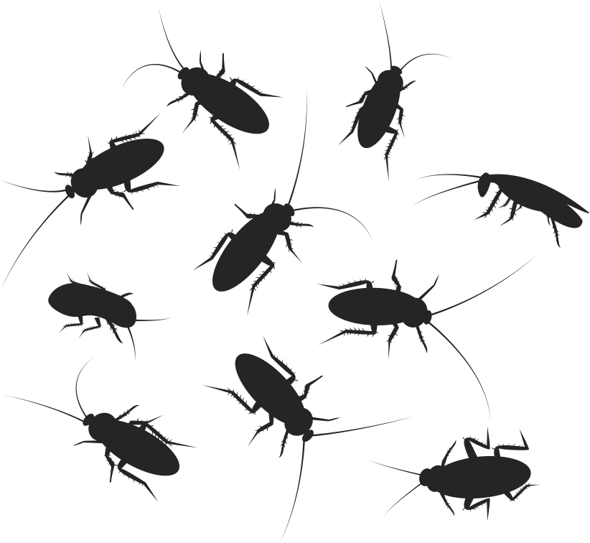
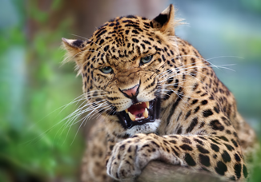
Now you have your breakfast. It’s a big bowl of crunchy beetles. Pretend you are biting and crunching the hard beetles. Clench your jaw as tight as you can as you crunch the beetles up. Feel the muscles in your face and neck get tighter and tighter the harder you clench your jaw. Then relax and have a rest – it’s hard work eating these beetles!
Now have another go – clench your jaw as tight as you can and imagine crunching the hard beetles into pieces. And then finally let your face and neck relax – letting all the muscles go soft and floppy.
Now you’ve had your breakfast you are ready to go off and do some exploring. Suddenly a buzzing bee lands right on your nose. You don’t want to swat him with your paw because he might sting you. You are going to have to wiggle him off.
Scrunch your face up as hard as you can and wiggle your nose. Feel your cheeks and your lips get tighter as you screw your face up. After a few seconds, the bee buzzes off. Phew, that was close!
Oh dear, he has come right back again and landed on your nose. Scrunch your face up again and wriggle your nose. Keep it scrunched up for a few seconds. Finally the bee buzzes off and goes to bother another leopard.
Now you can relax your face letting the muscles in your cheeks and lips feel nice and soft.

Slide 9
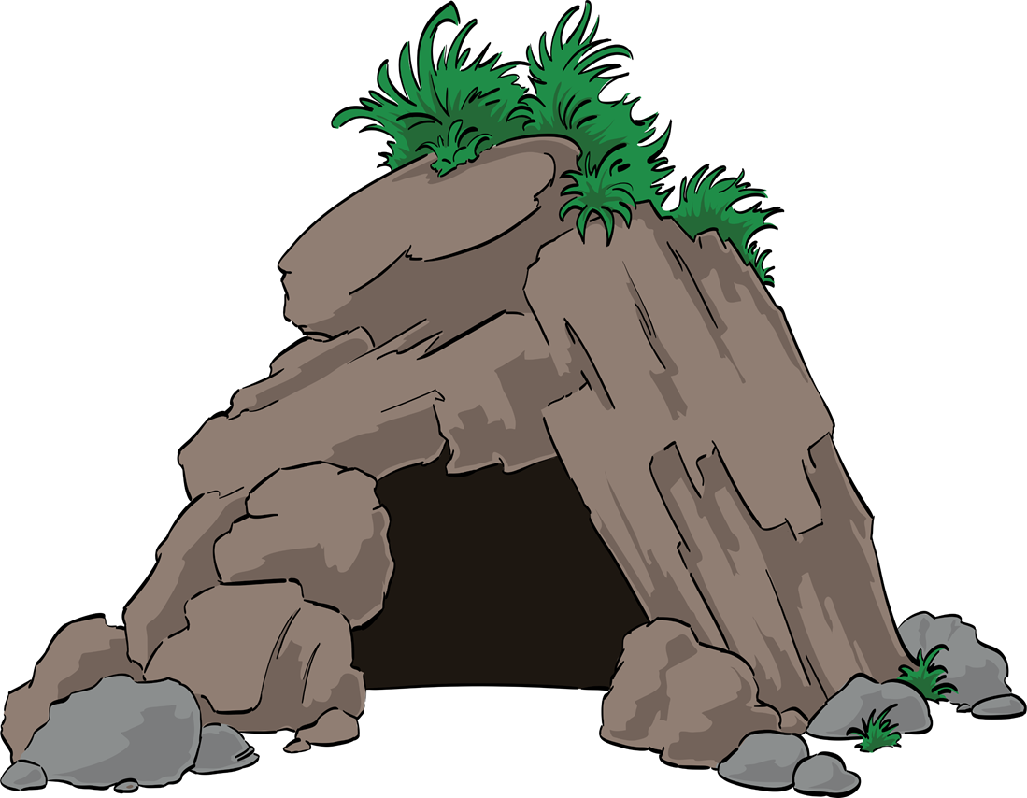
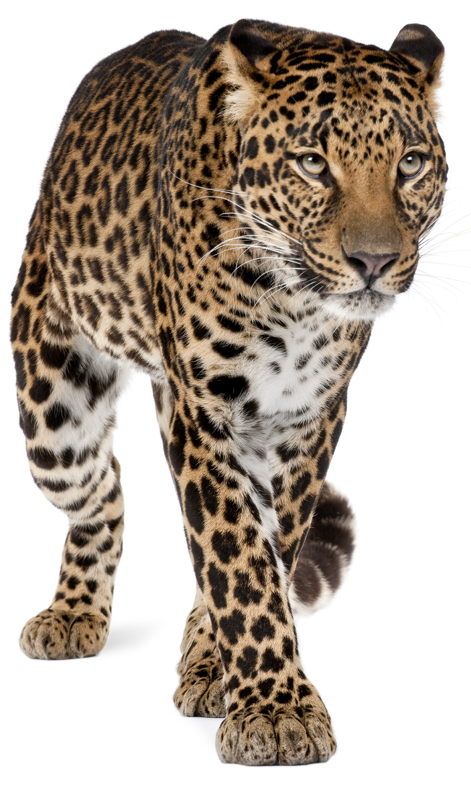
You see a cave nearby, walk over and push your head through. You try to get your tummy through but…oh dear….it is smaller than you thought. You have trouble squeezing through! Pull your tummy in as tight as you can, feeling the muscles get tighter and tighter as you squeeze it in. Squeeze yourself slowly into the cave keeping your tummy tight and flat all the way through.
Once you are inside you can relax your tummy again, letting all the muscles relax and go soft once more.
Walk through the cave and out the other side into a lovely forest. It’s lovely and peaceful in the forest. The only sound you can hear is the birds chirping quietly in the trees. You see a nice smooth rock in a clearing. The sun is shining brightly on this rock, making it really warm. You go over to the rock and decide you would like to have a little rest there.
First you need to flatten the grass around it down a bit. Get your left foot and press firmly into the ground, and then get your right foot and press firmly into the ground. Press as hard as you can into the floor; squash it down as much as you can with each foot. Feel the muscles tighten in your legs as you push down. Keep swapping feet and pushing down into the ground until you are happy that the grass in good and flat.

Slide 10
Now you can relax your legs and pretend that you are going to curl up on the lovely warm rock. The sun is shining on you. You feel all warm and cosy. You feel a little sleepy; why not just have a little snooze in the sunshine for a while?
You start to relax all your muscles – you have exercised a lot of them this morning. You’ve tensed your hands, your arms, your neck and shoulders, your face, your jaw, your tummy and your legs and feet.
As you lie in the sun feel all these parts of your body relax a little bit more. Listen to your breathing again as you start to relax even more. Take a long breath in through your nose and a long breath out through your mouth, a long breathe in through your nose and a long breath out through your mouth…in through your nose….and out through your mouth.
Breathe in slowly….and breathe out slowly, breathe in slowly…and breathe out slowly. Breathe in….and breathe out, breathe in….and breathe out. And with each breath out you feel more and more relaxed like a sleeping leopard just snoozing away in the sunshine.
Well done. Now you should be feeling really relaxed and comfortable. Now, when you are ready to, you can open your eyes and you will feel nice and calm and relaxed, feeling good and ready to carry on with your day.
Think about how you can use simple exercises to help you relax when you are feeling worried.

Slide 11
What have we learnt?
How can you help yourself to feel calm?
Who can you talk to if you are worried about something?

Slide 12
Buddy says…. “Breathe deeply and talk about your worries!”

Slide 13
Extension Activities
Have a go at Cosmic Yoga on YouTube​
Choose an animal and make up your own relaxing story.​
Have a go at these calming activity ideas: https://www.childline.org.uk/toolbox/calm-zone/

Slide 14
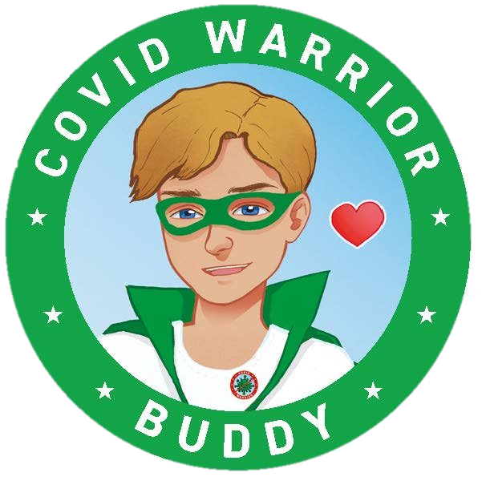
Bye,
see you soon!

