Slide 1
Worries
Objectives:
To understand that everyday things affect our feelings.
To understand that everyone has worries.
To express feelings & try to support others who express their feelings.
To use strategies to help themselves feel better.

Slide 2
Video Introduction
Watch COVID-19 Warriors
Video Introduction

Slide 3
Main Activity
Read the book “Ruby’s Worry”
Everyone has worries sometimes...
How does worry manifest itself in our bodies?
Think about how you might feel physically and emotionally...

Slide 4
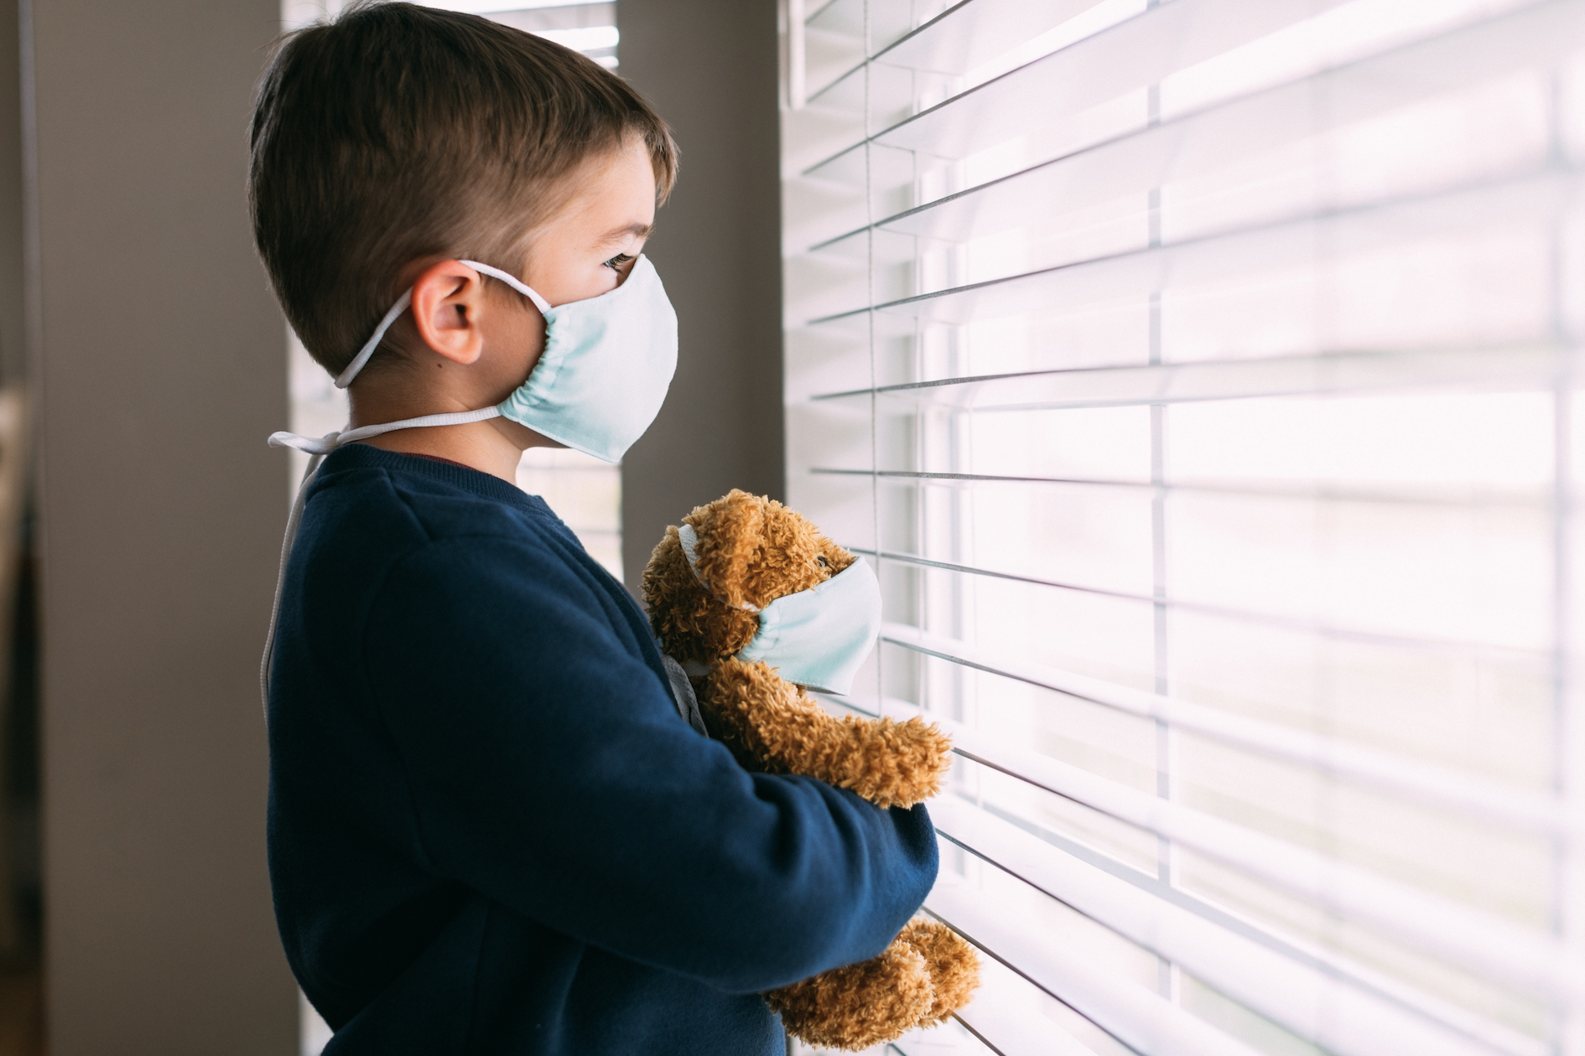
Main Activity
Coronavirus made many people worried…
Have you got worries about Coronavirus?
What can you do when you are feeling worried?
Draw your idea on a piece of card and share with your class.

Slide 5
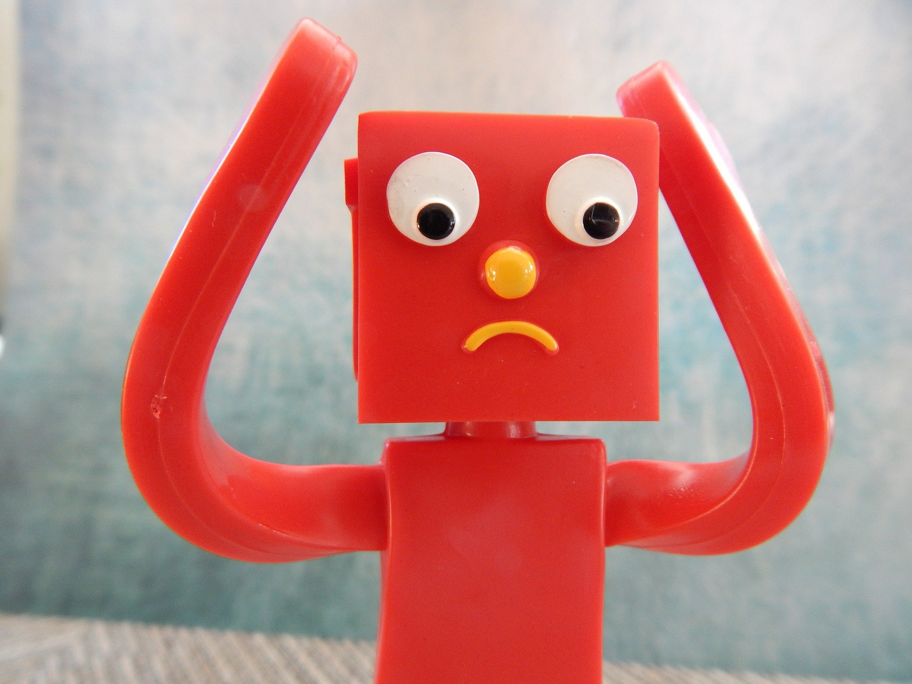
What have we learnt?
How do you know if someone might be feeling anxious or worried?
What new tools for dealing with worries have you learned about?

Slide 6
Don’t forget - it’s good to chat to someone if you are feeling worried, so don’t keep your worries to yourself!

Slide 7
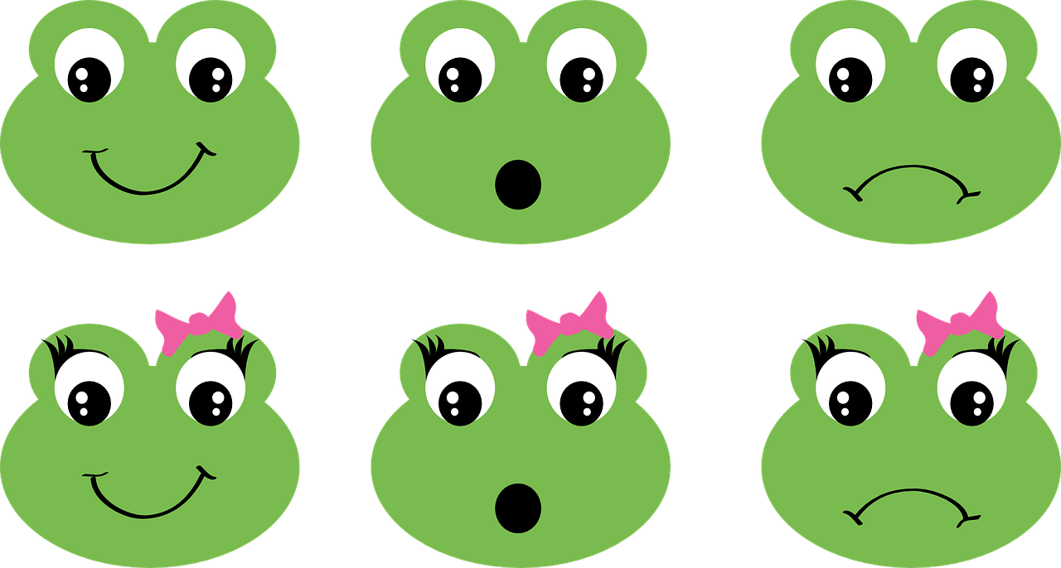
Extension Activities
Create a Class Worry box from an empty shoe box or tissue box.
Create a display board of
“Things we can do if we are feeling worried”
​
WORRY BOX

Slide 8
Bye,
see you soon!

