Slide 1
Coronavirus
The R number

Slide 2
How confident are you that you are fully aware of and understand the current Government guidelines?
How many in your class feel……..
Very confident, I know the current guidelines and understand them all
Confident, I know most of the current guidelines but I’m not sure I understand them all
Not Sure, I know some of the current guidelines but don’t really understand them
Not very confident, I only know a few of the current guidelines and don’t really understand them.
Not confident at all, I don’t know or understand any of the current guidelines.

Slide 3
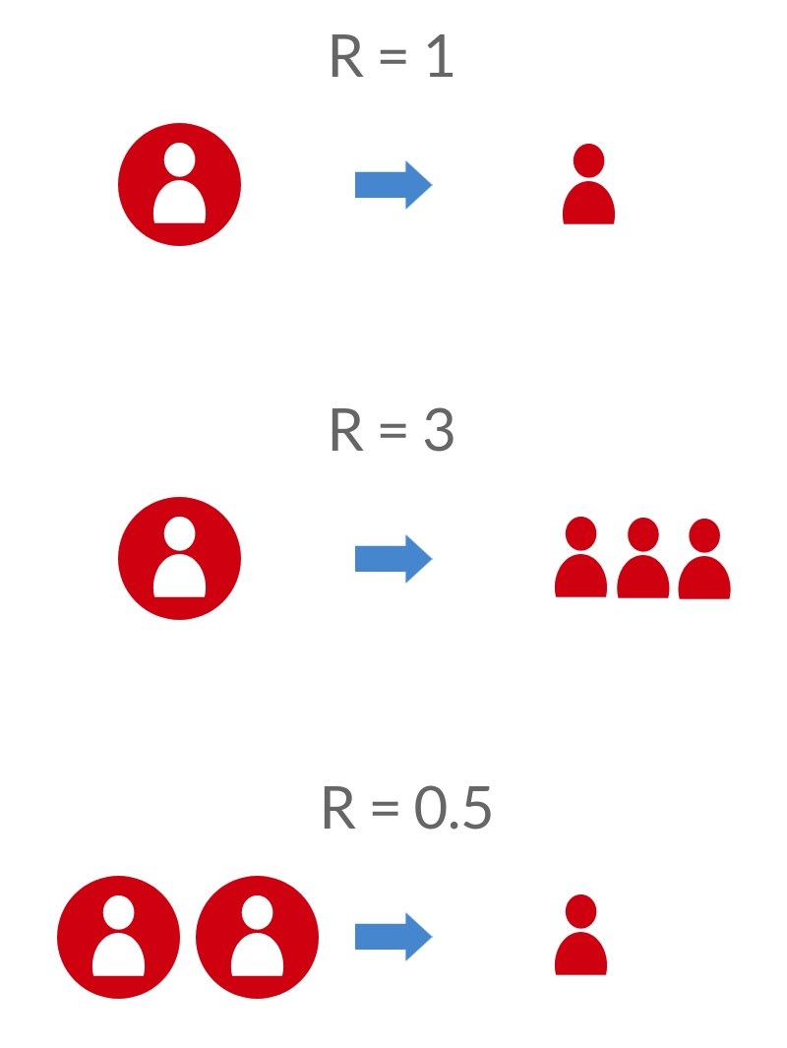
The 'R' number
Reproduction number (R) is the average number of people that one infected person will spread the disease to
R > 1 = epidemic is growing
R < 1 = epidemic is shrinking
The bigger R is, the more people are infected by each person with the virus and the faster the epidemic grows

Slide 4
How quickly the virus can spread in one month
NEW Infections
TOTAL Infections
If R0 = 2, then how many people will 1 person infect?
1x2 = 2
3
Typically, this will take 5 days
How many people will those 2 people go on to infect?
2x2 = 4
7
This is 10 days from 1st person being infected
How many people will those 4 people go on to infect?
4x2 = 8
15
This is 15 days from 1st person being infected
In 1 month (30 days), how many people could be infected from that first infection?
Day 1 1 1 Day 5 2 3
Day 10 4 7
Day 15 8 15
Day 20 16 31
Day 25 32 63
Day 30 64 127

Slide 5
This isn’t new Science!
Scientists have always used this terminology to describe viruses, most of us are only just hearing about it.
Check out this clip from the film Contagion in 2011, you may recognise some of the terms they are discussing!
https://www.youtube.com/watch?v=W3T988K2DR4&feature=youtu.be (2mins 24secs)

Slide 6
What is the current R number in the UK?
Discuss the options and select your response on the scale:
Up to date R number information can be found here: https://www.gov.uk/guidance/the-r-number-in-the-uk
It also gives a regional breakdown so you can see how our area compares with the UK
0
1
2
3
Notes:
Need to add scale

Slide 7
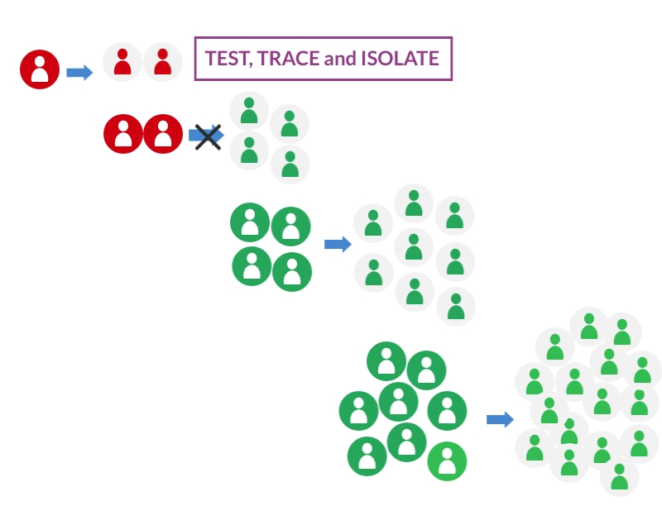
How we reduce the spread?
So if we test, trace and isolate, we can stop the virus spreading

Slide 8
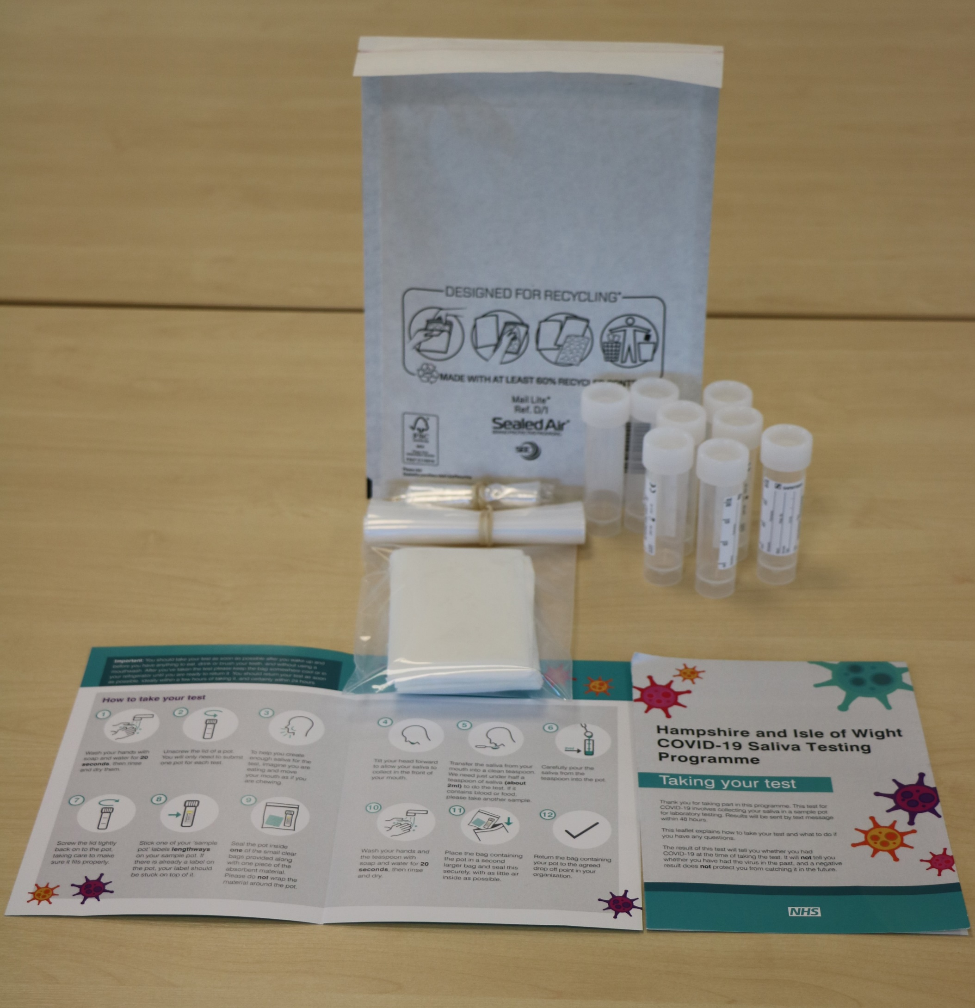
#BePartOfTheSolution
Please remember to do a test!
You are helping to stop the spread.
This work is funded by the Department of Health and Social Care and the National Institute for Health Research (NIHR). The views expressed are those of the authors and not necessarily those of the Department of Health and Social Care or NIHR.

Slide 9
Master slide: 1 custom design = with footer
Notes:
NB. Layout master slide: 2 custom design = without footer

