Slide 1
Coronavirus
Vaccine Hesitancy & Social Responsibility

Slide 2
Where do you stand on vaccines?
Why are some people undecided or choosing not to get vaccinated?
Watch the video to find out the reasons why.
https://www.bbc.co.uk/news/av/world-56198229 (2mins 36secs)

Slide 3
What could help people make a decision?
What do you need to make an informed decision?
Where would you get your advice from?

Slide 4
What should people consider when deciding on whether or not to get vaccinated?
The impact on them, the impact on others, or both?
Explain why.
Notes:
Where do you stand on current health issues? Activity 1: Set up a class line and have students position themselves along the line as to whether they agree or disagree with the statement on each slide. This opens the activity up to discussion in the classroom around the ideas. Students can be asked to justify their decision. ‘What is the reason for your position?’

Slide 5
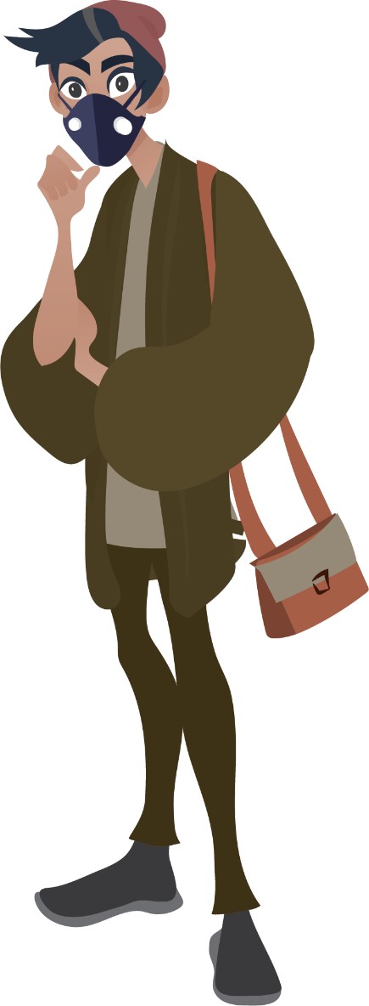
Vaccination side effects
What are the possible side effects of vaccination?
Watch the video to find out more:
https://www.youtube.com/watch?v=wG7c9KA8RMA (1mins 10secs)

Slide 6
Vaccination side effects facts
Not everyone will experience side effects
Of those that do 75% will only have very mild symptoms such as a heavy arm where they were vaccinated
Less than 5% will have a fever
Symptoms should settle within a week

Slide 7
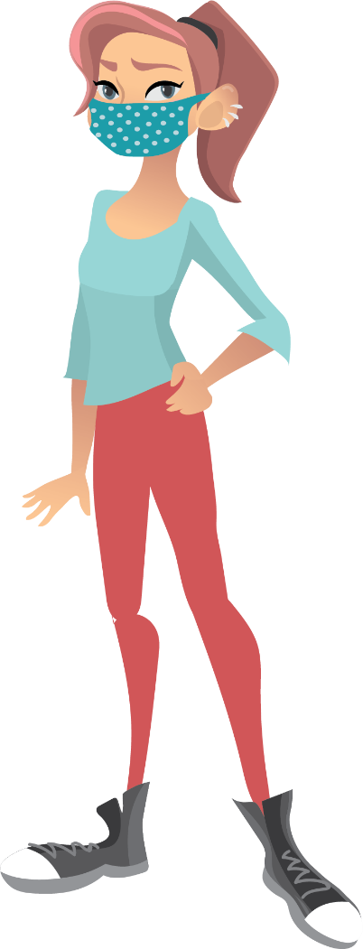
Long COVID
What is Long COVID?
What are the symptoms?
Who can suffer from Long COVID?
Watch the video to help you answer these questions.
https://www.youtube.com/watch?v=QPbdbC02Cco (2mins 31secs)

Slide 8
Long COVID facts
This is when people continue to suffer symptoms over a long period of time
Fatigue is one of the symptoms commonly experienced, but people also experience breathlessness, dizziness, aching, headaches and other COVID-19 symptoms
Anyone can suffer from Long COVID including children

Slide 9
‘The COVID-19 vaccine should be made compulsory for everyone’
Do you agree or disagree?
Why?

Slide 10
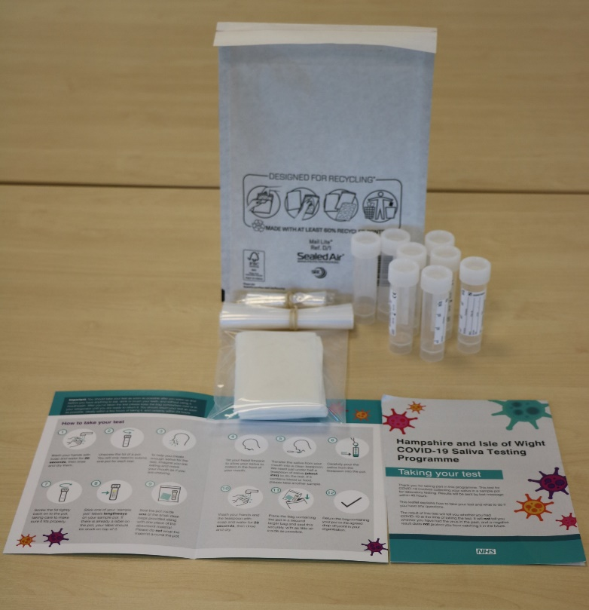
#BePartOfTheSolution
Please remember to do a test!
You are helping to stop the spread.
This work is funded by the Department of Health and Social Care and the National Institute for Health Research (NIHR). The views expressed are those of the authors and not necessarily those of the Department of Health and Social Care or NIHR.

Slide 11
Master slide: 1 custom design = with footer
Notes:
NB. Layout master slide: 2 custom design = without footer

