Slide 1
Coronavirus
The Journey of the Saliva

Slide 2
How will your saliva be tested?
Use the Prezi to find out what happens to your saliva sample when it arrives at the laboratory for testing
https://prezi.com/p/vsr9xzaw2gxc/the-journey-of-the-saliva/

Slide 3
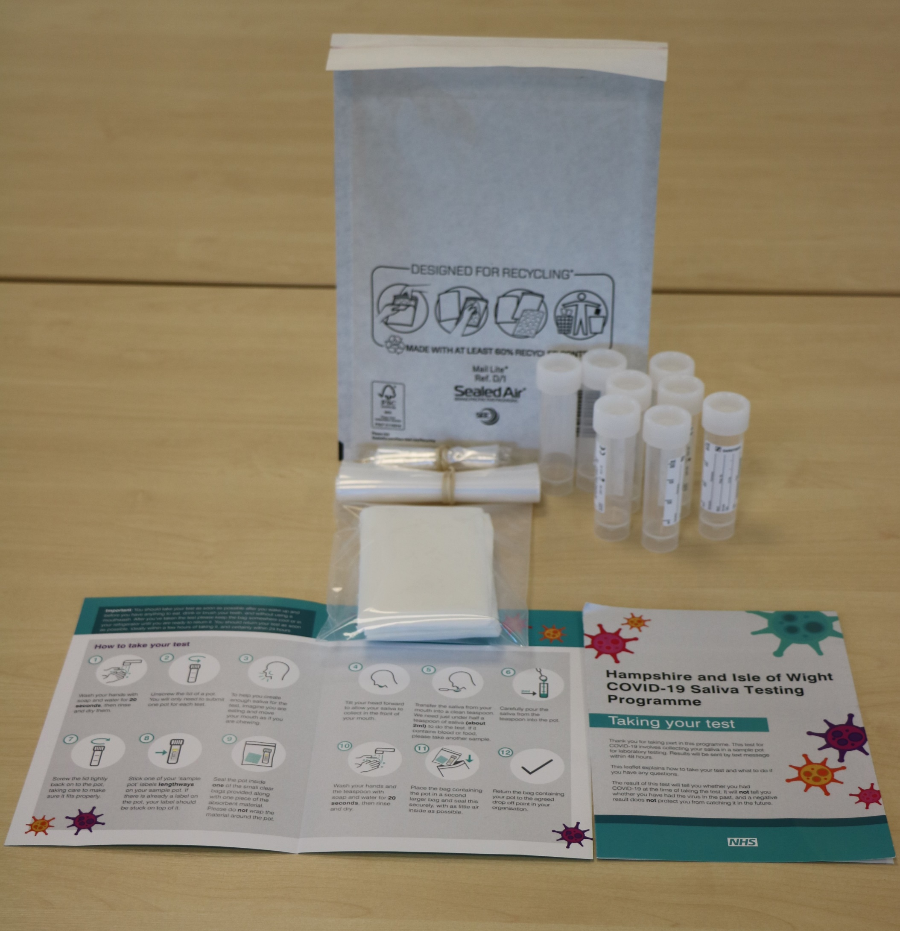
#BePartOfTheSolution
Please remember to do your saliva test!
You are helping to stop the spread.
This work is funded by the Department of Health and Social Care and the National Institute for Health Research (NIHR). The views expressed are those of the authors and not necessarily those of the Department of Health and Social Care or NIHR.

