Slide 1
Saliva testing
Objectives:
To recognise that our saliva can be used to detect Coronavirus
To describe in simple words the testing process
To order in the right sequence the steps followed during a saliva test
To talk about how transmission to others can be limited by identifying people who are infectious

Slide 2
Video Introduction
Watch COVID-19 Warriors Video Introduction.
(*Optional)
Watch a short clip about saliva testing
https://www.youtube.com/watch?v=DvVUqWR4qgw

Slide 3
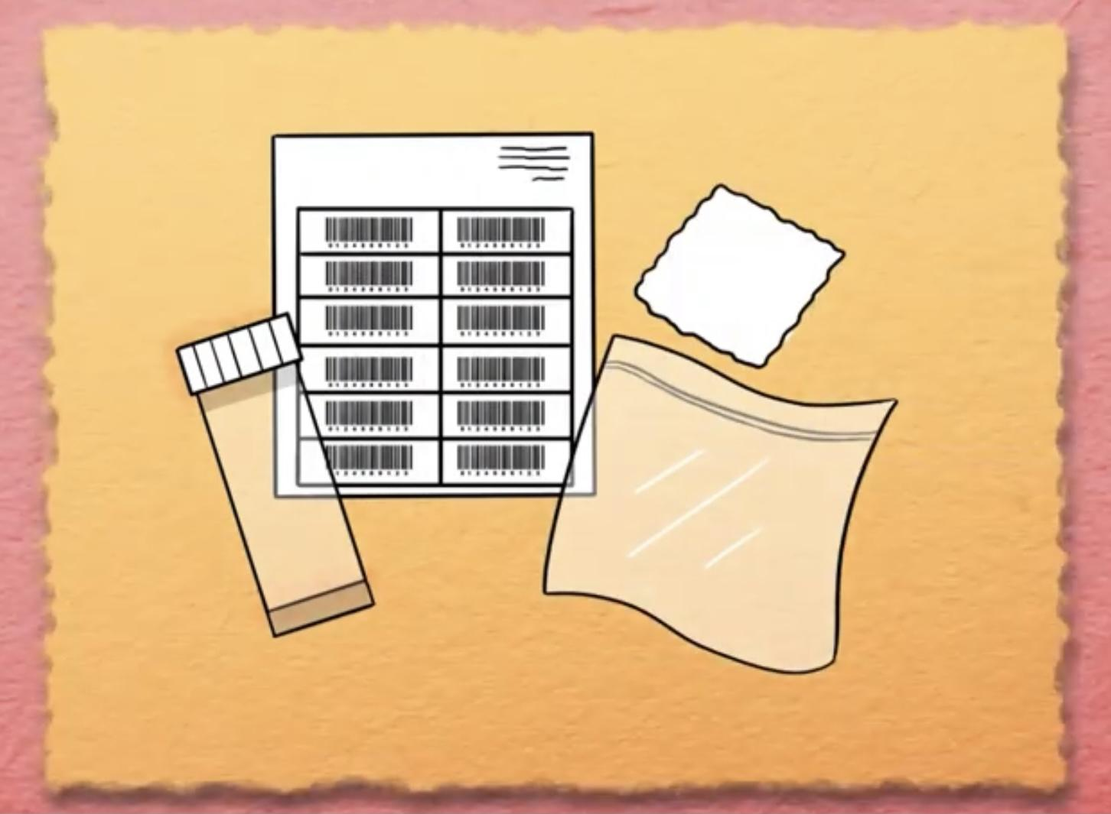
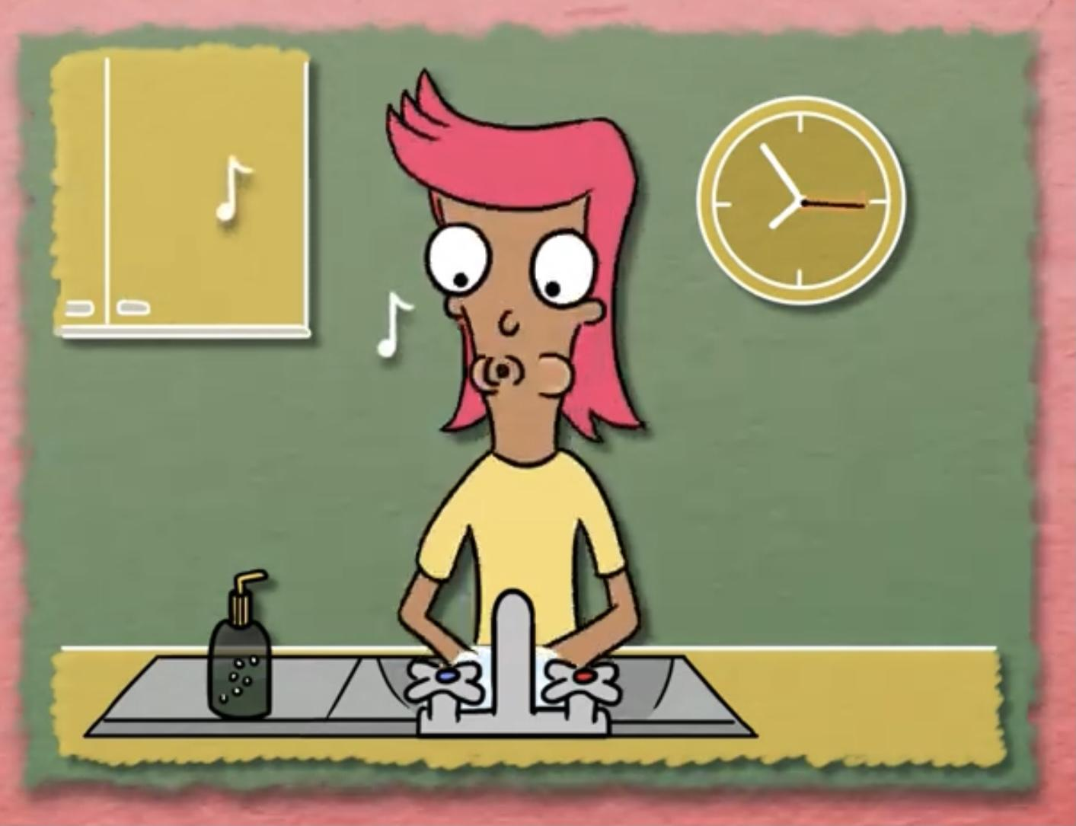
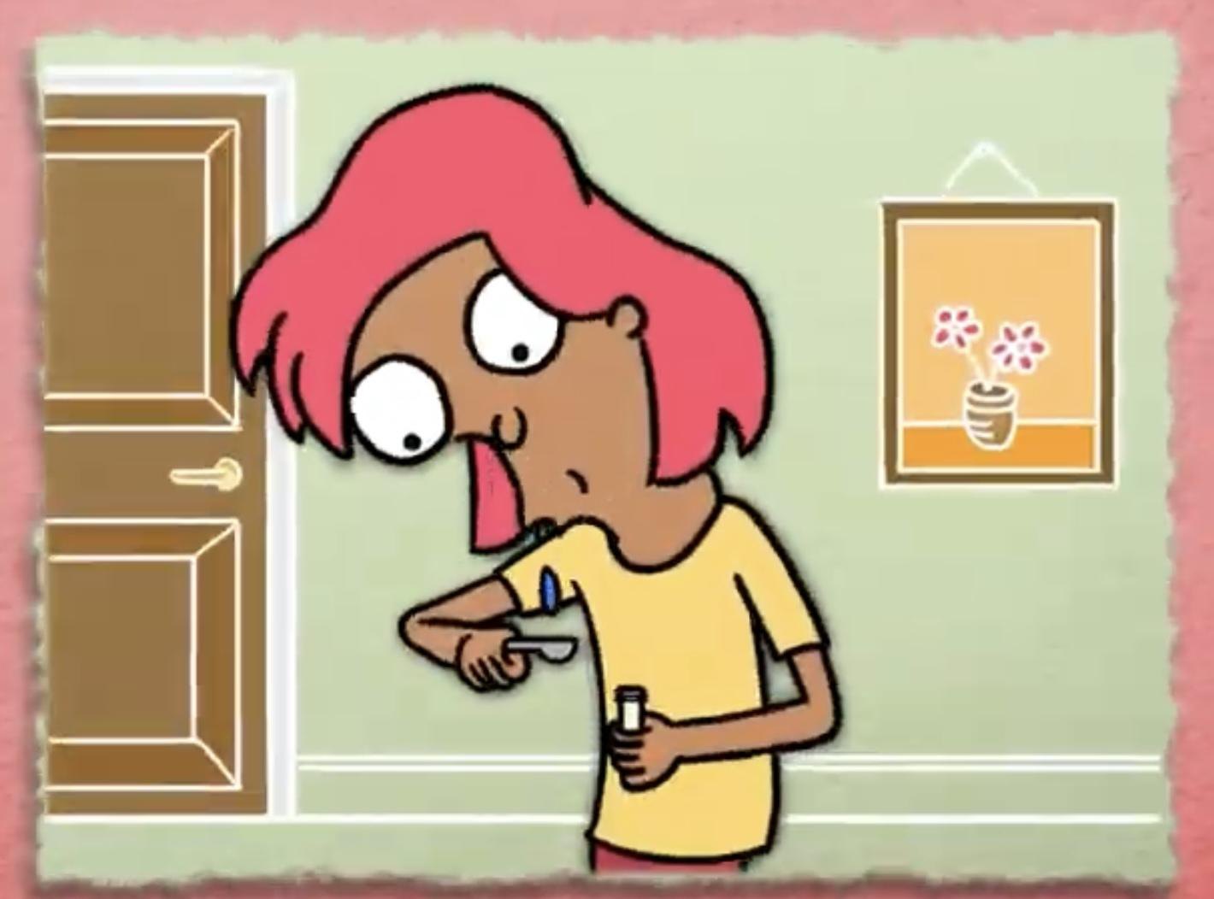
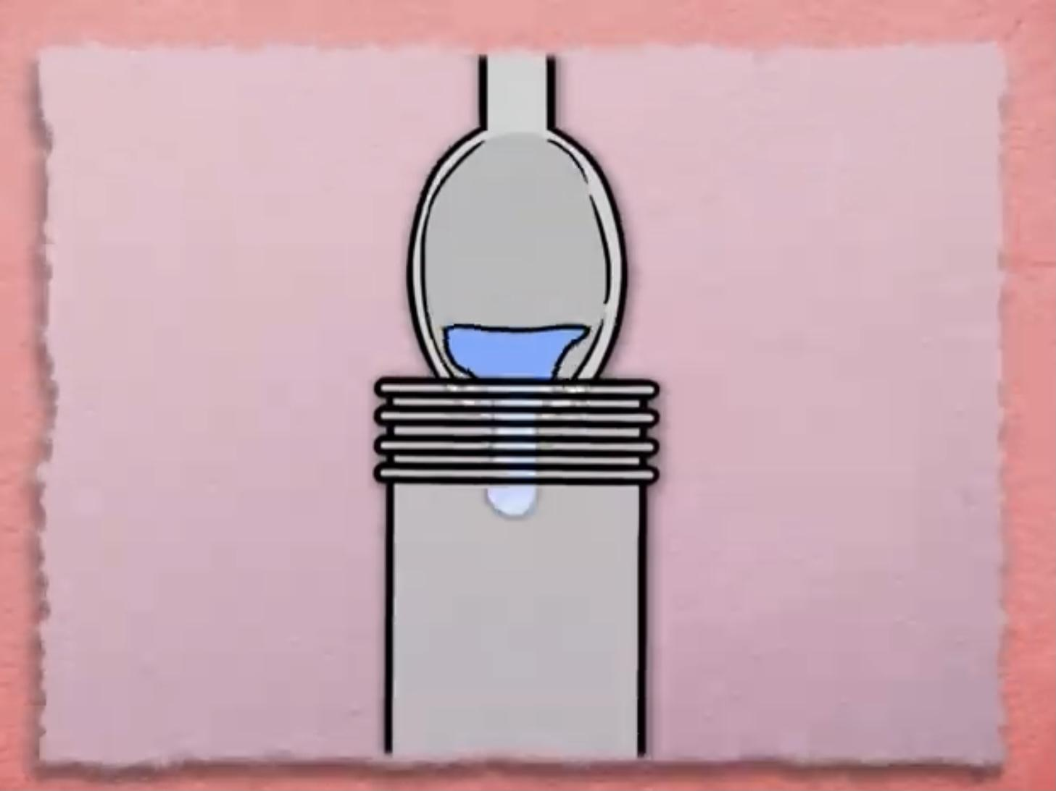
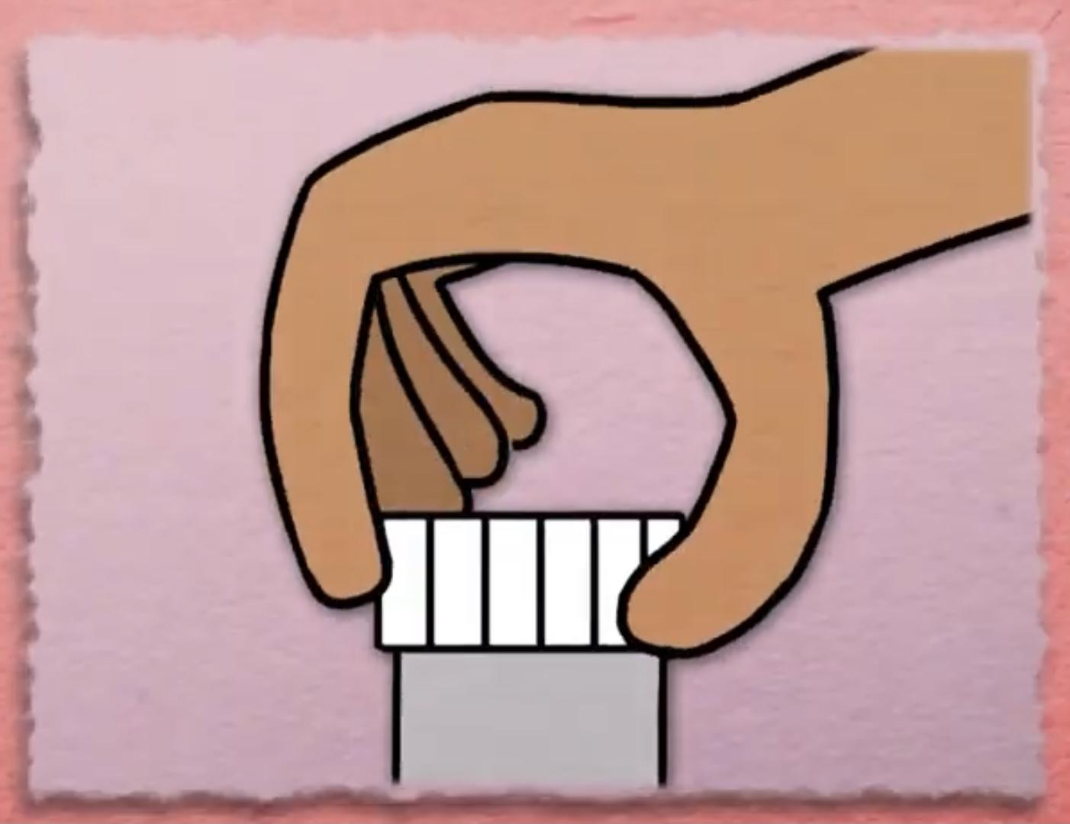
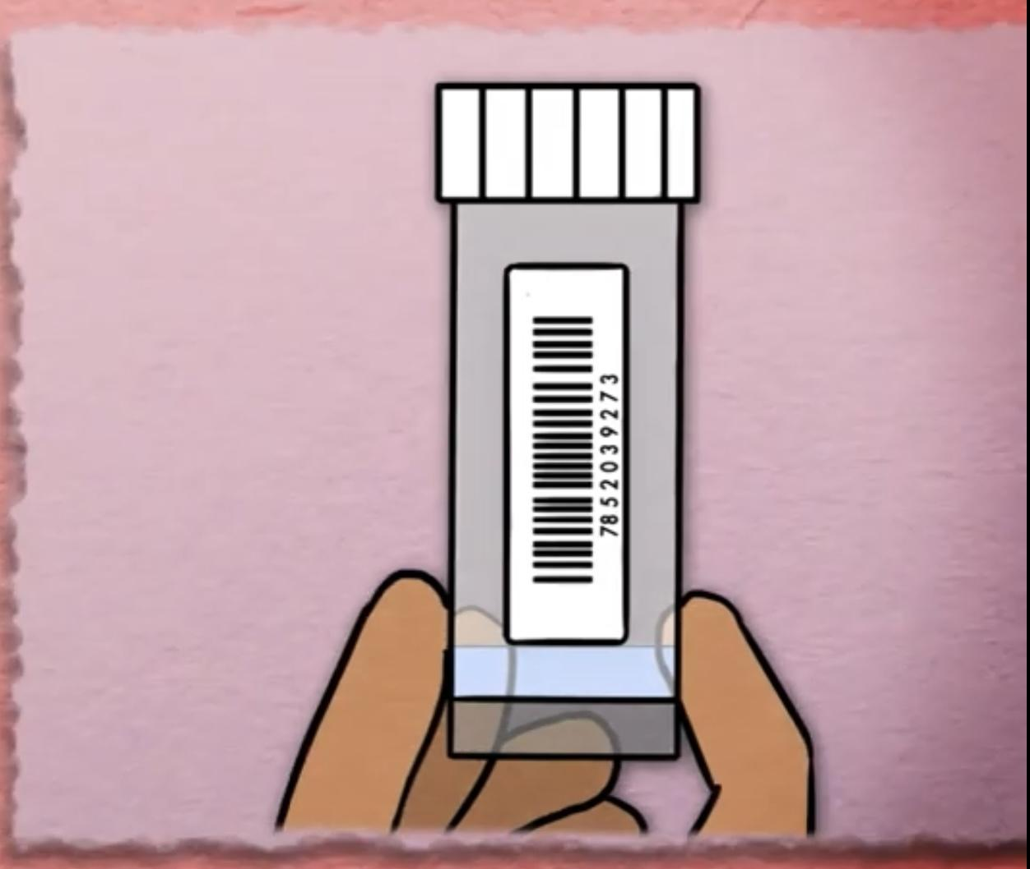
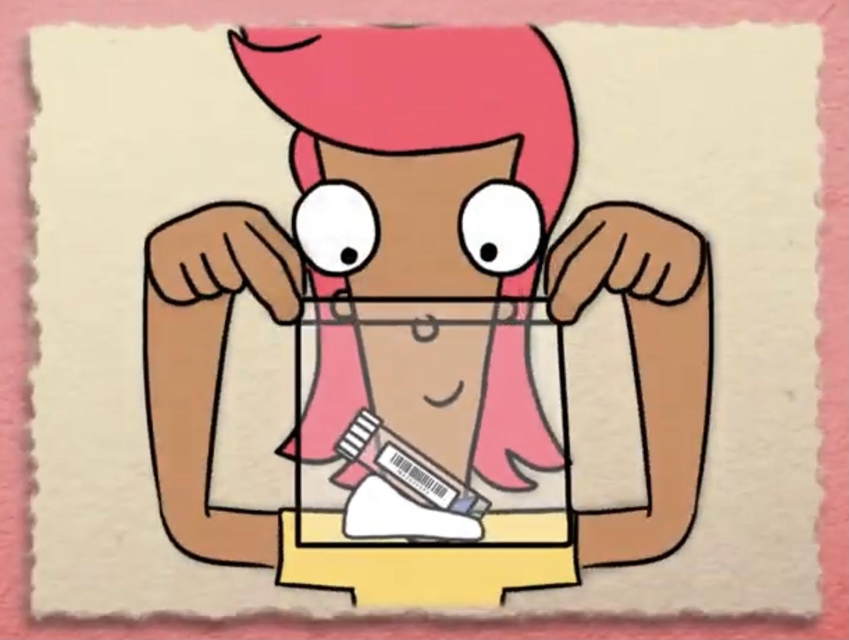
Main Activity
1. Wash your hands.
2. Spit on a spoon.
3. Pour saliva in the pot.
4. Screw the lid on.
5. Stick the label on.
6. Place in the bag and seal.
7. Now wash your hands again!

Slide 4
Key vocabulary
test pot
label
saliva
test
laboratory

Slide 5
Can you put these steps of the
saliva testing process in order?
Pour saliva in the pot.
Place in the bag and seal.
Wash your hands.
Wash your hands.
Stick the label on.
Spit on a spoon.
Screw the lid on.

Slide 6
What have we learnt?
What new words have you learnt today?
Can you tell a friend how to do a saliva test at home?
What are the important tips to give someone who is going to do a saliva test?

Slide 7
Well done for learning about saliva testing - one of the tools to fight COVID-19!

Slide 8
Extension Activities
Make a model of a Lab - think about the robots that might be used.
Role play a drive-through testing centre using toy cars and a garage.
Spot the difference in the Lab:
https://static1.squarespace.com/static/5fa5248fcb87d6680ec908e6/t/5fd933e450d96b1a1c6412bb/1608070119474/Storicise-Key-Stage-3-Activity-SPOT-THE-DIFF.pdf

Slide 9
Bye,
see you soon!

